Slide 1

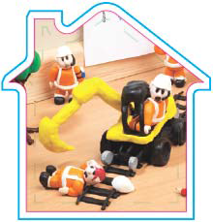
Any Line Open (ALO)
Responsible Manager
Briefing Pack

Slide 2

What is ALO?
“Where any railway line open to traffic could foreseeably be fouled by any vehicles including OTP, construction plant, lorry loaders, cranes etc. or the loads associated with them.”
This also includes:
Delivery and retrieval activities
Construction plant activities
Examples of which are on the next few slides.

Slide 3
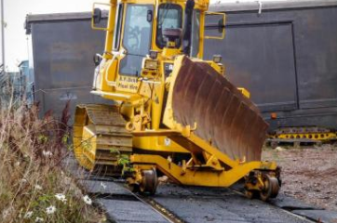
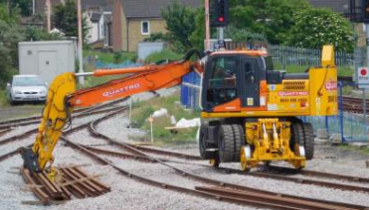
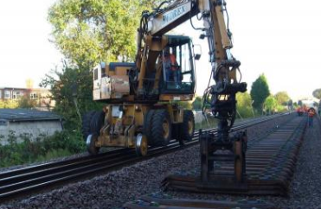
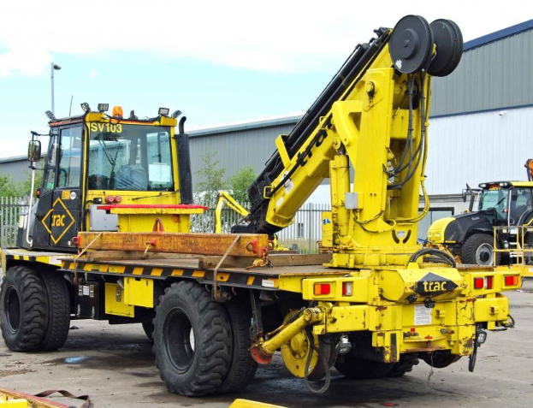
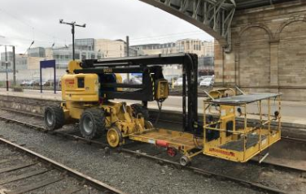
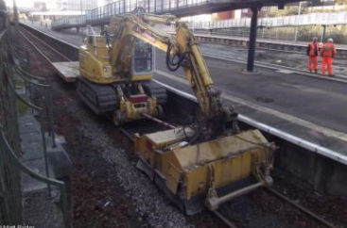
Some types of OTP

Slide 4
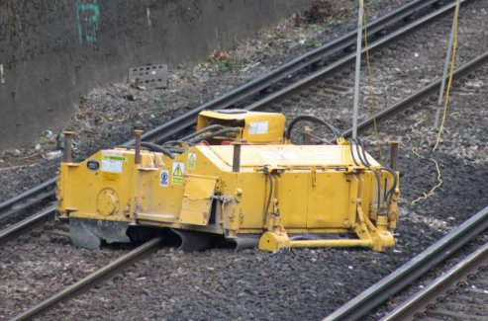
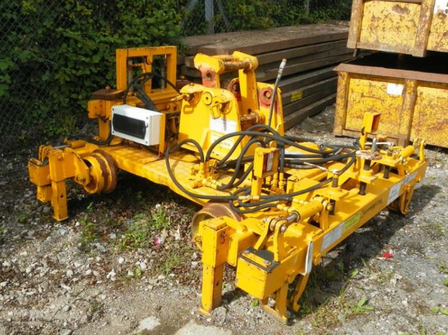
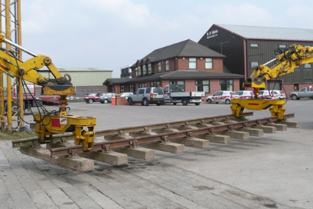
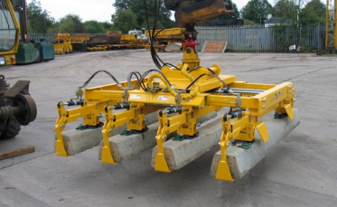
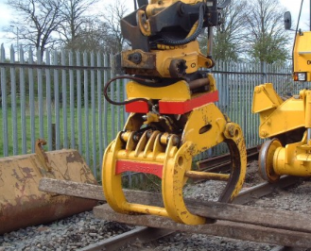
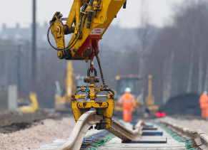
Don’t forget the attachments & loads!

Slide 5
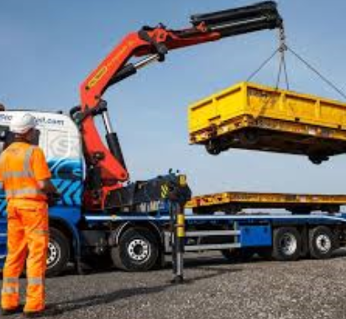
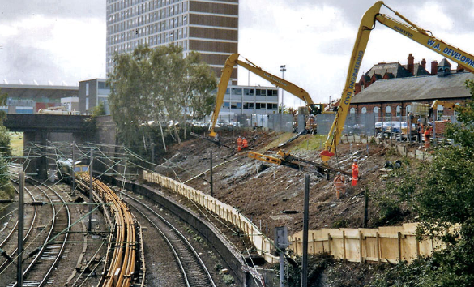
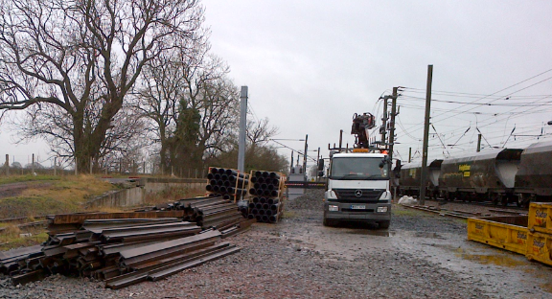
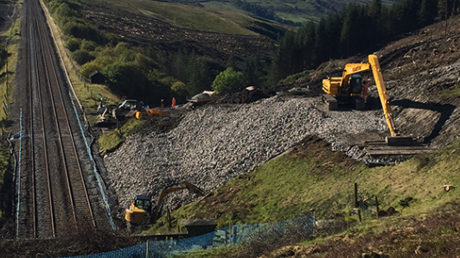
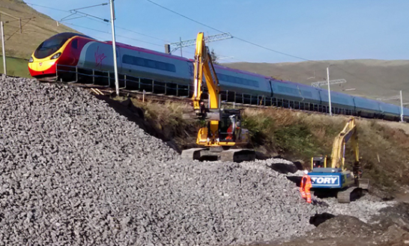
Examples of ALO Working: Off-Track

Slide 6
Purpose of the Briefing
Plant working alongside lines open to traffic is now a frequent activity and presents a significant risk to the operational railway. An ALO competency has been added to the Sentinel framework for those carrying out ALO planning and ALO Coordinator duties. As a responsible Manager your role will be to authorise ALO plans for work.
This briefing will:
Highlight the tasks and responsibilities when working ALO.
Provide you with a greater understanding of the risks and the control measures required to work alongside lines open to traffic

Slide 7
Network Rail Managed Infrastructure
We will never plan work that involves any part of plant or materials encroaching into the kinematic envelope of a line open to traffic. Where there is a potential to foul a running line we will always block the line(s) affected beforehand.
Network Rail has conducted a review of a series of incidents involving near misses or collisions between plant and trains passing on an open line in this country and in continental Europe. It has been concluded that there is the potential risk of plant inadvertently encroaching upon an immediately adjacent line. Such activity can only be safely undertaken by plant with known high-performance physical, or control interlocked, slew/reach limiters.

Slide 8
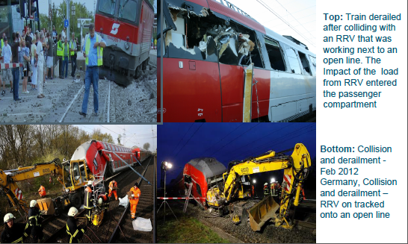
Catastrophic Consequences (Europe)

Slide 9
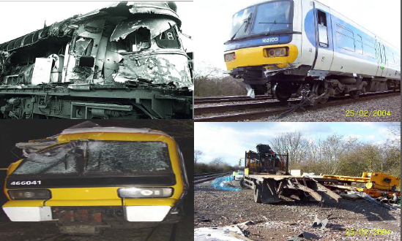
Catastrophic Consequences(UK)

Slide 10
Recurring Themes of Non Compliance
Lack of understanding that there is an “absolute duty to apply the Principles of Prevention when planning work”
The lack of knowledge and understanding of ALO within the industry
Inadequate planning in advance of the works
Poor understanding of the complexity of plant selection
Site Safety Issues/Poor Site Communication/Understanding the plant orientation or configuration
Competence of those managing and operating plant
Culture and Behaviours of site staff

Slide 11
Any Line Open Working
Where it is foreseeable that any part of the OTP/plant or load might foul an open line during normal work (irrespective of whether the fouling is planned or unplanned)
  A Possession or Line Blockage With Additional Protection shall be taken during work; OR
  The OTP/plant shall be set up in such a manner that it is not capable of fouling an open line during work
  The documents published to assist with planning and authorisation are:
  Safe System of Work found within NR/NR/RMVP/0200
  Code of Practice (COP0032) for Any Line Open Working (available on Safety Central)

Slide 12
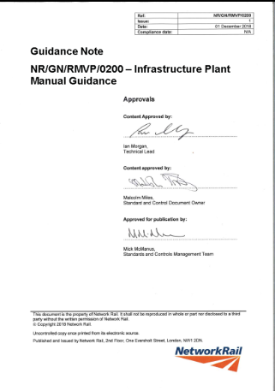
Any Line Open Working
The Infrastructure Plant Manual (NR/L2/RMVP/0200/Module P501) provides details of the safe system of work that must be in place for any work undertaken on Network Rail Managed Infrastructure where the plant has the potential to foul lines open to traffic.
The standard also applies to work that is undertaken by organisations working outside of the railway infrastructure boundary but where there is the potential to foul lines open to traffic.
The Guidance Note (NR/GN/RMVP/0200) provides additional details of how to estimate or calculate the fouling point for ALO planning.

Slide 13
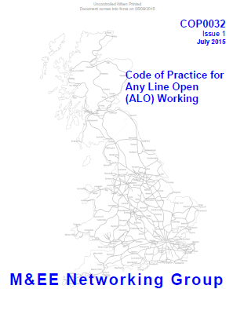
Any Line Open Working
M&EE COP0032 provides additional information on planning and implementing ALO activities.
Contains flow diagrams detailing the processes
Includes Definitions, Abbreviations, Planning Parameters, Generic Working Scenarios, Activity Considerations, Identifying Risk, Reliable Control Systems.

Slide 14
Any Line Open Working
ALO personnel
ALO Planner
ALO Responsible Manager
ALO Co-ordinator
On-Call Management for Changes
Management Assurance Checks
ALO actions
ALO Planner - Plans the Work and produces an ALO plan
ALO Responsible Manager - Reviews the plan and authorises ALO working
ALO Coordinator – Implements the ALO plan and controls on site

Slide 15
ALO Planner
Where a requirement for ALO working has been identified the ALO planner must carry out the following:
  Site Visit – Complete the ALO site visit checklist taking details of the site to assess hazards and risks. Take all required measurements such as the plant position and the distance from the nearest open line(s) and the planned limit of work measured from the fouling point.
  ALO Plan – From the details contained in the ALO site visit undertake the ALO plan & methodology of work. Identify the fouling point, the plant position, limit of working, movement limiting device required and site demarcation.
  Once the ALO planner has completed the ALO plan he must brief the responsible manager.

Slide 16
ALO Responsible Manager
“A person appointed within an organisation with suitable knowledge and experience to review and approve safe systems of work when the work is taking place when lines may remain open to traffic”
Typically, but not limited to IMDM, IME, Level 3 on-call manager (for out of office hours situations), Project Managers, Programme Managers, Projects – Contractors Nominated Manager
In the planning process the risks that are identified and the control measures selected should be recorded for review by the Responsible Manager for assurance purposes.

Slide 17
ALO Responsible Manager
All Planned ALO work must be assessed by the ALO Responsible Manager.
The Responsible Manager will review the control measures for adequacy and will do one of the following:
- approve the controls proposed;
- require the implementation of additional controls;
- or reject the proposed controls.
Where the responsible manager approves the plan he must issue a unique Authorisation Number for the work to proceed
The Responsible Manager is able to seek advice from their relevant plant specialists if there is any uncertainty regarding the plan.

Slide 18
Control Measures
The following measures are to be applied to each ALO method implemented:
    Operations are supervised at all times
    The position and orientation of the machine relative to the open line can be maintained
    A load control/stabilisation method is in place (where required)
    The system is tested prior to the work commencing
    Safety devices are to be secured such that the operator is not be able to over-ride them
    Duplex communication system must be in use

Slide 19
ALO Management Assurance
Formalises the assurance of ALO activities on site.
Assurance form available for a management level individual to complete during a site visit, to confirm that ALO working is as per the approved plan
A reasonable understanding of ALO is required but not a detailed knowledge
ALO Planner – Identify the requirement for monitoring during the planning process
ALO Responsible Manager - Identifies team members to undertake on-site monitoring.

Slide 20
ALO Management Assurance
Assurance form questions:
1) Does the person responsible for testing, implementing and monitoring the ALO measures on site have a copy of the ALO Work Plan?
2) Can the responsible person demonstrate that this plan matches the work being carried out on site?
3) Verify (through Q&A) that the personnel have received a briefing on the ALO work plan and understand the ALO control measures as detailed in the ALO plan. Confirm that a test of the control measures has been completed prior to work commencing.

Slide 21
ALO Management Assurance
4) Are the personnel who are operating and managing plant complying with the control measures that are identified in the ALO Work Plan?
5) Are the personnel who are managing and operating RRVs utilising duplex communication equipment to control plant movements?
6) Is the person responsible for testing, implementing and monitoring the ALO Control Measures ACTIVELY carrying out this activity?
7) Are you satisfied that the ALO Control Measures are adequate to protect the safe passage of trains on open lines?

Slide 22
Change Control
There are 2 types of changes:
  Planning Stage Changes
  On Site Changes
A flow chart is included in COP 0032 which describes the steps to be followed.
Planning Change
  Changes arising prior to site works commencing are to be dealt with as part of the planning process and be documented on the A3 Planning Sheet - they do not have a specific check sheet.
  These changes are likely to be managed by the ALO Planner

Slide 23
Change Control
On Site Change
  There must be an ALO Responsible Manager available at all times (normal office hours & out of hours) to review and authorise any on site changes that are required. The manager that authorises these change MUST fully understand the ALO planning principals.
  These changes will be managed by the ALO site coordinator using the one page checklist
ALO Coordinator On Site Change Control
Needs to be authorised by a responsible manager who fully understands the ALO process and controls
    1) What is the reason for the change?
    2) What is the proposed revised methodology?
    3) Are risk control measures in place for the proposed ALO activity?
    4) Has the responsible manager reviewed and agreed the proposed change and issued an authorisation number?

Slide 24
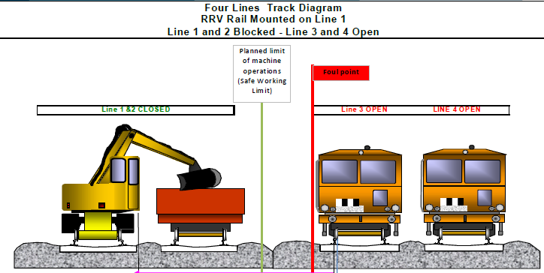
Working Scenario (Rail)
Identify the planned limit of machine working and foul point

Slide 25
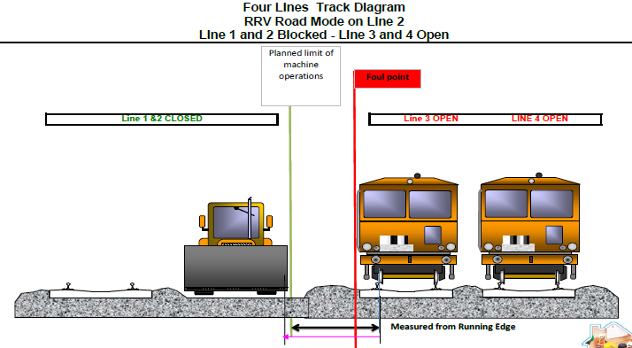
Working Scenario (Road)
Identify the planned limit of machine working and foul point

Slide 26
Emergency Arrangements
Emergency situations can develop at any time endangering site staff and those travelling on an operational railway. These situations can be made worse if the planned emergency arrangements are not fully understood and implemented. Responsible managers should establish that:
Planned emergency arrangements are documented, have been briefed, understood and can be discharged on site.
They can confirm with the ALO coordinator/MC/CC/POS Rep that emergency equipment is available on the plant.
A test of the emergency arrangements by asking the ALO coordinator/MC/CC/POS Rep to describe the arrangements to be followed if the plant failed and fouled an line open to traffic.

Slide 27

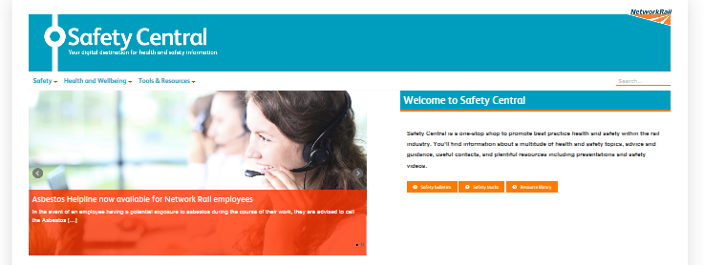
Safety Central
All information & documents can be found on Safety Central
www.safety.networkrail.co.uk

Slide 28
The End

