Slide 1
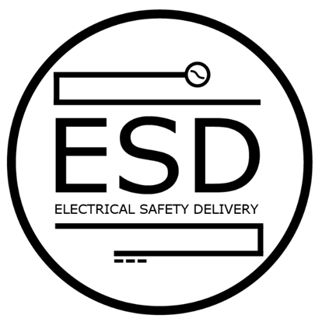
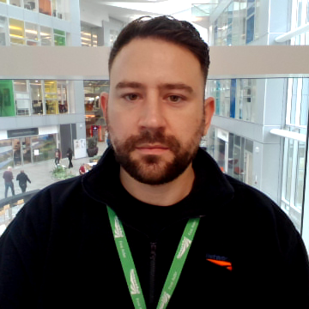
NR/L3/ELP/SAI25 Module D
Overview Brief
Created: August 2023
Updated: January 2024
ESD Programme | SAI OLE Project
Approximate time to complete: 15 mins

Slide 2
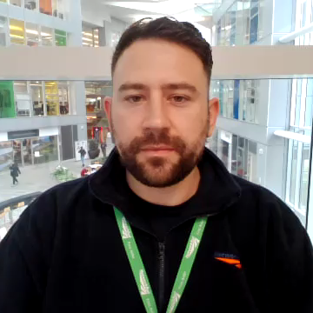
Aims & objectives
The aim of this overview brief is to provide awareness and insight to the addition of Module D – Distribution System Interfaces, which has been introduced within NR/L3/ELP/SAI25 ‘Working On or About Overhead Line Equipment (SAI)’.
Detailed briefs/training will be given to specific competences; therefore all roles identified will receive an overview brief unless an identified competence is held.
The objective for providing this overview brief, is to: -
  Provide the reason for why the changes were made and explain their purpose
  Lay out the scope of the Module
  Show what’s changed and what’s new
Copies of briefings are available from the Standards and Controls intranet site or your
external standards portal.

Slide 3
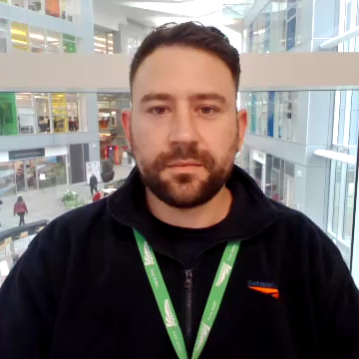
What is the purpose of the standard?
Prior to the introduction of NR/L3/ELP/SAI25 there were many references made to the requirements for work on or near distribution equipment. These references appeared throughout the suite of modules.
By consolidating all references to such requirements into a single module (Module D) it makes locating the information simpler and more accessible.
Prior to the introduction of NR/L3/ELP/SAI25 there was an inconsistent approach to the way we isolate, earth and work on or near the boundary between distribution equipment and OLE. Introducing standardised approaches to work on or near these Distribution System Interfaces, and formalising methods of collaborative working between overhead line and distribution staff (where required) achieves closer alignment with Network Rail’s safety vision by:
  Improving identification and mitigation of electrical hazards
  Increasing knowledge of how distribution system arrangements impact
  the safety of work on OLE
  Increasing the emphasis on the securing of all isolated and earthed OLE

Slide 4

What is the scope of the standard?
Module D falls within the scope of NR/L3/ELP/SAI25. It applies to all those required to work on 25 kV a.c. electrified lines, or so near to them that danger might arise, including persons who:
Assess electrical risk;
Plan, prepare and implement mitigations of electrical risk such as isolating, earthing, implementing electrical risk control measures and issuing of formal safety assurance documents;
Install, test, operate, maintain, repair and dismantle 25 kV a.c. overhead line equipment and traction return systems;
Use special tools to work on live overhead line equipment
It is applicable to Network Rail personnel and to Network Rail’s contractors.
To provide a consistent approach to working on or about 25 kV a.c. electrified lines,
Train and Freight Operating Companies may, as best practice, apply this standard
to infrastructure they control.

Slide 5

What’s new and what’s changed?
Inclusion of Module D – consolidating all ‘Distribution System Interfaces’ requirements
Referencing the High Voltage Isolation and Earthing Certificate (HVIEC input to NR/L3/ELP/21067 only)
Detail of Change:
  General requirements for work at distribution system interfaces
  Detailed requirements identified for work on lineside track feeder disconnectors
  Detailed requirements identified for cable circuits forming part of the OLE
  Detailed requirements identified for work on 25kV auxiliary supplies
  Detailed requirements for work on harmonic dampers and cable sealing ends
  Referencing the High Voltage Isolation and Earthing Certificate (HVIEC input to NR/L3/ELP/21067 only)
  NOTE: corresponding content from other modules has been removed to avoid
  duplication/conflict
New Forms:
High Voltage Isolation and Earthing Certificate (HVIEC input to NR/L3/ELP/21067 only)

Slide 6

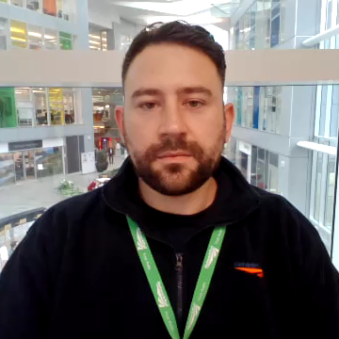
Questions
Contact ESDSAISupport@networkrail.co.uk or visit Safety Central for further support.

