Slide 1


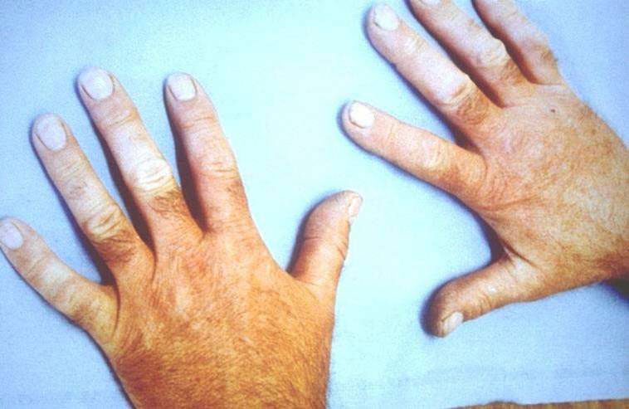
ANGLIA’S HAVS PACK
A Quick Guide for Managers

Slide 2
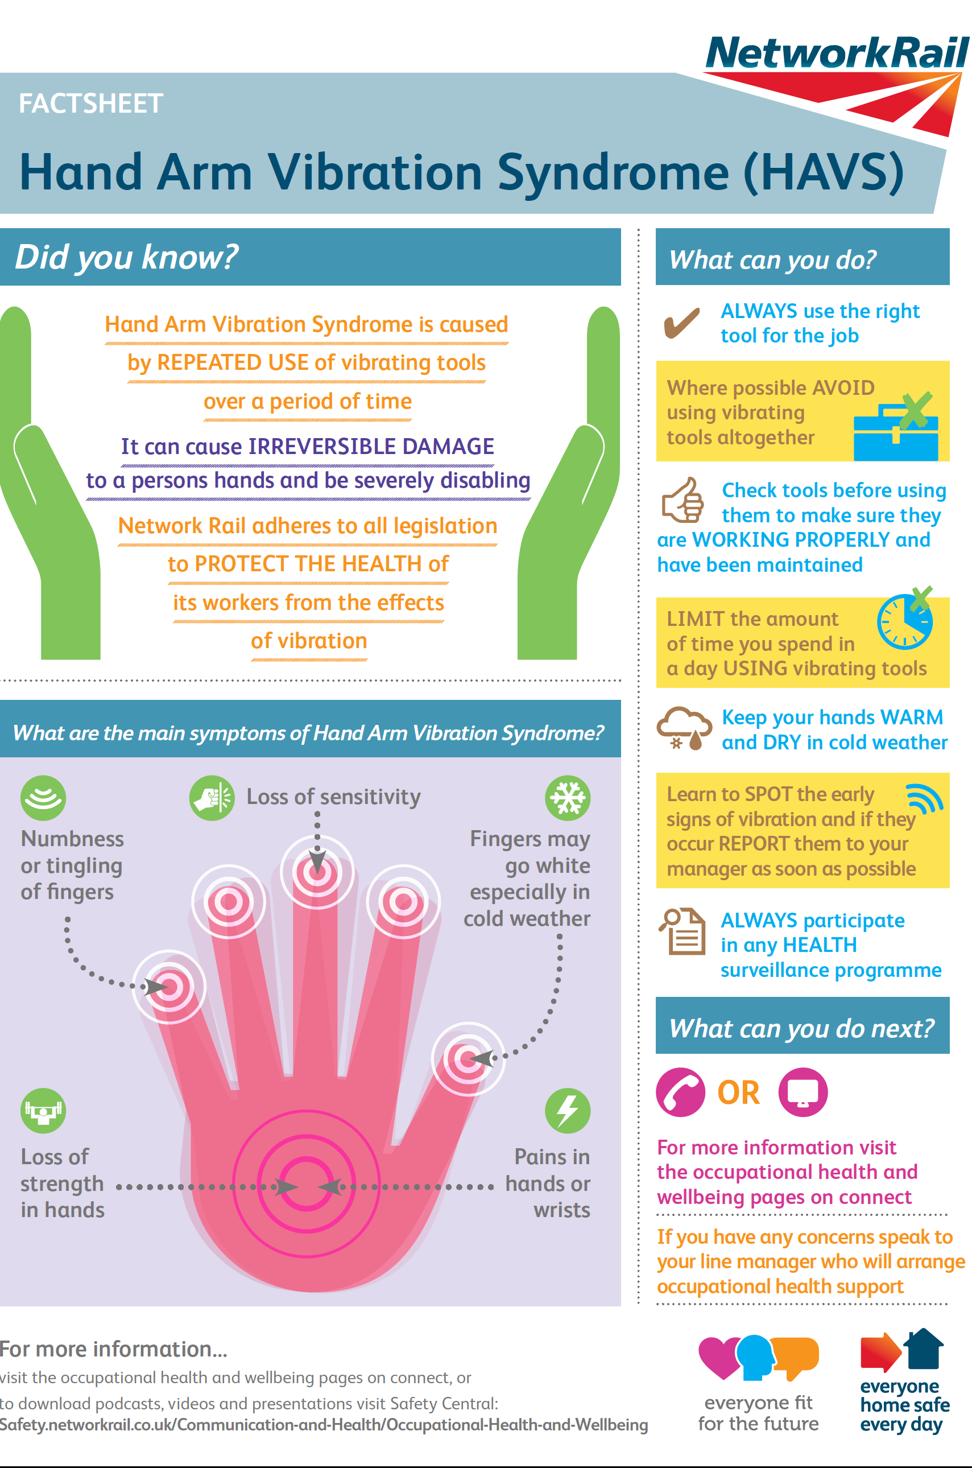
HAVS Factsheet

Slide 3
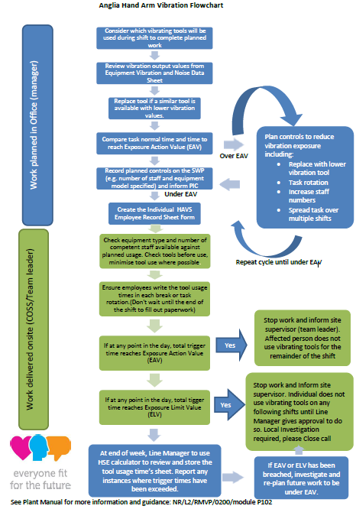
HAVS Flowchart

Slide 4




Planning Stage
The manager shall consider the work or task to be undertaken and will:
Consider if the job can be done without vibrating equipment or other methods such as On Track Machines.
Choose your tools carefully to minimise vibration levels looking at available alternatives
Work out how to minimise duration for using the vibrating tools for the work planned.
Other options
Review the data sheet to guide your tool selection and to get the magnitude of HAVS exposure for each tool to be used.
Other Tasks to be completed during the same time
Plan to rotate staff round tasks to reduce and minimise exposure
Try and spread out the use of vibrating tools across the working week,
When selecting tools for use:
Identify tools with lower vibration emissions for the same task
Use electric tools – they vibrate much less than petrol powered (and are lighter to carry)
Refer to the Equipment Vibration and Noise Data Sheet for the vibration magnitude and exposure for each tool;
Know your tool labels, choose the ones with the green labels, they have less vibration emissions; see next page
Select the tools required and to be used for the activity or task
Calculate the vibration limits of the chosen tools against the task at hand

Slide 5
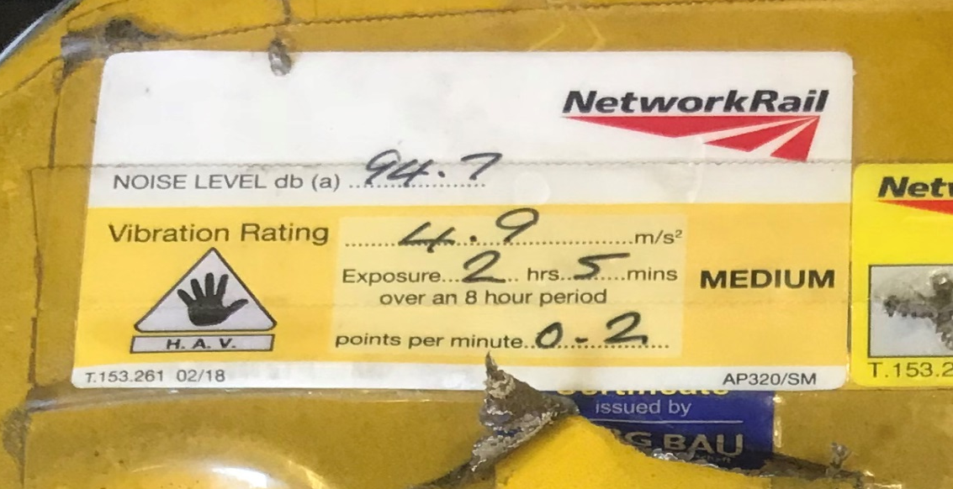
New Tool Labels
Vibration Emissions: Lower is best
Noise Level:
use ear defenders above 85db
Vibration Rating: Red is bad
Orange is better
Green is the best
Vibration Exposure Time: You can use the tool for 2 hours 5 mins; then avoid vibrating tools for 2 hours 5 minutes before another exposure.
HSE Points per minute for each use EAV: 100
ELV:400
Ensure all your vibrating tools have the correct label as above; these are supplied and fitted by Torrent.

Slide 6

Staff Selection
Assess the likely exposure and work out how the job can be done with the staff you have.
1. Divide the task HAVS exposure amongst the competent staff e.g. if the task will take 100 minutes and you have 4 competent staff
100/4 = 25 minutes HAVS exposure for each individual.
2. Add more resources to help keep exposure below the EAV for the task.
Ideally you should aim to work below EAV, but with suitable rest* periods you could work to 90% of ELV for each shift. Ie up to 360 points / day
3. Ensure that each staff records their daily HAVS exposure on the HAV Employee Weekly Record Sheet during each tool use. (see sample on next page). These can be created specific for your area and tools.
4. Keep a register of current HAVS exposure limits or restrictions for the each member of staff. Where people are restricted and plan them out of the process.
5. Check the current HAVS exposures for the week for each individual to ensure no one is overexposed to HAVS.
6. Consider other tasks over the whole week for the team, to see if you have enough resource in the team for alternate roles e.g. lookout
NB: * Suitable rest = the same amount of time but using non vibrating tools
If you reach EAV in 1 hour; then you can go back to using vibrating tools after 1 hour.

Slide 7
HAV Employee Weekly Record (sample)

Slide 8
Review of Plan and Actuals
Section Manager to review returned records from your team, change the minutes to points using the HSE Calculator and put on the form to achieve assurance that the plan is being followed and your people are within the exposure limits.
We want to stay below 100 points (the EAV).
All breaches of ELV over 400 points will need to be formally investigated. All instances where times have exceeded the limit need to be raised to the functional engineer and WHS&EA for review and investigate.
Keep digital copies of the recorded exposure as they are required to be kept for 40 years.
HAVS Surveillance
Surveillance is to be carried out every year for each employee as below, to comply with Statutory Health Surveillance Requirements
Tier 1: Done at start of employment
Year 1: HAVS Tier 2 form
Year 2: HAVS Tier 2 form
Year 3: HAVS Tier 3 face to face assessment with OHA (Nurse)
The cycle repeats if there are no issues or symptoms
NB: DU will send form
If there is a flag at Tier 2 its escalated to Tier 3. The employee attends and will revert back to the normal cycle if no issues arise.
If HAVS symptoms are identified at any point of the cycle; your staff member will have a face to face HAVS Tier 4 assessment with an Occupational Health Physician (Doctor) OHP for diagnosis
Any questions, ask the route Occupational Health & Wellbeing Manager

Slide 9
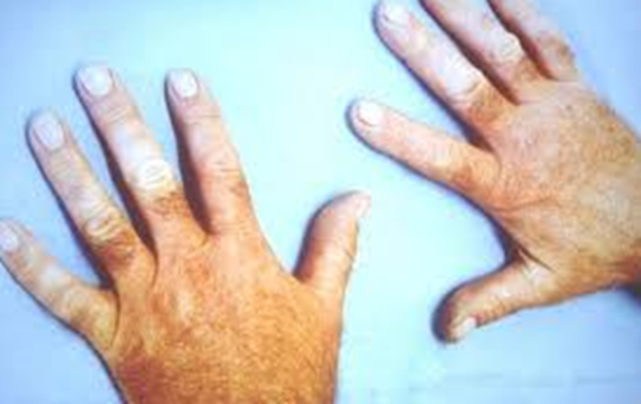
HAVS Tier 4 Escalations
Anyone showing signs or symptoms of HAVS following the Tier 3 assessment will be escalated to have a Tier 4 assessment with the Doctor.
Due to the ill health effects of HAVS; there is immediate restriction from the use of all vibrating tools, until the individual is cleared by the OHP; who will advise on what activities they can undertake going forward.
An employee with a new or worsening case of HAVS requires support through a Health Management Action Plan (HMAP) see Appendix 1.
A new HAVS diagnosis (White finger or Carpal Tunnel Syndromme) requires a Level 1 investigation to be done and this may lead to a level 2 to understand the causes. See Appendix 2
Please Note: Once an employee is diagnosed with HAVS; they will require a HAVS Tier 3 assessment every year, unless advised otherwise.
Update the HMAP as required

Slide 10
Appendix 1: HMAP (Sample) p,1

Slide 11
HMAP (Sample ) p,2

Slide 12
HMAP (Sample) p,3

Slide 13
Level 1 Investigations
After a HAVS Tier 4 Diagnosis a Level 1 MUST be completed
Appendix 2: Level 1 Investigation
HAVS Tier 4 Diagnosed
Relevant DCP notified
Trained/ Competent Investigator Appointed L1
→
→
TU notified and offered to observe
Evidence collected from site and office records
→
→
Level 1 completed
DCP Decision/Sign Off
→
→
All completed Level 1 must be reported to AngliaSafetyReporting@Networkrail.co.uk

Slide 14
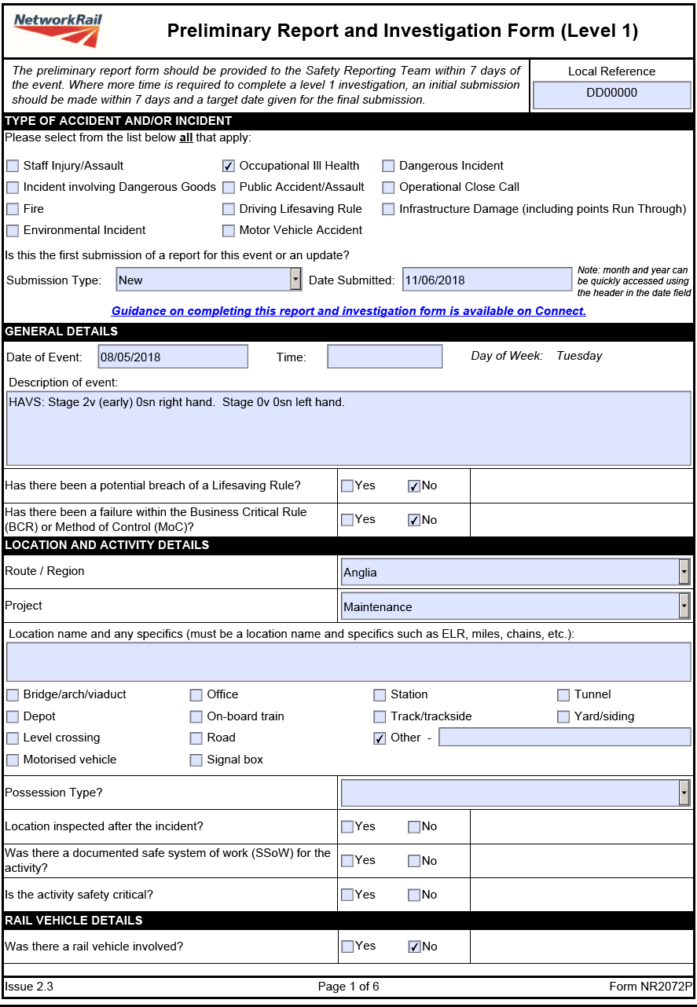
Appendix 2: Level 1 (Sample )p1

Slide 15

Level 1 (Sample) p2

Slide 16
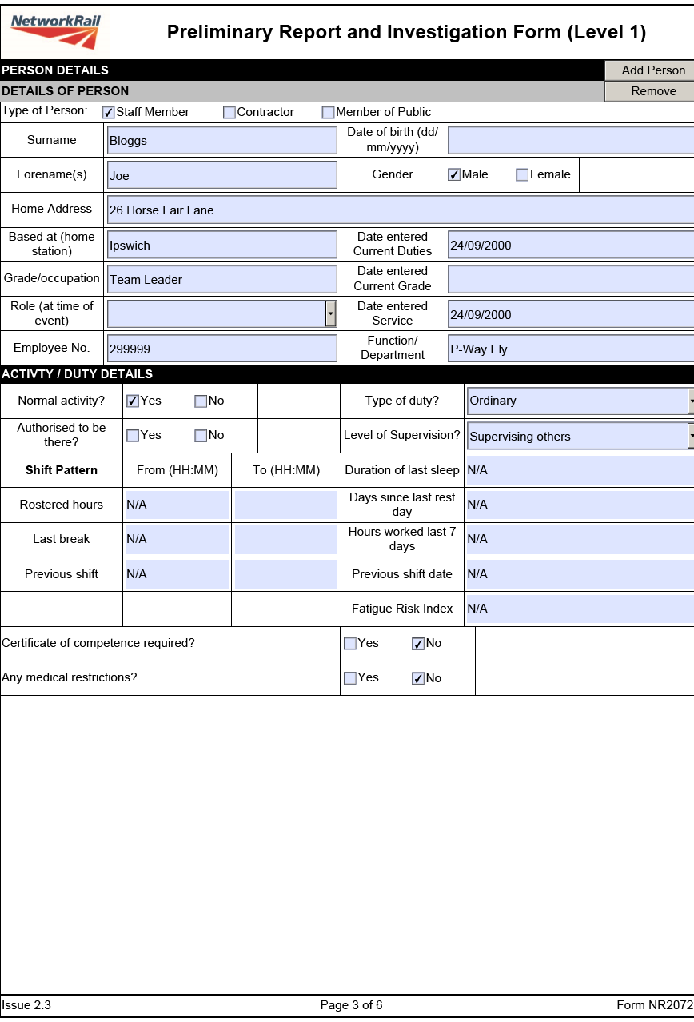
Level 1(Sample) p3

Slide 17
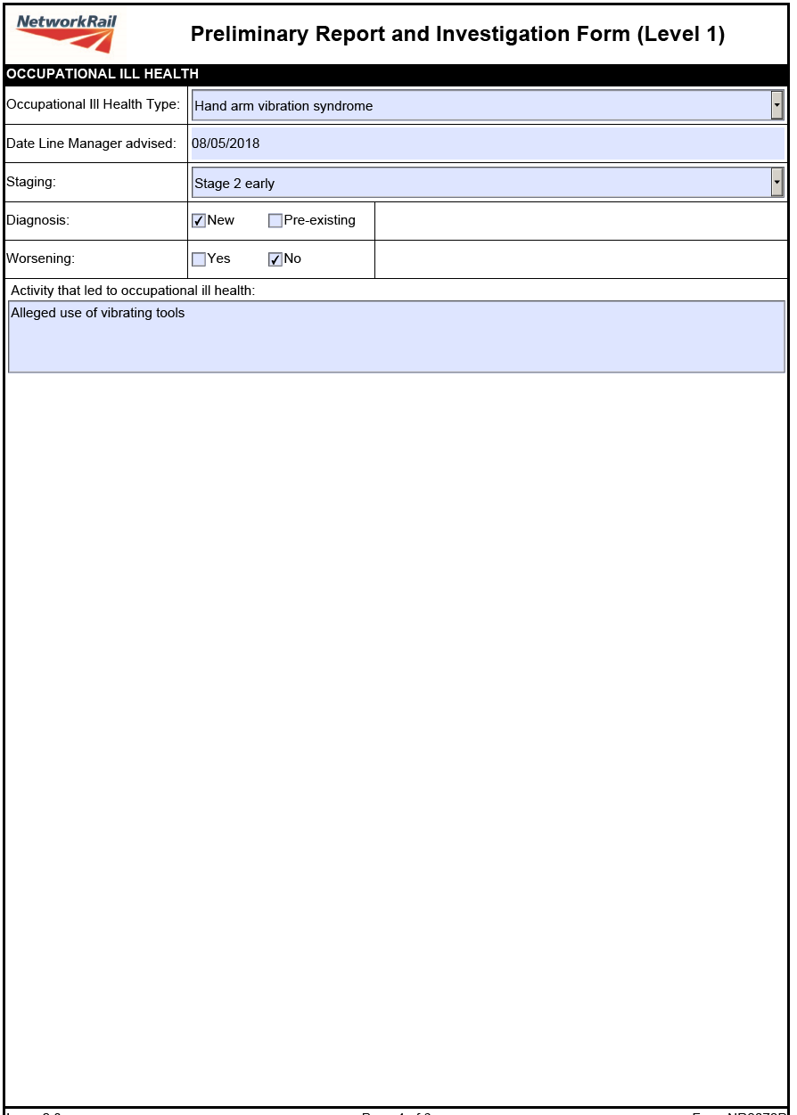
Level 1 (Sample) p 4

Slide 18

Level 1 (Sample) p5

Slide 19
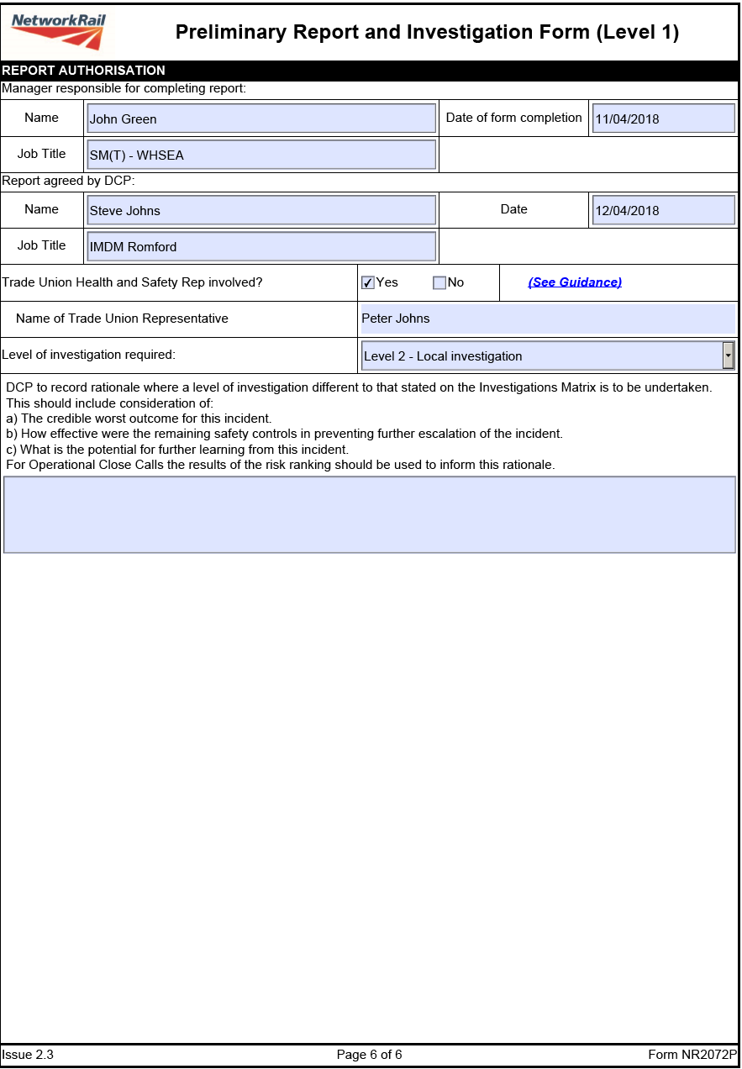
Level 1 (Sample) p6

