Slide 1
Standard 019 Update Briefing
Version 1

Slide 2
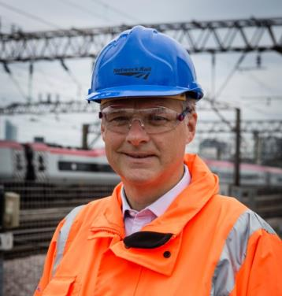
Network Rail Safety Vision
Safety… we have committed to eliminating workforce fatalities and all major injuries.
I know that improving workforce safety is not only the right thing to do from a moral and ethical perspective, it's also good business.
Safety and performance go hand in hand.
My belief in this approach led to the launch of our Safety Vision and the refresh of our Lifesaving Rules.
Mark Carne
Notes:
Emphasise the message from Mark Carne

Slide 3
Why?
1 November 2014
21:45 hrs
Garnant Branch line in Carmarthenshire
22 January 2014
11:34 hrs
Newark North Gate station
4 December 2012
13:50 hrs
Saxilby, near Lincoln

Slide 4
Background
Notes:
The old standard used to be protection from trains, now it focuses on protection from many things that may impact the workforce on or near the line. This is why 019 has been changed.

Slide 5
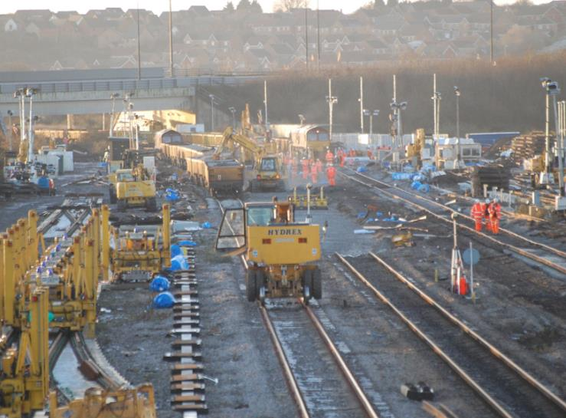
Background
Old Standard:
Ref: | NR/L2/OHS/019
Issue: | 8
Date: | 04 September 2010
Compliance date: | 04 September 2010
Revised Standard:
Ref: | NR/L2/OHS/019
Issue: | 9
Date: | 03 July 2017
Compliance date: | 03 July 2017
Notes:
Bullet points on what are the key changes in the standard…

Slide 6
Affected Parties
Responsible Manager
Planner
Individual Working Alone (IWA)
Controller of Site Safety (COSS)
Safe Work Leader (SWL) – Note: IP only

Slide 7
What’s new? The person in charge
The person in charge is a new capability, not a competence
The person in charge will be appointed by the Responsible Manager on their ability to manage the work activity planned and have an understanding of the risks
The person in charge will make sure that all risk controls have been implemented
The person in charge must hold a COSS competence and may act as the COSS or delegate the COSS duties
The person in charge and the planner will collaborate to produce the Safe Work Pack (SWP), which the person in charge will verify.

Slide 8
What’s new? Safe Work Pack (SWP)
The SWP provides information on how work is to be carried out safely and gives details on how to manage and control task, site and operational risks.
It enables effective management and implementation of controls for the safety of people involved, or who might be affected by the work activities on or near the line, or which might affect the line.
SWP refers to the documentation provided to the person in charge for the work they are to undertake. The information contained in the SWP should be:
concise and relevant to the task and location where the work is being undertaken; and
provide clear information to allow the person in charge to effectively use it to manage the risks to themselves and those working under their supervision.

Slide 9
Currently a SSOW pack looks like….
SSOW pack verification form
Part completed RT9909 Record of arrangements
Part completed RT3181 form(s) – where blockage(s) of the line are part of the SSOW pack
Possession arrangements
Safe access and egress information including walking to and from site
Sectional Appendix extracts showing the relevant running lines, track layout and work location for the entire mileage for which the work group will be On or Near the Line
National Hazard Directory extracts that are relevant to the work and location
Signalling or track diagrams where used
Emergency arrangements
SSOW

Slide 10
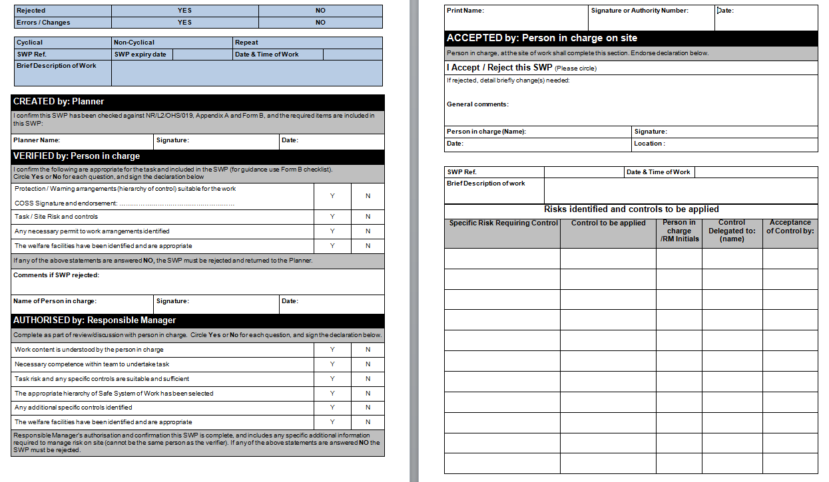
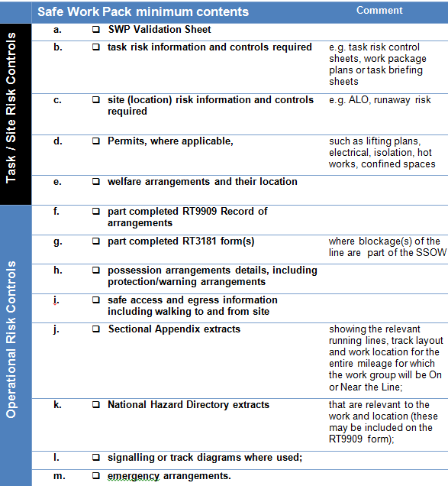
What extra goes into a Safe Work Pack?
Additional contents required:
SWP validation form, instead of the SSOWP verification form.
Site risk information and controls required
Task risk information and controls required e.g. task risk control sheets, work package plans or task briefing sheets
Permits, where applicable, such as lifting plans, electrical, isolation, hot works, confined spaces
Welfare arrangements and their location
Safe Work Pack

Slide 11
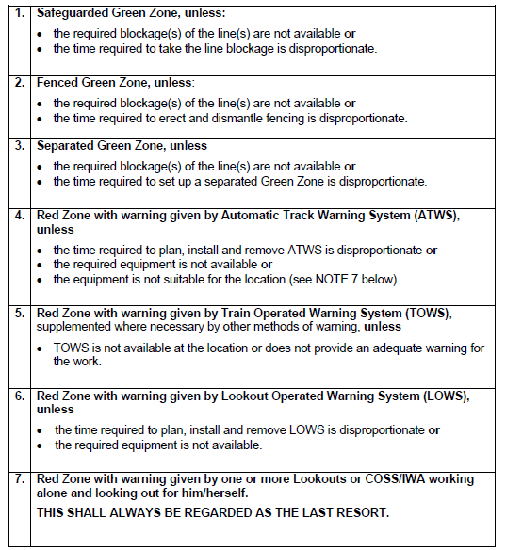
What’s new? Hierarchy of Control – Operational Risk
There are 8 Levels of hierarchy now, with a renaming of previous levels – Red & Green zone terms replaced with Protection and Warning arrangements. Same requirements are required for justification of level planned.
 | Safe System of Work | Type
1 | Safeguarded site of work | Protection
2 | Fenced site of work | Protection
3 | Separated site of work | Protection
4 | Warning systems – permanent | Warning
5 | Warning systems – Train Operated Warning System (TOWS) | Warning
6 | Warning systems – human activated equipment | Warning
7 | Warning systems – Portable | Warning
8 | Lookout warning | Warning
OLD HIERARCHY

Slide 12
Step 1 - What do we associate as a risk?
Site
Task
Operational
Working at night
Hazardous dust
Trains
Electricity
Slips, trips and falls
On track machines
Working at height
Noise
On track plant
Access and egress points
Vibration

Slide 13
Definitions
Site
Task
Operational
Hazards associated with the location or work environment
Hazards associated with the work activity
Hazards associated with railway operations

Slide 14
Modules in working practice

Slide 15
Modules
Ref: | NR/L2/OHS/019
Issue: | 9
Date: | 03 July 2017
Compliance Date: | 03 July 2017
Module 4
Planning and working using warning arrangements
Module 3
Planning and working using protection arrangments
Level 2
Business process
Safety of People at Work On or Near the Line
Module 2
Planning and working in a possession
Module 1
Planning and working during incident response
Notes:
Modules will run alongside each other depending on the operational requirements.

Slide 16
Core 019 standard overview
Responsible
Manager
Responsible
Manager
The Responsible Manager identifies work to be undertaken, appoints the Planner and the person in charge, giving them suitable resources to produce the SWP.
The Planner will review the SWP for amendments for future planning. Where a pack has not been returned, a record must be kept by the Responsible Manager.
The Responsible Manager must authorise the SWP. In doing so they are confirming that all operational, site and task risk controls have been appropriately identified.
The Responsible Manager will review the SWP and record the details as per local arrangements.
The person in charge will check and accept the SWP details are valid (at least one shift in advance of the work) and checks the Responsible Manager has authorised the SWP for use.
The Planner will create the SWP in conjunction with, and appropriate help from, the person in charge.
The person in charge will verify the Safe Work Pack when they are satisfied the plan is appropriate.
After work has finished the person in charge returns the used or unused SWP back to the Planner.
Planner
Planner
Person in charge
Person in charge
Person in charge
Person in charge
Responsible
Manager

Slide 17
Module 1: Planning and working during incident response
On site
Return
Review
Planner
Person in charge will send the IRP to the Planner (or Responsible Manager where no planner exists). Where a pack has not been returned by the person in charge a record must be kept by the Responsible Manager.
The person in charge shall decide what response and resources are required for the incident. The following must be considered:
Is protection/warning arrangements required?
What task and site risk controls are required?
Identify safe systems of work and the controls required.
The person in charge shall arrange for a Incident Response Pack (IRP) to be completed including task, site and operational risks.
The person in charge shall arrange for the work group to be briefed on the protection/warning arrangements including the task, site and operational risks.
The person in charge will be contacted as the appropriate person to respond following an incident.
The Planner/Responsible Manager will update any systems and store the IRP for assurance processes.
The person in charge shall arrange for the Signaller to be contacted to arrange appropriate protection, if required. The person contacting the signaller, if not the person in charge, will act as:
COSS
IWA
SWL (IP only)
PC
The Signaller shall confirm protection arrangements they are able to provide.
Person in charge
If the Signaller is unable to provide the protection arrangements required, the person in charge shall consider using a lower level in the protection/warning hierarchy. If no suitable arrangement can be implemented, the person in charge must escalate to Route Control or the on call Responsible Manager.
When work is complete, the person in charge shall check the work group is clear of the site and the line has been left in a safe state. They should make sure the line has been handed back to the Signaller where protection has been arranged.
Responsible
Manager
Signaller

Slide 18
Video
Notes:
Download instructions – Safety Central – zip file to include slide pack and video. Users to bulk download.

Slide 19
Over to you, what does this module mean for you?
What are we currently doing that meets the requirements in the updated 019 standard?
What's new for us in the updated 019 standard?
How can we bridge the gap that will meet the updates in the standard 019?

Slide 20
Module 2: Planning and working in a possession
Create
Verify
Authorise
Accept
On Site
Return
Review
The Planner shall apply for a worksite under possession using the possession planning system (PPS).
The Responsible Manager must authorise the SWP at least one shift in advance of the work taking place. In doing so they are confirming that all operational, site and task risk controls have been appropriately identified and the following has been considered:
Work content is understood by the person in charge
Necessary competence within team to undertake task
Task risk and any specific controls are suitable and sufficient
The appropriate hierarchy of Safe System of Work has been selected
Any additional specific controls identified
The welfare arrangements have been identified and are appropriate.
The Planner will create the SWP with appropriate involvement from the person in charge to produce a SWP. This will include things such as, welfare arrangement, the amount of people required, tools needed, and the duration of the work.
Planner
The person in charge, when also acting as COSS will sign into the ES/SWL worksite before they commence any work (or the delegated COSS will sign into the ES/SWL worksite). The ES/SWL gives permission for the COSS to sign the RT3199.
The person in charge will accept the SWP details are still valid and the Responsible Manager has authorised the SWP for use at least one shift in advance of the work taking place.
Person in charge to conduct briefings including task and site risk controls. If acting as COSS they will also brief the operational risk controls. All required paperwork must be completed before work can begin.
The person in charge, when also acting as COSS, will contact ES/SWL (IP only) when work has been completed to confirm the line is clear and safe before signing out.
Person in charge will send the used or unused SWP to the Planner (or Responsible Manager where no Planner exists). Where a pack has not been returned by the person in charge, a record must be kept by the Responsible Manager.
The Planner will review the SWP for amendments to support future planning. If there isn't a designated Planner, the Responsible Manager will carry out the review of the pack.
Person in charge completes a final check of the SWP on site against the site conditions before implementation.
The person in charge will verify the SWP at least one shift in advance of the work taking place.
For cyclical and repeated tasks, the Responsible Manager must authorise the initial SWP to be implemented repeatedly for the following periods without further authorisation:
Twelve month period when the SWP uses protection (formerly green zone); and
Six month period when the SWP uses warning (formerly red zone).
Person in charge
The Responsible Manager identifies work that needs to be undertaken and appoints the Planner and the person in charge, giving them appropriate resources to produce the SWP including operational, task and site risk controls.
Responsible Managers will review at least 10% of completed and implemented SWP, up to a maximum of 50 packs per period. However, the Responsible Manager must review all SWPs where there has been a change made on site.
Responsible
Manager
Notes:
Emphasise what is new.

Slide 21
Video

Slide 22
Over to you, what does this module mean for you?
What are we currently doing that meets the requirements in the updated 019 standard?
What's new for us in the updated 019 standard?
How can we bridge the gap that will meet the updates in the standard 019?

Slide 23
Module 3: Planning and working using protection arrangements
Create
Verify
Authorise
Accept
On Site
Return
Review
The Planner will arrange for a line blockage application when required.
The Responsible Manager must authorise the SWP at least one shift in advance of the work taking place. In doing so they are confirming that all operational, site and task risk controls have been appropriately identified and the following has been considered:
Work content is understood by the person in charge
Necessary competence within team to undertake task
Task risk and any specific controls are suitable and sufficient
The appropriate hierarchy of Safe System of Work has been selected
Any additional specific controls identified
The welfare arrangements have been identified and are appropriate.
The Planner will create the SWP with appropriate involvement from the person in charge to produce a SWP. This will include things such as, site and task controls, and welfare arrangements.
Planner
When work is complete, the person in charge shall check the work group is clear of the site and the line has been left in a safe state. They should make sure the line has been handed back to the Signaller where protection has been arranged.
The person in charge will accept the SWP details are still valid and the Responsible Manager has authorised the SWP for use at least one shift in advance of the work taking place.
Person in charge to conduct briefings including task and site risk controls. If acting as COSS, they will also brief the operational risk controls and if required arrange the planned line blockage(s). All required paperwork must be completed before work can begin.
Person in charge will send the used or unused SWP to the Planner (or Responsible Manager where no planner exists). Where a pack has not been returned by the person in charge a record must be kept by the Responsible Manager.
The Planner will review the SWP for amendments to support future planning. If there isn't a designated Planner, the Responsible Manager will carry out the review of the pack.
Person in charge completes a final check of the SWP on site against the site conditions before implementation.
The person in charge will verify the SWP at least one shift in advance of the work taking place.
Person in charge
For cyclical and repeated tasks, the Responsible Manager must authorise the initial SWP which can then be implemented repeatedly for a twelve month period when the SWP uses protection arrangements (formerly known as green zone) without further authorisation.
The Responsible Manager identifies work that needs to be undertaken and appoints the Planner and the person in charge, giving them suitable resources to produce the SWP including operational, task and site risk controls.
Responsible Managers will review at least 10% of completed and implemented SWP, up to a maximum of 50 packs per period. However, the Responsible Manager must review all SWPs where there has been a change made on site.
Responsible
Manager

Slide 24
Video

Slide 25
Over to you, what does this module mean for you?
What are we currently doing that meets the requirements in the updated 019 standard?
What's new for us in the updated 019 standard?
How can we bridge the gap that will meet the updates in the standard 019?

Slide 26
Module 4: Planning and working using warning arrangements
Create
Verify
Authorise
Accept
On Site
Return
Review
The Planner will create the SWP with appropriate involvement from the person in charge to produce a SWP. This will include things such as, welfare arrangement, the amount of people required, tools needed, and the duration of the work.
The Responsible Manager must authorise the SWP at least one shift in advance of the work taking place. In doing so they are confirming that all operational, site and task risk controls have been appropriately identified and the following has been considered:
Work content is understood by the person in charge
Necessary competence within team to undertake task
Task risk and any specific controls are suitable and sufficient
The appropriate hierarchy of Safe System of Work has been selected
Any additional specific controls identified
The welfare arrangements have been identified and are appropriate.
Planner
The person in charge will accept the SWP details are still valid and the Responsible Manager has authorised the SWP for use at least one shift in advance of the work taking place.
Person in charge to conduct briefings including task and site risk controls. If acting as COSS they will also brief the operational risk controls. All required paperwork must be completed before work can begin.
The Planner will review the SWP for amendments to support future planning. If there isn't a designated Planner, the Responsible Manager will carry out the review of the pack.
Person in charge will send the used or unused SWP to the Planner (or Responsible Manager where no planner exists). Where a pack has not been returned by the person in charge a record must be kept by the Responsible Manager.
When work is complete, the person in charge shall check the work group is clear of the site and the line has been left in a safe state.
The person in charge will verify the SWP at least one shift in advance of the work taking place.
Person in charge completes a final check of the SWP on site against the site conditions before implementation.
Person in charge
For cyclical and repeated tasks, the Responsible Manager must authorise the initial SWP which can then be implemented repeatedly for a six month period when the SWP uses warning (formerly known red zone) without further authorisation.
The Responsible Manager identifies work that needs to be undertaken and appoints the Planner and the person in charge, giving them suitable resources to produce the SWP including operational, task and site risk controls.
Responsible Managers will review at least 10% of completed and implemented SWP, up to a maximum of 50 packs per period. However, the Responsible Manager must review all SWPs where there has been a change made on site.
Responsible
Manager

Slide 27
Video

Slide 28
Over to you, what does this module mean for you?
What are we currently doing that meets the requirements in the updated 019 standard?
What's new for us in the updated 019 standard?
How can we bridge the gap that will meet the updates in the standard 019?

Slide 29
Our commitment
Safe behaviour is a requirement of working for Network Rail:
We will always comply with our Lifesaving Rules.
We will plan work to ensure that it can be done safely.
Our work environments will be tidy and we will leave them tidy when we’ve finished.
We will ensure people have the skills and the equipment required to work safely.
We will stop work if it cannot be done safely.
We will personally intervene if we feel a situation or behaviour might be unsafe.
We will use Close Calls to report unsafe behaviours and conditions.
We will use our Fair Culture principles to investigate incidents and learn lessons to prevent them occurring again.
We will relentlessly strive to find new ways to keep ourselves, colleagues, passengers and the public safe.
We will design, construct, inspect, operate and maintain the railway to keep everyone safe.
Safety leadership is key to how we assess our people’s performance and readiness for progression.

Slide 30
Worksafe procedure

Slide 31
Over to you…
Now that you’ve seen in full the revised 019 standard, to conclude the brief it is over to you. Discuss in your groups:
What you believe the key issues you will face locally?
Agree consensus on the top priority issues you believe need to be resolved in your area.
Suggest actions which could address each of your priority issues.
How can you individually contribute to these actions?

Slide 32
Final summary
Let’s recap on all the key points:
The person in charge is new, it’s a new capability, not a competence.
The person in charge will be appointed by the Responsible Manager on their ability to manage the work activity planned and have an understanding of the risks.
The person in charge will verify the Safe Work Pack.
Person in charge must hold a minimum of a COSS competence or be a Safe Work Leader (IP only).
The person in charge will make sure that all risk controls have been implemented. If any changes need to be made, these should be reported to the on call manager.
The Responsible Manager will authorise the Safe Work Pack.
The Planner will still create a Safe System of Work pack but will need additional documents alongside to create the Safe Work Pack. These additional documents are:
Safe Work Pack validation form
Site risk information and controls required
Task risk information and controls required
Permits
Welfare arrangements and location
Planners should plan for the highest level of protection possible.
Possession planning meetings are important to deconflict between work groups.
Formally there were 7 levels of hierarchy, formally known as red and green zone working. Now there are 8 levels of hierarchy and they are now known as protection and warning arrangements.
Incident Response Pack is there to enable you to plan how to respond to an incident safely, importantly this now includes task and site risk assessments.

