Slide 1
Ballast Dust on worksites
General Safety Awareness and Precautions

Slide 2
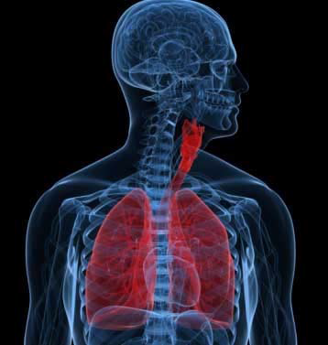
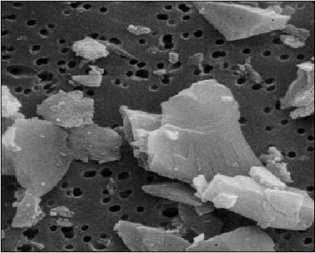
The risks…
Ballast handling activities create fine particles (dust). Ballast dust contains small quantities of Respirable Crystalline Silica (RCS)
Breathing in this dust at high concentrations over prolonged periods of time may lead to the development of a condition known as silicosis
Silicosis: RCS scars the lung tissue and can lead to permanent breathing difficulties
Notes:
When the ballast is disturbed (e.g. during ballast unloading or ballast tamping) it creates fine particles (dust). Ballast dust contains small quantities of Respirable Crystalline Silica (RCS).
Breathing in this dust at high concentrations over prolonged periods of time may lead to the development of an illness known as ‘Silicosis’. RCS scars the lung tissue and can lead to permanent breathing difficulties.

Slide 3
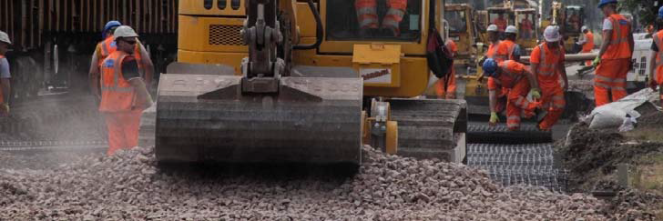
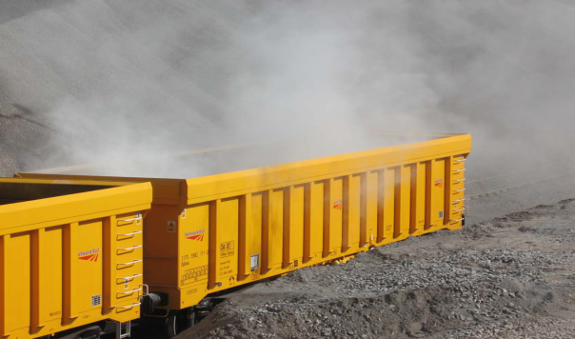
Whilst working, consider….
Dust created by your own work activity Dust created by other worksites close to you e.g. on adjacent lines High concentrations of dust building up in confined spaces (such as tunnels) Weather conditions, as heat and wind can increase dust concentration levels in the work area Wind conditions may also reduce concentrations of dust if you can work up-wind
Notes:
Dust created by your own work activity
Dust created by other worksites close to you e.g. on adjacent lines
High concentrations of dust building up in confined spaces (such as tunnels)
Weather conditions, heat and wind can increase dust concentration levels in the work area
Wind conditions may also reduce concentrations of dust if you can work up-wind

Slide 4
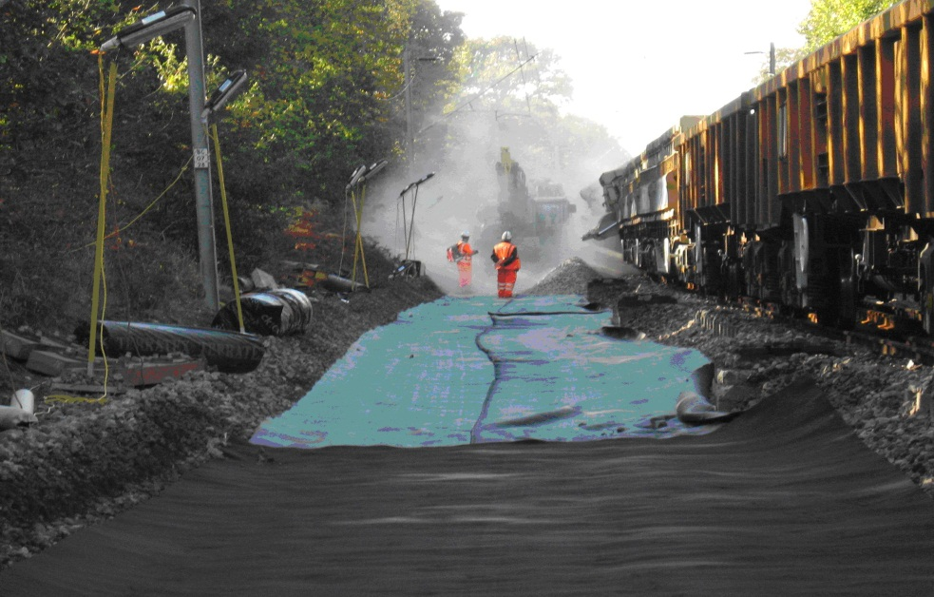
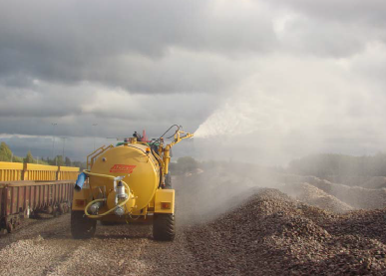
Move clear!
Move away from the area if you are not involved in the task Instruct those who don’t need to be there to move clear Wear appropriate RPE if you are involved in the task and it’s deemed necessary to wear Keep cab/machine doors and windows closed
Notes:
Ballast is often wetted where possible whilst stored at NSC Aggregate Handling Depots (AHD’s); this is for the control of dust at the AHD and is not meant to be the sole control measure on the worksite.
If you are not working directly with ballast, then move clear of that area
If you are in charge of the work instruct those who don’t need to be there to move clear!
If you are in a machine cab keep the door and windows closed

Slide 5
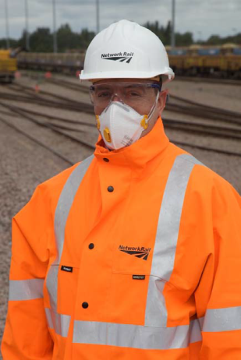
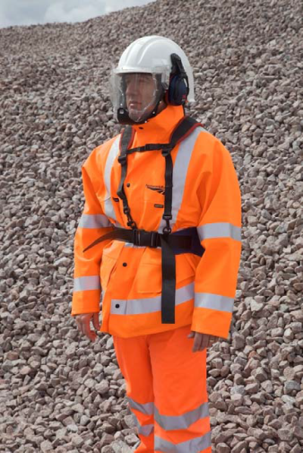
Respiratory Protective Equipment (RPE)
Have you received face fit testing?
Is the RPE as detailed in COSHH risk assessment?
Has it been allocated to YOU?
Is it in good condition?
Is it clean?
If appropriate, did you shave within 8hrs of the start of the shift?
Do you have a good seal between your face and the RPE?
Notes:
If you do work in dusty environments on the track, wear appropriate Respiratory Protective Equipment (RPE) as detailed in the COSHH risk assessment
Only use RPE allocated to you and that you have been trained to use (e.g. face fit testing for tight fitting face pieces
Only use RPE that is in good condition
Keep the RPE clean and replace where necessary
Facial hair will reduce the protection provided by tight fitting RPE. If you are unable to create or maintain a good seal between your face and RPE, report it to the person in charge

Slide 6
If you are concerned about dust levels STOP WORKING and contact your manager
Please report very dusty events to NSC 24/7 on 01908 723500
Notes:
If the dust is creating visibility problems, stop working and invoke the work safe procedure.
Please report very dusty events to NSC 24/7 control on T: 01908 723500

Slide 7
What have you learnt?
Question: What should you consider if you need to work in a dusty environment?
Question: If you are not working directly with the ballast handling activity, what should you do if you find yourself in a dusty area?
Question: If you are having ballast dust visibility problems whilst working – what should you do?
Notes:
If the dust is creating visibility problems, stop working and invoke the work safe procedure.
Please report very dusty events to NSC 24/7 control on T: 01908 723500

