Slide 1
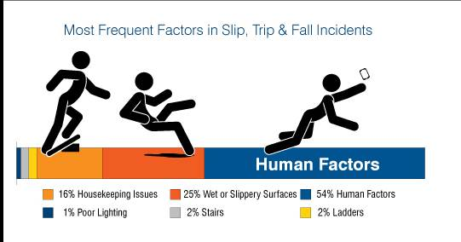

Welcome to a Slip Trip and Fall
Who Wants to be a Millionaire
12
£1 Million
11
£500,000
10
£250,000
9
£150,000
8
£75,000
7
£50,000
6
£20,000
5
£10,000
4
£5,000
3
£2,000
2
£1,000
1
£500

Slide 2
Question 1

Slide 3
How many people in Network Rail had to take time off work due to an accident in 2016/17 ?
A 234
B 421
C 678
D 974

Slide 4
How many people in Network Rail had to take time off work due to an accident in 2016/17 ?
A 234
B 421
C 678
D 974

Slide 5
£500

Slide 6
Question 2

Slide 7
Between period 1 and 6 of 2017, how many STF have been reported?
A 338
B 108
C 222
D 641

Slide 8
Between period 1 and 7 of 2017, how many STF have been reported?
A 338
B 108
C 222
D 641

Slide 9
£1,000

Slide 10
Question 3

Slide 11
So far this year (P1-P7) according to SMIS what has been the reported cause for the most STF reported ?
A Environmental /Ground Condition
B Manual handling
C Stairs or Steps
D Ballast

Slide 12
So far this year (P1-P6) according to SMIS what has been the reported cause for the most STF reported ?
A Environmental /Ground Condition (13%)
B Manual handling (13%)
C Stairs or Steps (9%)
D Ballast (15%)

Slide 13
£2,000

Slide 14
Question 4

Slide 15
Since 2010 which month historically has the most Slip Trip and Falls recorded?
A January
B March
C October
D November

Slide 16
Since 2010 which month historically has the most Slip Trip and Falls recorded?
A January
B March
C October
D November

Slide 17
£5,000

Slide 18
Question 5

Slide 19
Per hour worked which region has the lowest number of STF since April 2017 (correct as of end of P7)?
A Wales
B Scotland
C LNE
D South East

Slide 20
Per hour worked which Route has the lowest number of STFs since April 2017 (correct as of end of P7)?
A Wales
B Scotland
C LNE
D South East

Slide 21
£10,000

Slide 22
Question 6

Slide 23
How many RIDDOR’s related to STF have taken place in first 7 periods of this year?
A 97
B 18
C 325
D 117
CDM Co-ordinator

Slide 24
How many RIDDOR’s related to STF have taken place in first 6 periods of this year
A 97
B 18
C 325
D 117

Slide 25
£20,000

Slide 26
Question 7

Slide 27
What is the statutory weekly sick pay amount?
A average of your last 10 pay packets
B means tested
C £89.35
D £147.89.

Slide 28
What is the statutory weekly sick pay amount?
A average of your last 10 pay packets
B means tested
C £89.35 for up to 28 weeks
D £147.89.

Slide 29
£50,000

Slide 30
Question 8

Slide 31
On average how long is it before you can drive after a broken ankle?
A 8-9 weeks
B week
C 6 weeks
D 4 weeks

Slide 32
On average how long is it before you can drive after a broken ankle?
A 8-9 weeks
B week
C 6 weeks however it depends on so many circumstances
D 4 weeks

Slide 33
£75,000

Slide 34
Question 9

Slide 35
What does ERIC PD?
A Eliminate, Reduce, Isolate, Control, PPE, Discipline (to monitor controls)
B Eric Police Detective
C Educational Resource Information Centre Public Domain
D Excellence,Respect,Integrity,Courage,Professional Development

Slide 36
What does ERIC PD?
A Eliminate, Reduce, Isolate, Control, PPE, Discipline (to monitor controls)
B Eric Police Detective
C Educational Resource Information Centre Public Domain
D Excellence,Respect,Integrity,Courage,Professional Development

Slide 37
£125,000

Slide 38
Question 10

Slide 39
Habits- approx how times do you undertake a task to form a habit?
A 3
B 10
C 21
D 33

Slide 40
Habits- approx how times do you undertake a task to form a habit?
A 3
B 10
C 21
D 33

Slide 41
£250,000

Slide 42
Question 11

Slide 43
To break a set habit, approx how many times do you need to perform the new task?
A 10
B 21
C 42
D 100

Slide 44
To break a set habit, approx how many times do you need to perform the new task?
A 10
B 21
C 42
D 100 – according to behavioural based safety theory

Slide 45
£500,000

Slide 46
Question 12

Slide 47
What is the close call telephone number?
A 0800 40 50 40
B 0345 7114141
C 01908 723500
D 01270 721600

Slide 48
What is the close call telephone number?
A 0800 40 50 40
B 0345 7114141
C 01908 723500
D 01270 721600

Slide 49
£1,000,000

