Slide 1
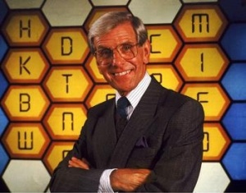
Slip Trip and Fall Blockbusters
Make sure you have the ppt. in slide show mode
Get a copy of the accompanying question set from Safety Central (titled STF Blockbusters Questions)
Split into 2 teams
Team1 will aim to cross the board from left to right
Team 2 will aim to go from top to bottom
Each team to take turn and choose a number and answer the question that corresponds to that number
Get it right- change to your colour, wrong goes to your opposing team
Click once to turn red, twice to turn green.

Slide 2
Slip Trip and Fall Blockbusters
1
3
2
4
5
7
6
8
TEAM 1
9
11
10
12
13
15
TEAM 2
14
16

