Slide 1

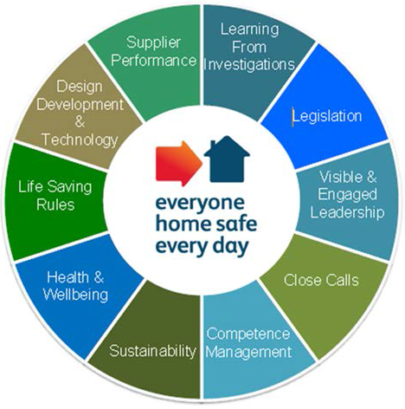
IP SNE Step up for Safety
December 2016
Notes:
Thank you all for attending, we realise holding these stand downs can be disruptive but the next 90 minutes are hugely important in keeping ourselves and colleagues safe.
I hope you will embrace and engage in the session.

Slide 2



Agenda
Introduction and purpose of session
What’s it all about?
Case Study 1
Case Study 2
Case Study 3
Final discussion and commitments
Notes:
There are six parts to the agenda today. We will all get out of it, what we put into it.
Thank you to AMCO, Balfour Beatty and Galliford Try for assisting in the production of this presentation.
We will hear from their employees and discuss three injury accidents that took place on their sites.
These Principal Contractors have allowed the learning from these events to be shared with you in order to promote and improve safety performance. Some of the events focus on items that the Principal Contractors should have done in a better way; its important that we recognise that they care enough to be honest and share this with you. We ask that you consider throughout the presentation if these areas for improvement exist on the projects and sites that you work on.
NEXT SLIDE WILL GIVE YOU THE FOCUS ON THE STEP UP

Slide 3
What’s it all about?
An opportunity to review and reflect on our events
Dedicate time to discuss what's gone wrong
Share the learning for the benefit of others
Notes:
What is Step up for Safety?
It is a time to take a closer look at safety across our sites.
Step up for Safety is running across all supplier sites for those working on projects throughout Infrastructure Projects Scotland and North East and we’re asking all sites to stand works down to take a look at some of the key issues affecting site safety and to have a think about what we can do more of or start doing, to make sure everyone goes home safe everyday.
This quarter, we’re taking a look at the LNE Renewals team. They were experiencing a good safety record but then started to experience a number of incidents, the types of accident that could have happened anywhere and its important we understand what happened, why they happened and what we can learn from them.
THE NEXT SLIDE IS AN INTRODUCTION FROM STUART WHITE, HEAD OF Safety & Sustainable Development

Slide 4
Introduction by Stuart White
**Please insert Step Up For Safety Introduction film**

Slide 5
Neville Hill Depot - Galliford Try
Case Study 1
Notes:
PAUSE HERE
The video is a summary of events that led to an injury accident.
The workgroup were working in a carriage wash, they were running cables out.

Slide 6
Neville Hill Video 1
**Please insert Step Up For Safety Incident 1-Clip 1 film**

Slide 7
Your review
What could have prevented this accident?
Who could have prevented this accident?
What can be learned from this accident?
Notes:
The cable drum rolled over the injured persons foot causing injury. (Make sure all below points are covered)
What could have prevented this accident? Start a discussion about what a good planning and risk assessment would be for this type of work.
There was no risk assessment that covered the moving of the drum in this location. Remember the manager said that manual handling was covered in the task briefing sheet but moving the cable drum wasn’t included. A risk assessment and a good task briefing may have prevented the accident by eliminating the risk altogether.
There was no particular plan for this work that covered the activity that day, the operatives were managing the plan and the risks at the ‘front end’
Who could have prevented this accident?
We would like to consider those that are responsible for identifying the tasks in the work plan and developing the risk assessments. There was, of course numerous people involved at different stages of the work that may have had the opportunity to question what appears now to be an obvious risk, e.g. Project Manager, Site Manager, Supervisors and operatives…
What can be learned from this accident?
The next video will give us the lessons learned and reflections of the injured persons manager and the Network Rail Route Delivery Director.

Slide 8
Neville Hill Video 2 – Managers reflections
**Please insert Step Up For Safety Incident 1-Clip 2 film**

Slide 9
Key Learning
Identifying specific tasks
Risk assessing the task
Finding practical and safe solutions
Speaking up and sharing concerns about risk
Notes:
Work your way through the four boxes, one at a time.
Box 1
How do we go about Identifying specific tasks
The Principal Contractor failed to recognise the task in its own right in relation to the overall work.
Box 2
How good are we at Risk assessing the task
The first step in an assessment is trying to eliminate the risk. This is sometimes easier than you may think, as is the case here. Generic risk assessments can be a starting point but they cannot hope to prevent accidents.
Considering the solution to the problem, it’s clear to see now that the Principal Contractor could have easily eliminated the risk before an accident of this nature occurred.
Box 3
How do we go about Finding practical and safe solutions
Running cable isn't just running cable; the environment, people and equipment needs to be considered EVERY time. This is when we can see what's different and allows us to find the right solution.
In this case, the movement of a large, heavy cable drum in a confined space, with the rails that had to be crossed, resulted in a solution where it became safer to cut the cable off site and transport it to where it was to be used.
Box 4
Speaking up and sharing concerns about risk
Why don’t you?

Slide 10
Stead Lane - AMCO
Case Study 2
Notes:
PAUSE HERE
We’re going to hear about an injury accident that occurred at Stead Lane.
The accident occurred after an inspector came to site to carry out an unplanned inspection.

Slide 11
Stead Lane Video 1
**Please insert Step Up For Safety Incident 2-Clip 1 film**

Slide 12
Your review
What could have prevented this accident?
Who could have prevented this accident?
What can be learned from this accident?
Notes:
(Make sure all below points are covered)
What could have prevented this accident? Start a discussion about what good planning and risk assessment would be for this type of work.
There was no plan for the inspection that day, the site team tried hard to facilitate the visit because they saw the value in the activity. This is something that we can all face at some point at work. There is a change or something unexpected comes along, we want to do the right thing and in this case it was to facilitate the inspection. Once again the site team were faced with managing the risk of the activity at the ‘front end’.
Who could have prevented this accident?
We should consider that those who are responsible for inspection, ought to have had a contingency for the work they couldn’t complete off site. A simple work plan and risk assessment could have been in place. There was, of course numerous people involved at different stages of the work that may have had the opportunity to prevent the accident, e.g. Site Manager, Supervisor and of course the inspector.
What can be learned from this accident?
The next video will give us the lessons learned and reflections from AMCO and the Network Rail Route Delivery Director.

Slide 13
Stead Lane Video 2 – Managers Reflection
**Please insert Step Up For Safety Incident 2-Clip 2 film**

Slide 14
Key Learning
Identifying specific tasks
Risk assessing the task
Finding practical and safe solutions
Speaking up and sharing concerns about risk
Notes:
Work your way through the four boxes, one at a time.
BOX 1
How do we go about Identifying specific tasks
The Principal Contractor failed to recognise the task in its own right in relation to not being able to complete the inspections off site.
BOX 2
How good are we at Risk assessing the task
There wasn’t a plan for this activity to take place on site. This meant that the site had to cope with the extra activity without any foresight or the opportunity to plan. The inspector chose to climb on the scaffold, he knew this wasn’t correct. The site team also knew this wasn’t correct but their ability to manage the situation was impeded through a lack of planning.
BOX 3
How do we go about Finding practical and safe solutions
The safe solution was already planned because the work was planned to take place off site. So we need a solution to the element of change. Change can be introduced at any stage in project delivery – from the boardroom to the worksite. Change at any level has the potential for introducing an uncontrolled safety risk.
What change is being proposed? What will it impact? e.g. • Information • Equipment • Practice & Process. At what stages will you ask: “What have we not thought about / recognised and / addressed?” What will tell you that risks have been both identified and addressed?
BOX 4
Speaking up and sharing concerns about risk
Put yourself in the position of the site manager. Can someone please share how they would have handled this situation differently?

Slide 15
Haigh Lane - Balfour Beatty
Case Study 3
Notes:
PAUSE HERE
We’re going to hear from Frank now, he had an injury accident that occurred at Haigh Lane.
Frank was stepping down from a dumper and had an accident that has had a considerable impact on him.

Slide 16
Haigh Lane Video 1
**Please insert Step Up For Safety Incident 3-Clip 1 film**

Slide 17
Your review
What could have prevented this accident?
Who could have prevented this accident?
What can be learned from this accident?
Notes:
(Make sure all below points are covered)
What could have prevented this accident? Try to have a discussion about what risks we face and don’t realise
What is it like to climb down from a dumper in a dark and wet environment? Frank tells us he ‘feels’ for the step.
Frank said that he ‘miss-footed’ at an earlier point, there was an opportunity to record and review this as a close call. We have to consider if this was reported there may have been the opportunity to review the activity. Would you have close called the ‘miss-footing’? If you were reviewing or responsible for the follow up to the close call, would you have seen the accident potential?
There is also a design element that we’ll focus on in the next few slides.
Who could have prevented this accident?
This event has fewer people involved. It’s essentially Frank and the designer of the dumper… or is it? What about if the principal contractor now reviewed dismounting of machines as a specific risk, is there improvements that could be made? Could we look at all machines? A week or so after this event another dumper driver fell while dismounting in IP SNE, he wasn’t injured but that was just luck.
What can be learned from this accident?
The next video will give us the lessons learned and reflections of the injured persons manager and the Network Rail Route Delivery Director.

Slide 18
Haigh Lane Video 2 – Managers Reflection
**Please insert Step Up For Safety Incident 3-Clip 2 film**

Slide 19
Key Learning
Is getting out a dumper a task?
Risk assessing the task
Finding practical and safe solutions
Would you have close called?
Notes:
Work your way through the four boxes, one at a time.
BOX 1
What do you think? Is getting out a dumper a task?
We undertake an infinite amount of tasks everyday, so at what point do we recognise that getting in and out of a dumper is a task? Is it too much to say as an organisation that we do recognise this and could assess it just once? This would give us the time to look at what could be improved. The design of the steps played a large part in this accident. In an otherwise new and fit machine, are we looking for risks that others (designers) missed?
If we see them what can we do about them? – Close Call.
BOX 2
How good are we at Risk assessing the task
There wasn’t a risk assessment for getting off the dumper – why would there be?
BOX 3
How do we go about Finding practical and safe solutions
The safe solution should have been in the design. The design of the steps is the root cause of the event. The next slide shows a picture of a dumper on a site in Scotland. The Principal Contractor heard about the Heigh Lane accident and quickly reacted, painting the steps of the machine.
BOX 4
Speaking up and sharing concerns about risk
Would you have close called the ‘miss-footing’? How seriously would you have treated the close call if Frank had raised it with you?

Slide 20
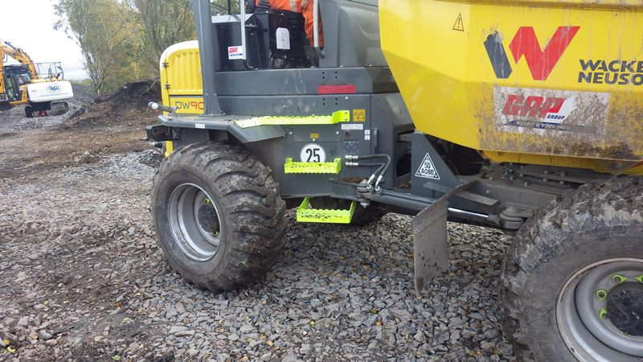
And finally, talk to Frank.
Notes:
A quick and welcome solution from another Principal Contractor.
We’d like you to write to Frank and tell him what one thing you’ll do differently as a result of today’s Step up for Safety?
Please use the attached commitment sheet and ask all attendees to participate. Please take a photograph of the commitments sheet and send to s&sdsne@networkrail.co.uk
WHAT ARE OUR SUGGESTIONS AND COMMITMENTS?
CAN WE USE EACH OTHER TO CHECK WE DID WHAT WE SAID WE WOULD?
Things to consider;
What else can be done to the dumper?
How might you react to change on site from now on?
How might you decide what a task is?
Your commitment to reviewing risk assessments and making them real.
What are you going to do the next time you should speak up?

Slide 21
Stuart White – Closing Video
**Please insert Step Up For Safety Close film**

