Slide 1
Safety stand down
3-31 July 2018
Notes:
FACILITATOR INSTRUCTIONS
This is part of a national stand down for the whole of Network Rail.
It will take place in July and involve ALL staff.
Please prepare for this session carefully.
Please personalise this with your own thoughts and experiences to give this session personal meaning.
Your personal commitment and leadership will be key to the success of this stand down.
This session will take around 60 minutes.
Before you begin
Print a copy of the pledge form (A3) for participants to sign
Print the slides with the notes pages for you to refer to (or print the separate facilitator guide).
There are two discussion activities and one ‘commitment’ action
Throughout this presentation, speaker points will be marked in BOLD (i.e. script/notes for you to talk through in your team session) AND general guidance/instructions in non-BOLD

Slide 2
Agenda
Introduction and purpose of the session
The seemingly ordinary
Team discussion
Call to action
Notes:
FACILITATOR INSTRUCTIONS
Start your session by talking through the agenda with your team. Explain there will be three discussion activities and a call to action.
Points to say:
The purpose of this session is to make a focused behaviour change to improve our safety culture
We are a safety critical company – the lives of 4.5 million people who travel on the network every day depend on us and our safety behaviours.
2. We are talking about this now because a seemingly ordinary activity, something similar to what most of us would do at home or at work, led to a fatality on 5 June 2018.
We need to identify what we can learn from this and act upon it.
The behaviours and failings that led to this incident have also been seen in other high potential and serious incidents.
We must set a higher standard for ourselves in our basic safety behaviours.
We have to become better at seeing potential hazards and at intervening if we see something that isn’t right.
3. We will have a team discussion - where we can learn together and agree how we can help each other to do the right thing to keep us all safe.
4. The session ends with a call to action for everyone - a visible demonstration that safety matters to every one of us.

Slide 3
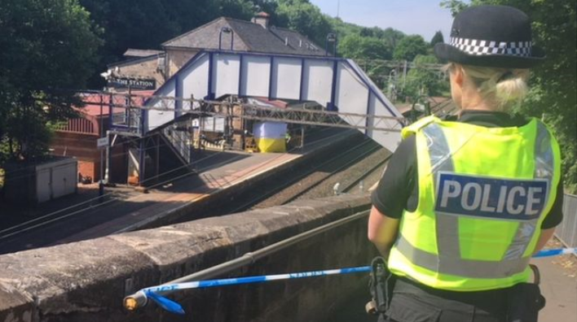
Why are we having a Safety Stand Down?
A 20 year old colleague
lost his life in a fall on 5th June 2018
Notes:
Points to say:
Matthew, a 20-year-old colleague from a contracting company Linbrooke, tragically lost his life on Bearsden station in Scotland on 5th June 2018
His family will have to move on in life without him. Many people are hugely impacted by this tragic event
He joined the company three years ago as a 16-year-old apprentice.
He was extremely highly regarded as one of their up and coming employees
This accident could have happened anywhere at work or at home.
We must consider hazards and risk no matter where we are
This accident occurred because of a combination of many small risks coming together
This accident highlights that we haven’t yet created the right culture where we pay attention to safe behaviours in all the things we do.

Slide 4
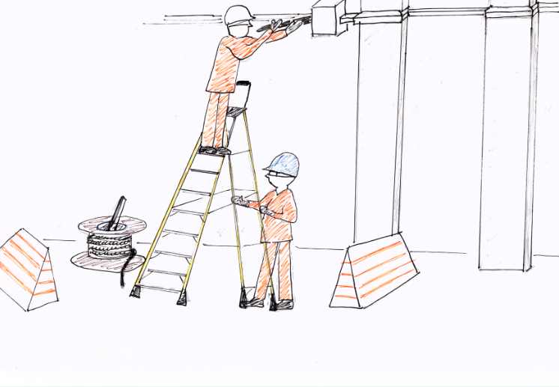
Sketch created 28 June 2018 based on information at the time and solely for the purpose of the safety stand down. This accident is still under investigation.
Notes:
Points to say:
Working at height on a step ladder, doing a task which would not be considered complex. Rewiring a public address system
The drawing here is based on a summary of the facts as we currently understand them (28 June 2018) and investigations are ongoing. This is what we know.
He was working on a 10 step stepladder pulling cable
He had his feet just above 2 meters from the ground
He was on the ladder, pulling the cable with both hands
A cable drum was placed underneath.
A steel pipe had been used to carry the cable drum. It was not a proper tool for the job - it was what they had to hand and this had become accepted practice. Storing it in the drum was to prevent it rolling away.
Working on a platform at an open station, keeping the worksite as small as possible so as not to obstruct passengers.
He fell from the ladder and landed on the upturned pipe.
Paramedics arrived in 8 minutes but he died before they could get him to hospital.

Slide 5
Exercise 1 What do you see?
Sketch created 28 June 2018 based on information at the time and solely for the purpose of the safety stand down. This accident is still under investigation.
Notes:
Exercise 1 – what do you see?
GUIDANCE: On the sketch, point out each area (ladder, clothing, cable drum, barriers) one at a time and ask the group: What do you observe?
For each item things to prompt are listed below.
Points to say:
1. What do you observe about the ladder?
think about the planning of this job. It could have been done using a platform, which would have been inherently safer.
they had someone to prevent the ladder toppling over – so they were aware of some risks
- the task required both hands to be off the ladder – pulling cable. Three points of contact was not possible.
2. What do you observe about the clothing?
- they were all wearing appropriate PPE.
3. What do you observe about the cable drum?
- This is too heavy for one person to lift. So they used a steel bar through the core of the drum so that two people could lift it. This was not a tool designed for this purpose, but it had become custom and practice.
- the pipe was stored in the drum to stop it rolling away and becoming a trip hazard….
4. What do you observe about the barriers?
- The barriers were used to keep the worksite separate from the passengers using the station – they were safety devices.
- the drum was stored close to the ladder so that the worksite was small and didn’t interfere with the passengers using the station. But it was too close to the ladder….
Anything else you see?
So there is often no single thing, but a sequence of small safety risks.
NOTE for facilitator: prompt discussion re planning, working at height, looking for hazards, use of PPE

Slide 6
Ordinary tasks also need risk awareness
A combination of small, seemingly isolated risks combined to create a fatal accident
There were many opportunities to prevent this accident – in the planning and in the execution.
We will learn the lessons from this accident and they will be communicated when the investigation is complete:
Working at heights / use of ladders
Safe planning
Risk awareness / exclusion zones
Notes:
Please take a moment to read out the points on the slide.
Points to say:
This tragedy has brought into sharp focus that we have to challenge and change our safety culture.
It starts with paying attention to the seemingly ordinary – and using the safety systems that exist to protect us
The more of us who actively engage in the reporting and reduction of safety hazards, the safer Network Rail will be.
We will learn the lessons and they will be communicated when the investigation is complete.

Slide 7
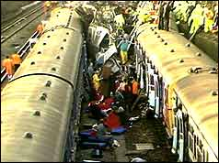
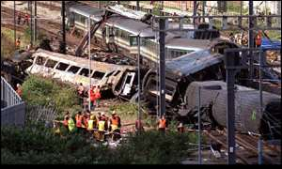
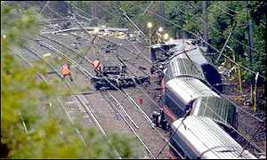
Previous accidents have left a lasting legacy that have changed our approach to safety
Legacy – safety engineering & processes
Event Legacy change
Clapham Junction 1988 Fatigue management introduced
Ladbroke Grove 1999 Introduction of Train Protection & Warning System (TPWS)
Hatfield 2000 Inspecting for rolling contact fatigue
Lambrigg 2007 Tubular stretcher bars introduced
Notes:
Points to say:
Previous accidents have left a lasting legacy through changes to our ways of working. The ones mentioned above all resulted in fatalities.
Follow up from these accidents changed our safety culture, technology and the processes we follow.
What is the legacy that will be left in our organisation after the death of our colleague? Will you make changes?

Slide 8
We must challenge the culture and behaviours that allow small risks to go undetected or tolerated
Legacy: making safe behaviour a habit
We still have too many accidents and near misses with similar root causes
How do we create a culture where safety and risk awareness is always present so that we look after ourselves and we look after each other?
How can we make safe behaviour a habit and one that we do even when no-one is looking?
Notes:
Facilitator guidance: you do not need to discuss these questions at this time. AFTER reading the points out loud, please move on to next slide.
Points to say:
We still have too many accidents and near misses with similar root causes
How do we create a culture where safety and risk awareness is always present so we look after ourselves and we look after each other?
How can we make safe behaviour a habit and one that we do even when no-one is looking?

Slide 9
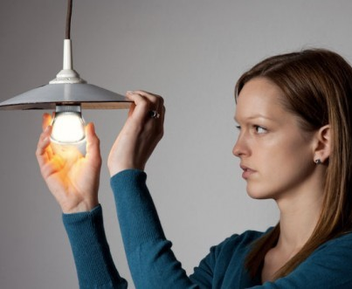
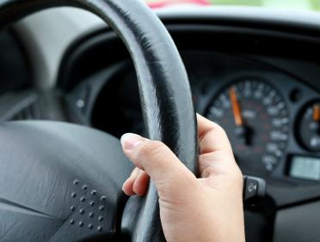
Exercise 2
When do ordinary activities become unsafe?
Discuss in groups:
Have you had an accident or near miss which involved an ordinary task?
What would have prevented these events?
When was the last time you intervened when you saw an unsafe act, at home or at work?
The tragic fatality and the two very serious near misses all occurred within just 1 week
They all could have been prevented with higher risk awareness
Notes:
Exercise 2 – when do ordinary activities become unsafe?
GUIDANCE: take a moment to discuss each question.
Conclusion: we have to make a habit of doing the simple ordinary things safely.
The incident in which our colleague lost his life could have been considered such an ‘ordinary’ task.

Slide 10
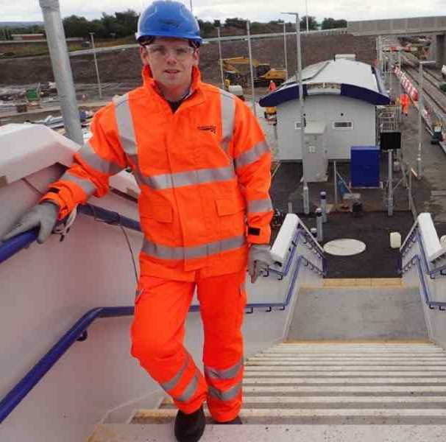
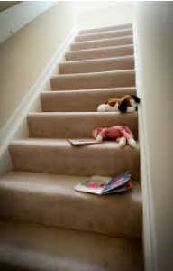
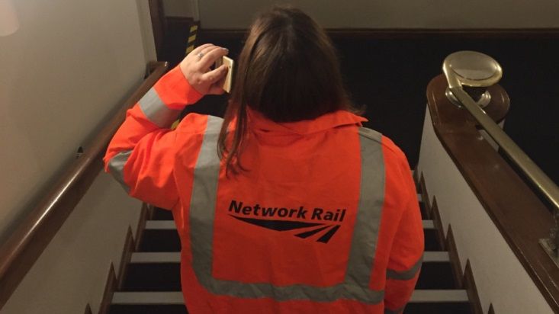
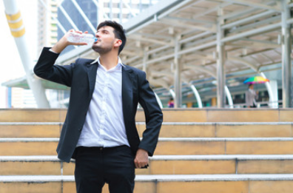
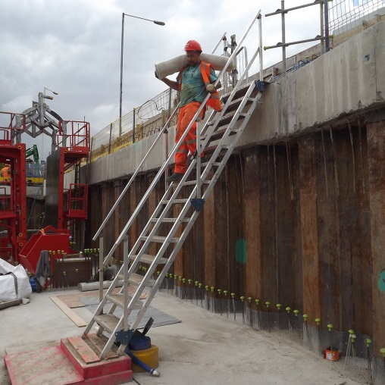
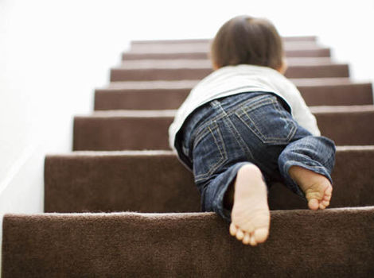
An ordinary activity for all of us – at work or at home
1,000 deaths every year: stairs are the place where most fatalities happen in the home
Notes:
Points to say:
Here’s an example of an ordinary task that we can do more safely.
Ladders and stairs both require ‘three points of contact’.
Falling down stairs is the highest cause of domestic fatal accidents. 1000 people every year.
Children and the elderly are especially vulnerable. For many of you, your elderly parents and your children are more likely to die in your house than you! But you can create a safe culture in your house for them and for you.
Going up and down stairs is an ordinary thing to do. We all do it everyday. It can be made safer – or less safe.
How many of you leave things on the stairs so that they are there to be taken up? …. Toys, piles of clean clothes, pairs of shoes? These are all hazards that increase risk of falling.
All of the pictures here are examples that increase the risk of falling.
NOTE: Three points of contact: defined as always having one foot and two hands or one hand and two feet in contact with the piece of equipment

Slide 11
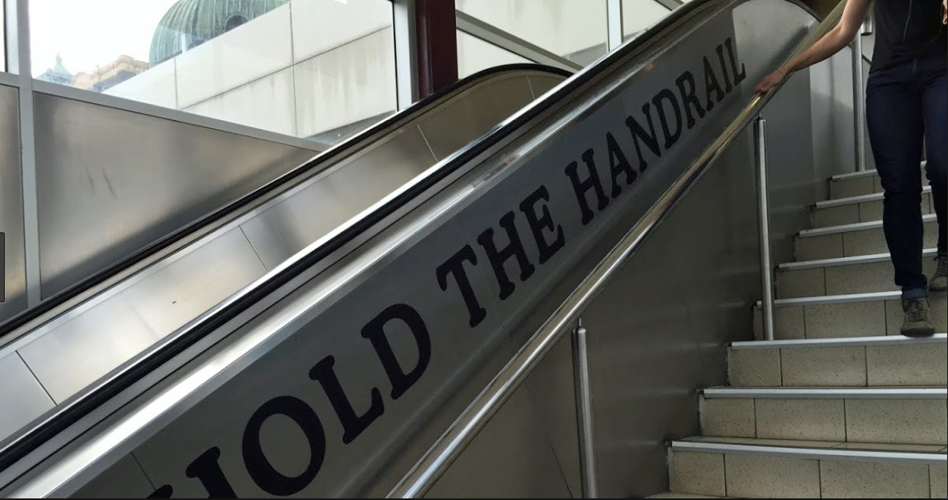
An everyday task: make using the safe system a habit
The tragic fatality and the two very serious near misses all occurred within just 1 week
They all could have been prevented with higher risk awareness
Notes:
Points to say:
Most stairs have a safety system – the handrail
It is free to use
It takes no more time to use the stairs
How many of us use the handrail when we use the stairs?
So why don’t we use the handrail?
If we make a habit of doing ordinary things safely we will also do more complex things safer, it becomes our habit.
Facilitator instructions:
Move the presentation on to the next slide and start with question 1

Slide 12
Exercise 3
The tragic fatality and the two very serious near misses all occurred within just 1 week
They all could have been prevented with higher risk awareness
Using the handrail
Discuss as a group:
1. Why don’t we use the handrail when it’s there?
2. Why do you think we’re focusing on holding the handrail?
3. What would stop you from intervening if you see someone not holding the handrail?
Notes:
Exercise 3 – Using the hand rail
Facilitator instructions:
Invite the room to discuss the below three questions. Take one at a time. Expect to spend a minute or two on each
QA document may prove useful during this discussion.
Points to say:
Stairs have a safety system – the handrail. Why don’t we use the handrail when it’s there?
Is it because we think we don’t need it? Won’t happen to me…
If we don’t use safe systems for the highest risk event in our home life – why should we expect people to use safe systems at work….
We need to create a safe culture.
2. Why do you think we’re focusing on holding the handrail?
It is safer to hold the handrail, it is also a constant visual reminder of our safety culture.
If we pay attention to safe practice even in the most mundane, every day situations, then we WILL behave safely at all times.
It is something the most of us have the opportunity to do every day.
It can become a symbol of our safe behaviour culture – in a safety critical company
3. What would stop you from intervening if you saw someone not holding the handrail?
Embarrassment? Not sure what to say? Hygiene? Being seen to be ‘overly sensitive’?
Practice makes this easier. Practice by speaking to people who aren’t ‘holding the hand rail’. Point out that you care about their safety and that they should be following the rules in Network Rail. Practice makes it easier to intervene on other occasions.
It is our obligation to intervene whenever we see an unsafe act. Walking by tolerates unsafe behaviour.
Perhaps we haven’t made our expectations clear before.
We are now. Holding the handrail is now a safety symbol for everyone in Network Rail.

Slide 13
The way we react when challenged is massively important to our culture
Reaction to intervention
Negative reaction
Don’t react in negative or defensive way. If you do, you make it more difficult for that person to challenge in future.
Positive reaction
If you thank someone for caring about your safety – not only will you be safer, but you will make them feel more inclined to keep challenging unsafe practice in future.
.
The ‘next time’ could be over something very serious…
Notes:
Points to say:
Can anyone recall a time where they were challenged about safety? How did you feel? How did you react?
The way we react when challenged is massively important
If you are challenged, think about the motivation of the person challenging you. It will be because they care about your safety
Don’t react in a hostile, negative or defensive way. If you do that, you instantly make it more difficult for that person to challenge in future.
If you react in a positive way – acknowledge, think about why they said something, maybe thank them for caring about your safety – not only will you be safer, but you will make them feel more inclined to keep challenging unsafe practice in future.
The ‘next time’ could be over something very serious…

Slide 14
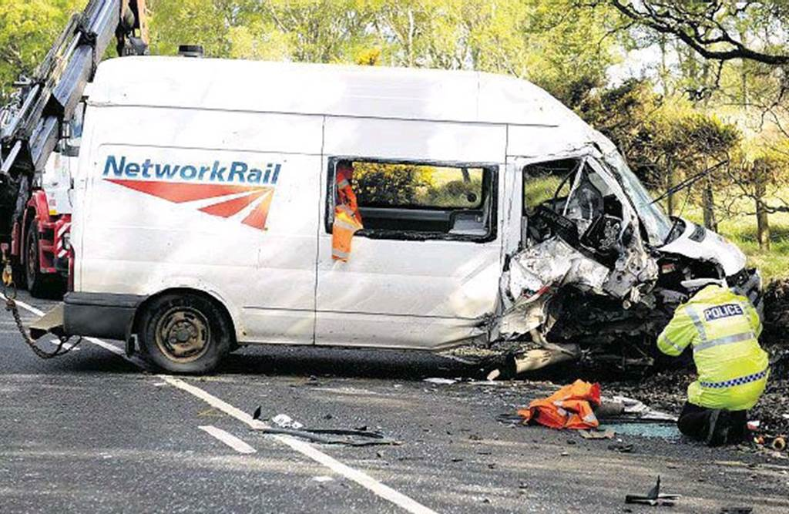
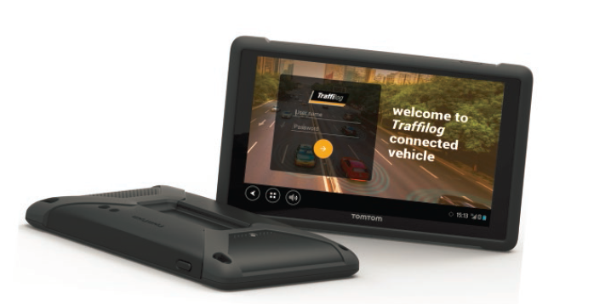
We can change our behaviours!
There have been five fatalities in CP5 caused by driving accidents
In four cases the failure to wear seat belts was a contributory cause
When we installed the Vehicle Speed Warning System we achieved an instant change to driving behaviours
80% reduction in accidents!
33% reduction in staff injuries!
£2 million saving in fuel costs
£1.5 million saving in repairs
Safety and Performance go hand in hand
Notes:
Over the last year we installed vehicle speed warning systems in all our Network Rail vehicles.
This device has supported a change in our safety behaviour which has seen a significant reduction in road traffic accidents involving Network Rail staff. In parallel, we have seen a drop in cost incurred by third party claims and repairs, and a hugely positive environmental impact has been achieved through the reduction in fuel usage.
The device itself has helped us in changing our behaviours by notifying drivers when speeding - but we do not need a device to change.
We can change just as well through a commitment to each other to change.

Slide 15
A step change in our safety culture
‘Hold the handrail’
Our safety culture protects us, and the public who depend on us
Holding the handrail
We want a safety culture that eliminates the small isolated failings
This culture will save lives
is a simple way to reduce the chance of hurting yourself
gives us the opportunity to practice our intervention skills
it symbolises and demonstrates our personal commitment to our safety culture – every day
Notes:
Points to say:
Our safety culture protects us, and the public, the 4.5 million people who depend on us
Holding the handrail
is a simple way to reduce the chance of hurting yourself
gives us the opportunity to practice our intervention skills
symbolises and demonstrates our personal commitment to our safety culture – every day
We want a safety culture that eliminates the small isolated failings
This culture will save lives

Slide 16
Call to action
‘Hold the handrail’
The tragic occurred within just 1 week
They all could have been prevented with higher risk awareness
I make the commitment to:
Always use the handrail on stairs/steps with handrails
Always intervene if I see someone not holding the handrail
Watch out for hazards in any task
Use safe systems even when activities are considered ordinary
Act safely both at work and at home
Notes:
Facilitator: Show and distribute the pledge form in the room. Invite people to sign while you use the speaker notes below.
Points to say:
We must pay attention to the seemingly ordinary. And use the safety systems that exist to protect us.
I would like everyone to commit to ‘hold the handrail’ as a constant reminder of our safety culture
I would like everyone to also commit to intervene if we see an unsafe practice
This is our chance to change!
The more of us who actively engage in the reporting and reduction of safety hazards, the safer we will all be
In summary, I’m inviting you to all make a commitment to ‘hold the handrail’ and challenge/intervene where you see a safety risk from this point onwards
Sign your pledge
Display your pledge on the wall at your workplace (if possible)
Take a photo of your pledge and post it on Yammer using the hashtag: #holdthehandrail

Slide 17
#holdthehandrail
Notes:
Points to say:
From today, let us all challenge and change our habits. Even the most ordinary.
Always choose the safest option.
Intervene.
And make sure everyone gets home safe, every day
Thank you
Facilitator instructions:
At the end of your session, make sure that you complete and return the attendance form and email to: STEcommunications@networkrail.co.uk.

