Slide 1

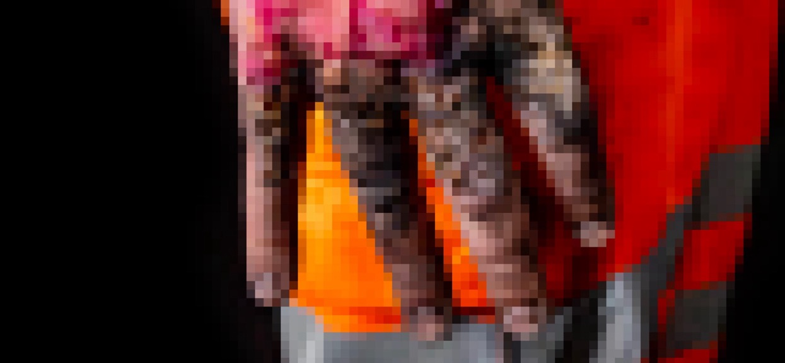

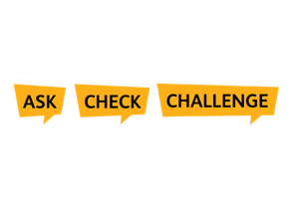


Electrical Safety Hour

Slide 2

1 in 146 isolation irregularities leads to life changing injuries*
Our safety controls are not correctly applied around 10 times every period,
resulting in an isolation irregularity.
Each incident has the potential for someone not to go home safe.
Every irregularity is a warning sign and statistics tell us that an electrical safety
incident is imminent.
Electrical safety shouldn't just be a priority – it needs to be second nature.
An isolation irregularity is when something goes wrong with the planning or implementation of
an isolation
*on average between 2015 and 2023
1

Slide 3
We are improving our electrical safety
Our workforce are still getting injured too frequently when working near high voltage traction power.
That’s why we’re introducing new standards and technologies to improve electrical safety for everyone working on or near the electrified railway.
We know there are many competing demands on our workforce, and mistakes can happen when people are working under pressure. But electrical safety standards cannot slip.
Whilst incidents may be low frequency,
they can have life-changing consequences
2

Slide 4

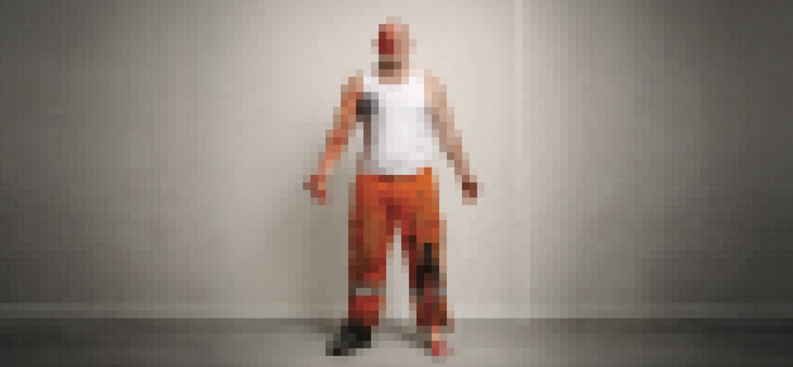

Warning
The following films depict replicated electrical injuries
Please only continue if you feel comfortable to do so
Notes:
Before I play this film, it DOES contain a very graphic recreation of electrical burn injuries.
Anyone that wishes to leave the room – feel free to do so.

Slide 5

4

Slide 6

Group discussion
How did the film make you feel?
What surprised you the most?
How do you think you'd be impacted by an electrical injury – at work and at home?
How often do you work around high voltage?
If you don’t work trackside, how does your role impact those who do?
What's your role in keeping people safe?
Have you experienced an electrical safety incident or near miss?
5
Notes:
If the discussion prompts in this presentation aren’t relevant to your audience, reshape them in a way that is.

Slide 7
Why we need to follow the Lifesaving Rules
Electrical injuries have lifelong consequences. Injuries from Overhead Line Equipment and the conductor rail can cause permanent disability or death.
Electrical injuries aren't like most other workplace injuries. What makes electricity so dangerous is that the damage isn't always limited to what you can see on the surface. Often the surface damage is the least significant injury.
The reason we're talking about this today isn't to be graphic for the sake of it. It's because understanding the reality of these injuries helps us understand why the Lifesaving Rules and electrical safety controls are so important.
Every Test Before Touch, every time you speak up when something doesn't feel right, it might prevent someone experiencing injuries that can affect the rest of their life.
6

Slide 8



The Wolverton incident
In the early hours of 14 May 2021, a linesperson sustained a serious electrical injury whilst working near Wolverton train station
Contractors checking the Overhead Line Equipment (OLE) unknowingly moved outside the limits of the electrical isolation.
A linesperson in a Mobile Elevation Work Platform made contact with live OLE and received an electric shock of up to 25,000 volts. His injuries were life-threatening and life-changing.
The planning was rushed, Test Before Touch was not undertaken and Reminder of Live Equipment (RoLE) devices were not yet in use.
This wasn’t a case of people not understanding the risks. Somewhere that morning, communication and process broke down. With electricity, that’s all it takes for a serious incident to happen.
.
.
The Electrical Lifesaving Rules are your last line of defence
Do you check your equipment is in
good working order before you start work?​
Do you always follow the Lifesaving Rules? Are there times when you don't? Why?
Always test before applying earths or straps.
Never assume equipment is isolated. Always test before touch.
7

Slide 9
Incidents on the Conductor Rail
Wallington Down June 2026 a DCCR Level B strapping colleague applied a short-circuiting strap in the wrong location, connecting the running rail clamps and passing the strap under the rail prior to testing. They sustained burns to the arm.
Wimbledon March 2026 a DCCR Level B strapping colleague applied a short-circuiting strap approximately 10 cm from the live part of a normally open hook switch. The strap came into contact with the live part of the hook switch, resulting in the conductor rail arcing, and they sustained burn injuries to their neck and wrist.
In both incidents the Strapping process was not followed, correct PPE was not worn, and the briefing/strapping locations were not fully understood. Always use the correct PPE for the task and always make sure you understand your briefing, location, and access of work.
We are developing improvements in electrical safety standards (NR/L3/ELP/SAI00750) and improvements to NR/L2/OHS/019 which will be deployed later in CP7. In 2026 a safety stand down is planned for colleagues who hold the strapping competence to support our response to the recent incidents.
How comfortable are you with
choosing to challenge?
Do you always receive a brief and fully understand them?
Do you always apply the Electrical Lifesaving Rules?
Have you got the right equipment and PPE for the task, do you always check it's in good working order?
The Electrical Lifesaving Rules are your last line of defence
Always test before applying earths or straps.
Never assume equipment is isolated. Always test before touch.
8

Slide 10
9
Notes:
It's important to understand that electrical injuries aren't like most other workplace injuries.
What makes electricity so dangerous is that the damage isn't always limited to what you can see on the surface. Often the surface damage is the least significant injury.
The current travels through the body looking for a path to earth, and as it does that it can cause significant damage internally.
That can include burns to the skin, muscle and nerves, damage to internal organs, and in the most serious cases permanent disability or death.
The reason we're talking about this today isn't to be graphic for the sake of it.
It's because understanding the reality of these injuries helps us understand why the lifesaving rules are so important.
Every Test Before Touch, every challenge when something doesn't feel right, every time we stop and check rather than assume, is there to prevent someone experiencing injuries that can affect the rest of their life.

Slide 11
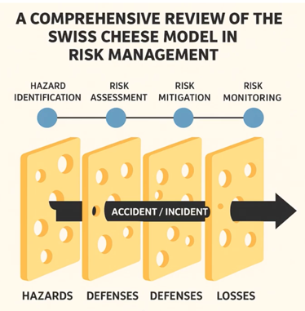
Accidents are the result of many failures
Accidents rarely occur because just one thing went wrong
Examples of contributing factors in a causal chain:​
Isolation limits aren’t set far enough​
The line isn't properly isolated, or is inadvertently re-energised
Isolation permits aren’t thoroughly checked​
Safety equipment is missing or incorrectly positioned​
Earthing clamps or straps aren’t properly applied​
Test Before Touch doesn’t happen
When one or more safety controls fail, things can go very wrong. That’s why every safety control matters:
Effective, accurate planning
Wear the correct safety equipment and check and recheck
your permits
Choose to challenge if something doesn’t feel right
Follow the Lifesaving Rules, every time
Can you share any examples of
near misses and what you learned?
Have you spoken up when something didn’t feel right? What happened?
10

Slide 12
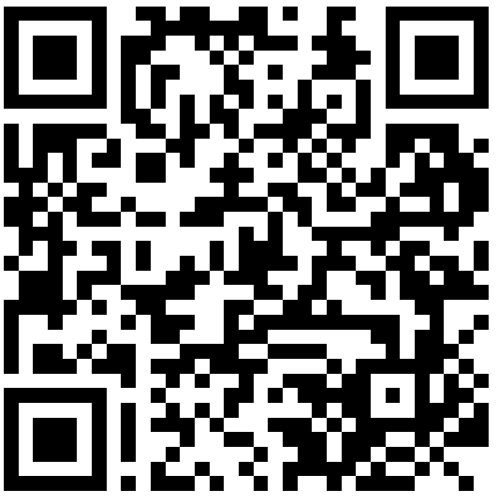
We're investing in safety
We’re putting new, safer systems and technologies
in place…​
And there's more to come...
We're deploying Remote Securing and Optimised Earthing through further improvements to the standards for working on or near OLE (SAI25000)
We're continuing to deploy local securing on conductor rail alongside to our improvements to the standards for working on or near the conductor rail (CRE standard SAI00750), based on learnings from historic incidents
We're increasing the understanding of electrical risk for those that plan and implement overall safe system of work through further integration of 019.
We've updated standards, and introduced new systems, tools and technologies to improve electrical safety.
The improved electrical risk assessment is in use on 90% of the OLE network
Introduced RoLE devices to serve as a visual reminder of safe working limits​ on OLE
Installing Negative Short-Circuiting Devices (NSCDs) and track feeder switches to enable local securing and reduce the volume of manually applied short circuiting straps​ on CRE
We’ve created regular electrical safety messaging to build a robust electrical safety culture
Scan to watch this film and learn more about our electrical safety improvements
11

Slide 13
12
Notes:
It's important to understand that electrical injuries aren't like most other workplace injuries.
What makes electricity so dangerous is that the damage isn't always limited to what you can see on the surface. Often the surface damage is the least significant injury.
The current travels through the body looking for a path to earth, and as it does that it can cause significant damage internally.
That can include burns to the skin, muscle and nerves, damage to internal organs, and in the most serious cases permanent disability or death.
The reason we're talking about this today isn't to be graphic for the sake of it.
It's because understanding the reality of these injuries helps us understand why the lifesaving rules are so important.
Every Test Before Touch, every challenge when something doesn't feel right, every time we stop and check rather than assume, is there to prevent someone experiencing injuries that can affect the rest of their life.

Slide 14

Group discussion
What's your lasting impression from this safety hour?
Will you do anything differently?
What's the one thing you can commit to today that will make working on or near the
electrified railway safer for you, or a colleague?
13

Slide 15
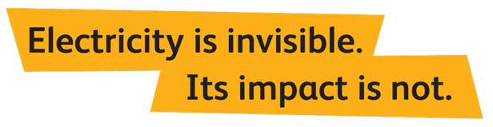
We need to look out for each other
The most important thing you’ll do today is get home safe to the people, places and hobbies you love.
Everyone Home Safe Every Day isn’t just a slogan, it’s a commitment to every Network Rail employee and contractor.
We will continue exploring new systems and technologies to help manage electrical risk.
But we also need everyone to embrace safer ways of working and look out for each other.
.
.
14

Slide 16
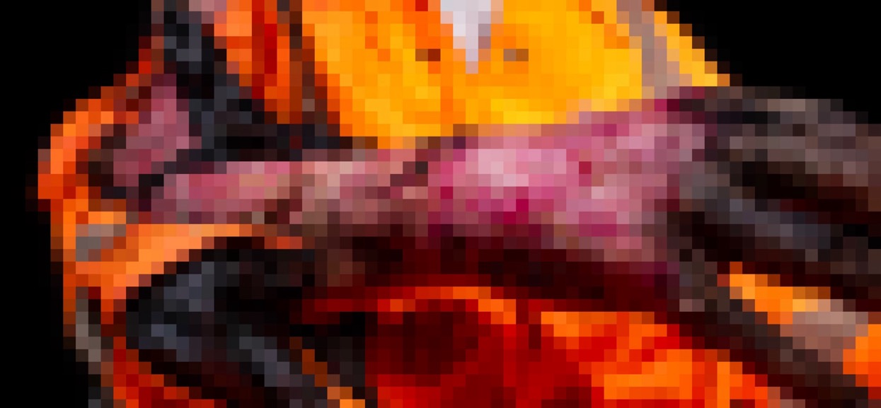

Thank you for attending todays
safety hour
Your feedback matters. Scan the QR code to tell us what you think, help influence future safety campaigns, and sign up for future communications
Got a question? Email ESD CommunicationESDCommunication@networkrail.co.uk

