Slide 1
Site Of Work Protection
New Method of Additional Protection for Line Blockages

Slide 2
Additional Protection (AP) for Line Blockages is an essential part of the drive to keep our track workers safe and forms part of the ORR’s Improvement Notice served to Network Rail.
The Rule Book states that Additional Protection must be used if the work being undertaken affects the safety of the line. However, any line blockage can, and should, be additionally protected.
Furthermore, Handbook 8 IWA, SWL, COSS or PC Blocking the Line states that:
You must arrange for at least one of the following additional protection arrangements, as shown in section 2.3 to 2.9, to be provided on the line to be blocked whenever this is possible.
Additional Protection is supplementary protection to signal protection. Additional Protection is for both the safety of the line and the protection of track workers.
More than one type of additional protection can be used to protect the line blockage/site of work and is to be recorded on the NR3180 form. This needs to be confirmed during the safety critical conversation when agreeing the details of the line blockage.

Slide 3
Reaching a Clear Understanding – Safety Critical Conversation
It is imperative that the person (COSS/PC/SWL/IWA) taking the line blockage and the signaller reach a clear understanding on what is to take place with regards to the line blockage and additional protection. This includes what additional protection is going to be used, how it is going to be used and where it will be used.
TCOD – Track Circuit Operating Device
TCODs effectively mimic a train occupying a track circuit with the signal interlocking subsequently maintaining the signal in rear at danger. TCODs are secured to the running rails by the person applying additional protection.
Manual TCODs are authorised as Additional Protection for use at the site of work even when this is not going to hold the protecting signal at danger but will instead hold a different signal within the line blockage to danger. Treat this scenario exactly as you would any other scenario. The requirement to place and maintain the Primary Protecting Signal to danger and apply reminder appliances remain the same.

Slide 4
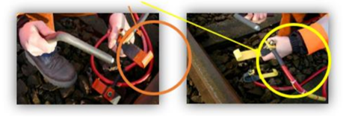
4
3
2
1

Slide 5

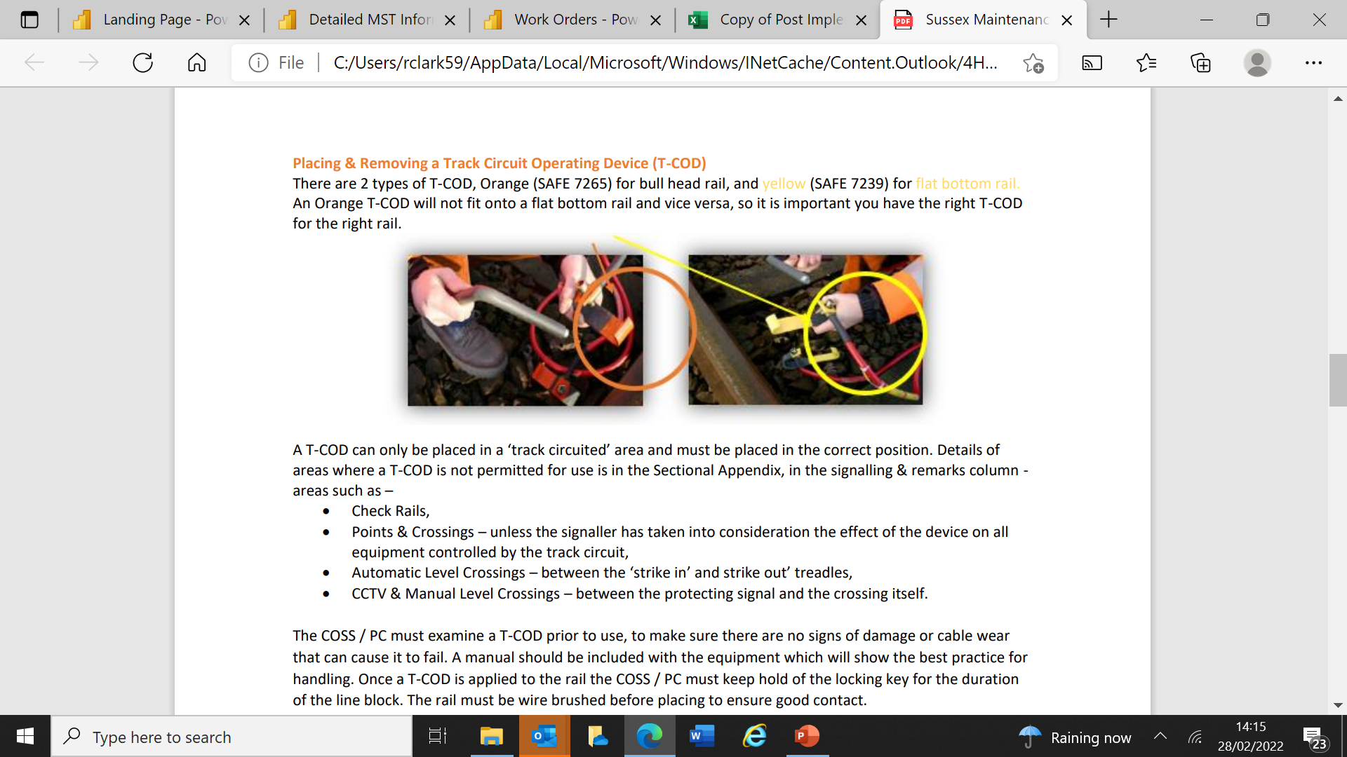
Additional Protection at site of work
Additional Protection placed at the site of work
Benefits:
The work group will place additional protection where practicable – Nationally currently at 30%
Safer Line Blocks
Signallers able to identify locations of workgroups
Signaller confirmation that the correct protection has been applied

Slide 6


