Slide 1
Signalling Shared Learning Engineering Services Delivery
Issue 01 - June 2023

Slide 2
Introduction
This Signalling Shared Learning details various events and incidents that have occurred on Signalling Projects between December 2022 and June 2023, and provides the key learning points associated with them.
It is intended for distribution within the Network Rail Signalling community and the wider Supply Chain in order to raise awareness of the learning points within, and to enable best practice to be applied throughout all of our signalling activities.

Slide 3
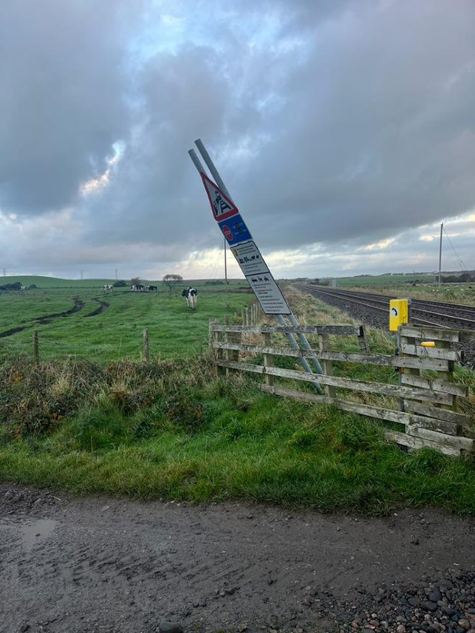
Level Crossing Signage
Background
Following the upgrade of a level crossing, new signage was installed utilising a single supporting structure, in line with a recently issued standard (NR/L2/XNG/30020/A28 - Signage for level crossings). During high winds, the sign was blown over.
Key Learning
Projects must ensure signpost foundations are appropriate for the ground conditions and take account of wind loading likely to be experienced at the site. Consult civil engineering colleagues if unsure of requirements.
Where practical, equipment should be installed in such a way that it will not fall foul of the railway or public areas.

Slide 4
SSI Workstation Competency
Background
A Driver reported an automatic signal showing Black (Blank) vice Green. Investigations showed the signal had been converted to a Colour Light Signal (CLS) Lite 4-aspect Light Emitting Diode (LED) type using Signal Intermediate Testing Handbook (SITH) two days prior
The SITH Tester had discussed the works with the signaller who stated a Green Aspect could not be displayed at the signal due to a long standing issue with a signal beyond, advising that no other route could be set to display a Green Aspect. However a separate route was available to allow the signal in question to display a Green aspect
The tester mistakenly believed it was not possible to display or test the Green Aspect, so disconnected of all of the outgoing links to the Green Aspect module causing the signal to display black vice green
The technician team did not hold an SSI competence to apply a signalling restriction on the tech’s terminal as an alternative measure
Key Learning
A signaller may not fully understand all the signalling operation and controls in place. There are other ways to confirm routes available from a signal, such as using control tables or aspect charts.
When planning work, ensure that all relevant competencies that may be required are available, either directly or from a separate, supporting team.

Slide 5
Recoveries TC failure
Background
A signalling area was converted from audio frequency Track Circuits to Axle Counters, with the Axle counters installed for soak test several months before commissioning
Minimal recoveries were undertaken at the commissioning, full recoveries were planned post commissioning
The rail to rail bond at the limit of a Track Circuit (TC) was omitted at commissioning
The minimal recoveries design failed to recognise that a TC Tuning Unit (TTU) needed to be disconnected from the rails at commissioning
This meant that a particular TC continued to work due to an adjacent TTU still connected to the rails. The other TC at this fringe wasn’t affected in this way due to having IRJs installed
When the adjacent TTU was removed, there was a requirement to test the original TC, which was not carried out
Key Learning
Projects must ensure their staff are competent in the apparatus they work with, and fully understand the consequence of their actions.
When planning and recovering redundant apparatus, consider that new installation work may also be required on the fringes to ensure the signalling system continues to work as designed.

Slide 6
Scheme Plan Review
Background
A signalling scheme plan was submitted to the Minor Signalling Review Panel (MSRP) showing line speed improvements on the approach to an Automatic Half Barrier (AHB), and alterations to an adjacent footpath. The works did not constitute a large scale scheme.
During the review process, a serious design error was identified whereby AHB strike-in positions had not been amended to take account of the higher speeds. A Level One investigation found:
A lack of understanding re working arrangements and communication
Requirements and responsibilities not fully understood
The design team were on an informal mentorship scheme and had no formal technical leadership or IRSE licenced staff (NR/L2/SIG/10160 - Specification for Application of the IRSE Licensing Scheme)
A lack of competent resource
Absence of level crossing strike-in tool use
Key Learning
Projects and design teams must ensure correct design processes are applied and followed, including a formal competence regime and a robust mentorship scheme, where staff only work within the limits of their authority and competence.
Design staff should be IRSE licenced and competent to do the work they are responsible for.

Slide 7
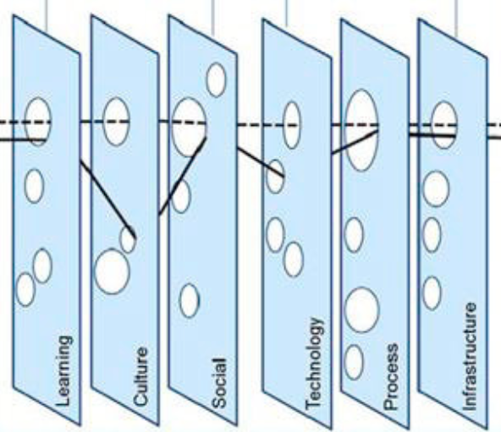
Design Review
Background
A Signal Box Special Instruction was in place to mitigate the risk of a train passing a particular station signal at danger.
A team undertook a subject matter expert review of the overrun mitigation and identified several errors in the design, including a situation whereby the signal in question could display a proceed aspect before it was safe to do so.
Prior to this review, the design had been production and independently checked by the supplier, reviewed by the supplier’s Contractor’s Responsible Engineer/Manager (CRE/CEM) and had also been subject to a peer review by the supplier due to the complexity of the interlocking. The designer and checker did not re-visit previously completed control table cross-checks during this update. This would likely have found the error. All the layers in the ‘Swiss Cheese’ model failed to identify the errors.
The team requested the Supplier to raise a Design Close Call and undertake an investigation to identify how the processes in place failed to identify the issue.
Key Learning
When designers update previously completed work, they must consider the possibility that other drawing sheets or design may also be subsequently affected (e.g. control tables) and the previous checks completed may now be invalidated, or need to be repeated.

Slide 8
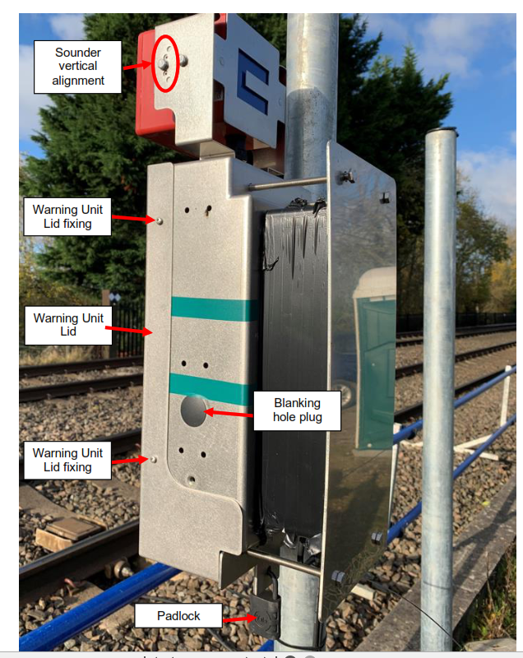
Uncommissioned LX apparatus Fatality
Background
A train collided with and killed a level crossing user in a rural area at a “Stop, Look, Listen” footpath crossing, with whistle boards.
It is was also the trial site for new Level Crossing apparatus operating in shadow mode, with no warnings given to users.
There was no signage regarding the trial apparatus, and no warning lights visible. The apparatus sounders were visible, but inactive.
A Level Three investigation was carried out.
Key Learning
Projects should cover up uncommissioned equipment in shadow mode if it could pose a risk by misleading crossing users. Use supplier approved bags where possible.
Notes:
There is going to be an NR Level 3 investigation. Do not yet know whether RAIB will investigate.
There is some witness evidence to suggest that no warnings were heard. The Meerkat sounders were intentionally disconnected as part of the shadow mode trial but are relatively prominent so it is possible the absence of an audible warning was taken as an indication it was safe to cross. The lights are covered by the black box and plate secured by long bolts seen in the photograph.
Do you have any equipment near a level crossing that is:
On a shadow mode trial, or
Installed but not yet commissioned, or
Decommissioned but not yet recovered?
If yes, we recommend checking that there is nothing on-site which could mislead a user into believing there is an operational active warning system at the crossing. This includes audible warning devices as well as lights (noting that bagging up inactive lights is routine practice).
Some systems (e.g. Vamos) have supplier approved bags or covers that should be used to cover up out of use equipment. Black bin bags are not a great solution as they tend to degrade quickly.

Slide 9
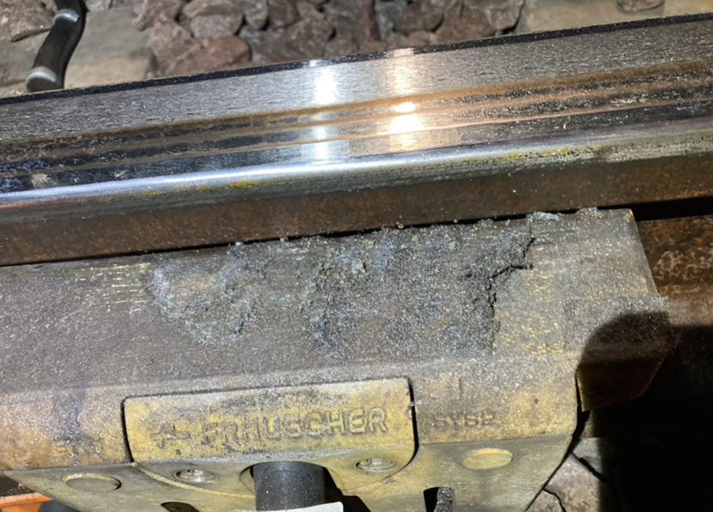
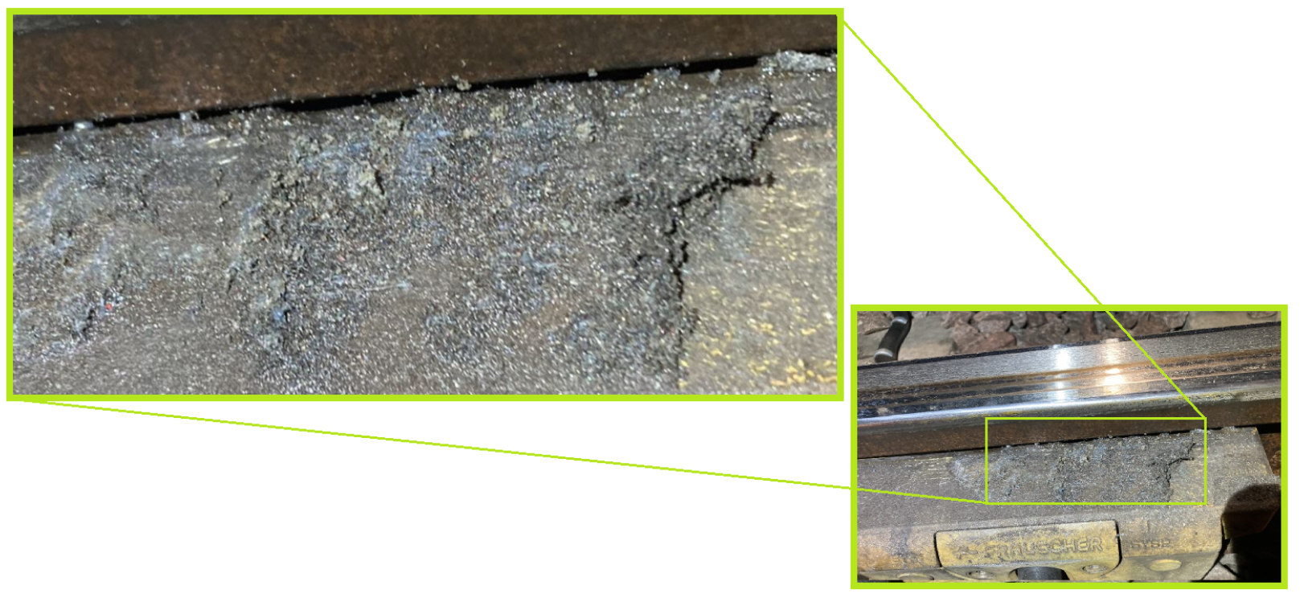
Milling over axle counters
Background
Significant delays were incurred after the passage of a milling train. The signaller reported four axle counter sections were failed and unable to reset after a possession, leading to signals held at danger. Initial investigations on the diagnostic system identified axle counter heads reporting overcurrent above the threshold. A further report from site stated the heads required replacement due to rail filings being stuck to the apparatus, which staff were unable to remove.
Key Learning
The root cause was traced to defective milling heads; however, learning points for consideration include:
Consider removing axle counter heads prior to rail milling
The amount of heat generated by the milling train could be too high for the heads
In the future, damage could be avoided by planning to lift the milling train heads around axle counter apparatus by understanding the length of the ‘run off’

Slide 10
Further Information For any further details or information regarding any of the incidents, please contact: Chris Ruddy: Senior Engineer – Engineering Services Delivery, Route Services Tel: 07799 336772 email: christopher.ruddy@networkrail.co.uk

