Slide 1

SMTH Competency: Industry Wide Engagement
10:30 Start
January / February 2024
Issue 1.2

Slide 2
Agenda
Housekeeping arrangements
Introduction
Progress update – since previous engagement
SMTH Standard update – December 2023
Training and assessment structure
Transfer of individuals into Sentinel
Next steps
IRSE Licencing for Signal Maintenance Testers

Slide 3

Housekeeping arrangements
Notes:
Should the Fire Alarm activate today the Fire Arrangements are …..
Today's breaks will be at …..
Lunch will be served in …… at …….
Toilets are located in ….
Please turn your mobile phones to silent.

Slide 4
Introduction

Slide 5

Why is SMTH Important? – Wingfield 2022
DY586 Correct sequence
DY574
DY584
DY586
5C23
1F02
Click to view animation
Notes:
Background:
Ballast cleaning works were taking place at Wingfield which is on the East Midlands Route between Derby and Chesterfield on the Midland main line.
At 07:14 on 26/10/22 there was a report of a SPAR (Signal Passed at RED) at signal DY586 which is on the Down Main. The emergency brakes had to be applied.
The train passed the signal by one train length after having received Green signals on the approach.
The train was travelling at 110mph when the driver saw DY586 at red.
A second train followed and passed DY584 at yellow. The train then passed DY586 showing a Yellow aspect instead of Red since there was the initial train still in the section ahead and at a stand.
The train was travelling at caution on the advice of the signaller and after passing DY586, the driver observed that there were tail lights ahead and was able to stop before a collision occurred.
Details
The Lead SMTH tester disconnected DY586 signal along with the signal post replacement switch, SPT and the AWS for this signal.
929 C&B track circuits and 934 E&D track circuits were also disconnected.
During the work, delay was incurred against the plan, which meant SMTH reconnection and testing works started later than planned
During the AFTER RE-CONNECTION steps, the relevant test plan was not consulted and steps marked with an Asterisk (Aspect Testing) was not undertaken.
A robust Aspect Test would have identified the anomaly.
A local fault team investigated the fault including wrong side failure testing.
Wrong-side failure testing identified a wiring anomaly, which resulted in the signal displaying a Yellow aspect instead of a Red aspect and a Red aspect instead of a Yellow.
The wiring for the Yellow and Red aspects was identified as having been transposed within the location wiring.

Slide 6
Action taken by Network Rail in response:
Changed our internal SMTH competence structure
Added the requirement for Non-Technical Skills to the competence profile
Risk assessed SMTH competencies, meaning more formal practical assessments every three years
Improved the way SMTH is trained
Changed the way SMTH is maintained
Testing is our last line of defence.

Slide 7

A Video
Notes:
Remind people that we have been successful in significantly reducing wrong side failures from maintenance testing irregularities
We want this succuss to continue
This video has been made to remind people of the potential personal consequences of not testing correctly
PLAY VIDEO

Slide 8
Question:
What are your reflections on the video?
Notes:
Ask audience question and capture feedback

Slide 9
Progress update – since the previous engagement

Slide 10
SMTH Industry Wide Competence
In February 2023 we held a series of workshops across the country asking you how we achieve a single competence and assessment structure for Signal Maintenance Testing.
Your feedback supported the provision of:
An industry wide suite of training and assessment solutions for Signal Maintenance Testing
The use of Sentinel to support the management of Signal Maintenance Testing competencies for the whole industry
A standardised authority to work.

Slide 11
SMTH improvements – the journey so far
2021
NR accelerated the SMTH practical recertification programme
2020
SMTH practical recertification commences within NR
December 2023
First round of the NR SMTH practical recertification programme completed
SMTH competence standard updated
June 2013
Risk assessment completed which identified SMTH as a high-risk activity
November 2023
An industry-wide SMTH competency framework created in Sentinel and implemented for NR staff
V1

Slide 12
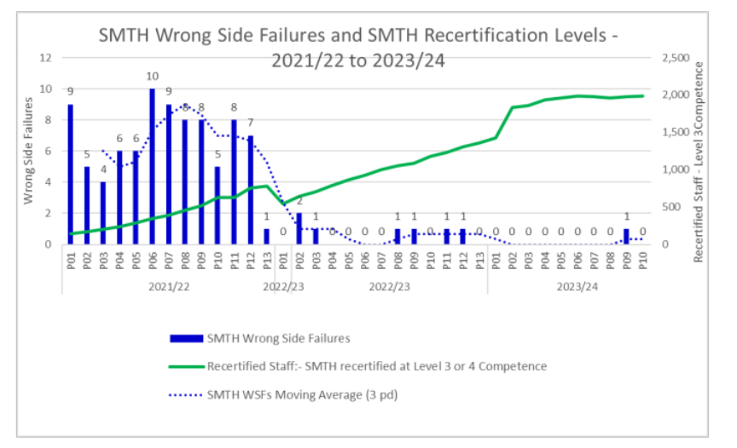
Impact
Notes:
This slide demonstrates the impact of what we have done so far.

Slide 13
Industry-wide SMTH competency framework
SIG MAINT TEST SMTH.a
CCS Signal Maintenance Testing – Core Skills
SIG MAINT TEST SMTH.e
CCS Signal Maintenance Testing – Block Testing
SIG MAINT TEST 05
CCS Signal Maintenance Testing – Instrumentation Engineer
SIG MAINT TEST SMTH.b
CCS Signal Maintenance Testing – Aspect Testing
SIG MAINT TEST SFI 01
CCS Signal Maintenance Testing – SFI Level 1
SIG MAINT TEST SMTH.c
CCS Signal Maintenance Testing – Points Testing
SIG MAINT TEST SFI 02
CCS Signal Maintenance Testing – SFI Level 2
SIG MAINT TEST SMTH.d
CCS Signal Maintenance Testing – Cable function testing
SIG MAINT TEST 04
CCS Signal Maintenance Testing Release of Controls
SIG MAINT TEST SMTH.f
CCS Signal Maintenance Testing – Diversion of a circuit
SIG MAINT TEST SMTH.MFL CORE
CCS Signal Maintenance Testing Mechanical Frame Locking Core
SIG MAINT TEST SMTH.MFL CMPLX
CCS Signal Maintenance Testing Mechanical Frame Locking Core; Complex
Green – Assured through NSAR and ready for industry wide use
Authority to work through Sentinel
Yellow – Stakeholder engagement required before training and assessment solutions are standardised.
Blue – there is currently one NR assured training and assessment solution. NR do not own the materials.
Key
Parent
Child

Slide 14
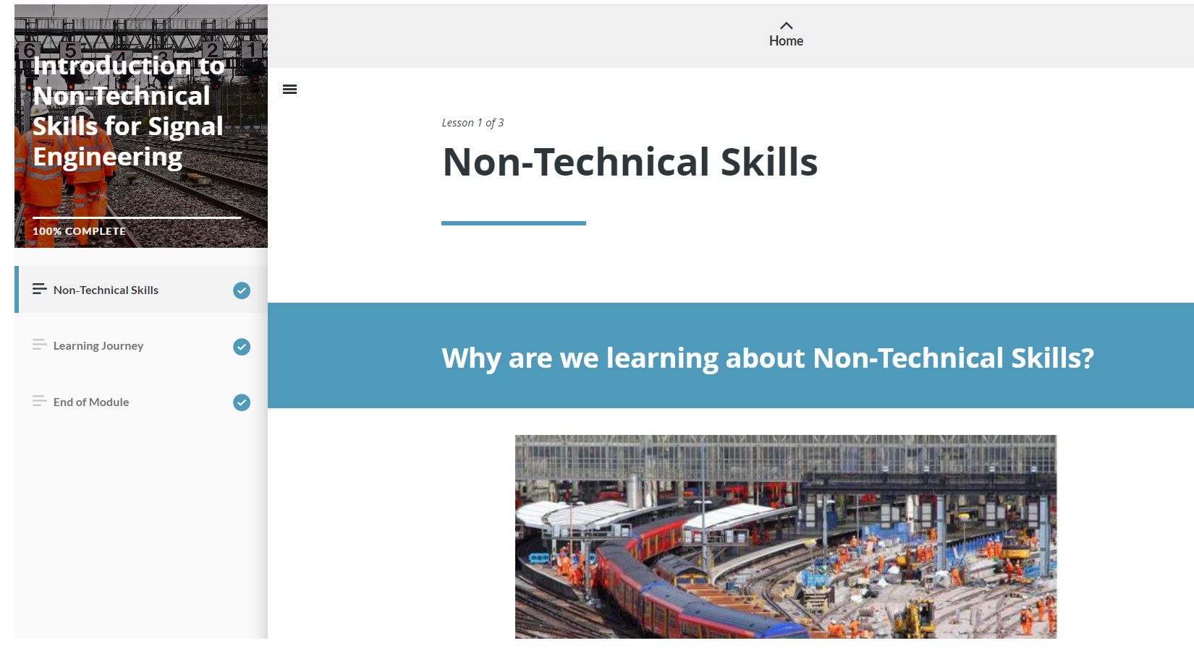
Non-Technical Skills
Following your request at previous engagement sessions, we made the materials available to the industry.

Slide 15
SMTH Standard Update
December 2023

Slide 16
Changes to SMTH competence requirements
  Duration of SMTH competence will not exceed 36 months
  Introduction of mandated action learning (mentoring) period for new SMTH testers
  Introduction of terminology that indicates where a tester is in the Learning cycle
  Authority to Work Requirements to support moving to an industry standard
  Reinforcement of IRSE Licence requirements
  Mandating the use of approved training material for initial and recertification training

Slide 17
Update to Part 1 / Module 4 of the SMTH Standard – Competence Level Definitions
Individual who requires training
Has not successfully completed the Initial Training Event
Signal Maintenance Tester in Action Learning
Has successfully completed the Initial Training Event
Not permitted to complete Signal Maintenance Testing Activities
Has not successfully completed a Signal Maintenance Testing Renewal Event
Not permitted to return equipment to service after Signal Maintenance Testing Activities
Requires the presence of a nominated Competent and Experienced Maintenance Tester

Slide 18
Update to Part 1 / Module 4 of the SMTH Standard – Competence Level Definitions
Competent Signal Maintenance Tester
Has successfully completed a Signal Maintenance Testing Renewal Event
Has successfully completed a Signal Maintenance Testing Renewal Event
Competent and Experienced Signal Maintenance Tester
Can return equipment to service after Signal Maintenance Testing Activities
Can perform / lead Signal Maintenance Testing Activity unaided
Nominated by their Line Manager with a minimum of 36 months experience, from the date of becoming a Competence Signal Maintenance Tester, holding the relevant Signal Maintenance Testing competence
Exhibits good non-technical skills and behaviours
Can perform / lead Signal Maintenance Testing activities unaided
Can act as a Nominated Competence and Experienced Tester responsible for testing activities being undertaken by a Tester who is in Action Learning

Slide 19
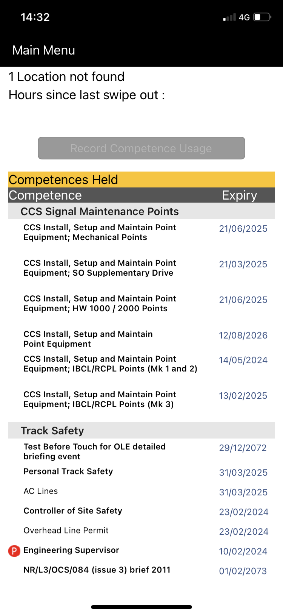
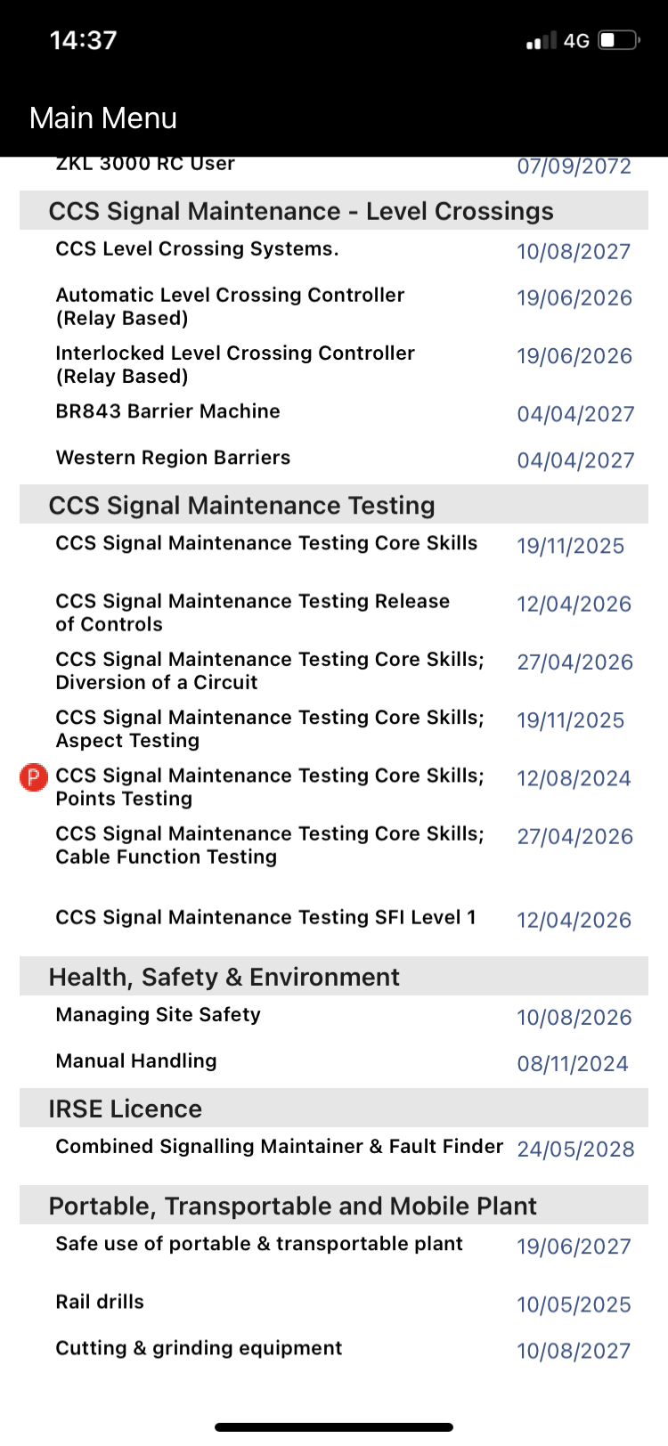
Sentinel Profile Examples
Competent Signal Maintenance Tester
Signal Maintenance Tester in Action Learning
(P for Probationary)
Individual that requires training

Slide 20
Training and Assessment

Slide 21
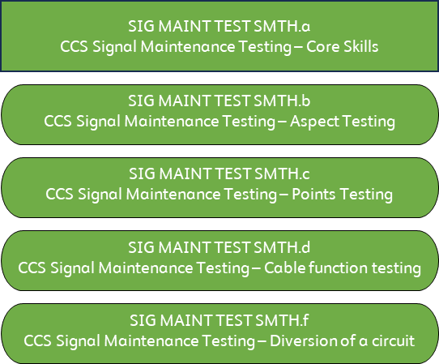
Route to competence from 2nd March 2024
The Network Rail and training supplier working group developed a training and assessment solution for the industry for these competences.
Mandated in the December 2023 update of the SMTH standard.

Slide 22
Training and assessment process from 2nd March 2024
The initial training and practical assessment have been split
A candidate who has successfully completed the 10-day course will leave as a ‘Signal Maintenance Tester in Action Learning’
The period of Action Learning is between 2 and 6 months
After Action Learning the candidate can return for a practical assessment to become a ‘Competent Signal Maintenance Tester’

Slide 23

Proposed Initial Route to Competence
-12 Months
0 Months
Pre-SMTH Initial knowledge test window opens. Test outcome recorded in Sentinel
Pre SMTH Initital knowledge test window closes
Initial Training
Outcome of Training:
- Individual that requires training or;
- Signal Maintenance Tester in Action Learning
2 Months
Earliest opportunity for Action Learning Completion
Pre-Practical SMTH knowledge test window opens. Test outcome recorded in Sentinel
Practical assessment window opens
6 Months
Expected completion of Action Learning
12 Months
Latest opportunity for Action Learning Completion
Pre-Practical SMTH knowledge test window closes
Practical Assessment window closes
Successful outcome: Competent Signal Maintenance Tester
The clock starts ticking on the
36 months competence validity

Slide 24

Maintenance of SMTH competence –
First renewal cycle after initial training
36 months competence validity ends
Successful completion of Practical Assessment
Entry as:
Competent Signal Maintenance Tester
18 months from end of Initial Training
Interim knowledge test window opens
Test outcome recorded in Sentinel
21 months from end of Initial Training
Interim knowledge test window closes
If interim test is not successfully completed, Authority to work expires
30 months from end of Initial Training
Renewal Practical Assessment window opens
36 months from end of Initial Training
Competence Validity Period ends
Authority to Work expires
38 months from end of Initial Training
Renewal Practical Assessment window closes
Full re-training required after this point

Slide 25
Maintenance of SMTH competence –
Subsequent renewal cycles
0 Months
Entry as:
Competent Signal Maintenance Tester or;
Competent and Experienced Signal Maintenance Tester
18 Months
Interim knowledge test window opens
Test outcome recorded in Sentinel
21 Months
Interim knowledge test window closes
If interim test is not successfully completed, Authority to work expires
30 Months
Renewal Practical Assessment window opens
36 Months
Competence Validity Period ends
Authority to Work expires
38 Months
Renewal Practical Assessment window closes
Full re-training required after this point

Slide 26

Example of a Learner Journey
Clock starts ticking on the 36 months competence validity
Clock resets on the 36 months competence validity
Joe Bloggs passes Pre SMTH Initital knowledge test. Test outcome recorded in Sentinel.
Joe Bloggs attends and passes SMTH Initial (Full) Training and therefore is a:
Signal Maintenance Tester in Action Learning
Joe Bloggs passes Pre-Practical SMTH knowledge test. Test outcome recorded in Sentinel.
Joe Bloggs completes Action Learning, attends and passes SMTH Practical Assessment and therefore is a:
Competent Signal Maintenance Tester
​
Joe Bloggs completes and passes Interim knowledge test. Test outcome recorded in Sentinel.
Maintains status as:
Competent Signal Maintenance Tester
Joe Bloggs attends and passes Practical Assessment and therefore continues as a:
Competent Signal Maintenance Tester
March 2024
-4 Months
April 2027
33 Months
November 2024
4 Months
January 2025
6 Months
July 2024
0 Months
February 2026
19 Months

Slide 27
Question:
What are your thoughts on the Training & Assessment process?
Notes:
Ask audience question and capture feedback

Slide 28
Transfer of individuals to Sentinel
Authority to Work

Slide 29
Transfer Process into Sentinel
New entrants
Existing holders – renewal due Sept 2024 – March 2025
Existing holders – renewal due after March 2025
Assuming a 24-month assessment cycle we expect ~25% will transition through renewal and ~75% will transfer through Transition Assessment.

Slide 30
Transfer Process into Sentinel continued…
Initial Training
Training successfully completed
Renewal
SMTH Renewal event successfully completed between September 2024 and March 2025
Network Rail Material
Results of training undertaken between March and September 2024 to be uploaded by the project to Sentinel in September 2024
Network Rail Material
Results to be uploaded by the training/assessment provider to Sentinel.
Validity period set to 36 months from day of successful completion.
Results of training undertaken from September 2024 will be uploaded by the training/assessment provider to Sentinel

Slide 31
Transfer Process into Sentinel continued…
Transition Assessment
Successfully compete transition assessment
Network Rail approved knowledge assessment – mixture of SEM1 (BS1) / SEM2(BS2) and SMTH
Results to be uploaded by the assessor on the day of the event.
3 attempts allowed (1 attempt per day, 3rd attempt 28 days after 2nd)
On day of first assessment, profile loaded into Sentinel and set provisionally to Signal Maintenance Tester in Action Learning
The applicable SMTH competence renewal anniversary remains unchanged
No change to next renewal date

Slide 32
Question:
Should transition assessments be delivered as a big bang approach or over a longer period (e.g. November 2024-March 2025)?
Notes:
Ask audience question and capture feedback

Slide 33
Transition assessment planning
We do not know how many SMTH holders there are outside Network Rail, and where they are located across the country.
Our intention is to contact all sponsors to establish the number of SMTH holders and their geographical location.
This will enable us to plan delivery of the transition assessments.

Slide 34
Question:
Is there another way of identifying all SMTH holders and where they are located?
Notes:
Ask audience question and capture feedback

Slide 35
Authority to Work During the Transition Period
From September 2024, an individual's Sentinel card should be swiped at the start of a shift that will require them to use an SMTH competence.
Where an SMTH competence appears on Sentinel, then Sentinel is the single source for the Authority to Work for SMTH activities only.
A paper Authority to Work for the industry wide elements of SMTH will only be accepted if there is no record of SMTH competence appearing in Sentinel.
Individuals may still use a paper or different Authority to work for other competences after transitioning to Sentinel for SMTH.

Slide 36
Sentinel Profile Examples
Competent Signal Maintenance Tester
Signal Maintenance Tester in Action Learning
(P for Probationary)
Individual that requires training
No record of SMTH in Sentinel – can use Paper Authority to Work for SMTH
SMTH competence appears in Sentinel – Sentinel is single source of individual’s Authority to Work for SMTH

Slide 37
For a competence to show as valid on Authority to work
Oracle for Network Rail Staff
Sentinel
Competence Valid and in Date
Medical Level Valid
Dependencies met
Any other checks and balances (Valid Sponsor / Medical in date / PTS )
Shows on Sentinel as Valid

Slide 38
Next Steps

Slide 39
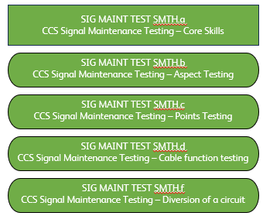
Next Step Timelines
Any training provided by a
3 ways to Transition into Sentinel:
training and assessment
1) Training has been provided from March 24 and is
All Training and
Training and
provider using the Network Rail
approved (automatically uploaded in September 24)
assessment results
Assesment
Training Material will have
2) Attendance at an assessment center and successful
to be loaded into
result recorded and be
completion of Transition assessment event
Sentinel
uploaded in September 2024
3) Attendance at an approved training provider and
result uploaded directly into Sentinel
Paper Authority to Work as
If Competence shows in Sentinel, that is the lead.
Sentinel is the only
Authority to
Where it does not show in Sentinel Paper Authority to
Work
today
work permissible
Authority to work
March
September
01 March
2024
2024
2025
Training material
standardized. Result
Transition Window
recorded and will be
starts for all holders.
uploaded to
Training since March
Sentinel
24 is uploaded
Can only be used on Network Rail
Managed Infrastructure if recorded
and valid on Sentinel

Slide 40
Next steps
Issue the SMTH training material for industry use from 4th March 2024
Create an assurance regime for SMTH Competence and training
Launch the industry SMTH competence framework in Sentinel based on NR SMTH competence standard.
Any further information or questions please contact:
signallingcompetencyframework@networkrail.co.uk

Slide 41
And finally…
IRSE Licencing for Signal Maintenance Testers
Notes:
Ask audience question and capture feedback

Slide 42
Network Rail Licence Process for 1.4.230 - Signalling Maintainer & Faultfinder
The IRSE licence process is a two-stage assessment, consisting of a workplace and competence assessment, for all licence categories.
We believe the industry uses 1.4.160 - Signal Maintenance Tester licence category.
Network Rail has an agreement with the IRSE to use a hybrid version of the process for the 1.4.230 Signalling Maintainer and Faultfinder licence category only.
  This allows observation elements to be captured through surveillance that is part of a business-as-usual activity.
  Where an individual holds SMTH.a and has gone through the approved assessment holding the competence is sufficient evidence for the SMTH elements of the 1.4.230 Competence Assessment Checklist only.

Slide 43
Question:
Would this agreement be helpful externally if it was expanded to cover other licence categories (Such as 1.4.160 Signal Maintenance Tester) that are applicable to SMTH testing?
Notes:
Ask audience question and capture feedback

Slide 44
Thank you for listening.
What final questions do you have?
Notes:
Ask audience question and capture feedback

Slide 45


