Slide 1
Standard 019 PDSW “One Year On”

Slide 2
The following slide deck and Q&A are to facilitate a debate/conversation on standard 019
The purpose of this activity is to help raise awareness/clarify understanding on 019
Once completed; record the sessions and capture feedback via Survey Monkey :
https://www.surveymonkey.co.uk/r/J87VBJR
This should be an interactive session rather than a Briefing and should promote debate with feedback captured from the issues that are raised.
Notes:
As a facilitator of this you may find, due to the debate, you will not complete all of the question set in one session.
Please select the questions based on the issues in you teams that most suit you and your needs and focus on these.
Slides do not need to be used but may provide prompts where necessary.

Slide 3
PDSW Vision
There will be a person in charge accountable for managing task and operational safety risk. That person will have been involved in the planning of the work.
The PIC will be involved in the planning and delivery of the work being undertaken.

Slide 4
Introduction
Embedment Issues:
Feedback has shown that the key themes for non-compliance towards to the standard include;
Lack of understanding of the new process
Lack of understanding of the PIC role and responsibility
Operational challenges making it difficult to always involve the PIC in planning
Planner capability and capacity

Slide 5
Introduction
The initial introduction left many aspects of the Standard unclear
Different approaches are being taken by teams across the rail network
Currently there are different ways that the Routes, Infrastructure Projects and third parties work to Standard 019
This brings an increased level of risk
The Safety Hour Question set and the discussions that you have will help you to understand what you have to do to be compliant to the Standard.

Slide 6
Appendix
Key Roles
Variations from planned work
Linear worksites
‘The Process’
Safety Hour Questions

Slide 7
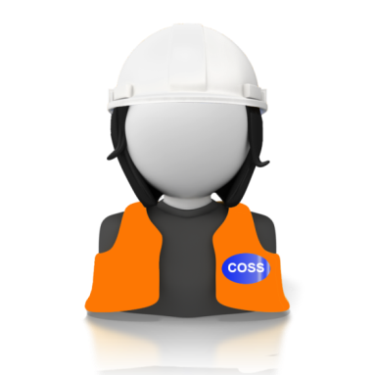
Key Roles
Person In Charge (PIC)
Collaborating with the Planner to produce a SWP
Co-ordinating and delivering the briefings on site
Accountable for the site, task and operational risks
Manage and Co-ordinate activities on site
Responsible for escalating issues (over runs, accidents, incidents)
The COSS ensures the line is clear and safe for the passage of trains
Person In Charge
(PIC)

Slide 8
Key Roles
Planner
Creating & Facilitating the production of the Safe Work Pack, in collaboration with all PICs, as directed by the Responsible Manager
Planner

Slide 9
Key Roles
Responsible Manager
Delegating the work activity to the appropriate Planner(s) and PIC(s)
Authorising that the Safe Work Pack is fit for purpose
Accountable for the safe planning and delivery of the works
Responsible Manager

Slide 10
Variations from planned work
If the PIC determines that the SWP is inadequate or it can’t be implemented as planned (due to weather conditions, failure of equipment, resourcing issues etc), the PIC may vary the task.
To do this, they must consider:
The planned protection or warning arrangements
New task and site risk controls
Be competent in the task or seek advice / guidance from competent persons e.g. COSS / SWL or task specific competence.
Have staff with the correct task competencies, correct equipment and PPE
The PIC can do this without an authority number if they use the existing planned level of hierarchy and mileages identified in the SWP (and the task risk has not increased)
The PIC must be able to brief the work team on the new task.

Slide 11
Long Worksites
The direction:
For any work that takes place at two or more locations (either common goal working or where there are discrete pockets of work e.g. installation of an earth strap, placing of protection)) there needs to be a PIC at each location
Each physically separated site of work within a long worksite must have a PIC
One site of work, one SWP, one PIC.
All PICs must be involved in the production of the SWP and the consideration of all task, site and operational risk
A COSS cannot carry out work without acting as a PIC
PIC
PIC
SITE OF WORK
SITE OF WORK

Slide 12
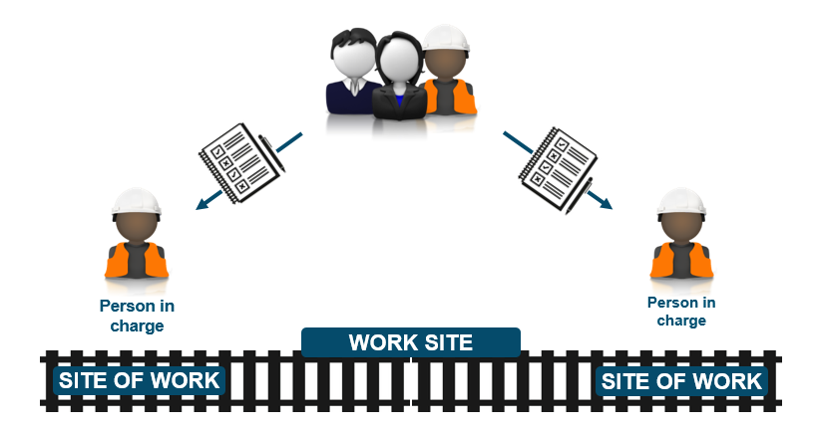
Practicalities of the process
Option 1 – multiple packs created through SSoWP
To comply to the Standard completely, each individual site of work ,within the Engineering Supervisors Worksite, requires a pack to be created involving the PIC in the planning. For Long worksites this would require all PICs involved in the work having individual packs and to have been involved in the planning of it.

Slide 13
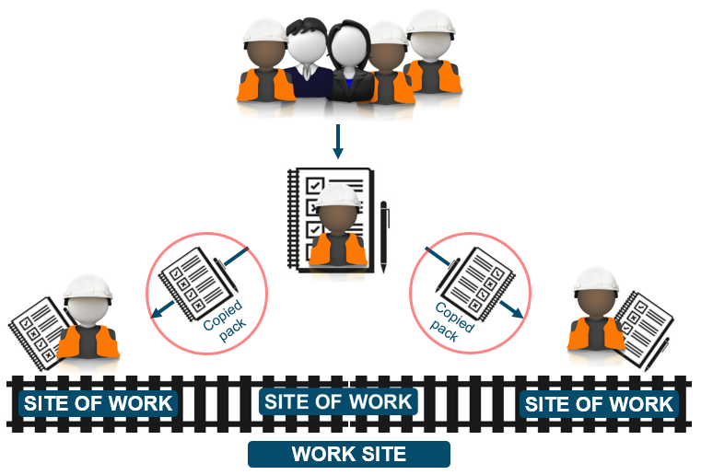
Practicalities of the process
Option 2 – single pack created through SSoWP
Alternatively planners may create a single SWP for the common goal, covering all tasks at the sites of work and including all site and task risks associated with the activities to be undertaken.

Slide 14
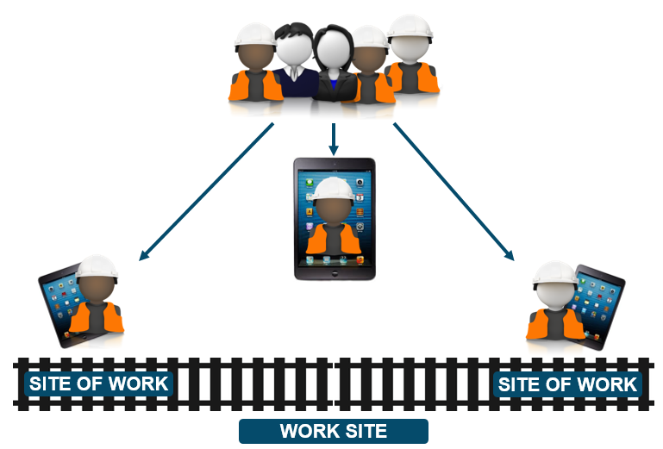
Practicalities of the process
Option 3 – multiple copies distributed through eSWPs
The eSWP solution simplifies this process. Provided all PICs have been involved with the planning of the activities it’s a simple matter of including them when sending out the emailed packs
Verification and authorisation processes still apply.

Slide 15
Safety Hour Questions
1. What do we want to make sure that has happened at the end of each day?
2. If the worst was to happen, what information do you require in the SWP to ensure the best possible response from the emergency services?
3. What would happen if the line block was not granted for the work?
4. What would you do if the work content had to change?

Slide 16
Safety Hour Questions
5. Risk: What risks does the safe work pack identify and what does the PIC do with these?
6. Risk: What is the difference between a hazard, risk and risk control and give some examples?
7. Risk: How is the sighting distance worked out on site?
8. Risk: How do you make sure your operational risk controls are fit for purpose?
9. Risk: How do you gather task risks for a multi-discipline site of work?
10. Risk: Do your task risks have to be written in the form of task risk control sheet?
11. Risk: When does a PIC delegate risk controls and give an example?

Slide 17
Safety Hour Questions
12. Controls: How are risk controls implemented?
13. Controls: If you identify an additional control is required on the day the work is to take place what do you do?
14. Controls: What happens if a PIC cannot implement a control?
15. Line Block: Do you require the use of PC if there is one team and a level crossing attendant in a line block?
16. Line Block: When do you require additional protection for a line block?

Slide 18
Safety Hour Questions
17. Responsibilities: Who is responsible for ensuring the line is safe for the passage of trains, after undertaking work (other than the Engineering Supervisor)?
18. Responsibilities: What paperwork should a level crossing attendant have?
19. Responsibilities: What is your expectation as a PIC involved in the planning process?
20. Responsibilities: Who is responsible for the following; keeping the work group safe, the site safe, identified risks controlled, conflict between sites?
21. Responsibilities: Does the pilot man need a SWP?
22. Responsibilities: If identified in planning stages that there is a conflict between work groups, what should happen?

Slide 19
Safety Hour Questions
23. If you have a trolley on the track what checks will be undertaken?
24. When do you require an authority number?
25. How long do we keep a SWP for?

Slide 20
A year on…
…what have the 019 changes meant for you?
A year on, what do we still need to do?
Remind our people of the key changes and the purpose of the core roles: RM, Planner and PIC
Continue to drive 019 compliance
Help our people to understand “what’s in it for them” and the overall safety benefit for the Programme
Review of end to end planning process which was put in place for 019 implementation
Challenge the method of working during planning to drive Protection rather than Warning as the preferred method

Slide 21
Contact
For more information please contact:
PDSW Programme team:
Dylan Edwards/Hannah Rennie/Toby Keates
Route | Change Lead
Anglia | Paul Ollivant
LNE | Joe Rowberry/ Moses Olivier
LNW | Rick Clark/Toby Keates
Western | Caroline Matcham/Matthew Courtliff
Wessex | Jill Nirmal
Wales | Steve Hood/Alex Roden
Scotland | Brendan McBrearty
South East | David Peters

