Slide 1
Standard 019 Update Briefing
Version 1

Slide 2
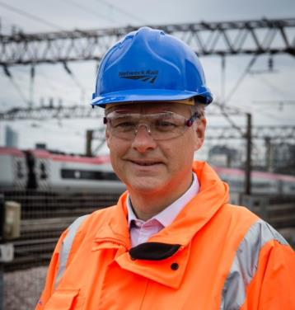


Network Rail Safety Vision
Safety… we have committed to eliminating workforce fatalities and all major injuries.
I know that improving workforce safety is not only the right thing to do from a moral and ethical perspective, it's also good business.
Safety and performance go hand in hand.
My belief in this approach led to the launch of our Safety Vision and the refresh of our Lifesaving Rules.
Mark Carne
Notes:
Emphasise the message from Mark Carne

Slide 3

Why?
1 November 2014
21:45 hrs
Garnant Branch line in Carmarthenshire
22 January 2014
11:34 hrs
Newark North Gate station
4 December 2012
13:50 hrs
Saxilby, near Lincoln

Slide 4
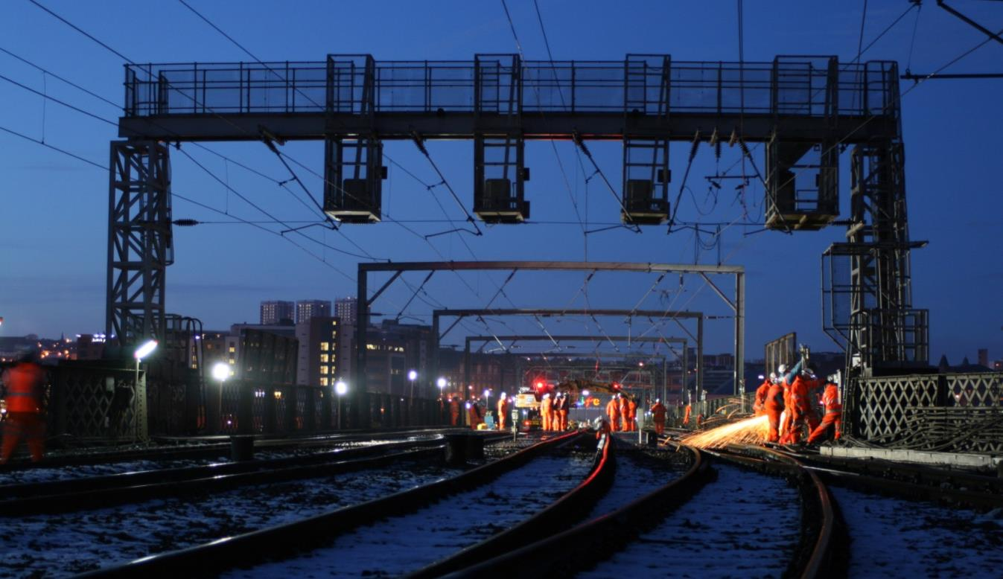
Background
Notes:
The old standard used to be protection from trains, now it focuses on protection from many things that may impact the workforce on or near the line. This is why 019 has been changed.

Slide 5
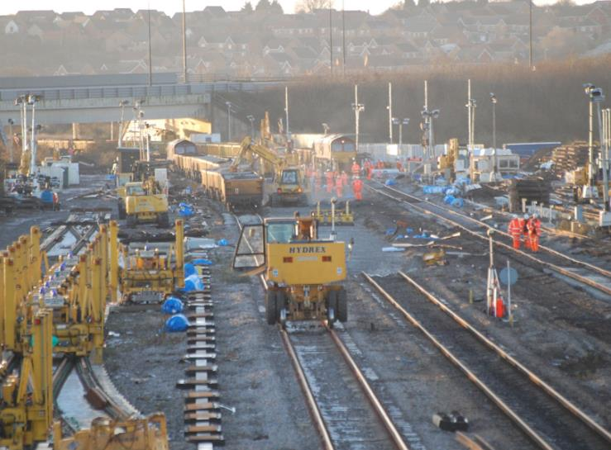
Background
Old Standard:
Ref: | NR/L2/OHS/019
Issue: | 8
Date: | 04 September 2010
Compliance date: | 04 September 2010
Revised Standard:
Ref: | NR/L2/OHS/019
Issue: | 9
Date: | 03 July 2017
Compliance date: | 03 July 2017
Notes:
Bullet points on what are the key changes in the standard…

Slide 6





Affected Parties
Responsible Manager
Planner
Individual Working Alone (IWA)
Controller of Site Safety (COSS)
Safe Work Leader (SWL) – Note: IP only

Slide 7

What’s new?
The person in charge
The person in charge is a new capability, not a competence
The person in charge will be appointed by the Responsible Manager on their ability to manage the work activity planned and have an understanding of the risks
The person in charge will make sure that all risk controls have been implemented
The person in charge must hold a COSS competence and may act as the COSS or delegate the COSS duties
The person in charge and the planner will collaborate to produce the Safe Work Pack (SWP), which the person in charge will verify.

Slide 8
What’s new?
Safe Work Pack (SWP)
The SWP provides information on how work is to be carried out safely and gives details on how to manage and control task, site and operational risks.
It enables effective management and implementation of controls for the safety of people involved, or who might be affected by the work activities on or near the line, or which might affect the line.
SWP refers to the documentation provided to the person in charge for the work they are to undertake. The information contained in the SWP should be:
concise and relevant to the task and location where the work is being undertaken; and
provide clear information to allow the person in charge to effectively use it to manage the risks to themselves and those working under their supervision.

Slide 9
Currently a SSOW pack looks like….
SSOW pack verification form
Part completed RT9909 Record of arrangements
Part completed RT3181 form(s) – where blockage(s) of the line are part of the SSOW pack
Possession arrangements
Safe access and egress information including walking to and from site
Sectional Appendix extracts showing the relevant running lines, track layout and work location for the entire mileage for which the work group will be On or Near the Line
National Hazard Directory extracts that are relevant to the work and location
Signalling or track diagrams where used
Emergency arrangements
SSOW

Slide 10
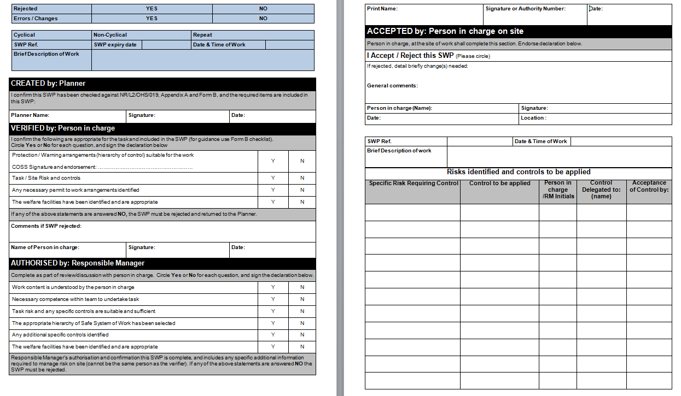
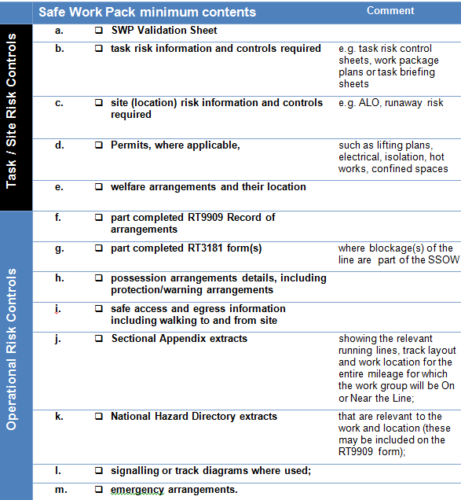
What extra goes into a Safe Work Pack?
Additional contents required:
SWP validation form, instead of the SSOWP verification form.
Site risk information and controls required
Task risk information and controls required e.g. task risk control sheets, work package plans or task briefing sheets
Permits, where applicable, such as lifting plans, electrical, isolation, hot works, confined spaces
Welfare arrangements and their location
Safe Work Pack

Slide 11
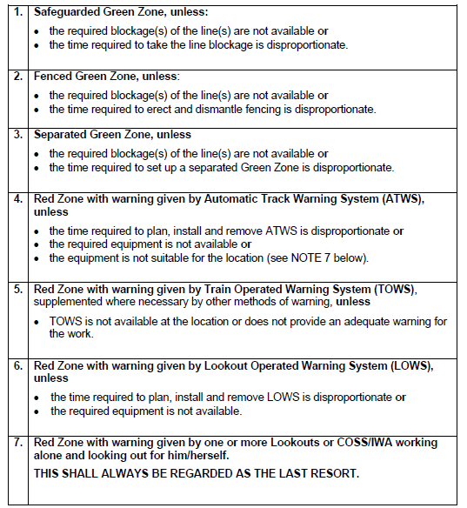
What’s new?
Hierarchy of Control – Operational Risk
There are 8 Levels of hierarchy now, with a renaming of previous levels – Red & Green zone terms replaced with Protection and Warning arrangements. Same requirements are required for justification of level planned.
 | Safe System of Work | Type
1 | Safeguarded site of work | Protection
2 | Fenced site of work | Protection
3 | Separated site of work | Protection
4 | Warning systems – permanent | Warning
5 | Warning systems – Train Operated Warning System (TOWS) | Warning
6 | Warning systems – human activated equipment | Warning
7 | Warning systems – Portable | Warning
8 | Lookout warning | Warning
OLD HIERARCHY

Slide 12
Modules in working practice

Slide 13

Modules
Ref: | NR/L2/OHS/019
Issue: | 9
Date: | 03 July 2017
Compliance Date: | 03 July 2017
Module 4
Planning and working using warning arrangements
Module 3
Planning and working using protection arrangments
Level 2
Business process
Safety of People at Work On or Near the Line
Module 2
Planning and working in a possession
Module 1
Planning and working during incident response
Notes:
Modules will run alongside each other depending on the operational requirements.

Slide 14



Core 019 standard overview
Responsible
Manager
Responsible
Manager
The Responsible Manager identifies work to be undertaken, appoints the Planner and the person in charge, giving them suitable resources to produce the SWP.
The Planner will review the SWP for amendments for future planning. Where a pack has not been returned, a record must be kept by the Responsible Manager.
The Responsible Manager must authorise the SWP. In doing so they are confirming that all operational, site and task risk controls have been appropriately identified.
The Responsible Manager will review the SWP and record the details as per local arrangements.
The person in charge will check and accept the SWP details are valid (at least one shift in advance of the work) and checks the Responsible Manager has authorised the SWP for use.
The Planner will create the SWP in conjunction with, and appropriate help from, the person in charge.
The person in charge will verify the Safe Work Pack when they are satisfied the plan is appropriate.
After work has finished the person in charge returns the used or unused SWP back to the Planner.
Planner
Planner
Person in
charge
Person in
charge
Person in
charge
Person in
charge
Responsible
Manager

Slide 15


Module 1: Planning and working during incident response
On site
Return
Review
Planner
Person in charge will send the IRP to the Planner (or Responsible Manager where no planner exists). Where a pack has not been returned by the person in charge a record must be kept by the Responsible Manager.
The person in charge shall decide what response and resources are required for the incident. The following must be considered:
Is protection/warning arrangements required?
What task and site risk controls are required?
Identify safe systems of work and the controls required.
The person in charge shall arrange for a Incident Response Pack (IRP) to be completed including task, site and operational risks.
The person in charge shall arrange for the work group to be briefed on the protection/warning arrangements including the task, site and operational risks.
The person in charge will be contacted as the appropriate person to respond following an incident.
The Planner/Responsible Manager will update any systems and store the IRP for assurance processes.
The person in charge shall arrange for the Signaller to be contacted to arrange appropriate protection, if required. The person contacting the signaller, if not the person in charge, will act as:
COSS
IWA
SWL (IP only)
PC
The Signaller shall confirm protection arrangements they are able to provide.
Person in
charge
If the Signaller is unable to provide the protection arrangements required, the person in charge shall consider using a lower level in the protection/warning hierarchy. If no suitable arrangement can be implemented, the person in charge must escalate to Route Control or the on call Responsible Manager.
When work is complete, the person in charge shall check the work group is clear of the site and the line has been left in a safe state. They should make sure the line has been handed back to the Signaller where protection has been arranged.
Responsible
Manager
Signaller

Slide 16

Video
Notes:
Download instructions – Safety Central – zip file to include slide pack and video. Users to bulk download.

Slide 17

Over to you, what does this module mean for you?
What are we currently doing that meets the requirements in the updated 019 standard?
What's new for us in the updated 019 standard?
How can we bridge the gap that will meet the updates in the standard 019?

Slide 18



Module 2: Planning and working in a possession
Create
Verify
Authorise
Accept
On Site
Return
Review
The Planner shall apply for a worksite under possession using the possession planning system (PPS).
The Responsible Manager must authorise the SWP at least one shift in advance of the work taking place. In doing so they are confirming that all operational, site and task risk controls have been appropriately identified and the following has been considered:
Work content is understood by the person in charge
Necessary competence within team to undertake task
Task risk and any specific controls are suitable and sufficient
The appropriate hierarchy of Safe System of Work has been selected
Any additional specific controls identified
The welfare arrangements have been identified and are appropriate.
The Planner will create the SWP with appropriate involvement from the person in charge to produce a SWP. This will include things such as, welfare arrangement, the amount of people required, tools needed, and the duration of the work.
Planner
The person in charge, when also acting as COSS will sign into the ES/SWL worksite before they commence any work (or the delegated COSS will sign into the ES/SWL worksite). The ES/SWL gives permission for the COSS to sign the RT3199.
The person in charge will accept the SWP details are still valid and the Responsible Manager has authorised the SWP for use at least one shift in advance of the work taking place.
Person in charge to conduct briefings including task and site risk controls. If acting as COSS they will also brief the operational risk controls. All required paperwork must be completed before work can begin.
The person in charge, when also acting as COSS, will contact ES/SWL (IP only) when work has been completed to confirm the line is clear and safe before signing out.
Person in charge will send the used or unused SWP to the Planner (or Responsible Manager where no Planner exists). Where a pack has not been returned by the person in charge, a record must be kept by the Responsible Manager.
The Planner will review the SWP for amendments to support future planning. If there isn't a designated Planner, the Responsible Manager will carry out the review of the pack.
Person in charge completes a final check of the SWP on site against the site conditions before implementation.
The person in charge will verify the SWP at least one shift in advance of the work taking place.
For cyclical and repeated tasks, the Responsible Manager must authorise the initial SWP to be implemented repeatedly for the following periods without further authorisation:
Twelve month period when the SWP uses protection (formerly green zone); and
Six month period when the SWP uses warning (formerly red zone).
Person in
charge
The Responsible Manager identifies work that needs to be undertaken and appoints the Planner and the person in charge, giving them appropriate resources to produce the SWP including operational, task and site risk controls.
Responsible Managers will review at least 10% of completed and implemented SWP, up to a maximum of 50 packs per period. However, the Responsible Manager must review all SWPs where there has been a change made on site.
Responsible
Manager
Notes:
Emphasise what is new.

Slide 19
Video

Slide 20
Over to you, what does this module mean for you?
What are we currently doing that meets the requirements in the updated 019 standard?
What's new for us in the updated 019 standard?
How can we bridge the gap that will meet the updates in the standard 019?

Slide 21

Module 3: Planning and working using protection arrangements
Create
Verify
Authorise
Accept
On Site
Return
Review
The Planner will arrange for a line blockage application when required.
The Responsible Manager must authorise the SWP at least one shift in advance of the work taking place. In doing so they are confirming that all operational, site and task risk controls have been appropriately identified and the following has been considered:
Work content is understood by the person in charge
Necessary competence within team to undertake task
Task risk and any specific controls are suitable and sufficient
The appropriate hierarchy of Safe System of Work has been selected
Any additional specific controls identified
The welfare arrangements have been identified and are appropriate.
The Planner will create the SWP with appropriate involvement from the person in charge to produce a SWP. This will include things such as, site and task controls, and welfare arrangements.
Planner
When work is complete, the person in charge shall check the work group is clear of the site and the line has been left in a safe state. They should make sure the line has been handed back to the Signaller where protection has been arranged.
The person in charge will accept the SWP details are still valid and the Responsible Manager has authorised the SWP for use at least one shift in advance of the work taking place.
Person in charge to conduct briefings including task and site risk controls. If acting as COSS, they will also brief the operational risk controls and if required arrange the planned line blockage(s). All required paperwork must be completed before work can begin.
Person in charge will send the used or unused SWP to the Planner (or Responsible Manager where no planner exists). Where a pack has not been returned by the person in charge a record must be kept by the Responsible Manager.
The Planner will review the SWP for amendments to support future planning. If there isn't a designated Planner, the Responsible Manager will carry out the review of the pack.
Person in charge completes a final check of the SWP on site against the site conditions before implementation.
The person in charge will verify the SWP at least one shift in advance of the work taking place.
Person in
charge
For cyclical and repeated tasks, the Responsible Manager must authorise the initial SWP which can then be implemented repeatedly for a twelve month period when the SWP uses protection arrangements (formerly known as green zone) without further authorisation.
The Responsible Manager identifies work that needs to be undertaken and appoints the Planner and the person in charge, giving them suitable resources to produce the SWP including operational, task and site risk controls.
Responsible Managers will review at least 10% of completed and implemented SWP, up to a maximum of 50 packs per period. However, the Responsible Manager must review all SWPs where there has been a change made on site.
Responsible
Manager

Slide 22
Video

Slide 23
Over to you, what does this module mean for you?
What are we currently doing that meets the requirements in the updated 019 standard?
What's new for us in the updated 019 standard?
How can we bridge the gap that will meet the updates in the standard 019?

Slide 24
Module 4: Planning and working using warning arrangements
Create
Verify
Authorise
Accept
On Site
Return
Review
The Planner will create the SWP with appropriate involvement from the person in charge to produce a SWP. This will include things such as, welfare arrangement, the amount of people required, tools needed, and the duration of the work.
The Responsible Manager must authorise the SWP at least one shift in advance of the work taking place. In doing so they are confirming that all operational, site and task risk controls have been appropriately identified and the following has been considered:
Work content is understood by the person in charge
Necessary competence within team to undertake task
Task risk and any specific controls are suitable and sufficient
The appropriate hierarchy of Safe System of Work has been selected
Any additional specific controls identified
The welfare arrangements have been identified and are appropriate.
Planner
The person in charge will accept the SWP details are still valid and the Responsible Manager has authorised the SWP for use at least one shift in advance of the work taking place.
Person in charge to conduct briefings including task and site risk controls. If acting as COSS they will also brief the operational risk controls. All required paperwork must be completed before work can begin.
The Planner will review the SWP for amendments to support future planning. If there isn't a designated Planner, the Responsible Manager will carry out the review of the pack.
Person in charge will send the used or unused SWP to the Planner (or Responsible Manager where no planner exists). Where a pack has not been returned by the person in charge a record must be kept by the Responsible Manager.
When work is complete, the person in charge shall check the work group is clear of the site and the line has been left in a safe state.
The person in charge will verify the SWP at least one shift in advance of the work taking place.
Person in charge completes a final check of the SWP on site against the site conditions before implementation.
Person in
charge
For cyclical and repeated tasks, the Responsible Manager must authorise the initial SWP which can then be implemented repeatedly for a six month period when the SWP uses warning (formerly known red zone) without further authorisation.
The Responsible Manager identifies work that needs to be undertaken and appoints the Planner and the person in charge, giving them suitable resources to produce the SWP including operational, task and site risk controls.
Responsible Managers will review at least 10% of completed and implemented SWP, up to a maximum of 50 packs per period. However, the Responsible Manager must review all SWPs where there has been a change made on site.
Responsible
Manager

Slide 25
Video

Slide 26
Over to you, what does this module mean for you?
What are we currently doing that meets the requirements in the updated 019 standard?
What's new for us in the updated 019 standard?
How can we bridge the gap that will meet the updates in the standard 019?

Slide 27
Hazard & Risk identification
Notes:
27
Talk around what's a task risk, what's a site risk?

Slide 28
What is a hazard and what is a risk?
Hazard = Something that has the potential to cause harm e.g. chainsaw, moving train, walking over uneven terrain, exposure to loud noise, exposure to chemicals, etc.
Risk = The likelihood that the hazard will actually cause harm e.g. what is the chances that someone will be hit by a train or suffer hearing loss or trip and fall etc.
When performing a risk assessment you have to consider:
  Likelihood i.e. how likely that is to happen and
  Severity i.e. how much harm the hazard will cause
Control measures = anything that when implemented will reduce the risk, change the likelihood and/or change the severity.
Reasonably foreseeable = can be taken to mean an incident or accident which is thought to be credible.

Slide 29
5 Steps to risk assessment
What do you think are the 5 logical steps to assessing risk or hazards are?
1.
Identify the hazards.
2.
Decide who might be harmed and how.
3.
Evaluate the risks and decide on precautions.
4.
Record your findings and implement them.
5.
Review your assessment and update if necessary.
Notes:
29

Slide 30
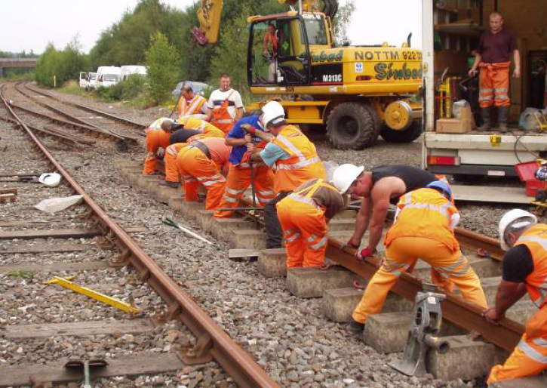
Step 1 – Identify hazards
(PPE)?
It is issued for a reason!
Tension – ‘Line of Fire’
What is the potential impact upon the team if that ‘torsion’ bends or they suddenly lose their grip?
Sprains – Spinal injuries
Proper lifting techniques…
Use mechanical means where possible
Broken bones (Hands, Jaw etc.), Spinal injuries, Trapped limbs, People skills & fatigues…
The list goes on…
Slips – Trips – Falls
Poor worksite maintenance
People & level of skill-set

Slide 31
Corporate legal responsibilities
Health and Safety at Work Act 1974
What do you think Network Rail and Principal Contractor responsibilities are?
Safe systems of work
Safe plant
Safe storage, handling, use and transportation of articles and substances
Information, training, instruction and supervision
Safe access and egress
Safe working environment and adequate welfare arrangements

Slide 32
Your legal responsibilities
Health and Safety at Work Act 1974
What do you think your personal responsibilities are?
Take care of your own safety and that of others
Co-operate
Wear equipment provided for your safety
Follow safety instructions and training
Not interfere with anything provided in the interest of health and safety

Slide 33
Step 1 - What do we associate as a risk?
Site
Task
Operational
Working at night
Hazardous dust
Trains
Electricity
Slips, trips and falls
On track machines
Working at height
Noise
On track plant
Access and egress points
Vibration

Slide 34
Definitions
Site
Task
Operational
Hazards associated with the location or work environment
Hazards associated with the work activity
Hazards associated with railway operations

Slide 35
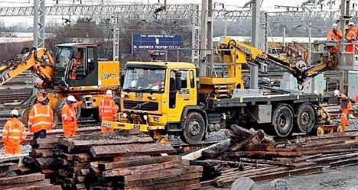
Step 2 – Decide who might be harmed and how
On any site, what group of individuals might be harmed?
Us (workgroup)
3rd party staff e.g. contractors
Passengers
Public
Visitors

Slide 36
Step 3 – Evaluate the risks and decide on precautions
The consideration of risk and controls is covered by legislation (Health & Safety and Work Act, Management of Health and safety at Work Regulations, CDM etc.
This standard gives an approach to controls to address site, task and operational risk by the use of the hierarchy (Principles of Prevention) in the order:
E
Does it need to be done? Can it be done in a different way?
Have we protected our people from the risk?
Eliminate
R
Can it be done less often? Can we reduce the number of people who do the task? Can it be done in a non-hazardous way?
Reduce
I
Can we keep it away from people? Can we introduce distance from the risk to lessen its Impact? Can we contain the Impact of it going wrong? Does it have guarding?
Isolate
C
Has it got a method statement? Have we trained our people? are we supervising them?
Control

Slide 37
Step 4 – Record your findings and implement them
You need to show that you have:
Made a proper check
Established who might be affected and briefed them accordingly
Dealt with all significant hazards
Implemented reasonable precautions
Managed the remaining risk
Involved the whole team
Recording your findings should be:
Concise
Easy to read (simple and legible)
Your risk assessment is expected to be fit for purpose.

Slide 38
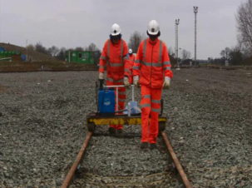
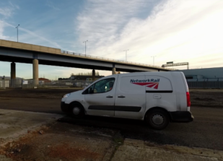
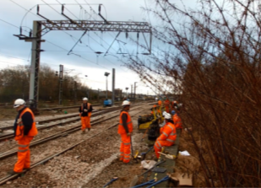
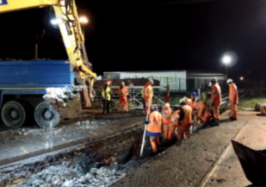
Step 5 – Review assessment and update
Why should we review our assessment?
Could it be improved?
Has anything changed? (weather, people, task)
Feedback?
Learning from events, e.g. near misses or accidents
Keep it up to date

Slide 39
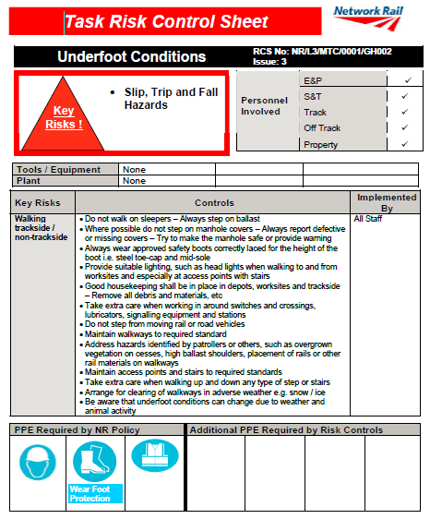
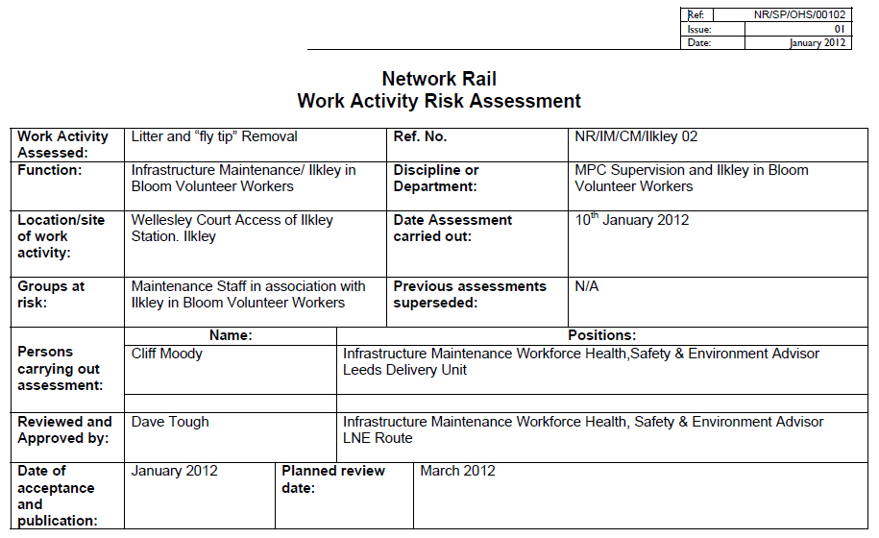
Risk assessment – CONTENT SUBJECT TO CHANGE
You will be expected to implement your skills/knowledge to assist you in the identification and control of hazards
Documented risk assessment should show why you did what you did
  http://connect/assurance/SafetyAndCompliance/WARA/Default.aspx
  http://connect/delivery/NetworkOperations/Infrastructure_Maintenance_Services/NationalSpecialistTeams/IMCProcedures/Default.aspx

Slide 40
Communications

Slide 41








Effective communications
41

Slide 42
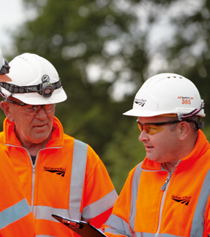
Effective communications
Strong delivery style
Use positive body language
  Don’t slouch.
  Stand straight and face-on to the group.
  If you look bored, the group will be bored.
Keep eye contact (remove any sun-glasses)
  If you look at them, they will look at you.
  Don’t look at the floor or stare at your notes.

Slide 43
Open questions
Good for…
Seeking information
Increasing awareness
Creating a feeling of responsibility
Establishing understanding
Notes:
Talk through open and closed questions. Sometimes we want a “ yes or no” answer, so a closed question – “ did you, can you..? Is fine.
More of the time we want to generate a discussion and get people to engage and think. That’s where open questions come in. These are..

Slide 44

Open questions
Notes:
Delegate Facilitated discussion on where and how to use these styles of questioning – benefits and limitations.
How do these help you facilitate a group more effectively?

Slide 45
Probing questions
TELL
EXPLAIN
DESCRIBLE
Notes:
Delegate Facilitated discussion on where and how to use these styles of questioning – benefits and limitations.
How do these help you facilitate a group more effectively?
Looking to develop a question bank – becoming a question thief

Slide 46
Effective questioning
Open and closed questions
  A closed question is one which has a short definite answer, often “yes” or “no”.
  An open question requires a more detailed answer.
For example:
  Do you have the risk assessment completed? “Yes” ‘Closed question’
  What risks have you identified? ‘Open question’

Slide 47
Effective questioning
Convert the following closed questions into open ones
Does the SWP mirror the worksite environment & activity?
How does the SWP accurately reflect the activity and the environment?
Have you identified the correct resources for the task?
What resources have you identified for the task?
Are the protection arrangements correct?
How can you confirm the protection arrangements are correct?

Slide 48










Our commitment
Safe behaviour is a requirement of working for Network Rail:
We will always comply with our Lifesaving Rules.
We will plan work to ensure that it can be done safely.
Our work environments will be tidy and we will leave them tidy when we’ve finished.
We will ensure people have the skills and the equipment required to work safely.
We will stop work if it cannot be done safely.
We will personally intervene if we feel a situation or behaviour might be unsafe.
We will use Close Calls to report unsafe behaviours and conditions.
We will use our Fair Culture principles to investigate incidents and learn lessons to prevent them occurring again.
We will relentlessly strive to find new ways to keep ourselves, colleagues, passengers and the public safe.
We will design, construct, inspect, operate and maintain the railway to keep everyone safe.
Safety leadership is key to how we assess our people’s performance and readiness for progression.

Slide 49
Worksafe procedure

Slide 50
Over to you…
Now that you’ve seen in full the revised 019 standard, to conclude the brief it is over to you. Discuss in your groups:
What you believe the key issues you will face locally?
Agree consensus on the top priority issues you believe need to be resolved in your area.
Suggest actions which could address each of your priority issues.
How can you individually contribute to these actions?

Slide 51
Final summary
Let’s recap on all the key points:
The person in charge is new, it’s a new capability, not a competence.
The person in charge will be appointed by the Responsible Manager on their ability to manage the work activity planned and have an understanding of the risks.
The person in charge will verify the Safe Work Pack.
Person in charge must hold a minimum of a COSS competence or be a Safe Work Leader (IP only).
The person in charge will make sure that all risk controls have been implemented. If any changes need to be made, these should be reported to the on call manager.
The Responsible Manager will authorise the Safe Work Pack.
The Planner will still create a Safe System of Work pack but will need additional documents alongside to create the Safe Work Pack. These additional documents are:
  Safe Work Pack validation form
  Site risk information and controls required
  Task risk information and controls required
  Permits
  Welfare arrangements and location
Planners should plan for the highest level of protection possible.
Possession planning meetings are important to deconflict between work groups.
Formally there were 7 levels of hierarchy, formally known as red and green zone working. Now there are 8 levels of hierarchy and they are now known as protection and warning arrangements.
Incident Response Pack is there to enable you to plan how to respond to an incident safely, importantly this now includes task and site risk assessments.

