Slide 1
Considerations
If viewing this presentation in slide show format; you will not see all of the extra information supplied within the footnotes.
If you want to print this presentation for paper use; you will need to change the view to ‘Notes Page’ to enable the extra notes to print off also.

Slide 2
SSoWPS v2.5 Launch Briefing
Supplementary Presentation
Part 5a – Value Adding Feature
Notes:
Welcome to the SSoWPS v2.5 launch briefing presentation.
This is supplementary and complimentary information to support the briefing video you will have accessed to show you the enhanced features created in order to create a SWP compliant to the revised 019 standard.
You are required to view the Video before changing the profile setting to use SSoWPS v2.5
In order to understand why the changes have been made, you need to make yourself familiar with the revised 019 standard, which can be accessed via the Standards Portal and Safety Central which will offer even more useful information to support you. Briefings are taking place across the company to inform people of this major safety initiative.

Slide 3
Value Adding – Main Highlights
We have made SSoWPS v2.5 better for you by -
Archiving 6 million SSoWPS packs
  This has sped up the system and you should notice a big positive difference by not having to wait while the system processes the packs
  A reduction on wait time during the production of packs
Restriction on cyclical packs to Maintenance Scheduled Tasks (MSTs) has been improved to allow for repeated pack use / multiple shifts &/or visits
  Reducing the number of packs that need to be re-verified and authorised
The pack has intentional page breaks so that valuable information for the Planner and the PIC do not get split up over different pages
Task Risk has been made logical for you to input
The PIC gets a briefing sheet they can use to deliver the site brief and not have to find the information over numerous pages
More boxes have ‘free text’ to help the Planner and PIC provide more valuable information
Notes:
The complete presentation has been broken down into five manageable parts.
It is advisable to start at Part 1 and then move onwards, but you can use each independently.
These will serve as reference material to assist you with your role in creating a Safe Work Pack (SWP) for those working on or near the line.
This slide is a main summary of the added value that the new system will provide, the rest of the slides will detail more information.

Slide 4
Value Adding – Flexibility of process
System enables individual Planners, Managers, Groups, Sections and Business Areas to take action when they are ready to go live (not forced by the system)
System enables Planners to control their own profile for v2.5 ready
System allows the use of old plans during the transition without any “big bang” of everyone onto v2.5 today
System enables each Route to control their own timetable towards compliance to the revised 019 Standard
Notes:
Part 5a is intended to advise you of the Value Adding Features available.

Slide 5
Value Adding – Current Plans are still available
Because v2.5 is being introduced by an Application Upgrade process – your existing “favourite template” plans are still in a SINGLE system
You do NOT have to re-input all plan details from scratch onto a new parallel system
Copy & Re-Dating a v2.0 plan will bring forward the original details into the right place in the v2.5 plan – and then you ADD the new details required.
15 months history of plans will be available for use**
Plans older than 15 months will be accessible “read only” **
** Policy requirement set by Network Rail
Notes:
The application upgrade means that you can work on either v2.0 or v2.5. There is no ‘Big Bang’ that would potentially disrupt performance in this area.
Not having to re-input means saving Planners time and reducing waste.
The new policy also means that all plans over 15 months will now be archived.
Completing this will speed up the system and increase performance, and thus make sure that we are using relevant data and information.

Slide 6
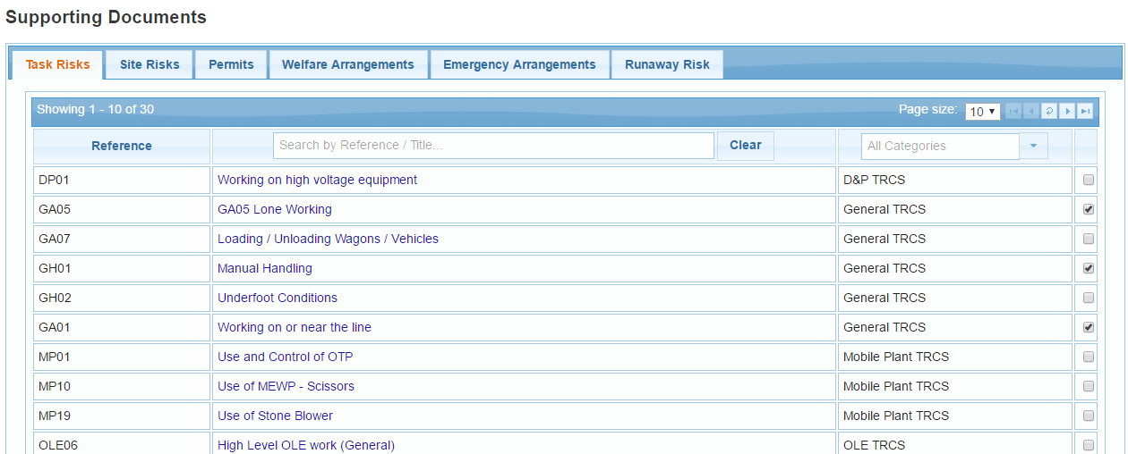
Value Adding – Efficient TRCS process
A slick process to see, pick & click TRCS into the plan
Notes:
This mirrors the information in the ‘Hazard Directory’ and also the information that some areas hold with in a TRCS Manual.
As the SWP only shows the reference and a brief explanation, it is then down to the PIC to deliver the relevant and concise briefing for this work.

Slide 7
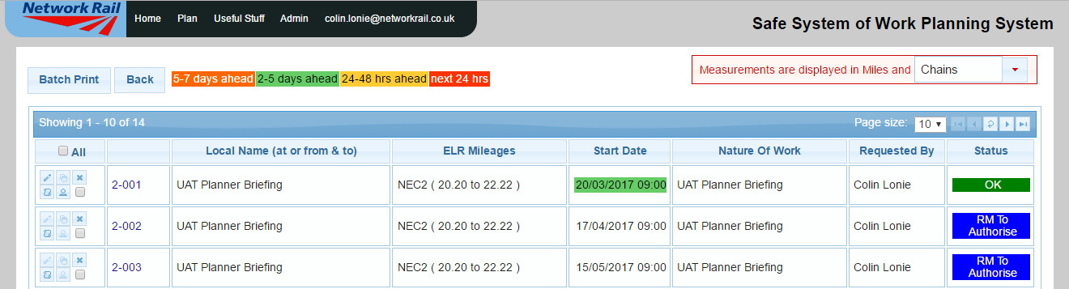
Value Adding – Plan Statuses
There are some new statuses for PIC/RM allocation and plan sign off
Rule of FIRST ONLY until signed off by PIC & RM
New Icon for inputting Authorisation/Verification, if after plan creation
Icons dis-abled (not allowed) if plan is not fully complete
Notes:
The new status process makes sure that the pack is created in the correct manner and that the PIC responsible for the work has been part of creating the pack and happy to verify before the RM authorises.
It is also a swift process to then add in the PIC verification if the plan has been previously created as it will take you straight to section required.
If the plan is not complete you will not be able to verify and then authorise.

Slide 8
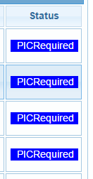
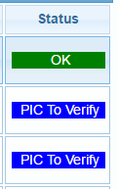
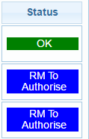
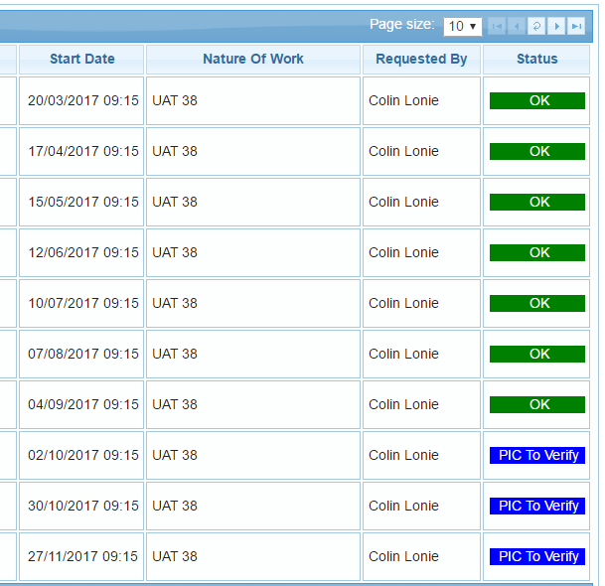
Value Adding – Plan Statuses
1.
2.
3.
4.
EXISTING STATUS still exist once plan has been signed off. (Waiting-OK, WithGZAC, Accepted, WithChanges, Rejected, OK)
STATUS & 12 month/6 month rules – This could get rid of maintaining excel registers of Cyclic plans at Manager/Planner level
Notes:
It is apparent that some areas create and maintain registers in excel of the information on cyclic plans.
The new statuses should remove the need to complete this and thus free up more time for those involved as the information will be readily available in the system.

Slide 9
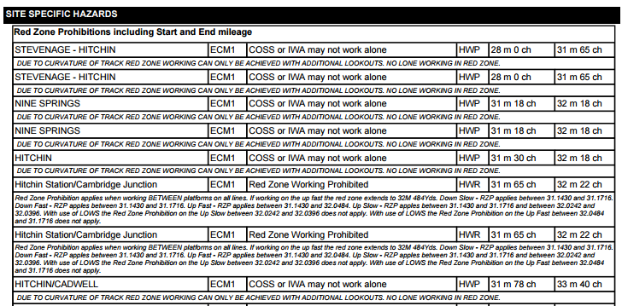
Value Adding – Hazard Directory Free Text
Notes:
The ability of ‘free text’ that explains where a Hazard Directory restriction specifically applies to (One line out of XX at site etc.) is now included on RT9909 COSS form.
This is an ORR required item.
This detail used to be available to the Planner when creating the plan but was not included for the COSS to see. Greater visibility of the information for all, improves understanding, knowledge and safety.
Please Note: You will notice that the hazard directory still references red zone prohibited areas, at a later stage this terminology will be updated.

Slide 10
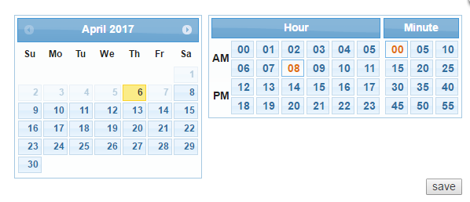
Value Adding – Clarity of changing time
During EDIT and COPY/RE-DATE it is now clear that you can change the times (the grey masking has gone)
Notes:
In the old system there was a grey mask which suggested that the dates/times could not be changed (but they could).
This now makes it clear and removes confusion or extra pack creation.

Slide 11
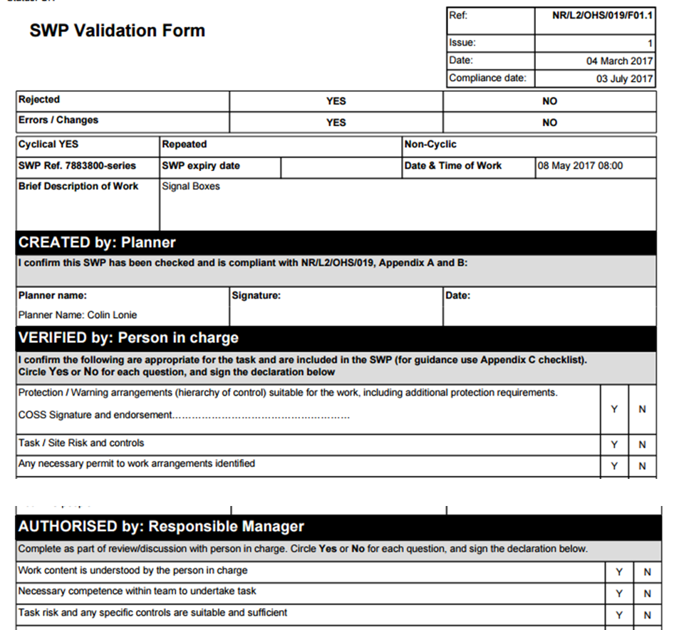
Value Adding – F01 auto-populate
Notes:
The F01 Verification Form is now auto-completed by the system without the need for manual intervention.
This again is a time saving feature.

Slide 12
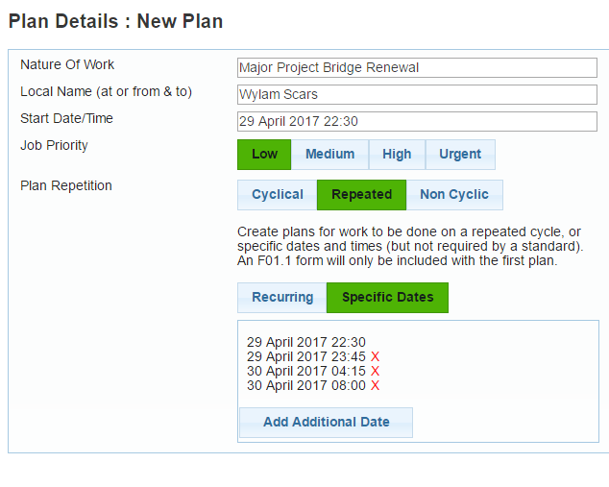
Value Adding – Multiple Shift Packs
(long possessions)
Notes:
There is now the ability to create many packs for use during long duration possessions where there will be many PIC/COSS roles starting at different times BUT where the Risk Controls and other arrangements are the same for all.
We emphasise that this means multiple or sequential shifts, (e.g. in a long possession/blockade) with only the first pack requiring to be verified and authorised.
Subsequent relief PIC staff carrying out the same work in the same place do not each need to verify the SWP which is authorised for repeated use by the Responsible Manager.
This again saves time when creating multiple packs and removes the risk that something could have been missed.

Slide 13
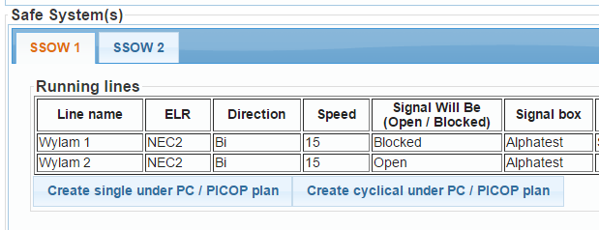

Value Adding – Under PC/PICOP process
Flexibility for the Under PC process to have mileages outside of the “Master” plan mileages - but still on same pages of Sectional Appendix and still within the Protecting Signals.
Flexibility to create Under PICOP plans in a timely process under the “Master Possession” plan mileages - but still on same pages of Sectional Appendix and still within the Protecting Signals.
Master Plan must contain either a Line Blockage type or a Possession

Slide 14
SSoWPS v2.5 Launch Briefing
Supplementary Presentation
Part 5b – Existing Features
Notes:
Part 5b is intended to advise you of the ‘Existing Features’ available.

Slide 15
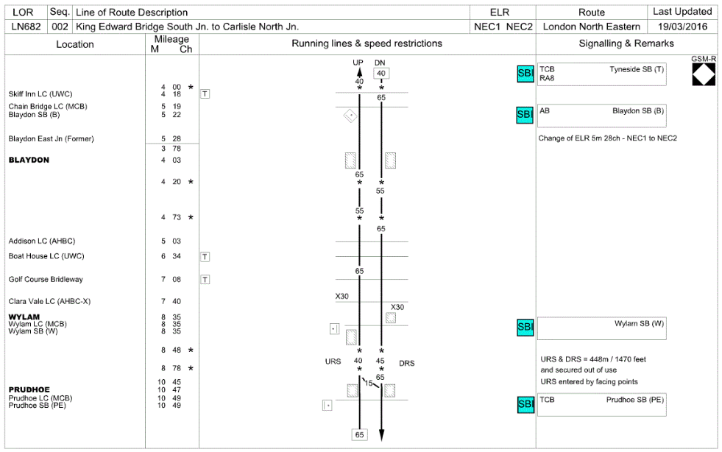
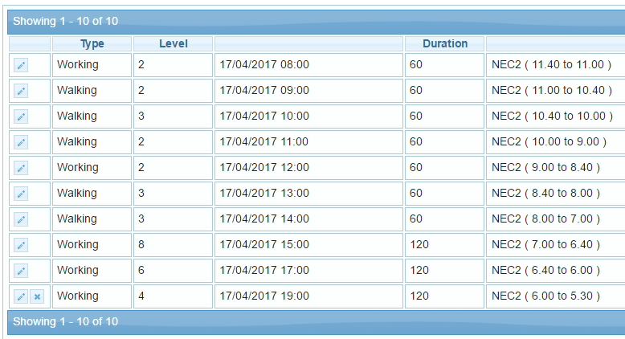
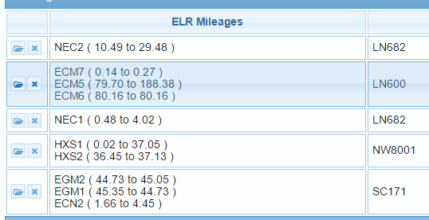
Reminder – Rule of 10’s
Up to
10
Notes:
You can add ‘up to 10’ pages of Sectional Appendix – ELR’s – Components – in a plan

Slide 16
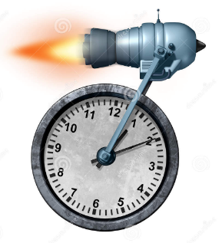
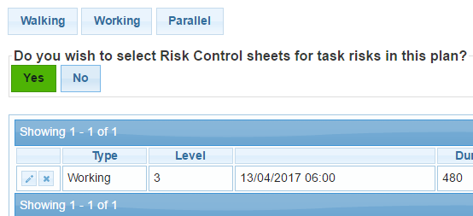
Reminder – Multi-component plans
When planning work that is going from mileages A to B, then B to C it is quicker to do a single plan with 2 components than it is to do 2 separate plans. (Even faster with more components)
When first component is finished – select to ADD another
Notes:
Removes the need to create multiple packs for the same PIC.

Slide 17


Reminder - Edits
Remember – you can edit a plan to make corrections or improvements to content.
This can be done at any time up to the actual date/time of the plan if it does NOT involve the submit to GZAC process for line blockages
For plans that will involve the submit to GZAC process – they can be edited up to the point where they are submitted and become WithGZAC

Slide 18
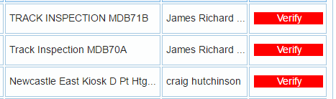

Reminder – Verification status (changes)
The red Verify status means that either the Sectional Appendix page(s) or the Hazard Directory extract detail has changed within the plan.
Select the Verify Icon to then be shown the changes so you can determine if there is an impact upon your planned safe system arrangement – and then take the appropriate action.
Accept (No impact) – Edit (amend plan to cater) – Delete (plan no longer works)

Slide 19
SSoWPS v2.5 Launch Briefing
Supplementary Presentation
Part 5c – Support Model / Help
Notes:
Part 5c is intended to advise you of the Support Model available and areas that you can gain help.

Slide 20
Support Model – for the unexpected
SSoWPS v2.5 has been designed and built to the requirements of Network Rail.
It contains the process and features defined by Network Rail.
There will be questions and issues arising as the system moves into broader use.
These should be directed as follows
    General Guidance (refer to Useful Stuff tab on SSoWPS or the Business Facing Content on Safety Central)
    Contact the Delivery Unit (DU) Lead (why is the process like this, I don’t like XX, could it become, can we have this feature added)
    Call the IT Helpdesk (I got an error message, bits of my plan were missing, system didn’t let me do XX, v2.5 isn’t working)
  All options will lead to the Network Rail Business Lead to achieve resolution or decide upon actions needed
Notes:
The support model will be communicated to you personally via separate communications.

Slide 21
Final Summary & Round Up
SSoWPS v2.5 is available to use from Monday 12th June 2017
The ‘Go-Live’ date for revised 019 Standard is Monday 3rd July 2017
Each Network Rail Business Area is accountable for producing an Action Plan to determine how the implementation of the revised 019 standard will be addressed.
Discuss & agree within your own Depot teams what can be done to ensure that Standard 019 and SSoWPS v2.5 become active in your area
Notes:
Please note that it is always good to share best practice.
If something has worked particularly well, please also share this via your local Yammer pages and other channels within your Business Area.

Slide 22
Part 5 Complete
Closing side
Notes:
You have now completed part 5 of the 5 and received detail on the of the value added features of the new SSoWPS v2.5 system to support the changes to the 019 Standard, and those already incorporated from v2.0. You have also been given details of the support model available and its process.
Please continue with the other parts to further enrich your knowledge and feel free to view the 019 Standard briefing videos and materials.
Please visit Safety Central and SSoWPS for extra information or direct your questions to your local safety lead.

