Slide 1
NR/L3/OHS/019-IP Work Instruction Briefing
Version 1

Slide 2
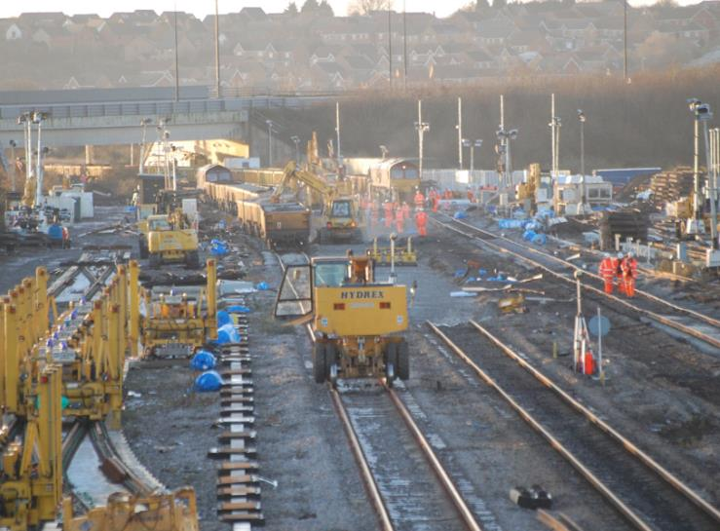
Background
Revised 019 Standard:
Ref: | NR/L2/OHS/019
Issue: | 9
Date: | 03 July 2017
Compliance date: | 23 September 2017
New IP level 3 Work Instruction:
Ref: | NR/L3/OHS/019-IP
Issue: | 1
Date: | 02 June 2018
Compliance date: | 24 September 2018
Existing IPEM level 3 Standard:
Ref: | NR/L3/OHS/133
Issue: | 1
Date: | 03 July 2017
Compliance date: | 03 July 2017
Notes:
NR Standard 019 was rewritten and implemented in September 2017. The IP level 3 standard highlights how IP will work in both IP led and Route Business sites and has been used throughout the country as a “how to guide” and was written to sit under 019 using the P&DSW principles of Responsible managers, the SWL working with the planner to create the SWP and a single controlling mind which we now know as the PIC (person in charge) and is now at the point we have progressed it through to become a level 3 standard. Please note the IP East Midlands Planning Route will continue to work to the already mandated NR/L3/OHS/133 using Proscient technology to created E Permits.

Slide 3
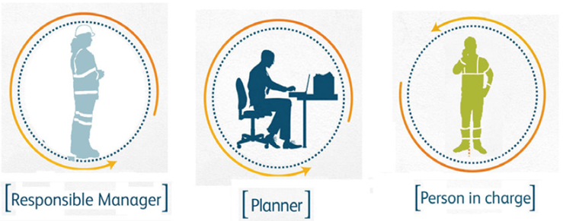
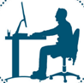

Background - Developments
Task Pic & Worksite Pic
Development of Safe Work Pack
Clarity of delegation
Safe Work Pack
Sponsorship Clarity
Notes:
Introduction of the key elements of 019 has occurred:
Person in Charge – Involved in planning, understanding the task and operational risk producing a Safe Work Pack.
To help this the IP Work instruction adds clarity by:
Introducing the principle of a Task PiC and Worksite PiC
Clarity on Delegation and Sponsorship
Development of the Safe Work Pack

Slide 4



Affected Parties
Responsible Manager
Planner
Person in Charge (IP)
Notes:
All planned work will start off with a PIC to assist in the creation of the SWP. In IP led Engineering worksites the lead worksite will become the overall Worksite PIC with other parties signing in with them as Task PICs. When Route Business are the lead worksite all worksite owners will continue to act as Task PICs. For line blocks the SWL1 will act as PIC and for line blocks with a protection controller both SWL’s will be the Task PIC (one of these could also act as Protection Controller if they choose to do so)

Slide 5
Hazard & Risk identification
Notes:
5

Slide 6
We all have Legal responsibilities
Health and Safety at Work Act 1974
Network Rail and Principal Contractor responsibilities
Safe systems of work
Safe plant
Safe storage, handling, use and transportation of articles and substances
Information, training, instruction and supervision
Safe access and egress
Safe working environment and adequate welfare arrangements
Your personal responsibilities
Take care of your own safety and that of others
Co-operate
Wear equipment provided for your safety
Follow safety instructions and training
Not to interfere with anything provided in the interest of health and safety

Slide 7
Hazard v’s risk
Hazard = Something that has the potential to cause harm e.g. chainsaw, moving train, walking over uneven terrain, exposure to loud noise, exposure to chemicals, etc.
Risk = The likelihood that the hazard will actually cause harm e.g. what is the chances that someone will be hit by a train or suffer hearing loss or trip and fall etc.
When performing a risk assessment you have to consider:
  Likelihood i.e. how likely that is to happen and
  Severity i.e. how much harm the hazard will cause
Control measures = anything that when implemented will reduce the risk, change the likelihood and/or change the severity.
Reasonably foreseeable = can be taken to mean an incident or accident which is thought to be credible.

Slide 8
5 Steps to risk assessment
There are 5 logical steps to assessing risk or hazards
1.
Identify the hazards.
2.
Decide who might be harmed and how.
3.
Evaluate the risks and decide on precautions.
4.
Record your findings and implement them.
5.
Review your assessment and update if necessary.
Notes:
8

Slide 9
Evaluate the risks and decide on precautions
The consideration of risk and controls is covered by legislation (Health & Safety and Work Act, Management of Health and safety at Work Regulations, CDM etc).
E
Does it need to be done? Can it be done in a different way?
Have we protected our people from the risk?
Eliminate
R
Can it be done less often? Can we reduce the number of people who do the task? Can it be done in a non-hazardous way?
Reduce
I
Can we keep it away from people? Can we introduce distance from the risk to lessen its Impact? Can we contain the Impact of it going wrong? Does it have guarding?
Isolate
C
Has it got a method statement? Have we trained our people? are we supervising them?
Control

Slide 10
What do we associate as a risk?
Site
Task
Operational
Working at night
Hazardous dust
Trains
Electricity
Slips, trips and falls
On track machines
Working at height
Noise
On track plant
Access and egress points
Vibration
Notes:
Site risks are hazards associated with the location or work environment
Task risks are hazards associated with the work activity
Operational risks are hazards associated with railway operations

Slide 11
Person In Charge
Notes:
11

Slide 12
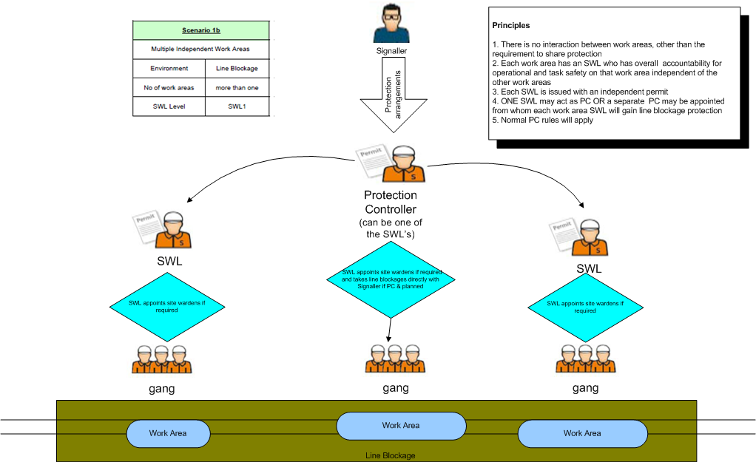


The person in charge (PIC)
Worksite PIC:
Accountable and responsible for deconfliction and integration within the engineering worksite in which they are leading.
Must be SWM or SWL 2
Must be primary sponsored and employed by lead organisation
Worksite PIC
Task PIC: Accountable for leading a task in a work area within a worksite in a possession.
Key Contact in the planning process
Will arrange the collation and provision of the relevant safe work pack for their task and work area.
Must be COSS or SWL1
Task PIC
Task PIC
Gang
Gang
Work Area
Work Area
Engineering Worksite

Slide 13

The person in charge (PIC)
The person in charge is a capability, not a competence
The PIC will be appointed by the Responsible Manager on their ability to manage the work activity planned and have an understanding of the risks
The PIC will make sure that all risk controls have been implemented
The Worksite PIC must hold a SWL2/SWM competence and the Task PIC will hold SWL or COSS
A PIC and the planner must collaborate to produce the Safe Work Pack (SWP), which the PIC will verify.

Slide 14
Safe Work Pack
Notes:
14

Slide 15
What as a minimum, should go into a Safe Work Pack?
Contents required:
SWP validation form
Site risk information and controls required
Task risk information and controls required e.g. task risk control sheets, work package plans or task briefing sheets
Permits, where applicable, such as lifting plans, electrical, isolation, hot works, confined spaces
Welfare arrangements and their location
Safe Work Pack
The Worksite SWP must be briefed to all task PICS
The Task SWP must be briefed to the team carrying out the work
Notes:
The SWP provides information on how work is to be carried out safely and gives details on how to manage and control task, site and operational risks and refers to the documentation provided to the PIC for the work they are to undertake. The information contained in the SWP should be:
a) concise and relevant to the task and location where the work is being undertaken
B) provide clear information to allow the person in charge to effectively use it to manage the risks to themselves and those working under their supervision.
All SWP’s must be returned to the RM for retention as stated in NR/L3/INF/02226 Corporate records retention schedule.
The Planner creates the Safe System of Work pack with the highest level of protection possible for either the task or the worksite and will need additional documents alongside to create the Safe Work Pack. These additional documents are:
Safe Work Pack validation form
Task Briefing sheet
Work package plan
Runaway risk mitigation where required
Permits (permit to dig, hot works for example)
Welfare arrangements and location

Slide 16
Task and Worksite Safe Work Pack
Task Safe Work Pack
Created to the highest level of protection possible
Concise information/ documentation that is relevant to the task
Include all of the content to brief out to team completing task
Safe Work Pack
Worksite Safe Work Pack
Created to the highest level of protection possible
Concise information/ documentation that is relevant to the worksite
Include all of the content to brief out to Task PICs
Is not a duplication of the Task Safe Work Pack

Slide 17
Key Points
Notes:
17

Slide 18
Final summary
Safe behaviour is a requirement of working for Network Rail and our lifesaving rules must be complied with.
Remember the worksafe procedure - If its not safe, the work stops!
The PIC is a capability, not a competence.
The Worksite PIC must be a Safe Work Leader 2 or SWM
All SWL 2 and SWM’s will be primary sponsored by the lead organisation
The Task PIC must hold a minimum of a COSS competence or be a Safe Work Leader.
The Responsible Manager will authorise the Safe Work Pack.
Possession planning meetings are important to deconflict between work groups but task and site risks must be included in deconfliction (PICs do not require the whole SWP, just what the risks are and a brief description of what work is being carried out to allow for deconfliction).

Slide 19
Final Summary
The planning process must have the involvement of the individual delivering the work as Person in Charge
The Safe Work Pack provides information on how work is to be carried
The information within a Safe Work Pack must be concise and relevant to the task/ worksite being delivered.
Notes:
All planned work will start off with a PIC to assist in the creation of the SWP. In IP led Engineering worksites the lead worksite will become the overall Worksite PIC with other parties signing in with them as Task PICs. When Route Business are the lead worksite all worksite owners will continue to act as Task PICs. For line blocks the SWL1 will act as PIC and for line blocks with a protection controller both SWL’s will be the Task PIC (one of these could also act as Protection Controller if they choose to do so)
The SWP provides information on how work is to be carried out safely and gives details on how to manage and control task, site and operational risks and refers to the documentation provided to the PIC for the work they are to undertake. The information contained in the SWP should be:
a) concise and relevant to the task and location where the work is being undertaken
B) provide clear information to allow the person in charge to effectively use it to manage the risks to themselves and those working under their supervision.
All SWP’s must be returned to the RM for retention as stated in NR/L3/INF/02226 Corporate records retention schedule.
The Planner creates the Safe System of Work pack with the highest level of protection possible for either the task or the worksite and will need additional documents alongside to create the Safe Work Pack. These additional documents are:
Safe Work Pack validation form
Task Briefing sheet
Work package plan
Runaway risk mitigation where required
Permits (permit to dig, hot works for example)
Welfare arrangements and location
The Worksite PIC must hold a SWL competence and the Task PIC may hold SWL or COSS

Slide 20
Questions
?

