Slide 1
Prep4Summer
Health and Wellbeing
Looking out for each other this summer

Slide 2
Health and Wellbeing
This section of the Prep4Summer pack contains tips and information to keep you healthy this summer. Here are some general tips:
Hydration: Remember to take on plenty of water
Skin care: Use sun screen on exposed skin
Heat can lead to increased fatigue, be careful not to overdo it
Workload: Are we sharing the load on site or in the office?
PPE: Remove Hi-vis layers as required remaining visible and cool
Sleep patterns may be affected by heat and return from holidays
Allergies: Be aware of increased risk of hay fever as pollen levels rise and report use of anti-histamines to your line manager.
Looking out for each other this summer

Slide 3
It’s holiday time! Are you sharing the load?
As many colleagues take time off over the Summer period to enjoy their holidays, this often means teams may have more than one team member on leave at a time.
In order to make sure those who are in work don’t feel over pressured it is important to plan for staff holidays:
Prioritise: What work has to be done and what can wait? Make sure staff understand the priorities.
Delegate tasks: Delegate urgent tasks or work that needs to be done. Don’t leave it up to chance or assume things will get done while others are off.
Maintain a health work-life balance: Don’t over work staff with extra tasks
Plan to make sure those returning from leave aren’t overwhelmed with work which hasn’t been delivered in their absence.
Keep calm!: Support colleagues who are undertaking tasks they wouldn’t normally be handling and make sure they are comfortable with what they are being asked to do.
Looking out for each other this summer

Slide 4
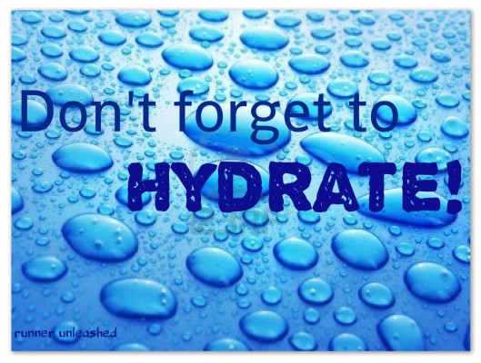
Knowing your Hydration
Water is essential for life and it is very important to get the right amount of fluid to be healthy.
Why?
Your body is nearly two-thirds water and so it is really important that you consume enough fluid
to stay hydrated and healthy. If you don’t get enough fluid you may feel tired, get headaches and
not perform at your best.
How Much?
This can depend on factors such a weather, physical exercise and age; however European recommendations
suggest 1.6L of fluid per day for women and 2L of fluid per day for men.
Choosing your drink... Be aware that although all drinks provide water and some also contain essential
vitamins and minerals, they may also provide energy (calories) which will contribute to your daily intake.
• Drinking water – delivers fluid without adding calories or damaging teeth.
• Tea/Coffee – Moderate amounts of caffeine do not affect hydration however they may contain calories depending on the milk and sugar you add which adds to the potential to damage teeth.
• Milk – contains lots of essential nutrients such as protein, B vitamins and calcium, as well as being a source of water – just watch out for the added fat content.
• Fruit Juices – Contain vitamins and minerals . Possible 1 of your 5 a day, however have to potential to damage teeth and be high in sugar.
Looking out for each other this summer

Slide 5
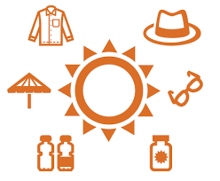
Sun awareness
Remember to take care of your skin this summer. Here are some tips if you are out in the sun:
- Wear sunscreen with a high SPF and re-apply regularly
- Remember the strongest sun is in the middle of the day
- Wear appropriate clothing, where possible cover your skin
Everyone should take care in the sun but you should take extra
care if you; have light skin, fair hair, tend to burn, have lots of moles or have a family history of skin cancer.
Click here for NHS advice about sun awareness and protecting your skin.
Looking out for each other this summer

Slide 6
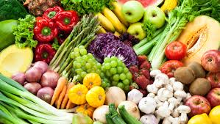
Sustenance
Summer is a great time to start a health eating plan. It's easier to eat healthily in the summer with loads of fruit and vegetables in season. Try incorporating more of the foods below into your diet this summer:
Tomatoes: an excellent source of antioxidants and can help reduce blood pressure and cholesterol levels
Courgettes: contains a fibre called pectin, which is linked to increasing heart health and lowering cholesterol.
Watermelon: Watermelon's high water content keeps you cool and hydrated. It also is a source of vitamins A, B6 and C, lots of lycopene, antioxidants and amino acids
Oranges: oranges have a high vitamin C content, oranges are a good source of
B vitamins
Apples, Pears: Both apples and pears contain vitamin C, which bolster the
immune system. They are also a good source of energy
Apricot, Peach, Nectarine: These fruits are a good source of dietary fibre
Did you know the hotter outdoor temperatures means we sweat more which ups your risk for health problems such as dehydration, skin sensitivities, and vitamin and mineral deficiencies.
.
Looking out for each other this summer

