Slide 1
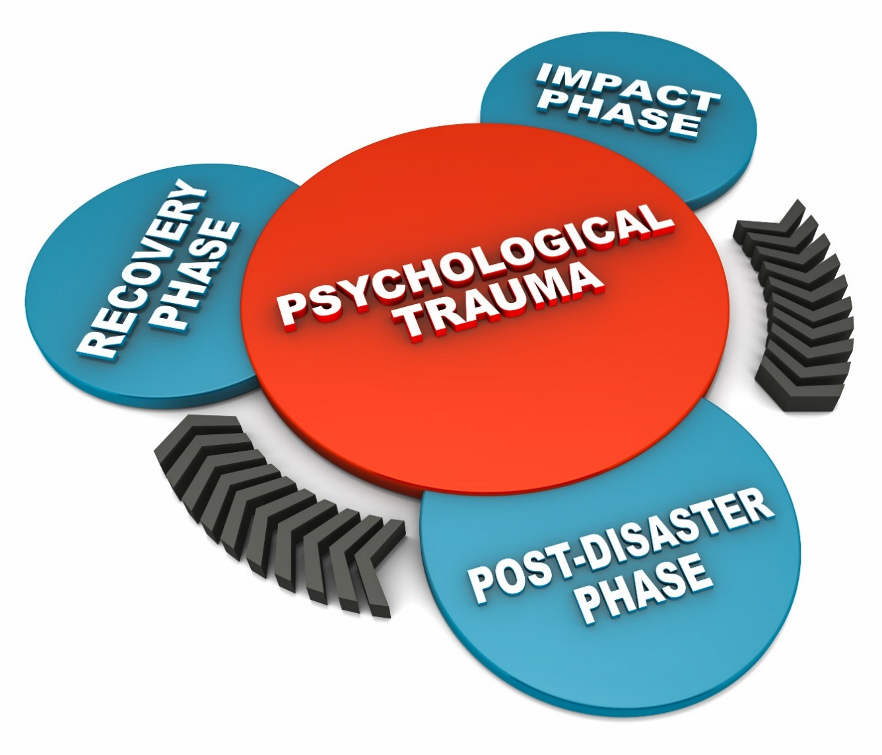
Trauma Management Programme
Notes:
Summer 2013 – a few team members experienced members of the public committing suicide
Our managers had little experience on how to help the team members cope
Concept of Trauma Management programme developed
Jim Mealand attended our first Management Development Programme, and decided he wanted to share his traumatic experience to help others (managers and staff)
Jim agreed to help develop the TES’s Trauma Management Programme and agreed to meet Dr Noreen Tehrani (Occupational psychologist) and tell his story, for the first time, on camera…

Slide 2
The TSA are proud to have worked in conjunction with TES 2000 in support of a Trauma Management Programme.
We feel it is an excellent tool to be shared across the industry, to raise awareness of post incident care for those who were not injured but witnessed an event.
Post Traumatic Stress is a well recognised condition for the Armed Forces returning from active service, however the same trauma and associated condition is often a side effect of a significant event within the rail industry.
The following slides and video detail a real life event and the traumatic effect it had on the individual over a prolonged period.
Please use the material to raise awareness and identify any potential signs within your teams.
Notes:
Endorsement of Best Practice by the TSA

Slide 3
Trauma Management Programme
Notes:
Play video
After video – thoughts? Observations?

Slide 4
Trauma Management Programme
Notes:
After video – thoughts? Observations?
Discuss with audience (allow time for staff to speak).

Slide 5
Trauma Management Programme
Demobilisation – Supervisor/Manager
Targeting those individuals who will be the first line of support if their team experiences a traumatic event. The course will highlight the effect traumatic events have on individuals, and look at various techniques to assist the recovery of an individual immediately following an incident.
Immediately
On-site or back at office
Group or one to one
Defusing – Manager
Responding to the psychological impacts of death, serious injury, violence, and other shocking events in the work place (called critical incidents), requires skilled managers to operate sensitive processes. This course is designed to teach managers emotional first-aid intervention skills, through the use of defusing techniques.
Within 24 hours of incident
Group or one to one
Debriefing - HR or Specialist
Providing managers with support to enable them to consolidate feelings and actions after a traumatic event, this element of the programme will encourage managers to use the events to assess current practices, identify root cause and where applicable take action.
Within 72 hours of incident
Group or one to one
Notes:
Training consists of 3 levels
Managers and supervisors trained in how to conduct these meetings with staff/individuals
Support will be provided as part of the Programme to help managers and supervisors themselves deal with their traumatic experiences.

Slide 6
For Further Information
John Tidyman
SHEQ Manager
TES 2000 Limited
Email; john.tidyman@tes2000.co.uk
Mobile; 07969 883 879
or
Track Safety Alliance (TSA)
www.tracksafetyalliance.co.uk

