Slide 3
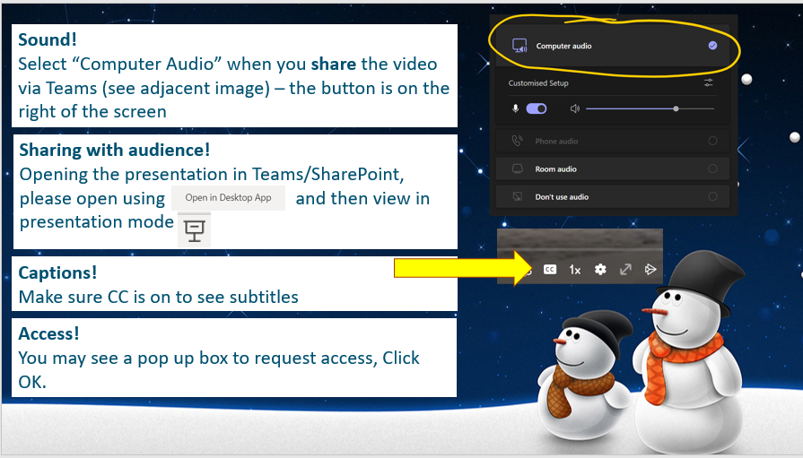

Slide 4
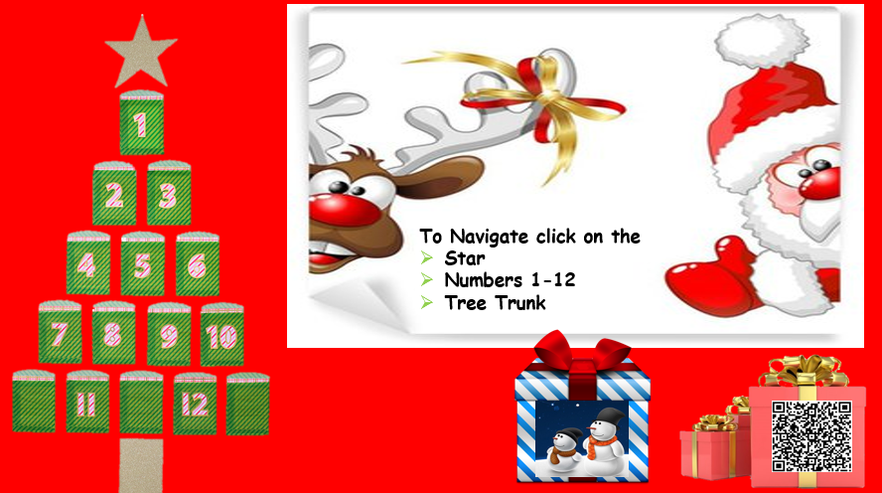


Slide 5

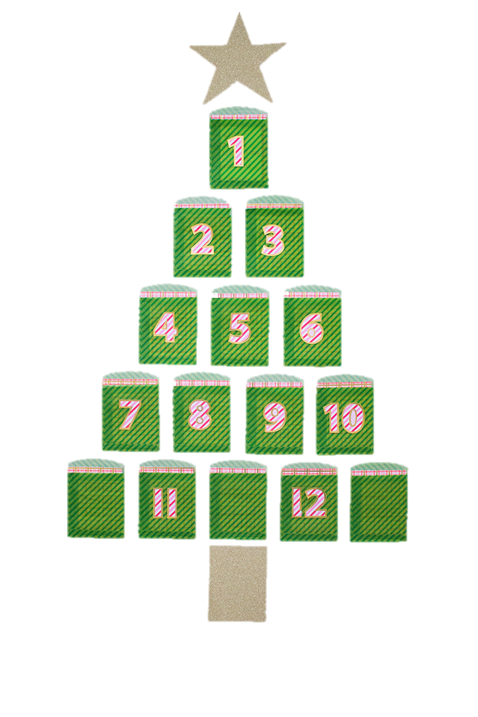


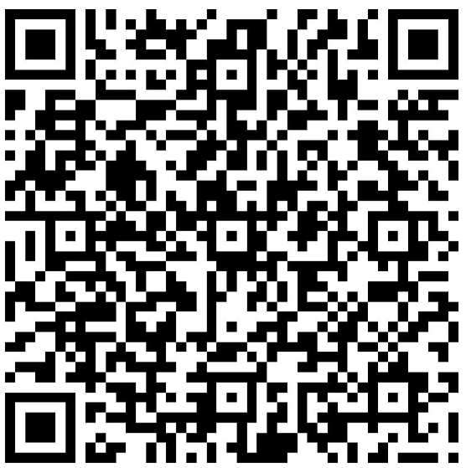

12 days of Christmas
Feedback Form

Slide 6
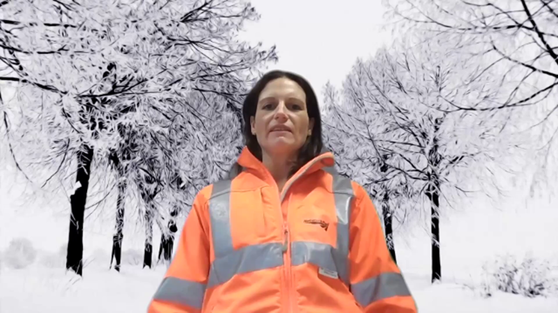

Slide 7
12 days of Christmas
Feedback Form

Slide 8
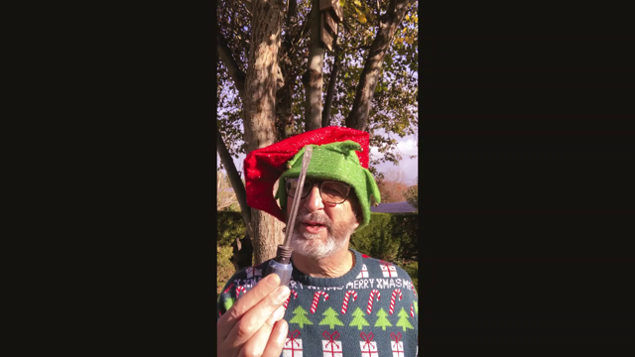

Slide 9
12 days of Christmas
Feedback Form

Slide 10


Slide 11
12 days of Christmas
Feedback Form

Slide 12
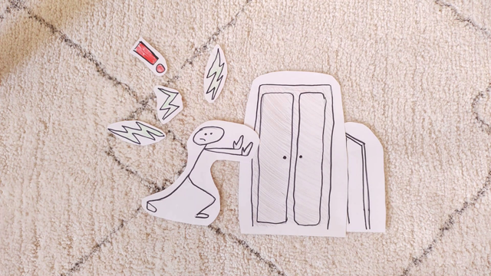

Slide 13
12 days of Christmas
Feedback Form

Slide 14


Slide 15
12 days of Christmas
Feedback Form

Slide 16


Slide 17
12 days of Christmas
Feedback Form

Slide 18


Slide 19
12 days of Christmas
Feedback Form

Slide 20


Slide 21
12 days of Christmas
Feedback Form

Slide 22


Slide 23
12 days of Christmas
Feedback Form

Slide 24
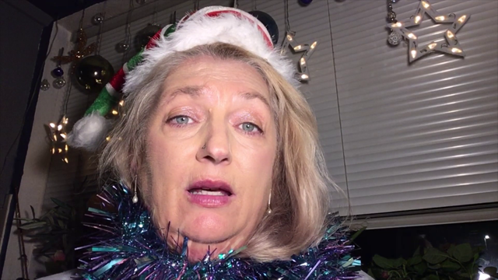

Slide 25
12 days of Christmas
Feedback Form

Slide 26


Slide 27
12 days of Christmas
Feedback Form

Slide 28


Slide 29
12 days of Christmas
Feedback Form

Slide 30


Slide 31
12 days of Christmas
Feedback Form

Slide 32
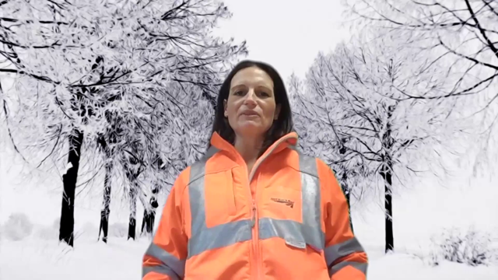

Slide 33
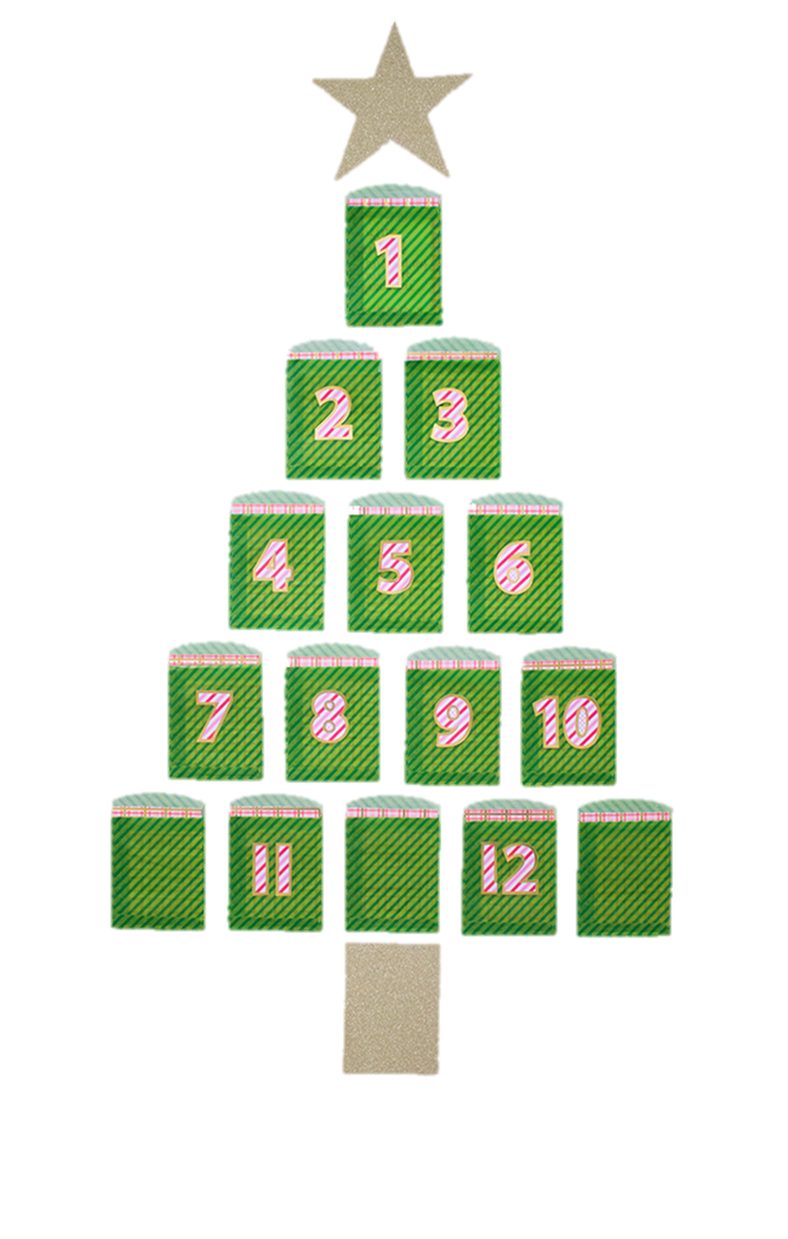

Please give your feedback – we really appreciate it
Click on Card
Or Scan with your mobile

