Slide 1

North West & Central and Eastern SHELT
Overview
October 2021

Slide 2

What is SHELT?
Overview - October 2021
A strategic Leadership forum for all Capital Delivery Principal Contractors and Designers for North West & Central (NW&C) and Eastern Regions.
SHELT is supported by a series of working groups and tactical forums within the Regions, Alliances and Programmes.

Slide 3
Who will attend SHELT?
Overview - October 2021
One representative from each Principal Contactor
One representative from each Principal Designer
ISLG representative
One Network Rail representative, at Route Delivery Director (RDD) level, from each of the Regional Delivery Areas from:
    Capital Delivery; Eastern and NW&C
    Consistent attendance and no delegation

Slide 4
Structure of SHELT
Overview - October 2021
Frequency
  Every 3 months (Jan, Apr, Jul, Oct)
Duration
  1 full day
Location
  Rotating cities/ sites across the UK
Content
  Open debating forum around key topics
  Occasional site visit where continuous improvement can be garnered from non-rail environments
Preparatory work
  Presented by all attendees and shared across group/ industry

Slide 5
SHELT Objectives
Overview - October 2021
To share best practice and learning to foster a leadership culture of continuous improvement
To focus on a series of key topics which are considered fundamental to safety improvement
An open debating forum following a rolling 12-month agenda
To be inclusive and diverse
Bringing ideas from rail and non-rail businesses
Act as a forum to give ISLG firm direction
Members are expected to champion SHELT outcomes with their Network Rail regions and parent companies – this is not a talking shop

Slide 6
SHELT Steering Group & PMO Team
Overview - October 2021
Consists of SHELT members
Members reviewed on an annual basis (Jan) to replace natural wastage and bring forward fresh ideas
Members meet in-between SHELT meetings to plan next agenda and preparatory work topics
Set agendas and direction of each SHELT meeting
PMO team consist of early career professionals to help manage the SHELT summits and steering groups.
SHELT Steering Group
Eoin O’Neill - Chair | Network Rail
Andy Belcham | Arup
Stuart Birch | Volker Rail
Steve Jones | Laing O’Rourke
Matt Kent | Siemens
Paul Mohan | Murphys
Phil Price | Keltbray
Shaun Thompson | Alun Griffiths
Daniel Mayhew | WSP
SHELT PMO Team
Mohammed Karmol | Network Rail
Jasmin Wright | Volker Rail
Dominic White | WSP

Slide 7
Working Group Structure
Overview - October 2021
Working Group | Working Group Lead | Support Teams
Leadership & Behaviours | Matt Kent (Siemens); Phil Price (Keltbray Rail) | Justin Page (Amey); Dave Maddison (Alstom)
Front Line Supervision | Shaun Thompson (Griffiths); Ian Purdham (Story); James Corker (Morgan Sindall) | Chris Hext (SPL Powerlines); Mike Halliday (NR); Ian Jones (NR); Craig Winter (Linbrooke)
Extended Supply Chain (Standards) | Inductions | Stuart Birch (Volker Rail); Eoin O’Neill (NR) | Sean Blackmore (Galliford Try); Mike Halliday (NR)
Innovation & Technology | Paul Mohan (Murphys); Simon Walkley (Buckingham Group) | Paul Taylor; Boris Lucic (NR); David Roberts (NR)
Better by Design | Andy Belcham (Arup); John Oldridge (Systra); Daniel Mayhew (WSP) | Fiona Tiley (NR); Keith Prentice (Atkins); Richard Johnson (Buckingham,) Robert Kaul (Jacobs), Johnathan Wright (AECOM), Ian Dodgson (Arcadis), Andrew Dugdale (Mott Mac)
High Potential Incidents/ Risks | Steve Jones (Laing O’Rourke); Paul Tuckett (Skanska) | Chris Hannah (NR); Nissar Mohammed (BAM Nuttall), Keith Prince (Laing O’Rouke)
Sustainability | Holly Bradley (NR); Anna Humphries(NR) | To be confirmed

Slide 8
SHELT Members
Overview - October 2021
Name | Company | Name | Company | Name | Company
Johnathan Wright | Aecom | Aaron Bell | Network Rail | Octavia Midgley | Network Rail
Susan Evans | Aecom | Alex Sharkey | Network Rail | Pablo Forteza | Network Rail
David Maddison | Alstom | Andy Beach | Network Rail | Paul Hodson | Network Rail
Shaun Thompson | Alun Griffiths | Anna Humphries | Network Rail | Paul (IP) Thomas | Network Rail
Alan Boyle | AmcoGiffen | Ben Lynch | Network Rail | Peter Luby | Network Rail
Ian Purdham | Amcogiffen | Boris Lucic | Network Rail | Pete Shrader | Network Rail
Justin Page | Amey | Chris Hannah | Network Rail | Rob Cairns | Network Rail
Ian Dodgson | Arcadis | Craig Winter | Network Rail | Robert Blackstock | Network Rail
Andrew Belcham | Arup | David Roberts | Network Rail | Steve Hughes | Network Rail
Keith Prentice | Atkins | Eoin O'Neill | Network Rail | Gary Burnett | QTS Group
Alan Atkins | Balfour Beatty | Fiona Tiley | Network Rail | Matt Kent, | Siemens
Mick Rayner | Balfour Beatty | Holly Bradley | Network Rail | Paul Tuckett | Skanska
Nisar Mohammed | BAM Nuttal | Ian Quick | Network Rail | Lee Daniels | Spencer Group
Simon Walkley | Buckingham Group | Ian Rubery | Network Rail | Gareth Armishaw | SPL Powerlines
Maurice Deans | CML | Immanuel Kemp | Network Rail | Steve McWhan | SPL Powerlines
Paul Taylor | Colas Rail | Joe Bennett | Network Rail | Craig Lafferty | Story Contracting
Mark Breen | Galliford Try | Jonathan Morris | Network Rail | john Macarthur | Story Contracting
Robert Kaul | Jacobs | Mark Downes | Network Rail | Martin Smith | Story Contracting
Robert Kaul | Jacobs | Mike Halliday | Network Rail | John Oldridge | Systra
Phil Price | Keltbray | Mike Heywood | Network Rail | John Cox | VolkerFitzpatrick
Steve Jones | Laing O'Rouke | Mohammad Karmol | Network Rail | Jasmin Wright | VolkerRail
James Corker | Morgan Sindall | Neil Gaskin | Network Rail | Niall McCreanor | VolkerRail
Andrew Dugdale | Mott MacDonald | Neil Holm | Network Rail | Stuart Birch | VolkerRail
Ben Weaterton | Mott MacDonald | Nick Millington | Network Rail | Daniel Mayhew | WSP
Danny O'brien | Murphy | Nicola Clifford | Network Rail | Dominic White | WSP
Paul Mohan | Murphy | Noel Connolly | Network Rail

Slide 9

Working Groups
October 2021

Slide 10
Leadership & Behaviours
Overview - October 2021
Working group leads - Matt Kent, Phil Price
Purpose & Objectives
What does great safety leadership look like and define those characteristics and behaviours? We will demonstrate great safety leaders across SHELT? First Impressions – anyone visiting our sites expects gold standard on welfare, inductions, PPE, signing in, task briefings and values Our Values and Behaviours – consistent visible site presence sharing our beliefs Empowerment and Support – cross company support and learning to all our people Production v Safety – always getting this balance right and rewarding good practice Fair Culture Model – eliminate the perception of the blame culture Engagement by all – our site and depot teams know who we are, we are SHELT!! Repeat all of the above – test our people and our environment for consistency

Slide 11
Front Line Supervision
Overview - October 2021
Working group leads - Shaun Thompson, Ian Purdham, James Corker
Purpose & Objectives
To develop excellent front line supervisors Support & equip our supervisors with knowledge and skills. Developing Supervisor’s training programmes for SHELT members to utilise within their own business. Giving Supervisor’s an independent voice into the rail industry. Providing a supervisors community to help and support each other. Promote best practice from the rail and other industry sectors to Supervisors. Champion initiatives to improve communication, efficiency and effectiveness to better control site risk directly to Supervisors.

Slide 12
Extended Supply Chain (ESC)
Overview - October 2021
Working group leads – Stuart Birch, Eoin O’Neill
Purpose & Objectives
Use the strength of the SHELT Summit membership to drive improvement in the extended supply chain’s safety performance, competence and standards Understand the barriers preventing the ESC from meeting customer expectations on safety performance Develop and implement workstreams and improvement plans Develop and implement performance regime (by service segment?) Develop opportunities to better incentivise & reward the ESC to elevate all partners to the same consistently high safety standards

Slide 13
Innovation & Technology
Overview - October 2021
Working group leads – Paul Mohan, Simon Walkley
Purpose & Objectives
Sharing current thinking and best practice with a focus on improving site safety and reducing the risk of on-site operations We are working to drive technological innovation into the industry which, as a whole, is behind other sectors in adoption To reduce the time actually spent on site through the use of current and emerging technology and innovative construction methodologies to remove people from the interface with trains and associated hazards. We are partnered with Industry Leaders IBM who have the products and the passion to help us change our industry. We are gathering the industry together to collectively fund, adopt and implement innovative solutions

Slide 14
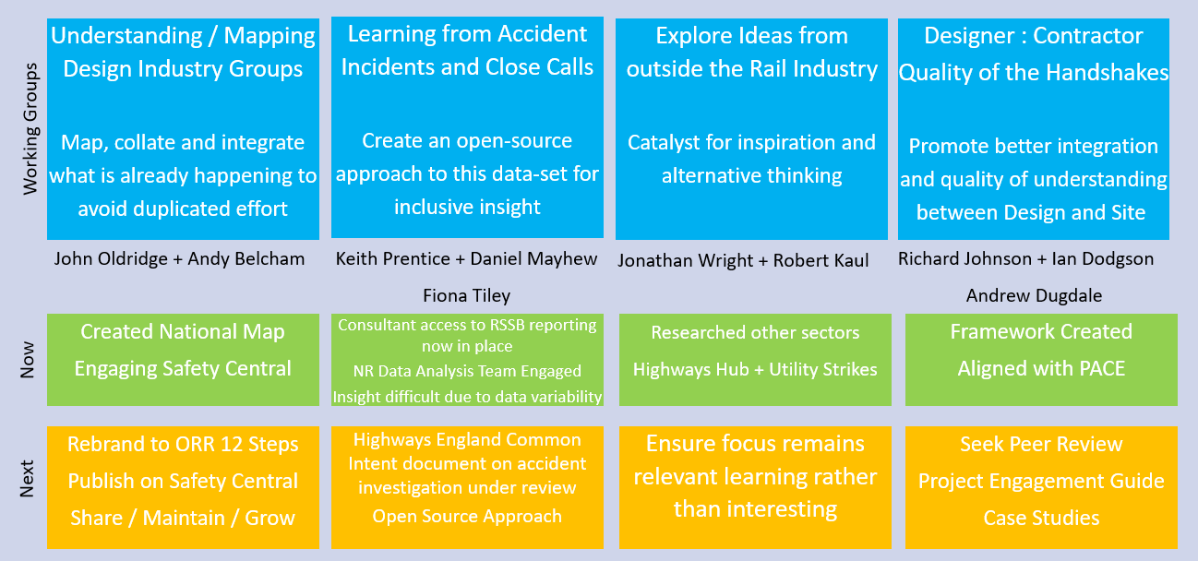
Better by Design
Overview - October 2021
Working group leads – Andy Belcham, John Oldridge
Promote a culture throughout the design process with a focus on integrating the activities and learning which will have a meaningful and direct impact on health, workplace safety and sustainability. ​​

Slide 15
High Potential Incidents / Risks
Overview - October 2021
Working group leads – Steve Jones, Paul Tuckett
Purpose & Objectives
High Potential Incidents are those incidents which on another day could have resulted in life changing injury or loss of life. They are therefore a most valuable source of learning. How do we ensure learning is communicated coordinated and embedded. Data Capture of OCC’s and HPI’s for 2019/20 from SHELT Members -Completed Analysis of data against primary causes of Competency, Complacency and Communication and capture of Best Practice Present Analysis findings Summarise Best Practice and propose branding for the 3 C’s Propose Way forward to sustain improvement

Slide 16
Sustainability
Overview - October 2021
Working group leads – Anna Humphries, Holly Bradley
Purpose & Objectives
This is a new Working Group. The Purpose and Objectives of this working Group will be decided at the October 2021 SHELT Summit.

Slide 17
Proposed Future Summit Dates
Overview - October 2021
19th October 2021 – Leeds
January 2022 – TBC
April 2022 – TBC
July 2022 – TBC

Slide 18































North West & Central and Eastern SHELT

