Slide 1
Signalling Shared Learning 21/01
Jan 2021
– June 2021

Slide 2
Introduction
This Shared Learning document details key issues and incidents that have occurred on Signalling Projects between January 2021 and June 2021 and provides the key learning points associated with them.
It is intended for distribution within the Network Rail Signalling community and the Supply Chain in order to raise awareness of the learning points within, and to enable best practice to be applied throughout all of our signalling activities.

Slide 3
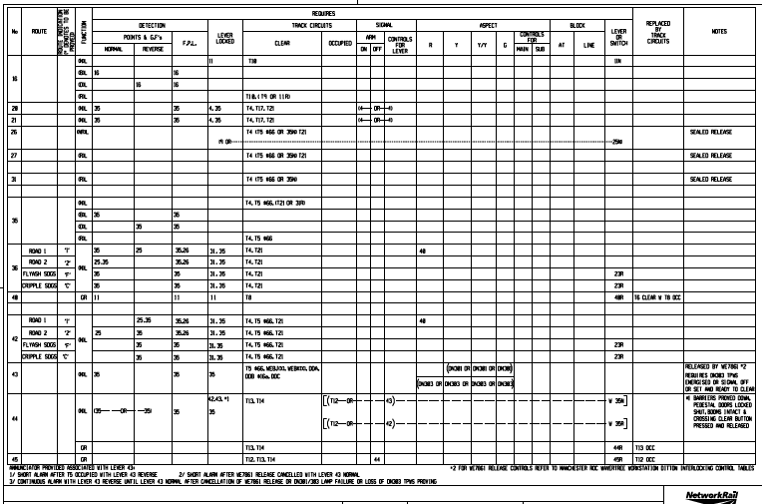
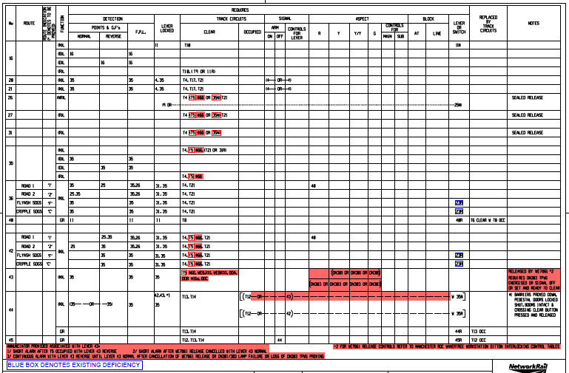
Digital signatures
Background
On a recent project, design was produced as a digitally signed soft copy and issued to the DPE for acceptance. A hard copy was also printed from the digitally signed master and sent to a Principal Engineer for independent review.
During the review it was noted that the hard copy control table depicting the majority of the works was signed, produced and checked but no red work was shown. This was present on the DPE’s soft copy, but they had noticed that the highlighting could be moved or deleted. It was further noted that the AIR sheet did not list the NR acceptance copy, and was not signed ‘prepared for issue’. This would normally signify that a check had been completed to ensure all drawings listed are present and were an accurate copy of the signed master with regards to colour balance, etc.
A Close Call was raised and it subsequently became apparent that the supplier was not following their own work instructions relating to digital signatures.
Key Learning
There have been a number of instances where the design has been able to be altered inadvertently or the coloured work is missing or changed. This leads to the potential for incorrect design being used on site.
It is important that designs are locked before being issued.
Further information can be found in NR/L2/INF/02237 Electronic Signatures

Slide 4
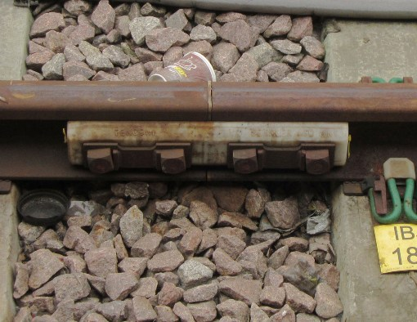
IRJ recovery
Background
A contractor was to undertake the recovery of a redundant IRJ associated with the berth and overlap track circuits for a repositioned signal’s former location.
The signal had been replaced with a new structure previously, and the redundant IRJ bonded out. An earlier walkout had taken place to survey the IRJ to be recovered, using PWay design which had the signal’s former position marked on it and the joint “greened up” to be recovered. On the night of the works the new signal was used as a reference point and the IRJ there was removed, failing two track circuits.
An investigation found signalling staff were under pressure from the PWay team, and did not take time to fully understand the details of the work.
Key Learning
Complacency had crept into the wider team with regards to lack of paperwork and suitable representation on the initial walkouts.
Project staff must be sure they fully appraise themselves of the work situation they are in, and not bow to the pressures of others when carrying out their duties.

Slide 5
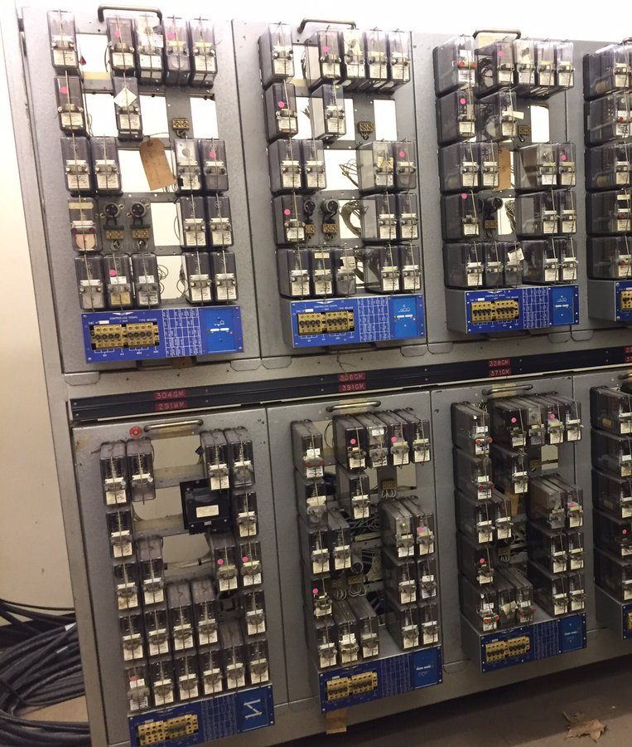
Loss of points detection after TORR
Background
Whilst replacing an FDM remote control with a TDM at a Geographical interlocking, control and supervision was transferred from a local panel to a remote workstation. The interlocking controls a passing loop on a section of single line.
Shortly after, the signaller reported a loss of detection on a trailing set of points after a train movement had initiated TORR. The points had been keyed normal during the incident due to an unrelated issue. Investigation and testing revealed that route cancellation, either by TORR or manual intervention, caused loss of detection to be indicated on the points. It was observed that a latched NWR relay was being de-latched during route cancellation. Removing the feed to the latched relay caused it to de-latch. The changes made required creation of a repeat of the initiation level DN X UNR relay. A front contact of the repeat relay was used in the subsequent completion and proving levels.
Key Learning
After accessing data logs, further investigation revealed that the use of the repeat relay caused the Completion level to release milliseconds after the Initiation Level, with the effect of momentarily energising the point’s RWUR relay.
Due to a phenomenon whereby BR935 relays can be unlatched by a circulating back EMF, the momentary removal of the positive feed on the latched NWR caused a de-latch of that same relay. The failure mode was rectified by cutting a contact of the primary relay DN X UNR back into both the Initiation Level and Proving Level.

Slide 6
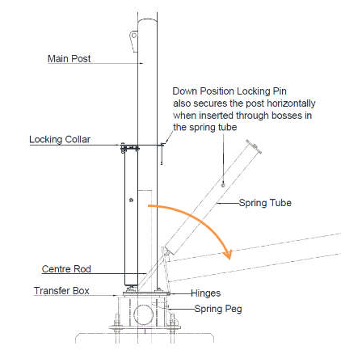
Lightweight Signal Post Operations
Background
An incident occurred when a team of testing staff were undertaking signal sighting checks on an LED signal head, which was mounted on a Hinged Lightweight Signal Post. The signal had been placed in the lowered position to prevent obscuration of an existing operational signal. When raising the signal structure to the upright position, the staff felt the weight of the structure increase significantly. At this point they were unable to continue to support the structure and it fell back to its lowered position in an uncontrolled manner.
Key Learning
Other than those involved in the lifting operation, staff should ensure they remain outside of the drop zone/area of the post and signal, in a position of safety.
Employees are reminded that no one other than the manufacturer shall make any alterations or modifications to Hinged Lightweight Signal Posts.
Notice Board 193 provides details of checks required to be carried out prior to any lifting or lowering operations.

Slide 7
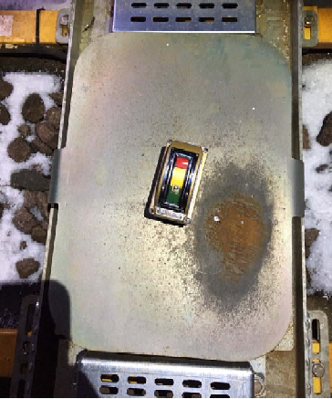
AWS shields
Background
Shortly after a signalling commissioning, several trains reported AWS errors. A faulting team discovered three AWS magnet installations still had shields on them. Two magnets were associated with a PSR, the third with a signal.
Investigations discovered there was confusion as to who was responsible for removing AWS shields.
Key Learning
Removal of shields from AWS should be a pre-planned activity undertaken during the commissioning and included on the installation recoveries list.
Clear and unambiguous arrangements must be made for their recovery.
Consideration should be given to the inclusion of critical recoveries on test certification.

Slide 8
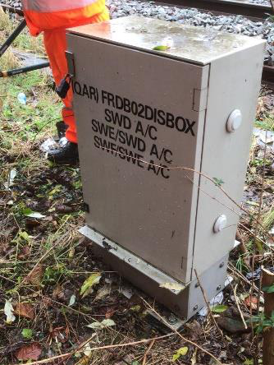
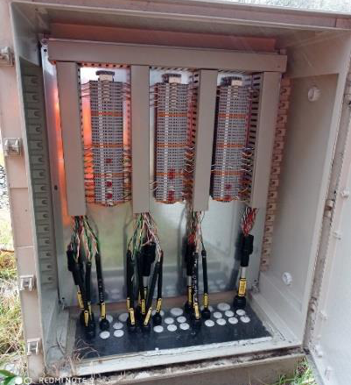
Axle counter detection points
Background
A signaller was unable to restore several axle counter sections to operation after a project possession hand back. A Network Rail fault team later identified crossed cables between two axle counter detection points. They corrected the error and the axle counters were successfully restored into use.
A contractor had been undertaking works on the axle counter cabling prior to the failure.
Investigation uncovered an error had been made in the renewed disconnection box wiring which crossed the data communication links between the evaluator and detection points. It was also discovered that specified testing had not been completed correctly. Inclement weather and the ergonomic design of the housing are also believed to have contributed.
Key Learning
Test Plans should be verified that they translate all specified tests to an allocated task.
Test certification/checklists must include comprehensive lists of all equipment affected by the work.
Open actions/incomplete tests are to have effective mitigations in place prior to restoring system into use.
The mounting positions of equipment housings/Disconnection Boxes should take cognisance of end user ergonomics as part of the design, a CDM requirement.

Slide 9
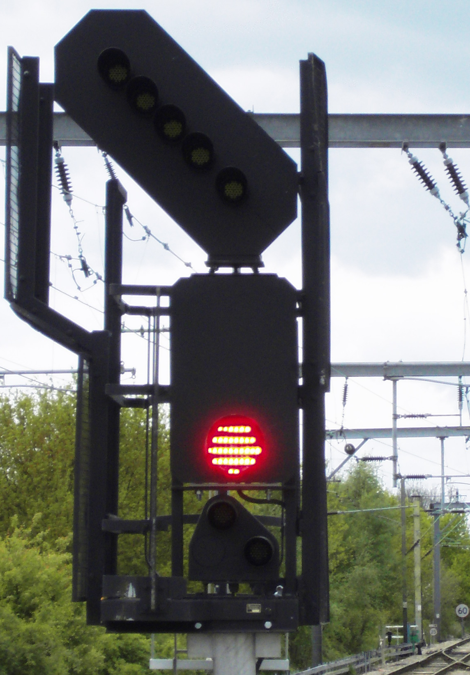
Uncommissioned Lock Out Devices (LOD)
Background
Some Lock Out Devices were being pre-tested prior to a commissioning, having been installed but not brought into use some time earlier. A tester was to confirm that all the components were present. Believing the LODs to be out of use, the tester undertook an additional test to ensure that the switches hadn’t seized. Although not formally commissioned, the LODs were live in the signalling circuit. When the key switch was turned, the proceed aspect for a cleared route returned to red.
Key Learning
Uncommissioned Equipment
• No uncommissioned equipment should be left connected in operational circuits. A design mod must be provided to leave a safe and compliant solution
• Where this cannot be achieved during a commissioning period, a test log must be raised and a suitable instruction prepared for both the signaller and maintainer
Pre-Testing
• Where any additional testing is undertaken, the tester must take reasonable measures to ensure that the testing is isolated from the operational railway, including a review of signalling drawings

Slide 10
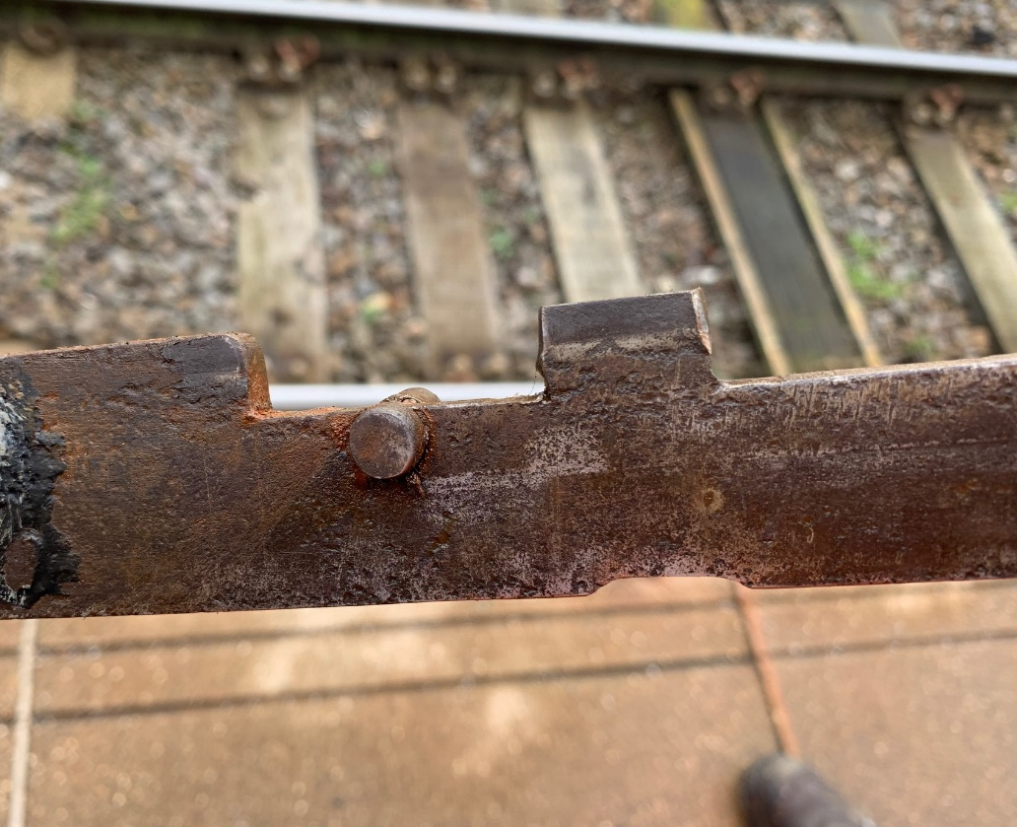
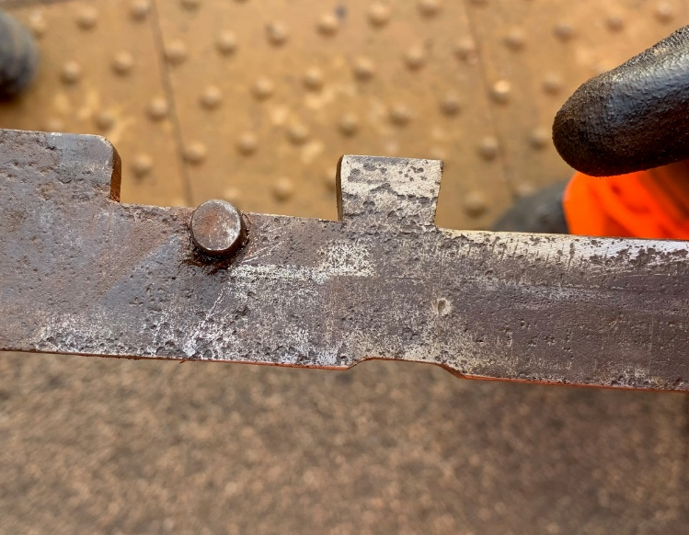
Electric lock face
Background
After commissioning of a new tokenless block system, the lead tester discovered that a signal lever could be put straight back into the frame without being held in the “check” position. The cause was a worn lock blade, allowing it to force the gravity held lock dog up and clear of the lock face. The same issue was then found with a second signal the following night.
Key Learning
The testing process should follow the maintenance procedure which should highlight any issues.
Guidance given in SMS/LV21 service B should reveal any issues.

Slide 11
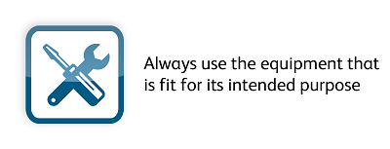
Signal blank aspect
Background
During work to install new relays, terminals and fuses in a location case, a signal blanked out. This is believed to have been due to contact between the Location case terminals and the installer’s non-insulated tape measure.
Key Learning
Staff are reminded to follow NR’s Life Saving Rules, and have the correct tools for job.
Staff should be only be issued with insulated tape measures.
Projects should also consider a review of installer training, and carry out an increased risk assessment of works in operational equipment housings.
The use of non-insulated tapes and other tools can have much bigger consequences than causing short circuits, and can lead to significant electric shocks.

Slide 12
Further Information
For any further details or information please contact:
Chris Ruddy: Senior Project Engineer, Route Services – Engineering Services
Tel: 07799 336772
email: christopher.ruddy@networkrail.co.uk

