Slide 1
Signalling Shared Learning 20/02
July 2020
– December 2020

Slide 2
Introduction
This Shared Learning document details key issues and incidents that have occurred on Signalling Projects between July 2020 and December 2020 and provides the key learning points associated with them.
It is intended for distribution within the Network Rail Signalling community and the Supply Chain in order to raise awareness of the learning points within, and to enable best practice to be applied throughout all of our signalling activities.

Slide 3
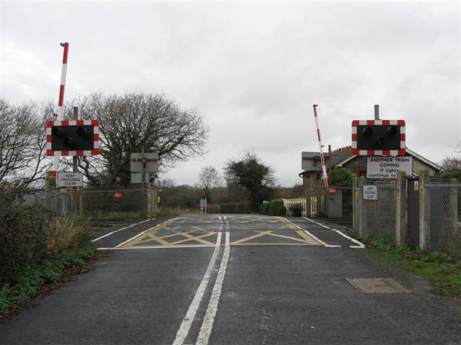
Level Crossing “race” condition
Background
A dis-engageable Auto Signal protecting an AHB (with local relay controls) in an SSI area experienced a ”race” condition affecting its operation. The signal was non-route setting; it had no interlocking function and no route lights on the VSCS (MCS). The AHB had Stopping and Non-stopping controls.
With the signal showing a red aspect, the signaller took it out of auto working and applied a reminder device. The arrival of the next train caused the signal to clear and it appeared to continue to behave as an auto. The signaller found it could only be reliably maintained at danger by replacing manually (‘pulling the button’).
Suspicion first fell on the operation of the reminder device in the MCS but this was quickly disproved. A simulation of the sequence of events described by the signaller was able to replicate the condition.
An error in the design of the signal controls was identified – there was a “race condition” between the track-repeat/crossing relays and the SSI which prevented the signal stick function disengaging. The situation did not occur for every train, but the probability of failure was high.
The SSI outputs ‘signal ready to clear’ to the crossing, receives a ‘GR energised’ input back when the regulation controls are satisfied, then clears the signal:
If the SSI registers the replacement track section occupied with the GR input still present (signal ‘Off’), the signal stick disengages correctly
If the SSI loses the GR input before it registers the replacement track section occupied, the signal will be replaced but the signal stick will not disengage and the signal behaves as if in auto mode, even when this has not been selected. NB: the replacement track section is included in the GR locally at the crossing
The TFM allocation was unfavourable and in terms of timing, increased the probability of the fault condition occurring.
The designers did not consider the prospect of a timing issue at this interface and did not conduct a timing analysis.

Slide 4
Level Crossing “race” condition contd.
Key learning
Seemingly simple designs can contain ‘traps for the unwary’. The designers were on a learning curve for new technology and considered the SSI/RRI interface to be comparatively straightforward, so their focus was placed elsewhere. There was no capacity for critical thinking about the simpler aspects of the scheme.
Designers and checkers should not be distracted by novelty and complexity to the extent that the more conventional features do not receive rigorous scrutiny.
On relay and SSI interfaces, designers should give timing issues due consideration.
NR/L2/SIG/30014/F210 The Verification & Validation of Electronic Interlockings, gives Testers guidance on interlocking interfaces:
“One specific case relates to track circuit equipment and is sometimes known as Tollerton Controls. Other interface situations shall be given careful consideration”.
Some timing issues are covered in the various chapters of SSI8003 SSI applications manual and associated DIS papers.
Whilst Tollerton is generally well documented and understood, other areas are not and require specific analysis.
The possibility of timing issues between all SSI and relay-based interface controls should be reinforced to the Design and Testing communities.

Slide 5
Camaster 32 terminations
Background
Some recent incidents have led to the need to highlight some issues with Bussman Camaster CM32F fuseholders, and to clarify the requirements for those projects where these fuseholders are installed. Walkouts carried out as part of pre and post commissioning checks have identified loose terminations on new projects. A trend has also been identified following a number of post-commissioning service affecting failures where the cause has been directly attributed to Camaster 32 fuseholders.
When the screw terminal is fully undone to accommodate a conductor wire, there is a possibility that the U-clamp has not moved sufficiently to accommodate the conductor, which could lead to the conductor being installed behind the clamp or catch on the U-clamp itself. As the screw is tightened, the installer could believe the wire is correctly installed, which may not actually be the case.
The screw terminal must be fully undone to open the cable entry fully, and when terminating the wire pressure should be applied on the screw head to provide a sufficient opening on the U-clamp to allow the conductor to pass through freely.
Note the screw is not captive, care should be taken by technicians carrying out installation work.
Wire insulation should be stripped to 10mm, markings are provided on the rear of the CM32F for guidance. Crimping of wires is not required.
All installations should be checked by means of a pull test to check for security.
In many cases, the CM32F is mounted very low in the location case which can make it difficult to terminate wires correctly. Furthermore, the proximity of the cable trunking can also make it harder to perform a pull test on the wiring in these instances.

Slide 6
Camaster 32 terminations cont.
Key Learning
Key learning differs for those specifying or using Camaster 32s:
Designers and location case builders:
Camaster position to be raised greater than 300mm from the location base and detailed on the location layout to achieve a better position for installation:
• The fuseholder shall be provided with a minimum gap of 70mm above and below to allow for sufficient space to terminate
• Minimum wire gauge of wire is 2.5mm²
• Maximum wire gauge of wire is 16mm²
Installers:
Crimped terminations are not to be used:
• Strip 10mm insulation from the wire to allow the conductor to fully enter the tunnel
• Stranded wire shall be tightly twisted together to make sure all strands enter the tunnel
• Slacken off the screw to open up the pressure plate fully
• Whilst the wire is being inserted, firmly press the screw head inwards to ensure the clamp plate remains open and cannot close up whilst the wire is inserted; this will allow the wire to locate into the correct position
• Tighten down the grub screw to close the pressure plate upon the wire
• Check that the conductor is gripped by performing a tug test

Slide 7
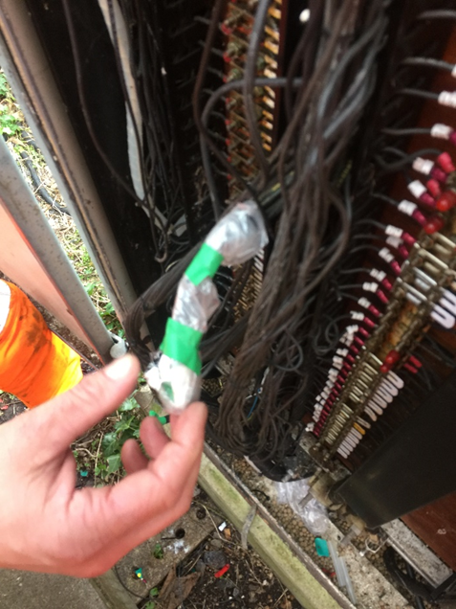
Poor insulation on partially recovered cable
Background
A project agreed that the planned commissioning was unachievable two weeks ahead of the date, and a plan B for partial commissioning was created.
During the partial commissioning only a handful of signals were changed over and some level crossing furniture renewed, but kept on existing controls.
Numerous design changes (mods) were implemented, in some cases on the same day. During a Network Rail post commissioning survey, it was noted that a plastic bag was covering what appeared to be a partially decommissioned cable dating from several months prior to the partial commissioning.
Key Learning
Investigations found the cause to be an error by a tester/installer team carrying out the changeover not complying with either the Testing Plan, or Network Rail company standards. There was insufficient attention to the planning, execution and quality assurance of the recoveries.
Investigations also highlighted some minor inconsistencies identified in Network Rail’s standards governing redundant assets and the insulation of unterminated wires, which could be potentially misleading. However, installation and testing teams should endeavour to comply with all NR company standards and testing documentation where possible. Particular care must be taken with redundant or partially redundant cables and the insulation of redundant cables/cores.

Slide 8
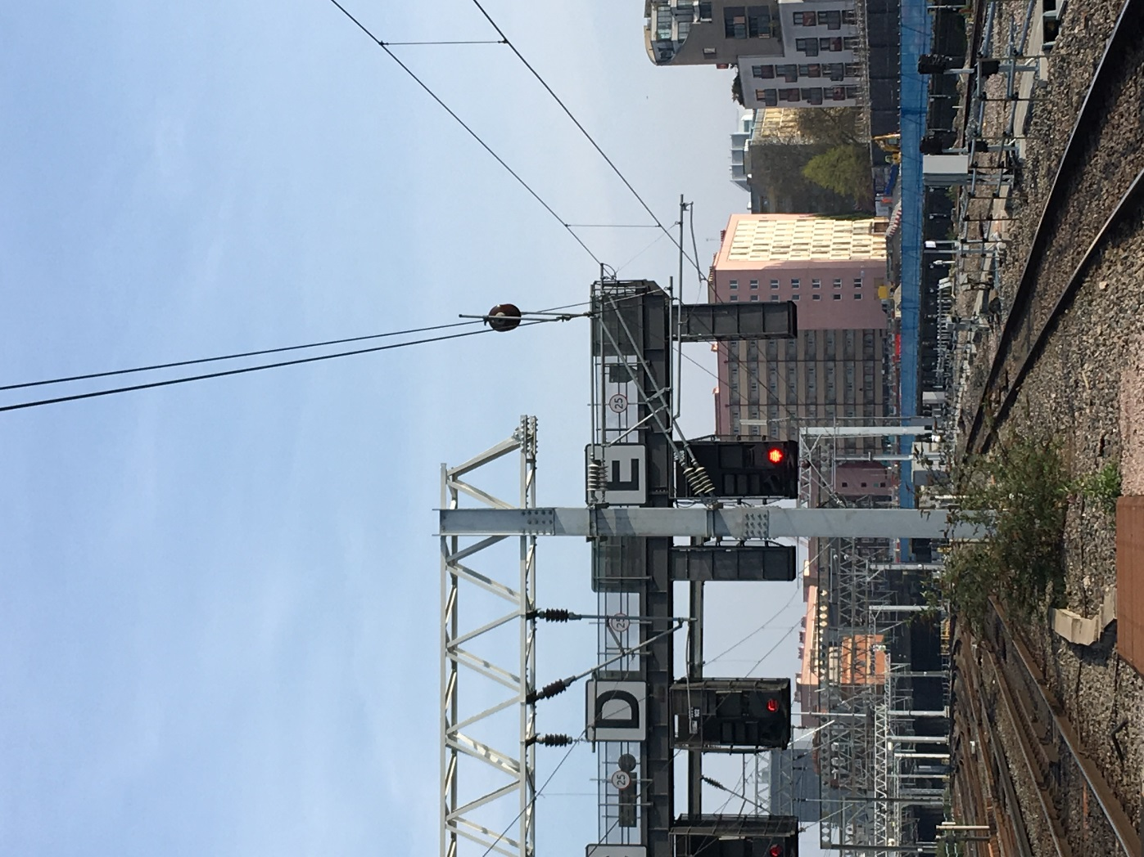
Indicator obscured by new OLE
Background
A train driver reported that a new OLE registration arm was obstructing the view of a signal route indicator (SARI).
Investigation revealed that due to an OLE redesign for forthcoming works, a non-compliant obscuration of the route indicator had occurred, resulting in a probability the driver could misread the platform number displayed.
Key Learning
Projects must not only consider the implications of stanchion positions, but also the apparatus attached to these structures and how they may affect the visibility of existing apparatus. Interdisciplinary checks and reviews (IDC/IDR) must be completed with all relevant disciplines.

Slide 9
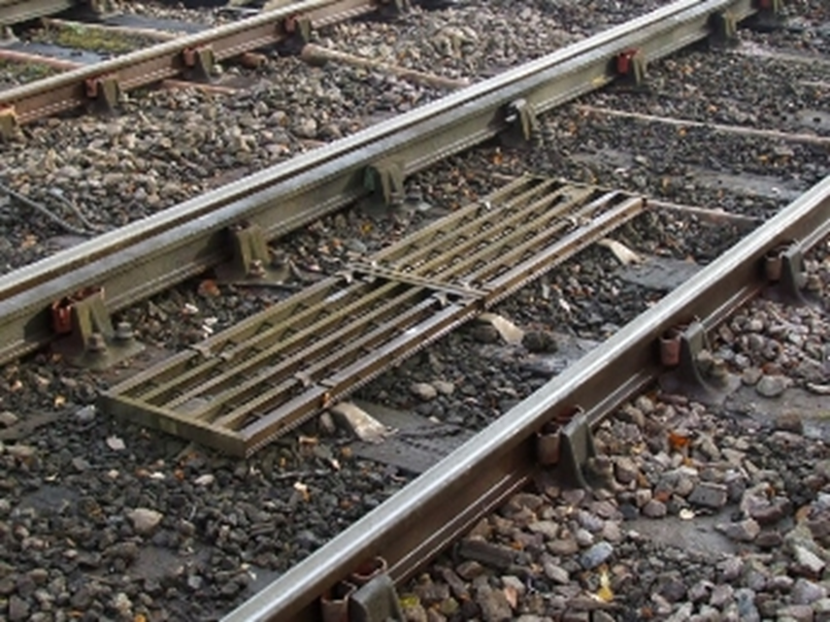
Erroneous TPWS Energisation
Background
Trains travelling through an area of project under construction with items of apparatus installed on site experienced multiple TPWS activations.
Investigations revealed E&P construction teams had energised feeders to PSPs which had all their fuses and links inserted, leading to new location cases and their associated apparatus becoming operational, including the un-commissioned TPWS loops.
Key Learning
It is believed a change of practice from a supplier meant apparatus arrived and was installed with all fuses and links present. Projects should check with their own suppliers and with apparatus installed on site that fuses/links not needed for testing proposes are not installed, or are removed prior to testing activities.
Projects may also wish to consider using an energisation plan.
A similar incident previously occurred, details are in Shared Learning 19/02.

Slide 10
Erroneous TPWS Energisation 2
Background
An incident occurred following re-railing work, where a TPWS Train Stop System (TSS) was re-instated with the cables to the arm and trigger grids transposed.
This error resulted in several trains receiving an unwarranted emergency brake application and left the network unprotected should trains pass the associated signal at danger.
Following the incident it was also found that the location case record cards had not been completed satisfactorily.
The requirements of the SMTH testing handbook must be followed at all times. Independence between installation and testing must also be maintained, as dictated by the SMTH process.
Key Learning

Slide 11
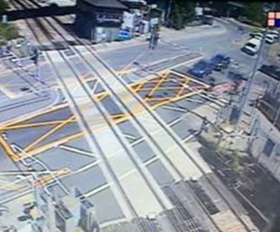
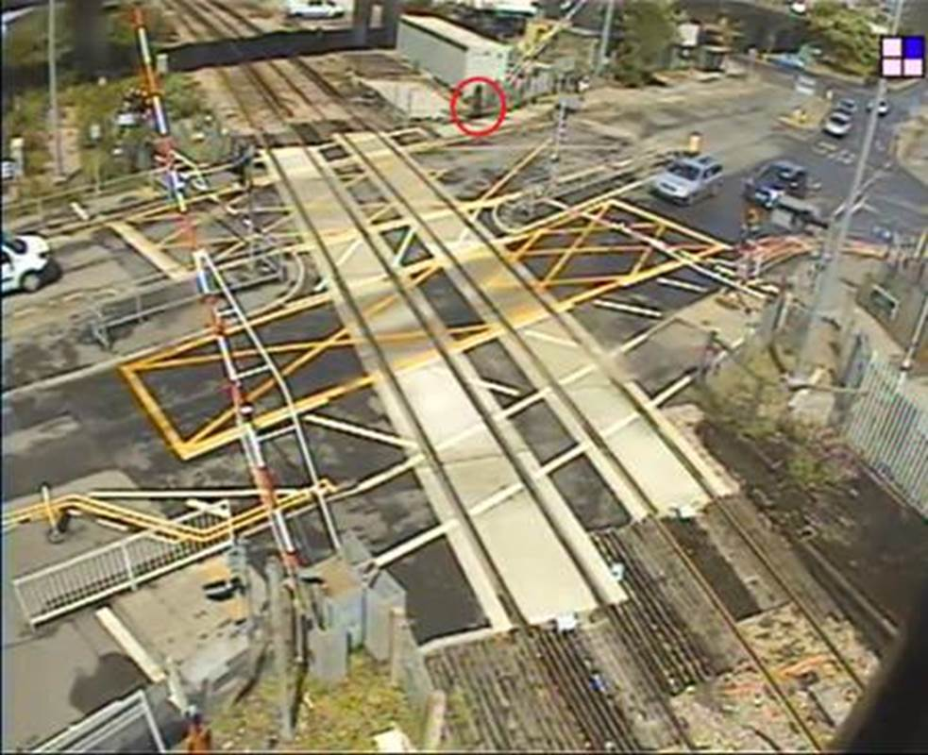
CCTV LX Close Call
Background
Following the demolition of a redundant signal box, a remote ROC signaller found it extremely difficult to identify pedestrian members of the public in CCTV images on their monitors. Prior to the works, the signal box had provided a clear background to identify these individuals.
Key Learning
Projects should consider making a formal assessment of changes to the built environment and to consider what the signaller may see as a result of their activities. They should also consider contrasting images and how these images may appear on signaller’s monitors.

Slide 12
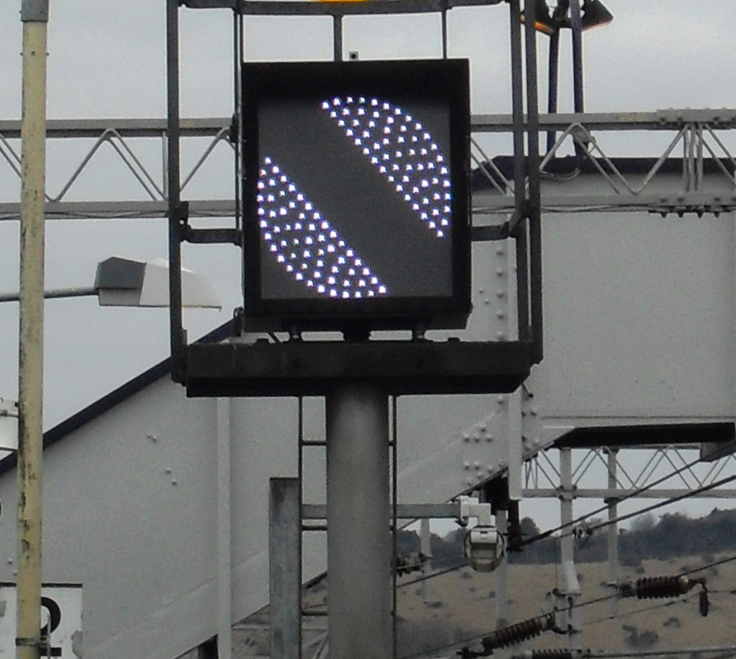
Blank banner repeater signal
Background
A train driver reported a blank banner repeater signal to the signaller in an area with a signalling project in progress.
Investigations discovered the banner repeater signal had been renewed like for like, on an existing structure. However, the signal head cable had been plugged into the dis-box for the new, un-commissioned location case rather than the existing location case.
Confusion with cable labelling and the existing/new signal IDs was found to be the cause. The new banner signal head had been supplied by the project, but installed by local Works Delivery. An informal process for stage works is believed to have contributed to the issue.
Key Learning
Documented control measures should be implemented for temporary or stage works. Communication and agreement on labelling practices should be implemented, especially when other parties complete work for resignalling projects.

Slide 13
Failed 650V termination stud
Background
A 650V power supply failed soon after work had been completed on it. A fractured termination stud was found to be the cause.
A laboratory examination revealed a stress related crack had occurred within the material of the stud, originating from a pre-existing manufacturing defect present at the thread root of the stud.
The stress related cracking within the stud would suggest that the fastener had also been over torqued during installation.
Key Learning
Projects should be aware that is possible to overtighten these terminations. Installers should use a suitable torque wrench and follow the manufacturer’s recommended settings when installing similar equipment.

Slide 14
Helical piles
Background
Several issues with helical piles have occurred on various projects in recent months:
Piles were not installed or tested as intended
Screw pile failure; excessive lateral movement of equipment support structure
Use of raked piles to increase lateral load resistance – following initial installation of vertical piles which could not resist the lateral loads
Helical piles may be specified for signal posts.
Key Learning
Helical piles must be designed, installed and tested to
prevent future failures during the specified design life of the structures, and comply with the following standards:
  CIV/003 including design check category
  CIV/020 Design of Bridges
  CIV/208 Guidance note – Ground Investigation
  CIV/071 Geotechnical design

Slide 15
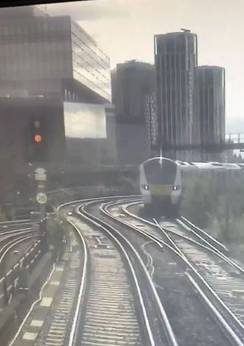
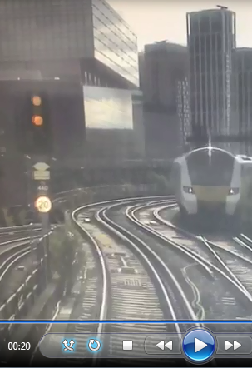
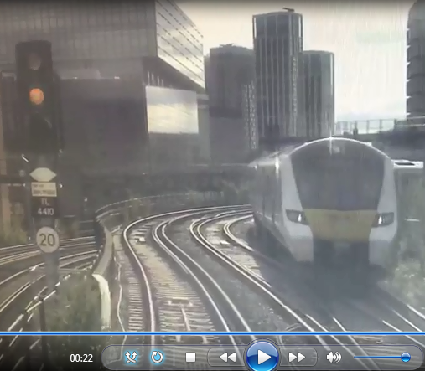
Phantom aspect
Background
A train driver reported a phantom top yellow aspect on a four aspect signal, in the evening low sun. A single yellow aspect had been expected.
A site visit discovered the signal head had not been aligned according to the signal sighting form. Further, the retaining clip of the lower signal module was not engaged and not in alignment with the top module, considerably affecting its luminosity. Low sunlight was considered to be the cause of the phantom aspect.
Key Learning
The effects of misalignment of the main beam and interior modules combined to increase the risk of a phantom aspect, especially where and when low sunlight can be expected.
The guidance given in NB179 should be followed at all times.

Slide 16
Incorrect fuse specified
Background
Following a signalling re-control project, a set of points failed with no detection. Fault finding identified a fuse in the 120V point drive circuit had ruptured. Further, the 6A fuse provided should in fact have been a solid link.
A design Mod was issued and the fuse replaced with a solid link.
An investigation revealed several design and testing processes had not been followed, any of which could have identified the issue and corrected it before the failure took place.
Key Learning
Projects may wish to consider a System Engineering approach, specifying functional interfaces with traceable requirements, and verify any design assumptions. A robust Design Interface Schedule (DIS) must be produced identifying all interfaces. Unofficial designs transferring preliminary information between disciplines must not be used as the checker’s source information. Power supply alterations must include a dynamic test to operate the supplied equipment.

Slide 17
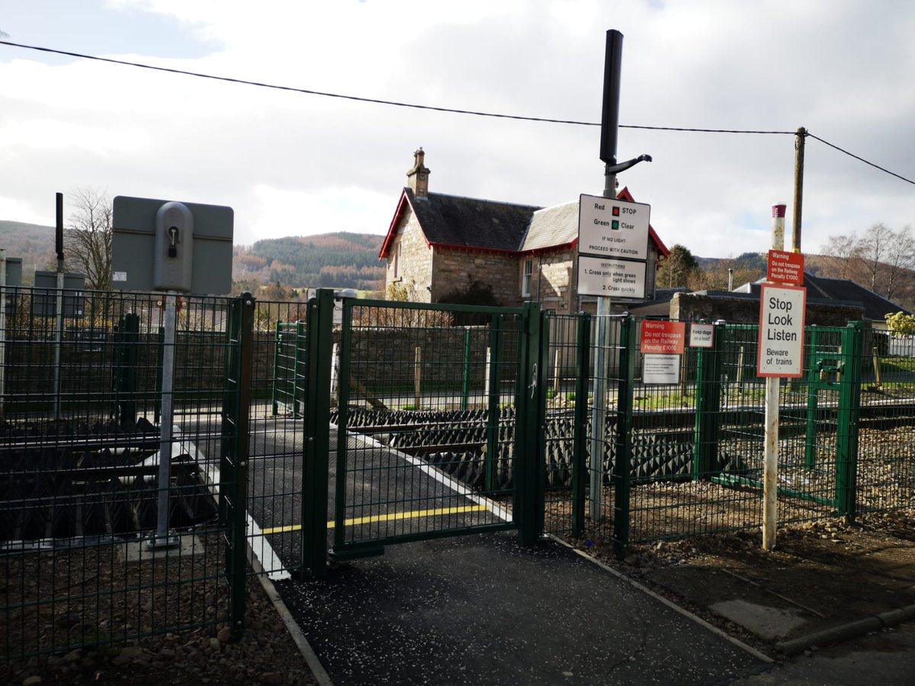
TC indication at UWC
Background
A signaller received a request to cross the line at a User Worked Crossing (UWC). The signaller checked the box diagram as a train was in the area, and observed that the track circuit where the level crossing was shown was clear, with the next track circuit occupied. Believing the train had already passed the UWC, the signaller gave permission for the user to cross. Shortly after, the user contacted the signaller to confirm they had crossed the line, however advised a train had travelled over the crossing once they opened the gates, after permission was granted.
Investigations discovered the UWC was shown in the wrong location on the signal box diagram, along with two additional UWCs. This followed diagram updates from a non-design organisation. Distance notation used was not consistent, i.e. used Miles/chains and yards on the same diagram.
This incident is very similar to a previous incident also regarding UWC diagram positions, at Lindridge Farm. See Shared Learning 008/14.
Further learning
All changes to signal box diagrams and workstation screens must be undertaken using a formal signalling design process. Position of any LX on a signal box diagram should not be taken for granted. Any alterations to diagrams should entail full correlation for accuracy, following standard design processes.
Distances quoted on signal box diagrams should use consistent notation.
Example of UWC

Slide 18
Incorrect Installation of Speed Sign
Background
During a review of sign sighting forms for a previously commissioned project, it was discovered that a speed sign had been installed in the wrong location.
The sign sighting form also had numerous errors, including incorrect and misleading diagrams showing an installed position in contradiction with the scheme plan.
The form itself was of poor quality with numerous errors, including erroneous diagrammatical depiction of sign type and positioning. This was believed to be the cause of the initial installation error.
Further, the execution of testing and the management of test documentation was not the required standard with respect to sighting forms and scheme plan verification:
• Test log management had been lax with Test Logs closed without rectification of the issues raised
• General practice of marking up testing pinks was poor
• Test certificates had been signed off with erroneous information
Key Learning
Management of the whole testing process is of the utmost importance and a project’s overarching management/quality assurance governance is key. This will also help to ensure that when concerns are raised they are formalised and tracked to enable remedial actions.

Slide 19
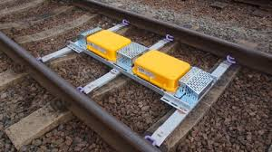
SMTH Testing anomaly - AWS
Background
Several train drivers reported a horn vice bell (AWS Code 2) on two signals. An investigation found that the supply fuses to the electro inductors had been removed, resulting in the failure of the inductors to energise. The magnets had been removed and replaced as part of a plain line track renewal the previous weekend.
The investigation established that although the AWS inductors had been removed and replaced as part of this track renewal, the required SMTH testing and entry into service had not been completed, along with the testing of the associated signal and SPT. The installation and testing had been split over two shifts.
Further learning
Where achievable, an overlap of shift times for the installation and testing shifts should be planned to allow for a face to face handover between staff. A process should be put in place to ensure that neither Tester or Team Leader leaves site before this handover has taken place. SMTH testing and installation staff are reminded of the requirement to ensure that fuses are not permanently installed until the functional testing of the equipment is about to commence.
Prior to Entry into Service, the Lead Tester must review all SMTH Log slips and ensure all testing is complete. This is to be checked against equipment listed on the RT3187 and Form D (where applicable).

Slide 20
Further Information
For any further details or information please contact:
Chris Ruddy: Senior Project Engineer, Route Services – Engineering Services
Tel: 07799 336772
email: christopher.ruddy@networkrail.co.uk

