Slide 1
Signalling Shared Learning 20/01
January 2020
– June 2020

Slide 2
Introduction
This Shared Learning document details key issues and incidents that have occurred on Signalling Projects between January 2020 and June 2020 and provides the key learning points associated with them.
It is intended for distribution within the Network Rail Signalling community and the Supply Chain in order to raise awareness of the learning points within, and to enable best practice to be applied throughout all of our signalling activities.

Slide 3
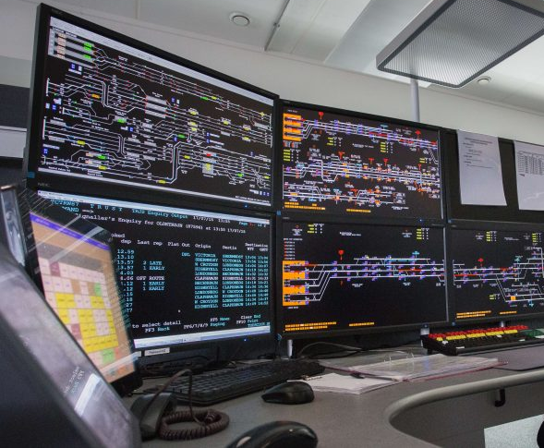
Signal Group Replacement anomaly in ROC
Background
During an unrelated regular maintenance test, a workstation controller reported a Signal Group Replacement operation. All signals had changed to red, however the signaller was able to clear the signals without removing the group replacement control.
Whilst the workstation operated both RRI and CBI, the issue was confined to the RRI area. Signallers had previously raised concerns re differing speeds of route setting between the RRI and the CBI. Some Signallers had resorted to sending multiple route requests to the RRI, believing that original requests had failed.
The Workstations were updated to include Interlocking Status Indications to overcome this, however during this change an error was introduced that rendered the prevention of Route Setting with the SGRC ineffective.
Key learning
It later transpired the workstation “quick fix” that had been implemented did not address dormant data that had been copied in from a previous installation. Changes made to implement Route Setting Available and I/L busy indications interacted with this dormant data. These changes significantly deviated from the standard system configuration with no further assessment carried out, and the testing of SGRC not identified as being necessary. A risk assessment is required to be carried out if redundant data is planned to be left in an interlocking.
Control system data changes must be tested, and any known dormant data should be removed, before implementing changes.

Slide 4
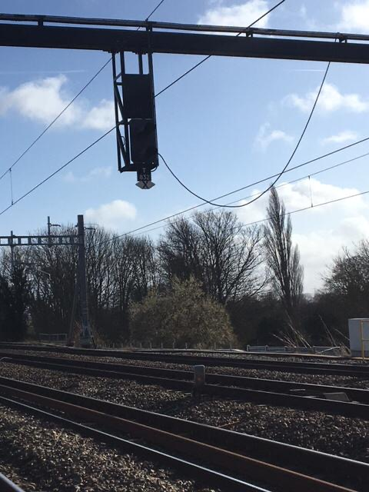
Insecure cable on gantry
Background
After a period of strong winds, a cable that had been secured to a signal gantry became loose, and arced from the 25kV OHLE causing extensive damage to the signalling apparatus. The equipment had been installed around 5 years previously.
Key Learning
Investigations highlighted standard nylon cables ties had been used to secure the cables to the gantry structure, contrary to NR/SP/SIG/19812 Cross Track Cable Management and NR/BS/LI/424 which states:
“New cabling shall not be attached to…
d) a cable tray or containment system using cable ties or fixings that are susceptible to degradation from heat, moisture and ultraviolet radiation within the design life of the system.”
This is believed to have caused the cables to come free.
Projects should ensure they install cable on gantries and other structures in line with this guidance, using an approved method of securing.

Slide 5
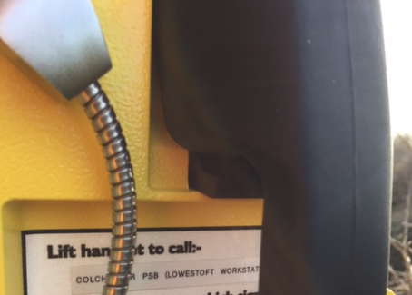
GSM-R phone handsets
Background
A project recently encountered issues with GSM-R phone handsets.
Two separate faults were reported, relating to a common manufacturing fault:
The handset cradle was not releasing cleanly
Inconsistent cradle release issues
The phone handset normally sits on a cradle that activates a microswitch, however the required 2mm tolerance of the gap between the microswitch and the PCB was found to be incorrect.
Seventy six handsets on the project required to be replaced.
Key Learning
Projects should inspect their phone stocks to ensure the handset releases cleanly from the cradle, prior to installation.

Slide 6
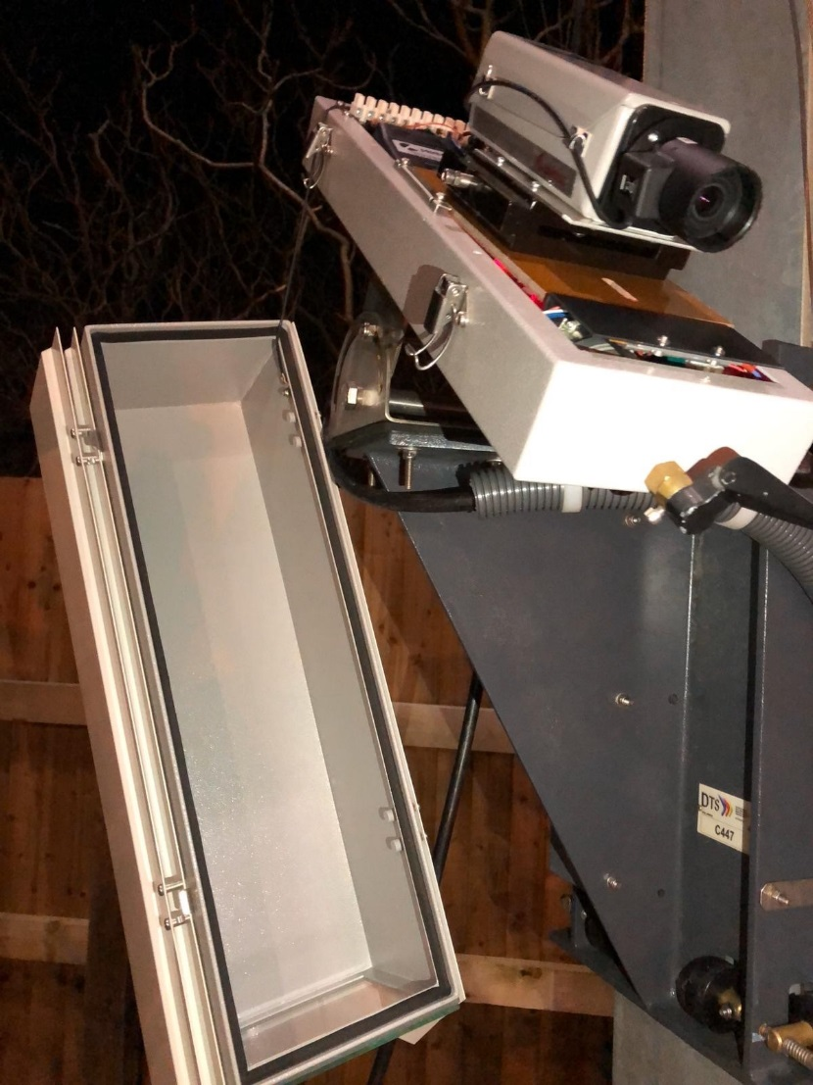
CCTV Camera Housing
Background
A recent project converted six level crossings to MCB-CCTV, using new camera housings under the product acceptance process. The cameras themselves were fully approved units.
Upon viewing from the signal box after installation, two issues were experienced:
Condensation on the housing glass
Partial obscuration due to the wiper blade
Investigation revealed that a cable entry grommet requiring silicon seal had been omitted, and air vents omitted in the housing. Further, the manufacturer provided the housing with the wiper not set up to site conditions. The wiper is provided with course and fine adjustment to allow the wiper to reach its full limit.
Key Learning
Installation of new camera housings should be fully inspected, sealed and tested prior to use, with wipers set up to site conditions where this function exists.

Slide 7
Cable cores diversions
Background
Shortly before a project commissioning, spare cores were identified for use on an existing cable, and tested for suitability. Upon commissioning, the cores previously identified did not pass insulation tests. A test log was raised and it was decided to modify the design, to make use of further spare cores in the cable. Site copies of drawings were amended to show straps applied, however the maintainer was not informed of the change.
Some months later, the maintainer was called to a fault. Commissioning copies were still on site, leading to further confusion regarding the marked up site copies and the straps that had been applied. The entire cable is now earmarked for complete renewal, requiring further drawing alterations to be made.
Key Learning
Where possible, the maintainer should be made aware of any changes to design left on site, and new copies of drawing made available. After commission, projects should leave “Maintenance Copy” drawings on site within the timescales mandated in Network Rail standards.

Slide 8
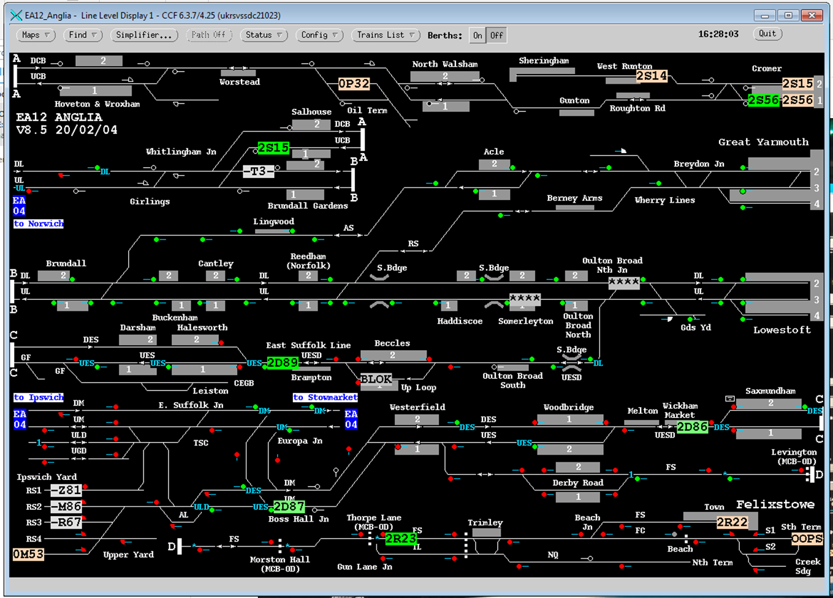
CCF Indications – Data Error
Background
A project required to provide TD updates to the CCF system at a signalling centre.
On the release of CCF data (v.4.25) to the project, it was noticed that all signals were green on CCF, however this was not the case on the MCS.
The root cause was discovered to be the signalling status bits (S Class Signal) the MCS was sending to SMART and other downstream systems had its logic inverted. This needed to be corrected at the source (TD Data).
A temporary fix was carried out to install a CCF data release on the server that removes the signalling indications but leaves the route set indications.
Key Learning
Projects should implement a thorough testing regime prior to uploading live updates, and consider the knock on effects to other interconnected systems.

Slide 9
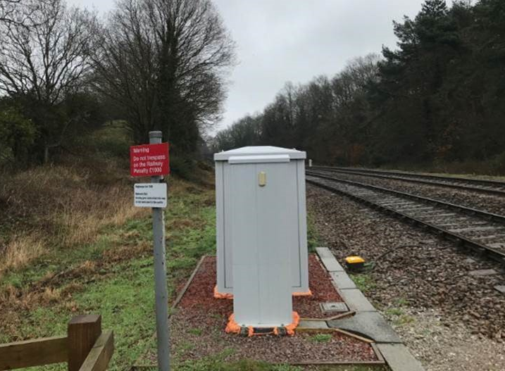
Loc Suite at UWC – Sighting Issue
Background
A project recently upgraded some User Worked Crossings, requiring location case suites to be upgraded, or renewed. At two separate crossings, the location cases were installed on the inside curve on the approach to level crossing, adversely affecting the user’s sighting of the crossing and approaching trains.
Key Learning
Careful consideration should be given to the position of apparatus on the approach to level crossings, where this may obstruct the view of the user, lineside personnel or train drivers. Location siting forms can be used to detail these requirements, or included as part of IDC/IDR.

Slide 10
SSI telegram delay
Background
An SSI and datalink system architecture revealed a potential issue with telegram transmission and time taken to be received, due to the cable diversity. The time taken for message packets to be sent and received was further affected by a protocol translation.
After several options to correct this were discounted, the final solution utilised Keymile XMC20 Multiprotocol Label Switching (MPLS) apparatus, reducing transmission time to an acceptable level.
Key Learning
The basic architecture of a project should be understood at GRIP 3 by producing a high level system architecture drawing to understand the telecoms requirements.
The telecoms provider should also investigate fibre diversity as part of the GRIP 3 National Safety Rules (NSR).
A propagation delay calculation spreadsheet is available from NRT which can be populated for an estimation of delay across the transmission system.
If diversity in FTN-X fibre is not currently available, this should be considered within the project GRIP 4/5-8 authority.

Slide 11
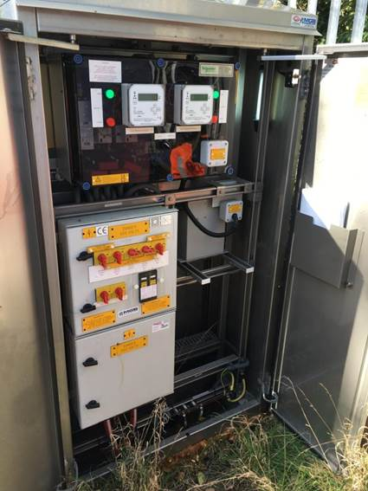
Electric shock from ASR
Background
An incident occurred where an E&P technician carrying out an internal Automatic Supply Restoration (ASR) battery voltage check suffered an electric shock. Their exposed arm felt an electrical discharge between the metal framework of the ASR unit and the metalwork inside the FSP. The manufacturer was contacted and they confirmed that this was due to the design of the product and not a result of the site installation. They have recommended that should the external cover require to be opened, the FSP ASR unit be isolated completely from the 650V ac supply (all three isolation switches opened). A temporary earth connection should also be made and kept in place, between the metalwork within the ASR unit and FSP cabinet earth, whilst the works are in progress.
Key Learning
The manufacturer's advice and all Network Rail work instructions should be followed when working on similar installations, and care taken when working on this apparatus. E&P Technical Advice Notice (EPTAN 091119) provides further detail.

Slide 12
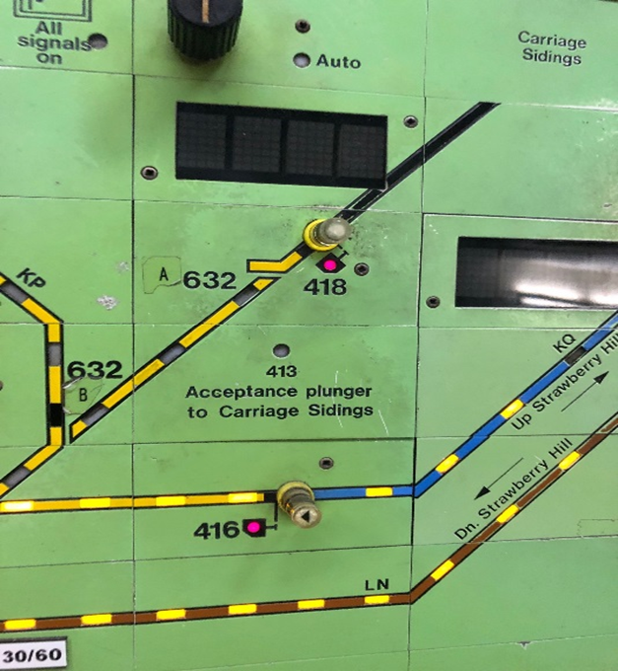
Acceptance plunger
Background
Shortly after a commissioning, Signallers raised a fault that they were not getting an indication on the panel when releasing an acceptance plunger into a local Depot. This was only an indication fault.
Upon investigation it was identified that positive looping that had been altered to remove some of the panel indications from a re-signalled branch line, had not been wired to design.
The positive looping was missing on the acceptance plunger circuit and as a result the system was entered into service with this fault. Additional issues discovered in the investigation were:
The labels on twin relay bases were the wrong way round. This was not identified under the (partial) correlation
The changeover was not completed to design
The affected circuits were not functionally tested after the changeover. This was because these circuits were not identified in the testing certification and plan
Key Learning
Recoveries could have been done at the IDF block and recovery of relays negating the need to alter the looping. Projects should give more consideration to correlation and having maintenance teams present to assist with more intrusive wire tracing. Testers should review whether the correct level of experience is used to prepare test plans and also if sufficient time is allowed in commissioning programmes for changeover.

Slide 13
RAIB Summaries of Learning
Background
The Rail Accident Investigation Branch has produced a series of summaries of the learning that has come out of its investigations into accidents and incidents in six topic areas:
Design and operation of User Worked Crossings
Protection of track workers from moving trains
Managing risk of train platform interface
Safe management of abnormal train events
Freight train derailments
Safe design, operation and maintenance of on track plant and trolleys
These are the most significant areas in which the RAIB have ongoing concerns about the control of risk in the railway industry. The summaries are intended to describe what the risks are and how they arise, what the investigations have found, and the important areas for safety learning.
They will be updated when they publish a new report or safety digest which deals with these topics.
The reports can be found at:
https://www.gov.uk/government/collections/summaries-of-learning

Slide 14
Good practice identified
Background
Recent internal audits of Network Rail’s signalling project delivery organisation have identified some good practice.
These included:
The use of a “DPE Register”, an MS Excel spreadsheet capturing a wide range of items a DPE is required, or may want to, keep track of
An updated and improved version of PAN40 Dashboard, showing a timeline of progress
Further learning
For full details of the good practice, please contact Chris Ruddy, Senior Project Engineer, Route Services – Engineering Services
christopher.ruddy@networkrail.co.uk Mobile: 07799 336772.

Slide 15
Further Information For any further details or information please contact: Chris Ruddy: Senior Project Engineer, Route Services – Engineering Services Tel: 07799 336772 email: christopher.ruddy@networkrail.co.uk

