Slide 1
Infrastructure Projects Signalling - Shared Learning 20/01
July 2019
– December 2019

Slide 2
Introduction
This Shared Learning document details key issues and incidents that have occurred on Signalling Projects between July 2019 and December 2019 and provides the key learning points associated with them.
It is intended for distribution within the Network Rail Signalling community and the Supply Chain in order to raise awareness of the learning points within, and to enable best practice to be applied throughout all of our signalling activities.

Slide 3
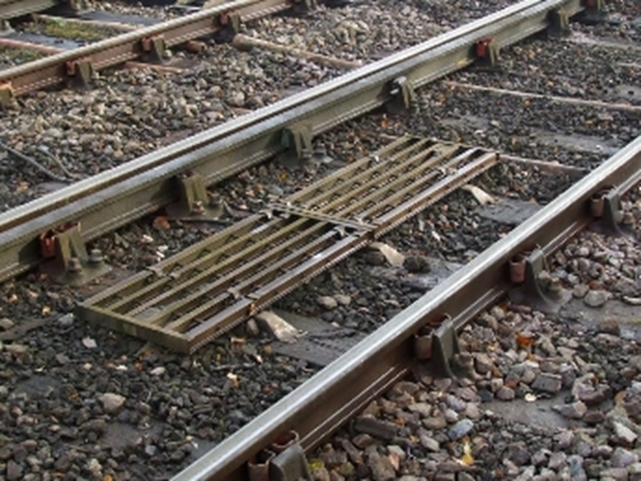
Inadvertent TPWS energisation
Background
During some pre-commissioning testing activities, members of staff energised some TPWS (Train Protection and Warning System) apparatus, by inserting fuses and closing links.
When they had finished the work they inadvertently left the fuses and links in place, leaving the apparatus active and in full working order when the possession was given up. A passing train was subject to a unsolicited brake demand whilst running on green signals.
Key Learning
Utmost care must be taken when operating and testing non-commissioned apparatus, and checks made when leaving site at the end of the shift.
When powering up apparatus temporarily for testing, consider using test straps and signing them out and back in, rather than using fuses and links.

Slide 4
Incorrect fuse pulled
Background
Staff were changing over surge units on SSI data links. Datalink B isolation was confirmed and changeovers commenced. However, the isolation fuse for equipment on datalink A was also removed. The signaller contacted the staff to inform that A and B datalinks had been disconnected. A signal changed to red as a train was approaching, it was unable to stop in time and passed the signal at danger (SPaD).
A report has been produced and updates the methodology for undertaking FURSE unit changeover project works going forward. A number of actions were identified and carried out locally.
Key Learning
Staff must ensure they understand the work they are carrying out and its effect on the signalling system, especially if during live train running. If in doubt, ask for a second opinion or do not carry out the work.

Slide 5
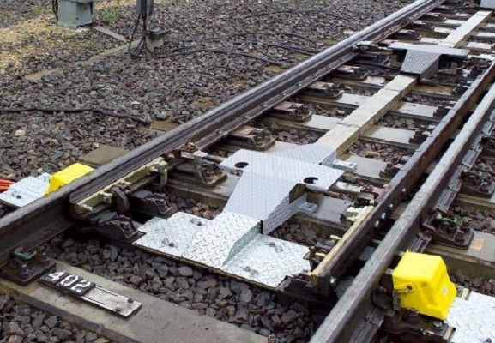
Clamp Lock Point Failure post installation
Background
Shortly after installation, an alarm was raised by the RCM of a new set of RCPL points due to high current.
Investigation showed that the oil level was low within the pump unit. Further, the FPL required adjustment, as the lock was engaged when using a 3.5mm gauge. The points also required additional lubrication.
Key Learning
New points must be installed, set up and commissioned by fully trained and competent staff, including checks for correct operation, including fluid levels, lubrication etc. after installation.
Where fitted, RCM and/or II apparatus should also be interrogated.

Slide 6
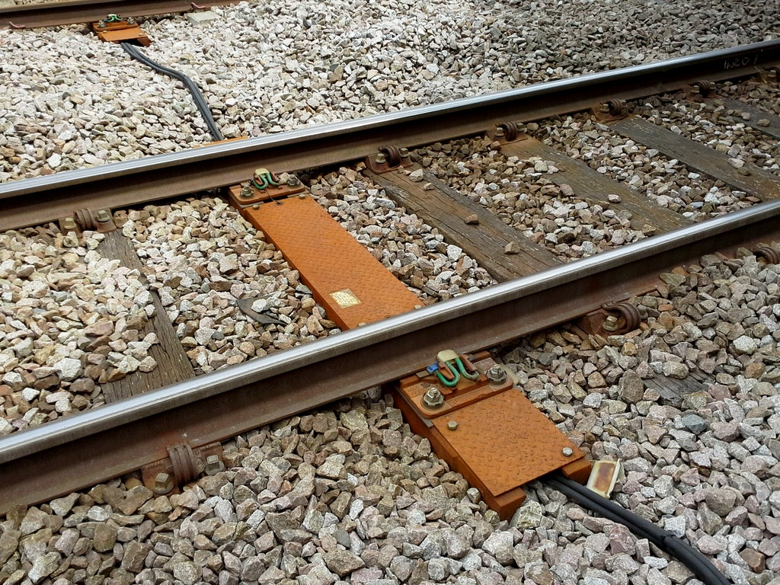
Hollow Bearer Installation failed Track Circuit
Background
A newly installed hollow bearer caused a track circuit failure. Upon investigation, it transpired that the insulation pads were either missing or incorrectly installed.
Key Learning
Projects installing hollow bearers must ensure they are installed correctly, and confirm any affected track circuits are unoccupied following the installation.

Slide 7
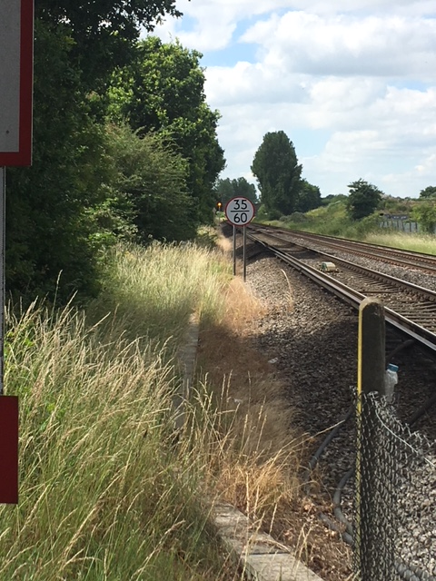
LX line of sight obscured
Background
A project recently installed a differential speed sign in the proximity of a footpath level crossing that obstructed the line of sight for users.
The sign required to be repositioned.
Key Learning
Sign sighting forms should be used for all new or repositioned signs, and checked for obscuration.
Particular care should be taken in the vicinity of level crossings.

Slide 8
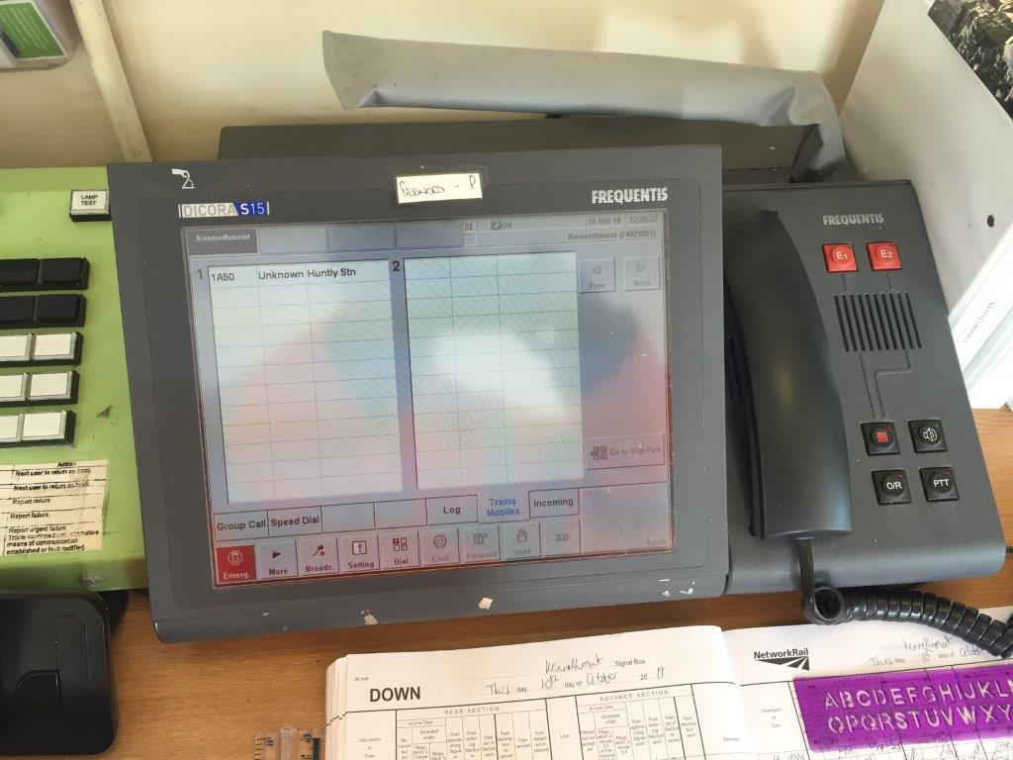
GSM-R Handset
Background
Post commissioning, a resilience train identified an issue with a GSM-R handset.
The project had intended to re-use an existing handset, reconfigured to a new signaller workstation, but the changeover did not happen. As a result, the Signaller was unable to receive calls at the new workstation.
Key Learning
It is important to ensure that requirements are clearly and unambiguously specified, and a clear understanding of the requirements is confirmed by all parties prior to implementation of the works. Thorough testing of all assets, including telecoms, should be completed.

Slide 9
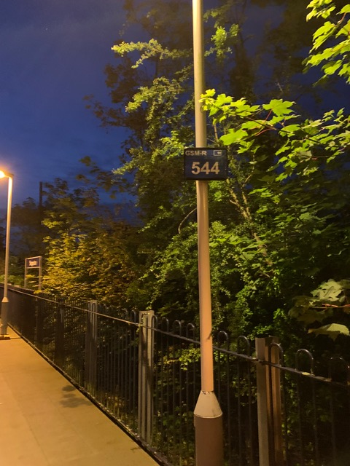
GSM-R Signage
Background
The same resilience train also discovered the GSM-R signage hadn’t been changed at a terminal station on the project.
The PAN61 application hadn’t stated that signage changes were necessary.
The telecoms contractor did not challenge the fact no signage was being updated, despite the fact the GSM-R database was being updated to reflect changes to signal IDs and TD berths.
Temporary signage was installed prior to the first train running.
Key Learning
Projects must consider all the implications of the changes they are making, to all affected asset types. A sign strategy should be considered for use.

Slide 10
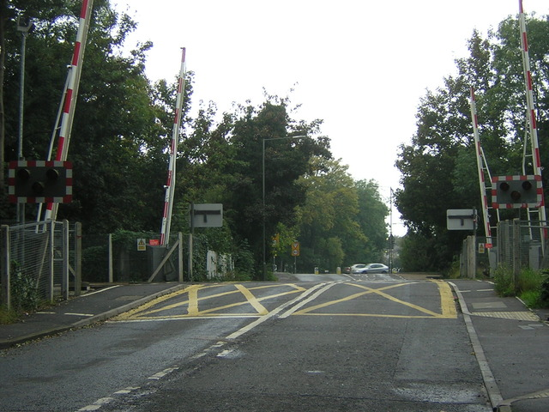
Level Crossing Anomaly
Background
A newly installed “push and hold” level crossing, consistent with others in the project area, failed three times in short succession.
A condition was discovered where if the Signaller releases the button early, before seeing down detection on both offside barriers, the barriers stop moving.
The barrier had to be power cycled locally on site to reset and remove the condition.
Signallers have been briefed on the issue, and it is seen less frequently. A software update was required to remedy the situation.
Key learning
Full testing of apparatus should try to include real life operation, rather than test scenarios.

Slide 11
TRUST reporting points
Background
TRUST gets train running information for ‘reporting points’, this is usually done automatically from the train describer but is sometimes manually entered. The system also contains the timetable comparing actual train running information to the timetable to determine how late (or early) a train is running.
TRUST works in half-minute increments rather than to the second. As the data is often derived from the TD, it is actually triggered by the train occupying the train detection section that triggers the TD step, rather then when it arrives at a particular station etc.
To overcome this, time is added to the recorded time to provide an approximate time of arrival.
Key Learning
Any significant change to train detection may affect a berth offset.
This can have a significant effect on performance reporting if it isn’t corrected.
Similarly, a platform extension project may also affect the offset.
For major projects affecting TD stepping/signal IDs etc., this should be considered as part of the updates.

Slide 12
CDM – Designer role
Background
Staff in a Signalling Centre TD Room reported a very strong smell emanating from one of the Uninterruptible Power Supply (UPS) batteries present. Investigation found the room did not have any external air vents, they had been removed during a remodelling of the equipment room. The Dangerous Substance and Explosive Atmospheres Regulations (DSEAR) 2002 Risk Assessment failed to identify the risk of battery outgassing, as did any CDM assessment.
Key Learning
Anyone who is undertaking a change to the signalling infrastructure is considered a Designer under CDM. All project staff should be aware of their obligations under CDM so that risks associated with installation, maintenance and operation can be eliminated.
Where it is not possible to eliminate these risks, the designer must, so far as is reasonably practicable, take steps to reduce or control the risks through the design process.

Slide 13
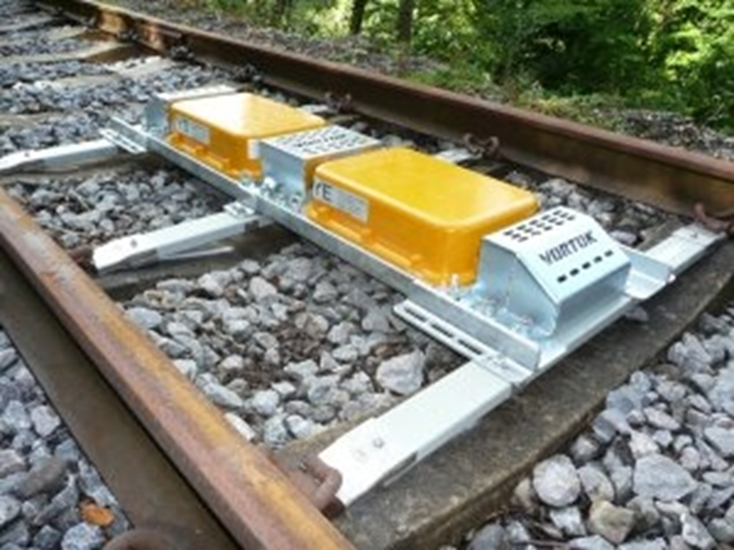
AWS water ingress issue
Background
A project has discovered some 24V dc AWS suppressor magnets were susceptible to water ingress.
Key Learning
Visually inspect apparatus prior to installation. Alternative magnets should be used if you suspect water ingress in any AWS components.

Slide 14
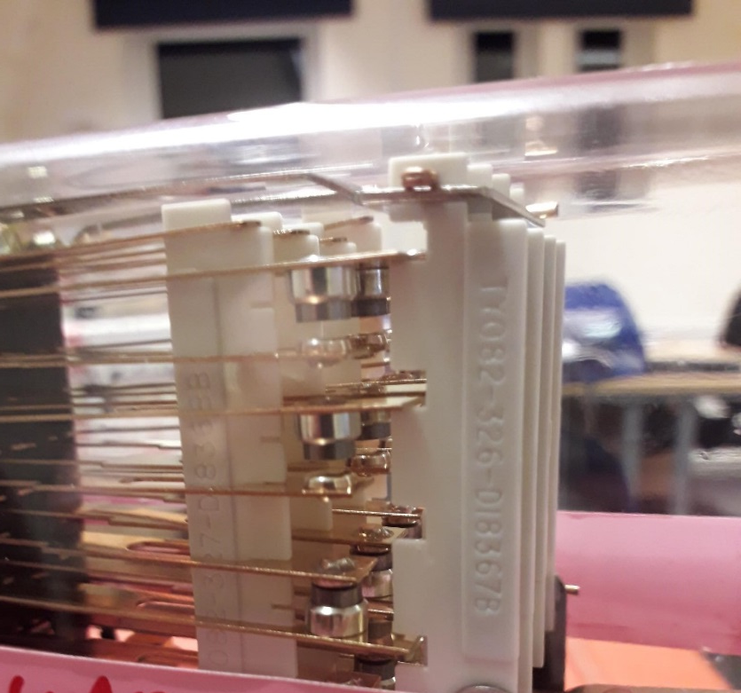
Relay issues - mechanical
Background
A project discovered a manufacturing fault with new relays, inspection revealed the problem was mechanical and affected more than one relay.
The vertical contact carrier which lifts and drops the contacts in the “A” row was not engaging the slot in the carrier/chassis on the yoke of the relay, causing the front contacts to be permanently made irrespective of the relay being energised of de-energised.
The relays in question were both manufactured by the same supplier and were PC 022 arranged in 8F 8B configuration.
The relays showed no sign of transit or mishandling damage, and were returned for inspection/investigation.
Key Learning
New relays should be visually inspected before use. Soak testing may help in identifying issues prior to commissioning.

Slide 15
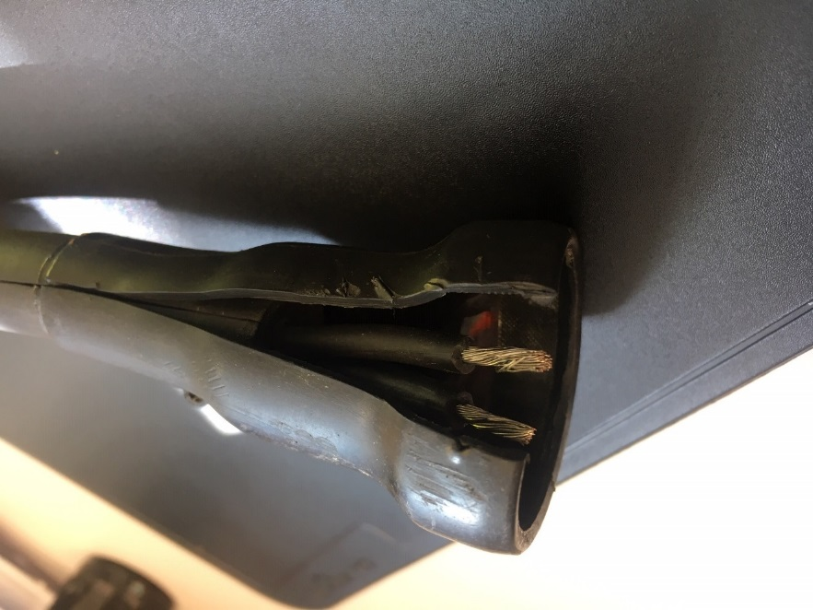
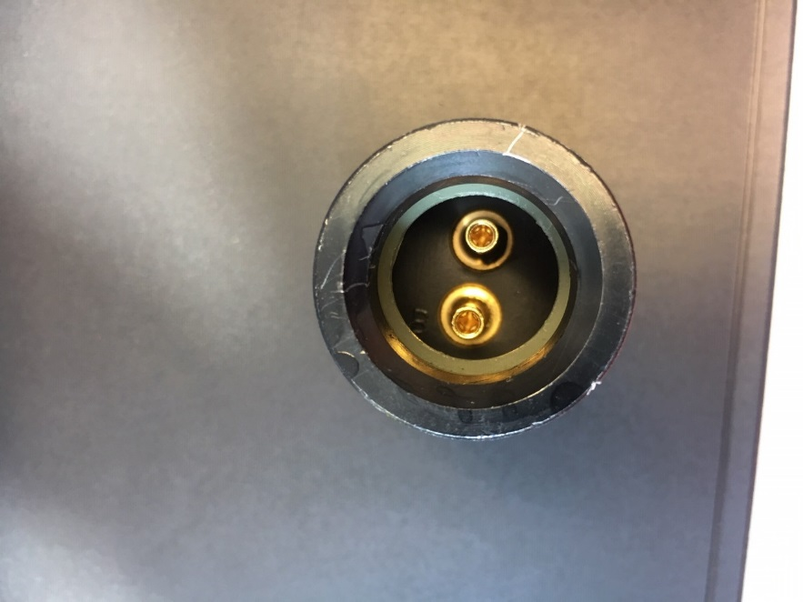
Plug coupler failure
Background
Following some cable recovery activity, a signalling failure (AWS Code 2) fault was reported. Local investigation discovered a failed, loose plug coupler termination was the source of the fault.
Key learning
Although this occurred during cable recovery works, this cable was not directly affected or involved in the recovery, and should have been able to withstand some gentle tugging.
Newly terminated connections should be given a tug test, and care taken during cable recovery activities.
The cable and coupler has been sent back to the manufacturer for further investigation.
Cable cores not correctly terminated
Pins still in receptacle

Slide 16
IP Signalling Engineering Close Call Trends
Background
After 12 months of data has been analysed, there have been some trends identified in engineering close calls. These are:
Construction not in accordance with design
Lack of consideration of “safe by design” principles
Lack of interface between design and construction
Late submission of test plans and/or testing documentation
Poor installation of trough route
Installation of incorrect access point/lineside signage
Signalling design process/technical acceptance process not followed
Key Learning
Identifying these trends allows us to choose associated controls to prevent re-occurrence, through briefings and sharing best practice. These trends can be reviewed at audit and assurance checks, and through supplier liaison and account meetings, to allow a review of the effectiveness of the controls applied.

Slide 17
Further Information For any further details or information please contact: Chris Ruddy: Senior Project Engineer - Process & Capability Tel: 07799 336772 email: christopher.ruddy@networkrail.co.uk

