Slide 1

Shared Learning
SL026/17 – Product Acceptance

Slide 2
Background
Experience has taught us a number of key lessons to enable successful introduction of new products to the rail environment and on changing the application of existing products to meet new requirements.
The Product Approval Process (NR/L2/RSE/100/05 ) and Design For Reliability (NR/L2/RSE/0005 ) are key processes in enabling projects to achieve this successfully.
The intent of this Shared Learning is to remind all our teams of the formal arrangements which lead to this success and where support and resources can be found.
Links to all relevant standards and processes can be found on the Product Acceptance Website.

Slide 3
Background
Projects need to consider the product acceptance status of all products to be utilised, during the development phases of the project. NR/L2/RSE/100/06 ‘How to Decide What Needs Product Acceptance’ is a useful reference if you are introducing new products.
Plans shall be made to progress and monitor product acceptance of all unapproved products, or new or novel applications of approved products; to achieve full or trial certificates prior to commissioning.
Equipment & Materials Acceptance Status Monitoring is a best practice process for this.
Product Acceptance (PA) Certificates contain much useful information about the application and restrictions on the use of a product. They can be accessed using your authorised log-in to www.padsnet.co.uk or for Network Rail staff via Certificate Search .

Slide 4
Process
Unless identified otherwise on the Engineering Compliance Certificate (ECC), the ‘Designer’ is confirming that all products referenced in the design have been used in accordance with the terms and restrictions on the Product Acceptance Certificate.
All new products being introduced must follow the ‘Product Design for Reliability’ process defined in NR/L2/RSE/0005 (DFR Briefing). Sufficient time must be allowed in the programme to accommodate this process where new products are being used.
The introduction of new products now requires a Network Rail Sponsor who takes an active role in the PA process.

Slide 5
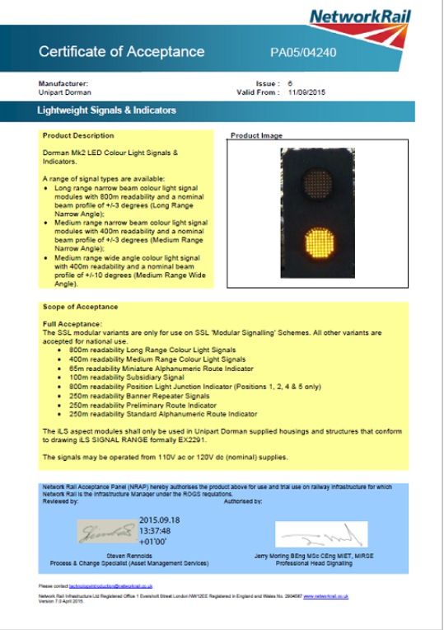
Details
The front cover of the PA Certificate contains overview information about the product, the scope of acceptance, the date the certificate is valid from and on trial certificates, an expiry date.
Subsequent pages contain specific conditions applying to the manufacturer and user, trial criteria (where applicable), list supporting manuals and training material, hardware and software configuration and the certificate history.

Slide 6
Details
The Modular Signalling concept and hence the products, take advantage of a set of agreed deviations which may not be appropriate to other applications e.g. reduced standby times, greater power supply variance etc.
Most PA certificates for Modular Signalling products do not allow use on none Modular projects. The product variance from standard signalling products needs to be clearly understood by projects if they plan to use modular products in a non-modular application. Under certain circumstances some such projects have been added to the PA certificate, after following the PA process in NR/L2/RSE/0005.
Guidance and support on this can be found on the Product Acceptance Website or for some items by the Signalling Innovations Group (SIG) contact SIG@NetworkRail.co.uk

Slide 7
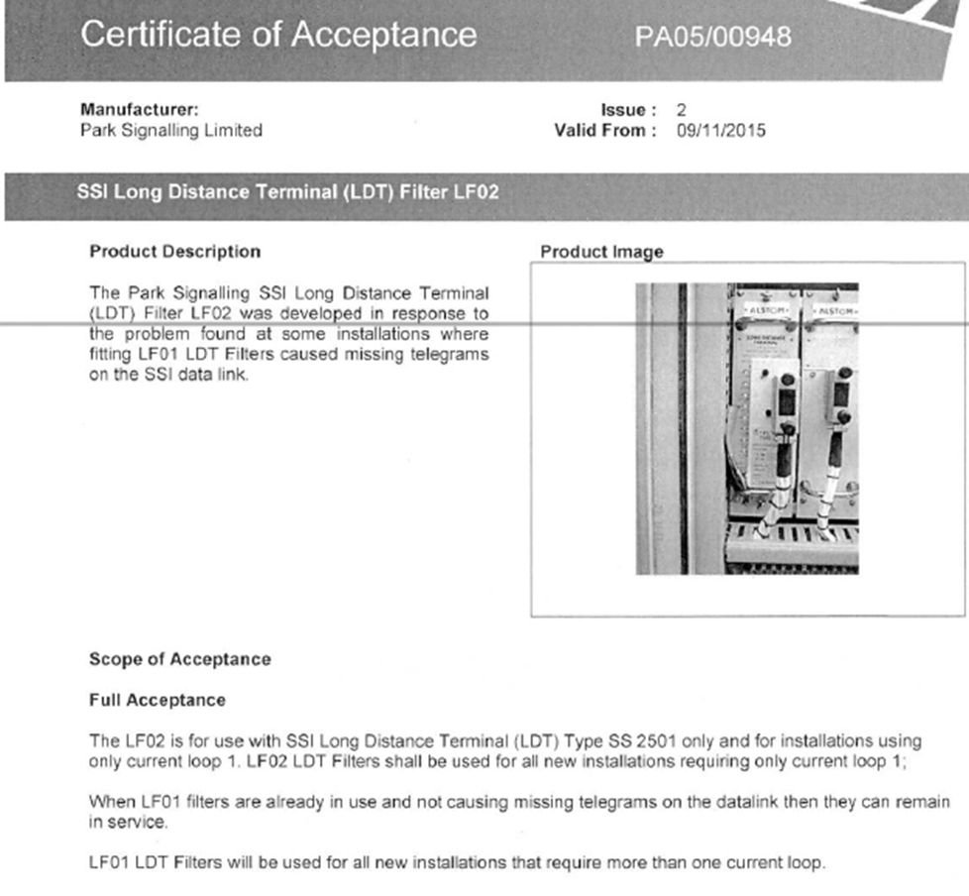
Examples
The PA Certificate for the SSI Long Distance Terminal (LDT) Filter LF02 states that
“LF02 LDT Filters shall be used for all new installations requiring only current loop 1. LF01 LDT Filters will be used for all new installations that require more than one current loop.”
Many projects are still installing LF01 LDT Filters in all cases.

Slide 8
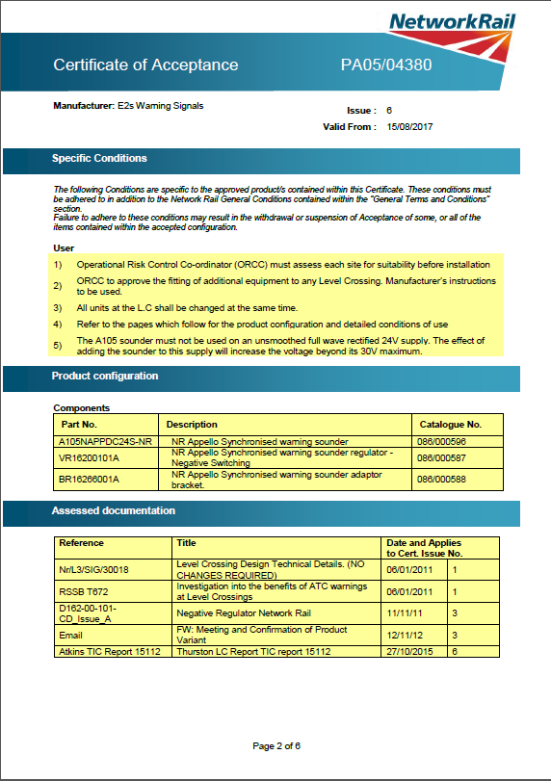
Examples
Clause 5 on the PA certificate for an Audible Warning Device for use at Level Crossings requiring Another Train Coming announcement, contains a requirements for designers to note.
“The A105 sounder must not be used on an unsmoothed full wave rectified 24V supply. The effect of adding the sounder to this supply will increase the voltage beyond it’s 30V maximum.

Slide 9
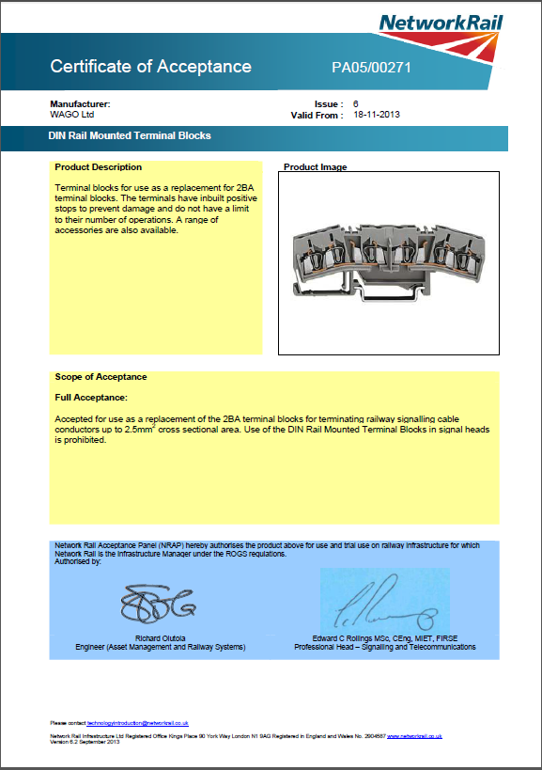
Examples
The PA Certificate for WAGO Terminal Blocks states that:
A 5mm intermediate plate or the 1mm by 3mm tall intermediate plate (086/043050 or 086/043051) must be used between terminal blocks. Where the 1mm intermediate plates are used a 5mm end plate is still required.

Slide 10
Further Information
For any further details or information please contact:
Nicola Crocker, Programme Engineering Manager, Process & Capability
07733127167
Nicola.Crocker@networkrail.co.uk

