Slide 1
Shared Learning
SL029/18 – FTNx Communications Failure

Slide 2
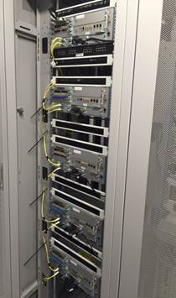
Background
A signaller reported a complete loss of signalling in a workstation area, with five trains trapped. Another signaller at a Signalling Centre c. 50 miles away also reported a loss of signalling and visibility of trains in their control area.
It was advised a Fixed Telecommunications Network (FTN) router issue was the root cause of the failure. Attempts were made to reconfigure the router which resolved the issue some time later. The incident resulted in 353 trains delayed accruing in excess of 4500 delay minutes.
Key learning
The trigger was plugging in the signalling network equipment to the FTNx network port provided for the purpose.
The technical root cause of the incident was a misconfiguration of the FTNx router devices, which blocked the normal mechanisms for controlling broadcast storms (Spanning Tree Protocol).
As the industry moves towards integrated network communication solutions it is essential that clear responsibilities are established and communicated to all concerned for each project.
All direct physical connections to NRT infrastructure must be planned and supported by an appropriate at-risk notice.
Refer to NR/L3/TEL/0092.

Slide 3
Further Information
For any further details or information please contact:
Christopher Ruddy, Senior Project Engineer (Process and Capability) IP Signalling
07799 336772
christopher.ruddy@networkrail.co.uk

