Slide 1

Ladbroke Grove Rail Accident
20 years on

Slide 2
Great Britain's Railway
1.7 billion passenger journeys - every year.
22,500 train movements - every day.
In fact, Britain's railway is currently the safest in Europe for its passengers. Our railway had its last passenger accident fatality nearly 12 years ago.
We now have a generation of railway employees without that experience.
And for those with the memories, time can erode the lessons learned from major accidents.
5th October 2019 marks 20 years since one of the worst railway accident in recent memory: Ladbroke Grove
Todays session:
  Remembrance
  Reflect on the accident
  Changes

Slide 3

Key Points
20 years since Ladbroke Grove.
Over a decade since our last passenger fatality due to an train accident,
a fantastic record.
But there is also a risk of complacency and to lose sight of day to day risks.
Take this opportunity to remember Ladbroke Grove and what we learned from it, and consider the changes made since.
The recent workforce fatalities have given us all a jolt.
This gives us a chance to reflect, remember and continue to learn.
Ladbroke Grove

Slide 4
Ladbroke Grove accident
05 October 1999

Slide 5
20 years ago at approximately 08:11 on 5th October 1999, 258 people were injured,
31 people lost their lives…

Slide 6
The Ladbroke Grove Rail Accident shocked the rail industry and the country…

Slide 7
On that day
2 train services:
London Paddington - Bedwyn
Cheltenham - London Paddington

Slide 8
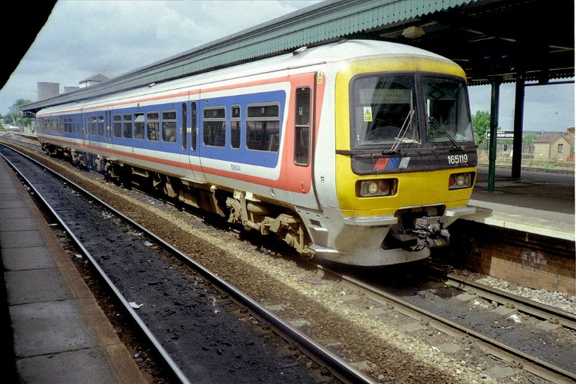
On that day
The 08:06 Paddington to Bedwyn 165 Turbo diesel service left Paddington station…

Slide 9
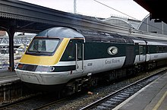
…as the 06:03 Cheltenham to Paddington HST approached Paddington Station…
On that day

Slide 10
On that day
… the Bedwyn 165 Turbo service passed through signal SN109 correctly showing Red…

Slide 11
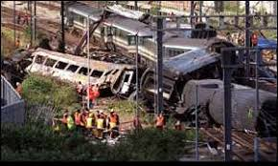
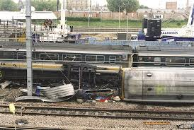
…and collided head-on with the Paddington HST service at near line speed…

Slide 12
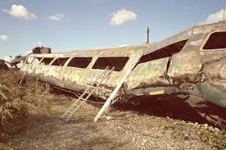
The resultant wreckage was then engulfed in a blaze when spilt fuel from the 165 Turbo ignited...

Slide 13
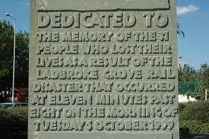
On that day
258 people were injured
31 people died

Slide 14
Why did it happen?
The accident was caused by the Paddington to Bedwyn Turbo service passing a signal showing a Red aspect, a Signal Passed at Danger (SPaD).
This train then collided head on with the Cheltenham to Paddington service at near line speed, with an estimated combined speed of 130mph.
Why it happened ‘Immediate causes’:
Poor sighting of SN109 signal
Questions over driver training
Ineffective SPaD mitigation activities
Whilst these were determined to be the immediate causes, as in all accidents, near misses and Close Calls there were other / contributing factors. What could these have been?

Slide 15
Other factors
SN109 signal had been passed at danger 8 times over the previous 6 years:
Poor line of sight to signal SN109
Obscuration by OLE apparatus – considered cost prohibitive to re-align OLE masts
Curvature of the track affected sighting
The new track layout was approved with an assumption it could be safely signalled
SN109 was 1 of 6 signals on a single overhead gantry spanning multiple lines
Low sunlight
Inexperienced driver
Driver was unaware of SN109 SPaD history

Slide 16
Cullen report –Recommendations
Lord William Cullen QC was brought in to chair the subsequent inquiry.
The report made a total of 74 recommendations, including:
Recommendations to address safety leadership
Recommendations to increase the use of risk assessment
Recommendations to improve the signal sighting process
Recommendations to introduce a formal accident investigation body
Recommendations to introduce an independent rail safety body
Some of these were to be in a similar format to that used by the aviation industry.

Slide 17
Learning
Ladbroke Grove was a major event in the evolution of signalling safety standards. This accident, together with the one at Southall, heralded the accelerated introduction of Train Protection and Warning System (TPWS) and a more robust Signal Sighting process adopted.
Many recommendations from Lord Cullen's report were made and improvements have followed.
The Cullen report was followed by a joint enquiry into Train Protection Systems report in 2001, after the Southall accident in 1997 and Ladbroke Grove in 1999.

Slide 18
Do we learn lessons?
Ladbroke Grove followed on shortly from another major accident, at Southall, just two years before. This was another Signal Passed at Danger accident where 7 people died and 139 were injured.
We must not forget these incidents, we must learn and we must follow the rules, standards and procedures that are in place as a result of the learning from these events.
SPaD risks are thought to be increasing, with the RSSB showing a keen interest. Despite all the mitigations put in place the risk still remains.
RSSB is keen to avoid any sense of complacency, and has asked whether enough is being done to address SPaDs.

Slide 19
Do we learn lessons?
In the last 20 years, the industry has reduced the risk from SPaDs by more than 90%. It has been over 12 years since the last train accident involving fatalities, and Britain has one of the safest railway networks in Europe.
However….
July 2019 saw 41 trains pass red signals, the highest number in a single calendar month since October 2007.
In the last 12 months, 10 trains have passed red signals and reached the ‘conflict point’, the position along the track at which a collision could take place.

Slide 20
What can you contribute in keeping the railway safe (for passengers, workforce and yourself) ?
What can you contribute to reduce SPaDs and their consequences ?

