Slide 1
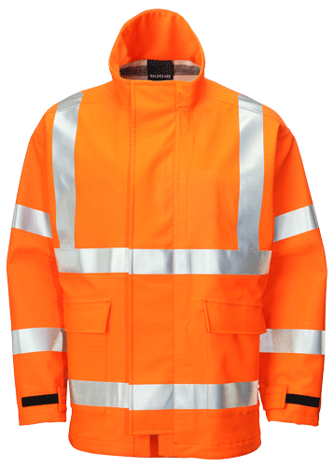
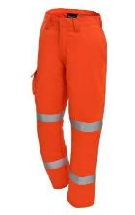
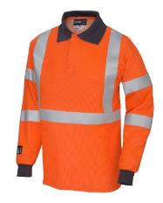
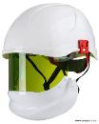
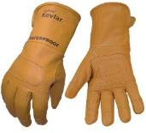

Issue 1.1 Jan 2020
Electrical Power Distribution Briefing:
National Arc Flash PPE Requirements

Slide 2
Introduction and Purpose
Following a serious safety incident at Godinton DC traction substation in December 2018, the STE M&EE Distribution Team have been reviewing our current Arc Flash PPE requirements and bench marking against our rail industry partners and Distribution Network Operators.
This briefing pack supports the outcomes of this review and sets out the national stance with regards to the requirements to wear Arc Flash PPE in traction and non-traction power distribution locations.
The Arc Flash requirements in this briefing pack supersedes the previously set requirements in the National Electrical Safety Briefing – Access to Distribution Sites March 2019, and also the requirements of National Safety Advice NRA 17/09.
These Arc Flash PPE requirements apply to any persons who are required to carry out any work activities within a traction or High Voltage (HV) non-traction power distribution location and are mandatory from 6th June 2020.

Slide 3
Introduction and Purpose
Common work activities have been risk assessed on the basis of an unexpected uncontrolled release of electrical energy (Arc Flash) and the required level of Arc Flash Protection calculated.
Notice board guidance posters and pocket guides have also been produced to support this and take into account the approved Arc Flash PPE garments and their application.
It is the responsibility of the individuals to ensure that their Arc Flash PPE meets the requirements (in terms of rating) for the task being undertaken.
The STE M&EE Distribution Team are currently working with our PPE suppliers to strengthen the approved Arc Flash PPE range and when new garments become available, the guidance posters will be updated.

Slide 4

Important Reminder
PPE is the last line of protection and is there to protect the wearer when the planning, operations or systems ALL fail.
Wearing of Arc Flash PPE does not prevent an incident from occurring. The relevant procedures and risk controls must ALWAYS be implemented.

Slide 5
REMEMBER to use your SENSES…
… a reminder of the requirements when accessing a distribution location, think of your SENSES….

Slide 6
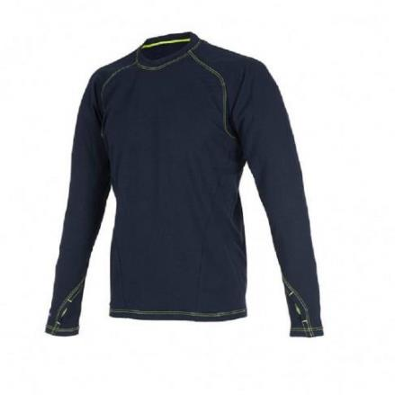
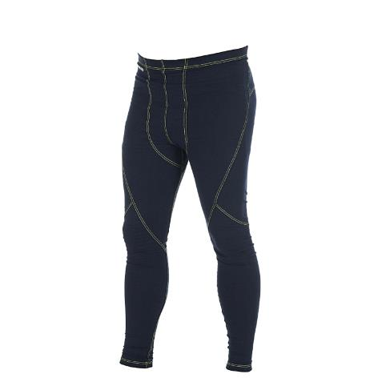
Arc Flash PPE - Underclothes (base layer)
Any underclothes MUST be either natural 100% cotton or approved flame retardant items
Metallic fastenings should be avoided where possible
Elastic or Lycra on underwear can be considered as ‘incidental’ and providing the rest of the material on the garment is 100% cotton, then these are acceptable to be worn.
NR Cat No:
FR-CPG-8210 OR WMP07 (Ballyclare)
PROGARM 8210 base layer top
NR Cat No:
FR-CPG-8220 OR WMP08 (Ballyclare)
Examples of approved flame retardant items
PROGARM 8220 base layer Leggings

Slide 7
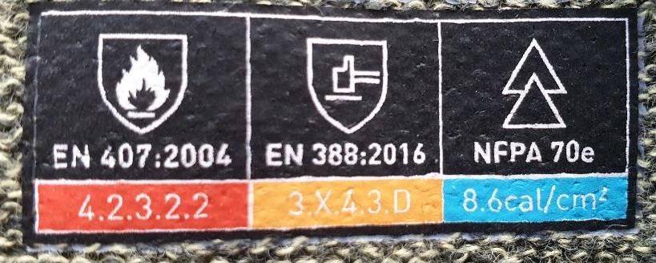
Arc Flash PPE - Identification of Rating
The rating of the Arc Flash PPE garment can be identified from the label within as follows:
Look for a ATPV (Arc Thermal Performance value). This will state the calorific rating of the garment in cal/cm². All garments tested for a ATPV will also meet the requirements for Class 1 (4 kA)
Some garments may not have been tested for a ATPV and instead will be rated for either:
Class 1 (4 kA)
Class 2 (8 kA)

Slide 8
Arc Flash PPE - Class 1 (4 kA) Main Layer
NR APPROVED ARC FLASH POLO SHIRT
NR APPROVED ARC FLASH CARGO TROUSER
Arc Flash PPE Rating
Class 1 (4 kA)
Arc Flash Rated Face / Hand Protection
None Required
NR Cat No:
Female: FR-GPG-5292-HO
Male: FR-GPG-5290-HO
NR Cat No:
Female: FR-GPG-4614-HO
Male: FR-GPG-4616-HO

Slide 9
Arc Flash PPE - Class 1 (4 kA) Main Layer
This main layer is to be worn AT ALL TIMES by Distribution & Plant Maintenance, Works Delivery and Projects Personnel when undertaking the following work activities:
Inspection / Maintenance / Faulting / Renewal of Distribution Equipment within a traction or HV non-traction Distribution location.
Examples of traction and non-traction distribution locations:
25 kV Traction – Feeder Stations, Mid-Point Track Sectioning cabin / location, Intermediate TSC/TSL, Auto Transformer Feeder station, etc.
DC Traction – DC Substations, Switching Stations, Track Paralleling Huts, Feeder huts, etc.
HV Non-Traction – High Voltage non-traction distribution substations feeding depots, stations or non-traction supplies such as signalling power.
Arc Flash PPE Rating
Class 1 (4 kA)
Arc Flash Rated Face / Hand Protection
None Required

Slide 10
Arc Flash PPE - Class 1 (4 kA) Main Layer
Also, this main layer is to be worn for the following work activities:
Isolation & Earthing Activities on traction or non-traction HV Switchgear (where task specific Arc Flash PPE requirements are not mandated)
Examples:
Isolation & Earthing activities on 25 kV Structure Mounted Outdoor Switchgear (SMOS)
Isolation & Earthing activities on 33 kV outdoor switchgear (i.e. JB424, OX36 3 phase)
Isolation and the racking in/out of Metal Enclosed DC Traction Switchgear
Isolation & Earthing of 25 kV indoor Gas Insulated Switchgear (GIS)
Isolation & Earthing of 6.6 kV to 33 kV 3-phase indoor switchgear with integral disconnectors / earth switches
Isolation of DC Rectification equipment
Arc Flash PPE Rating
Class 1 (4 kA)
Arc Flash Rated Face / Hand Protection
None Required

Slide 11
Arc Flash PPE - Class 1 (4 kA) Main Layer
Also, this main layer is to be worn for the following work activities:
Racking in and out of withdrawable DC Open Frame (where the breakers are not contained within a panel) Switchgear
Examples:
Racking in and out of GEC RJR530, RJR526, RJR721(not form A1-A3 and E), RLR151 circuit breakers
Racking in and out of BTH HSE, HSL circuit breakers
Arc Flash PPE Rating
Class 1 (4 kA)
Arc Flash Rated Face / Hand Protection
None Required

Slide 12
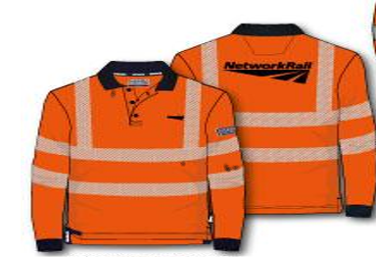
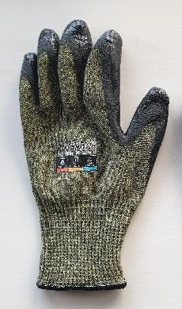
Arc Flash PPE - 6 cal/cm² rated Main Layer
Arc Flash PPE Rating
6 cal/cm²
NR APPROVED ARC FLASH LONG SLEEVED PLACKET SHIRT
NR APPROVED ARC FLASH COMBAT TROUSER
Arc Flash Rated Face / Hand Protection
NR Cat No:
NR313
NR Cat No:
HV316

Slide 13
Arc Flash PPE - 6 cal/cm² rated Main Layer
Arc Flash PPE Rating
6 cal/cm²
When carrying out the following work activity on 6.6 kV to 33 kV HV 3-phase transformers:
Application of Test before Touch on the internal transformer winding connections following the removal of the transformer lid and where the external HV connections of the transformer cannot be readily tested for DEAD
The NR approved Arc Flash Polo Shirt must be replaced with the NR Approved Arc Flash Long Sleeved Placket Shirt in order to meet the caloric rating required.
Also, NR Approved Hand / Face protection must be worn.
Arc Flash Rated Face / Hand Protection
NR Approved Arc Flash Helmet / Visor and Arc Flash Gloves

Slide 14
Arc Flash PPE - 16 cal/cm² rated Main Layer
NR APPROVED ARC FLASH BOILER SUIT
Arc Flash PPE Rating
16 cal/cm²
Arc Flash Rated Face / Hand Protection
NR Cat No:
NR137

Slide 15
Arc Flash PPE - 16 cal/cm² rated Main Layer
Arc Flash PPE Rating
16 cal/cm²
This main layer is also to be worn when carrying out the following work activities on 25 kV distribution equipment:
Application of Test before Touch on the internal transformer winding connections following the removal of the transformer lid and where the external HV connections of the transformer cannot be readily tested for DEAD
Examples:
Ground mounted 25 kV Auxiliary transformers,
Ground mounted 25 kV Booster transformers,
25 kV Auto-transformers
Also, NR Approved Hand / Face protection must be worn.
Arc Flash Rated Face / Hand Protection
NR Approved Arc Flash Helmet / Visor and Arc Flash Leather Gauntlets

Slide 16
Arc Flash PPE - 16 cal/cm² rated Main Layer
This main layer is to be worn when carrying out the following work activities on 25 kV distribution equipment:
Testing, Application and removal of Portable Earthing on the following 25 kV equipment (includes under Sanction for Test conditions):
GEC XE2, X82, X82S VCB internal busbars,
South Wales / HSS H25, HV25 VCB internal busbars,
S&C K11 busbars and circuit chambers
Siemens ASG25 switchgear,
25 kV CAIS internal busbars
Also, NR Approved Hand / Face protection must be worn.
Arc Flash PPE Rating
16 cal/cm²
Arc Flash Rated Face / Hand Protection
NR Approved Arc Flash Helmet / Visor and Arc Flash Leather Gauntlets

Slide 17
Arc Flash PPE - 16 cal/cm² rated Main Layer
Arc Flash PPE Rating
16 cal/cm²
This main layer is to be worn when carrying out the following work activities on 6.6 kV to 33 kV indoor HV Switchgear (in both traction & non-traction applications):
Racking in and out any 3-Phase HV withdrawable switchgear.
Where you are required to manually apply a test instrument (i.e. live line Tester) in the breaker cell before carrying out the earthing procedure.
Application of a busbar or circuit main earth via an earthing device attached to 3-Phase HV withdrawable switchgear.
Also, NR Approved Hand / Face protection must be worn.
Arc Flash Rated Face / Hand Protection
NR Approved Arc Flash Helmet / Visor and Arc Flash Leather Gauntlets

Slide 18
Arc Flash PPE - 41 cal/cm² rated Main Layer
NR APPROVED ARC FR WATERPROOF JACKET
NR APPROVED ARC FR WATERPROOF OVER-TROUSERS
NR APPROVED ARC FR WATERPROOF SALOPETTES
Arc Flash PPE Rating
41 cal/cm²
Arc Flash Rated Face / Hand Protection
OR
NR Cat No:
NR310 or FR/GPG-9440-OR
NR Cat No:
FR-GPG-9660-OR
NR Cat No:
HV311

Slide 19
Arc Flash PPE - 41 cal/cm² rated Main Layer
This main layer is to be worn when carrying out the following work activities on 25 kV distribution equipment:
Application of HV test bushings or test adaptors into 25 kV traction switchgear circuit or busbar spouts / test points (where the circuit or busbar spouts / test points are not inter-locked with CB position)
Examples of applicable switchgear:
Siemens 8DA11 and 8DA12 Gas insulated switchgear
Areva / AEG WI 25 kV Gas insulated switchgear
Also, NR Approved Hand / Face protection must be worn.
Arc Flash PPE Rating
41 cal/cm²
Arc Flash Rated Face / Hand Protection
NR Approved Arc Flash Helmet / Visor and Arc Flash Leather Gauntlets

Slide 20
Arc Flash PPE - 41 cal/cm² rated Main Layer
This main layer is to be worn when carrying out the following work activities on 6.6 kV to 33 kV indoor HV Switchgear (in both traction & non-traction applications):
Application of HV test bushings or test adaptors into 3-Phase HV switchgear circuit or busbar spouts / test points (where the circuit or busbar spouts / test points are not inter-locked with CB position))
Examples of applicable switchgear:
Whipp & Bourne CV, Areva / AEG / Alstom WSA Gas insulated switchgear, Siemens 8DA10 Gas Insulated Switchgear, GEC KC oil filled switchgear, GEC KA oil filled switchgear, Hawkgas 12 and Hawkgas 36 oil filled switchgear, GEC VMX and XMS switchgear, Switchgear & Cowan's A6 oil filled switchgear, ABB Safesix SF6/Vac switchgear
Also, NR Approved Hand / Face protection must be worn.
Arc Flash PPE Rating
41 cal/cm²
Arc Flash Rated Face / Hand Protection
NR Approved Arc Flash Helmet / Visor and Arc Flash Leather Gauntlets

Slide 21
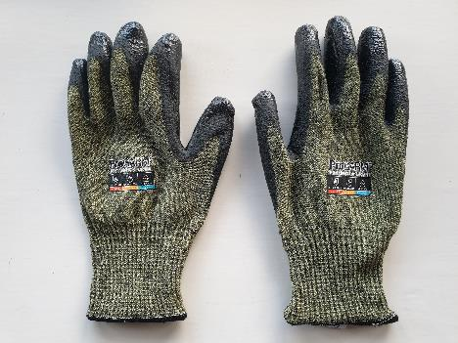
Arc Flash PPE - Hand / Face Protection
NR APPROVED ARC FLASH HELMET &VISOR
NR APPROVED ARC FLASH GLOVES
NR APPROVED ARC FLASH LEATHER GAUNTLETS
Arc Flash PPE Rating
Up to 24 cal/cm²
Arc Flash PPE Rating
Up to 8 cal/cm²
Arc Flash PPE Rating
Up to 50 cal/cm²
NR Cat No:
HD-LPG-2690-WT-NA
NR Cat No:
GL-APG-2700-KH
NR Cat No:
GL-APG-2678-TA
Note: Network Rail has accepted the use of the approved arc flash helmet & visor for the work activities which require 41 cal/cm² in terms of this item being more practical to wear for the activity against current arc flash PPE offerings at this rating.
Note: It is recommended that the FR balaclava (FR-LPG-8100-NV-NA) is worn under the approved arc flash helmet & visor.

Slide 22
Level C Access & Egress
Arc Flash PPE Rating
N/A
This is not applicable to Distribution & Plant Maintenance, Works Delivery and Projects Personnel.
When the activity includes access & egress only, or access & egress to carry out visual only surveys, there is NO REQUIREMENT for Arc Flash PPE to be worn.
Arc Flash Rated Face / Hand Protection
N/A

Slide 23
Other Work Activities
Arc Flash PPE Rating
As per approved risk assessment or WPP
For the following work activities, the Arc Flash PPE requirements will be detailed within an agreed risk assessment or work package plan, approved by the EPME or RAM E&P:
Distribution Level C - providing site access and site monitoring for 3rd party works
Telecoms / SCADA work which could result in either persons, materials or tools being above distribution equipment
Building Services work which could result in either persons, materials or tools being above distribution equipment
Arc Flash Rated Face / Hand Protection
As per approved risk assessment or WPP

Slide 24

Arc Flash PPE - Further advice
For any further advice or clarification, STE M&EE have set up the following email address:
DistributionSafetyMatters@networkrail.co.uk
Further FAQs with regards to Arc Flash PPE will be published soon and available via the following Safety Central website:
https://safety.networkrail.co.uk/safety/electrical-safety/national-electrical-power-distribution-safety-briefing

