Slide 1
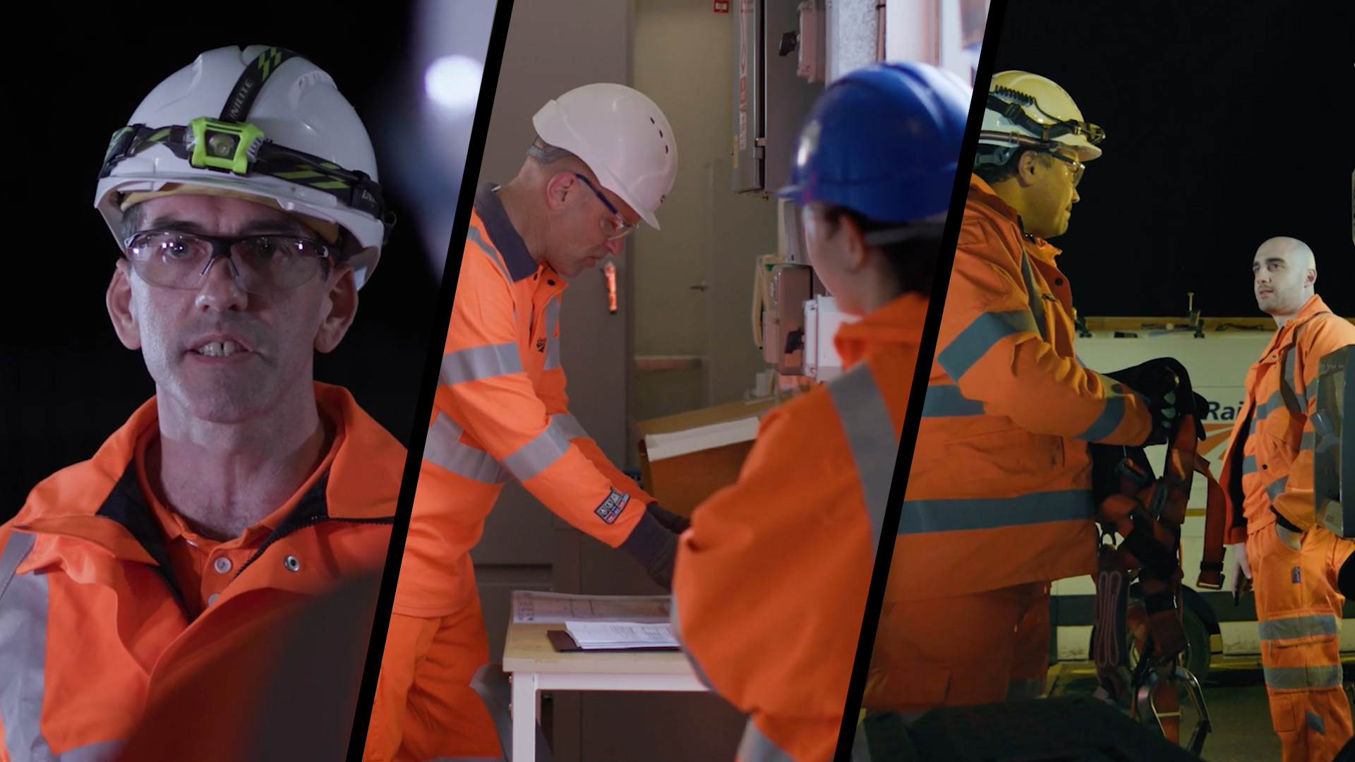

Electrical Safety Step Up
#electricalsafety

Slide 2
Today’s Agenda:
Andrew Haines Opens the Step Up
My Experience - Bryant Latham
Overhead Line Equipment Scenario
A Challenge to You – What Will You Do?
Call to Action

Slide 3

Ground Rules:
All participants are requested to mute mobile phones (unless on-call)
Please participate in all the discussions – these sessions have been designed to be interactive
If using Microsoft Teams we encourage you to switch on your camera and mute your mic when you’re not talking
Be open and honest, listen and be respectful of each other’s views
No question is a silly question
Questions that cannot be addressed during the session will be taken away and added to Frequently Asked Questions document where appropriate

Slide 4
Today’s Learning Outcomes
Working around electricity can be safe when you follow the correct safety measures, and the hazards are controlled.
Why we must all comply with the rules and procedures when working with High Voltage infrastructure.
Understand that you must have the correct competence and experience to undertake the work.
Understanding of the dangers of complacency and how you can remove yourself if your concentration is compromised.
How you have a personal responsibility for your own safety and those around you.
Finally, you are empowered to challenge electrical safety if at any time you feel your safety is compromised.
Notes:
Use this slide to let people know why they’re attending the Electrical Safety Step Up today.
Today’s learning outcomes are a stepping stone that will take us on a journey towards zero harm in electrical safety
In order to help us to do this, there will be a QR code at the end of the session that you can scan with your phone to provide us with feedback to help us to create the next stepping stone. For those without a smart phone, please write down your thoughts and give it to the facilitator.

Slide 5
Welcome to the Electrical Safety Step Up
Session 1
Notes:
Discussion points
Human factors play a large part in incidents – What are human factors in safety?
Human factors in safety is concerned with all those factors that influence people and their behaviour in safety-critical situations
Examples of human factors are
Memory lapses (including forgetting a step in the work process or a safety measure)
Impaired judgment or reduced reasoning power.
Distractions
Lack of competence and experience.
During this Step Up we will have an open discussion about Electrical safety. Electrical safety jobs are risky by nature. Several of them pose a life-threatening risk.
No matter how insignificant a risk may seem, our safety culture needs to take our culture and behaviours into account.
We will examine how behavioural safety will help every member of staff to be encouraged to take responsibility for their behaviour and e around them. Everyone takes care of each other.
Welcome to the Electrical Safety Step Up film: https://vimeo.com/726058309/b8cf189756

Slide 6
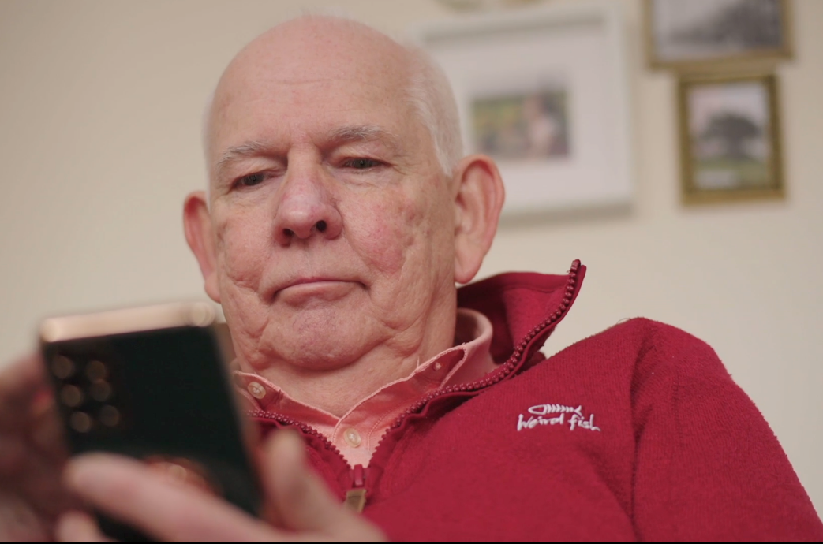
Bryant’s Story
#electricalsafety
Session 2
Notes:
Introduction to Bryant’s Story – Facilitator to read this out:
We have invited Bryant to introduce this session. Some of the points discussed in this film may be upsetting for some people. If you feel uncomfortable, please take a minute and leave the room if you need to. You do not have to participate in this part if you feel uncomfortable.
Bryant's words:
You are about to watch a video that I was asked to make regarding an incident that happened 40 years ago.
I hope that you will reflect on this video and that you will join me and the team in making our worksites the safest that they can be, consider what the impact would be on your family, friends, colleagues, and others working in a similar role to yourselves if you or one of your colleagues were involved in a similar incident.
I ask one question, after watching the video ask yourself and others around you…
What will you do differently?
Thank You for watching
Bryant Latham

Slide 7
My Experience – Bryant’s Story
Notes:
Without subtitles https://vimeo.com/676371341/c8366f96ef
With subtitles https://vimeo.com/678763371/5b59b3c4b5

Slide 8
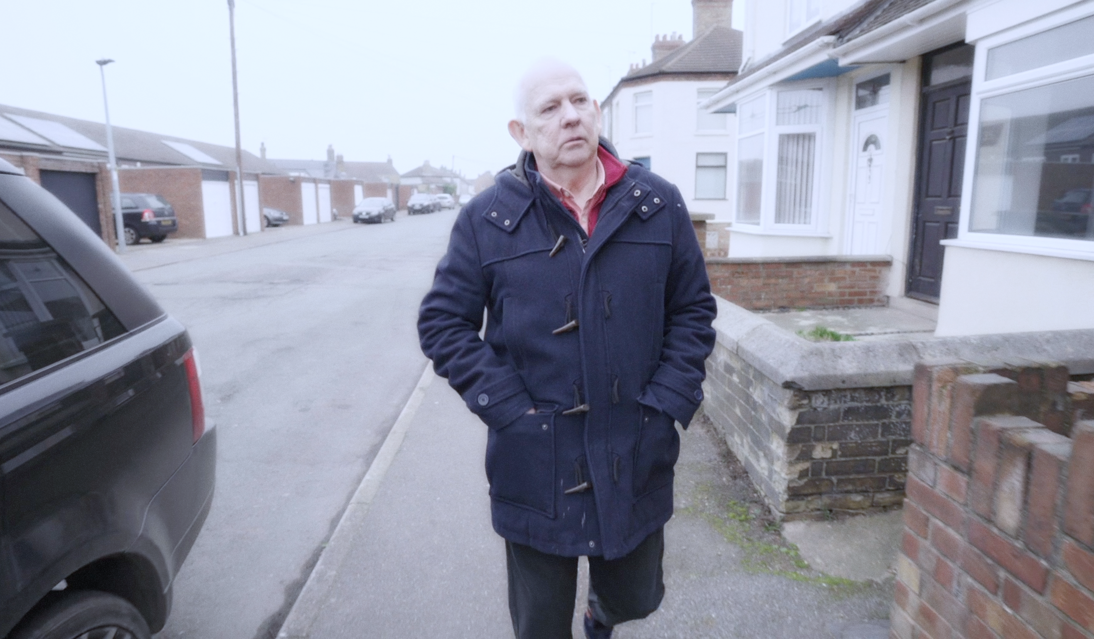

Discuss what you just saw, what are
your thoughts on what happened?
Notes:
Have an open and honest discussion about the film. If you need extra discussion points, please see the appendix
This incident happened in September 1981. What do you feel has changed since then to improve safety when working on, or in close proximity to live 25kV Overhead Line Equipment (OLE)?
The introduction of the Live Saving Rules, Test before earth, test before touch, the work safe procedure, Take 5
What could we do to make this type of incident less likely?
Understand the importance of procedure and process, check the paperwork against the location, roads, limits.
Have open discussions around the protection/paperwork
How do you think Bryant’s perception of personal responsibility has changed since the accident?
Behavioural changes
When establishing a new team or joining a new team, how can we build trust rather than complacency?
Be open, welcoming, approachable and understand each other. Fairness, inclusion, Respect
What are the barriers stopping you from using the Work Safe procedure and how can you/we overcome these?
People think it will stop the shift or cancel the work, it could be sorted in less than 30 minutes. people do not fully understand the procedure. People are worried they’ll be banned from site or dismissed and be viewed as a ‘troublemaker’.
Besides the obvious physical impact, what are the wider impacts?
Family/friends/work colleagues affected, others working in the same job role. Disruption to every day life, PTSD is a major issue, make sure people are offers help,
What, if anything, will you take from Bryant’s story?
Please record any feedback and send it to electricalculture@networkrail.co.uk.

Slide 9
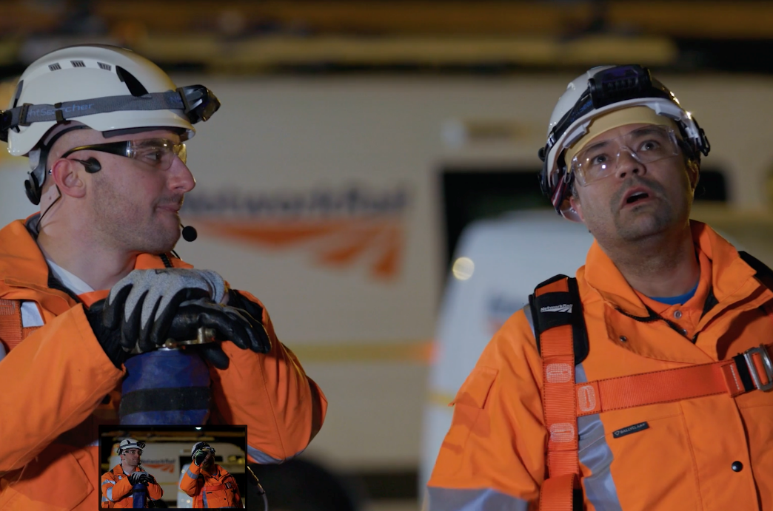
Overhead Line Equipment Scenario Film
#electricalsafety
Session 3
Notes:
Introduction
You’re about to watch a short film around OLE. As you watch this, look out for opportunities where you could choose to challenge. There will be time to discuss the scenario afterwards.

Slide 10
Overhead Line Equipment Scenario
Notes:
OLE Film: https://vimeo.com/714531099/8a0ffb9c3f
With English subtitles: https://vimeo.com/715252445/51aa7bd88f

Slide 11
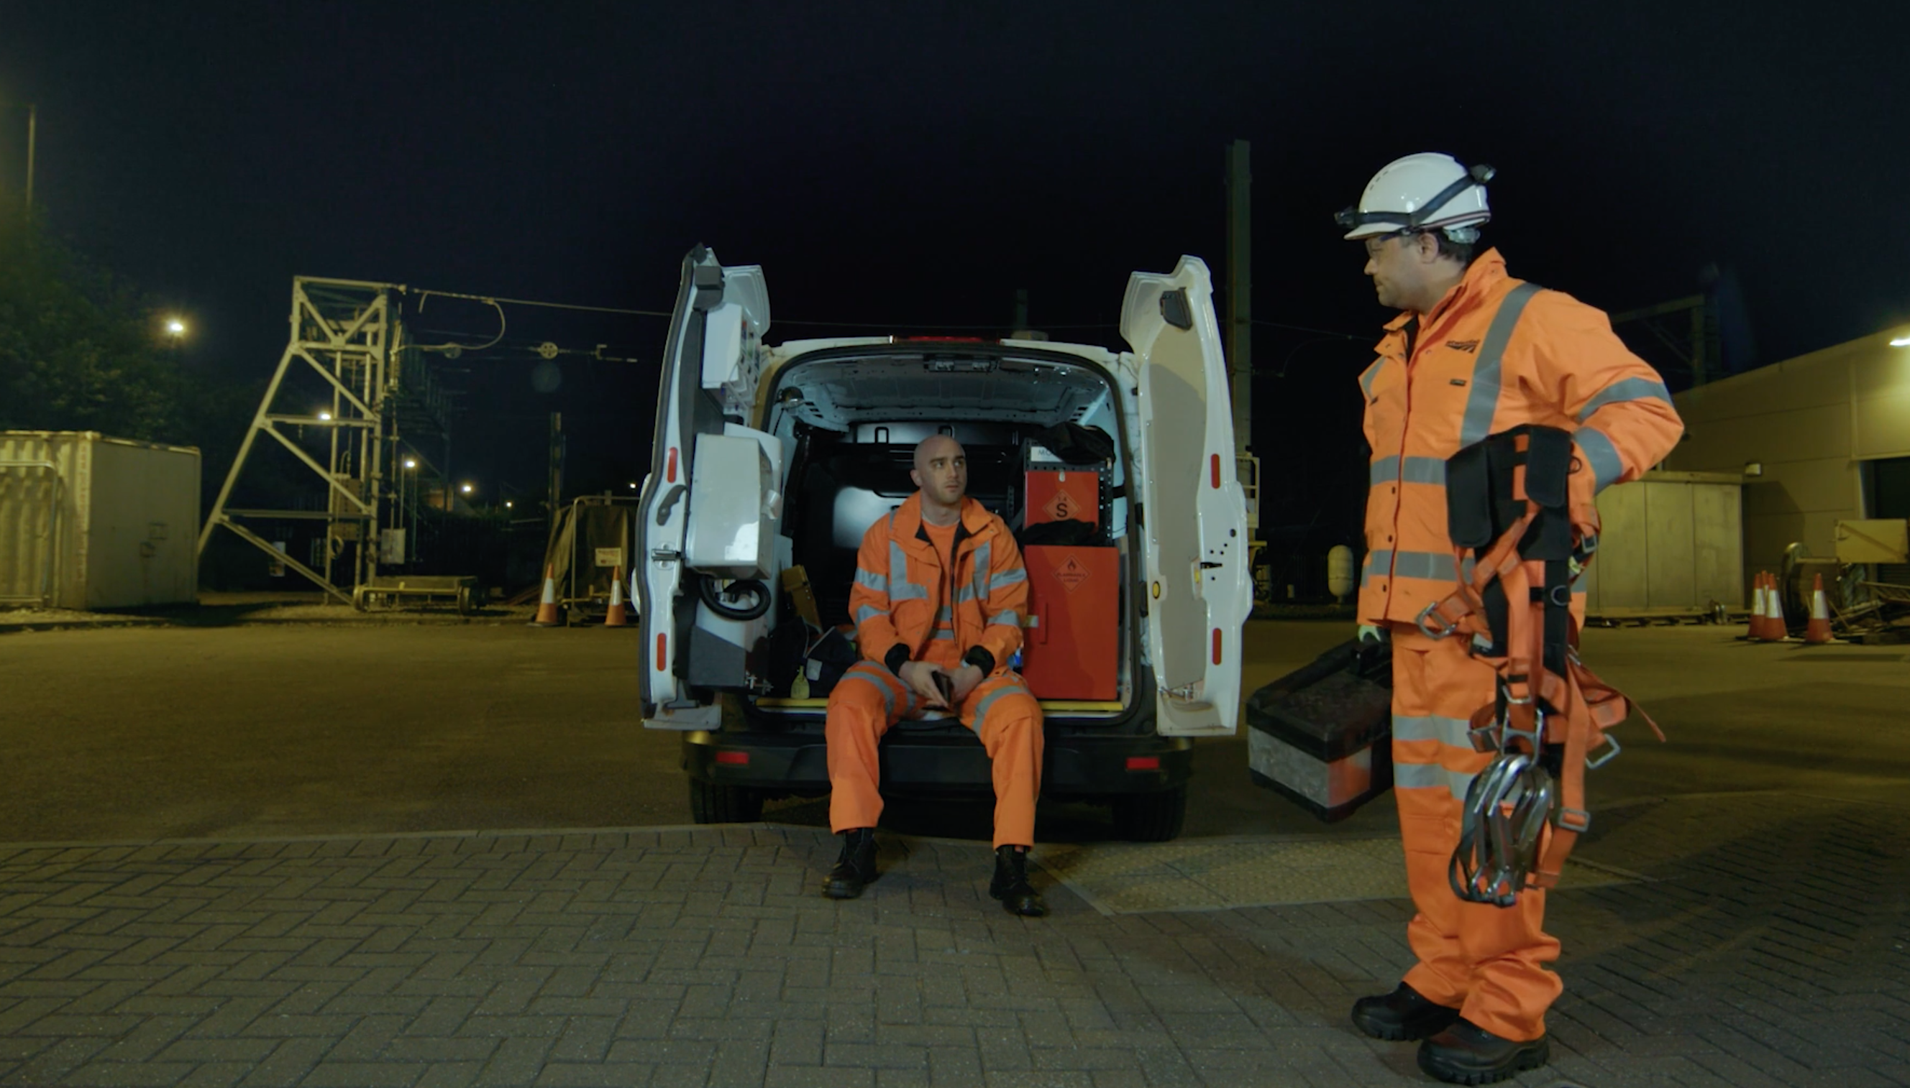
Discuss what you just saw, what are
your thoughts on what happened?
Notes:
Have an open and honest discussion about the film. The scenario films are all fictional. Try to keep the conversation around culture and behaviours rather than technical.
Discuss with the group at which stage they feel either individual had the chance to challenge the others.
The machine operator and operative in the basket when discussing the defect
The Machine controller before the movement took place
The COSS(OLP) brief - What was said? Did the COSS(OLP) confirm understanding? He clearly mentioned the adjacent goods line was live but were any control measures in place?
After the incident, what would you expect to happen next?
Reporting the incident, offer support to those involved.
Near Miss?
Think about the affects it had on those in the basket and the rest of the group, PTSD is rarely immediate, counselling?
Should the incident be formally investigated, drugs and alcohol screening, or was the ‘conversation with the COSS(OLP) enough?
Who’s responsible for your safety?
Everyone holds responsibility for their safety; your choices and actions determine how safe you are.
The best person to check if its safe is YOU, its your responsibility.
What human factors may have contributed to this scenario?
Distraction – they didn’t need to check anything else, he thought he saw another fault he needed to check
Lapse of judgment – forgotten fundamentals of training such as the procedures, Take 5
Familiarisation – it was his mate so it overruled his judgement
Do you undertake work that isn’t ‘planned’?
Do we put the work ahead of our own personal safety?
Discuss how doing the right thing in terms of improving the railway may be putting ourselves and others at risk.
Its important that a frank and open discussion takes place takes place
What are the physical and mental consequences to all those involved in an electrical accident or near-miss?
Life changing injuries, possibly fatal. What about the lasting impact on them physically and mentally, wider circle, family, friends colleagues
The surrounding teams would have witnessed the incident, the colleagues at the depot, make sure support is offered and remember its OK not to be OK.
Follow up conversation
Discuss what considerations should be made when a defect is found during routine maintenance, how is the work risk assessed?
Discuss what people feel the impact would be on the individuals involved, their families, their colleagues. Consider drawing back to Bryant's story and how its impacted him and his family.
Further probing questions
How often could you recall the COSS(OLP)s brief, 3 or 4 hours into the work? what can be done to improve this?
Can momentary lapses in concentration be dangerous? If yes, how and why?

Slide 12
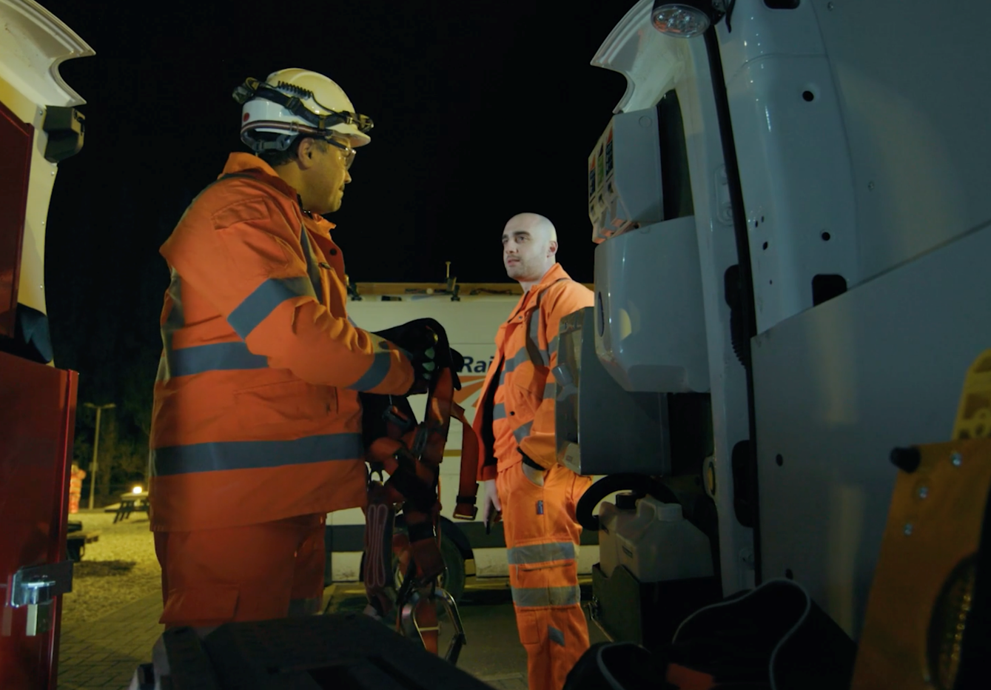
How Can We
Prevent a Similar Incident?
#electricalsafety
Notes:
Have an open and honest discussion about how a similar incident can be prevented. If you need extra discussion points, please use the slides in the appendix
What we are looking to do in the slide is collect views and measure the understanding of the group. The events in the film could have been prevented if we can reach a point where the group understands how and by who.
What If you were in the same situation, what could you and your team have done to prevent the event in the film from occurring?
COSS , if you was the COSS what would your brief contain, would you have added anything to highlight the presence of a Blue hat?
Challenges, are you comfortable being challenged as well as challenging
Would you have advised your mate to keep quiet, or encouraged him to challenge, maybe challenge on his behalf?
Assumption, what would be your response if told "it's the same as last night"?
Possible consequences
Life changing injuries, possibly fatal. What about the lasting impact on them physically and mentally, wider circle, family, friends colleagues
The surrounding teams would have witnessed the incident which can cause trauma
Potential disciplinary actions
Potential to lead to a full investigation that could lead to legal consequences
Valuable lessons
Speak up and support your colleagues if they have questions
The test before touch rule is not an optional requirement, always bringing the tester with you.
Open and honest discussion around Test Before Touch

Slide 13
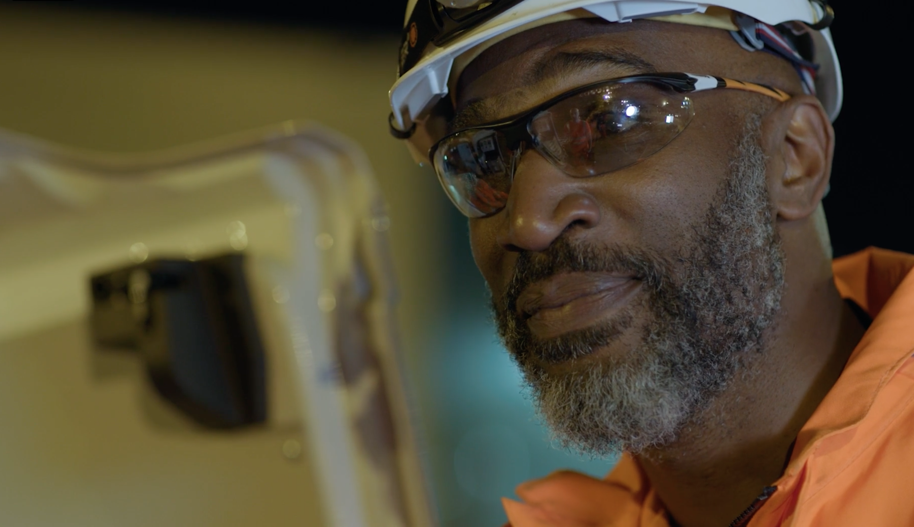
A Challenge to
You
#electricalsafety
Session 4
Notes:
Introduction
You’ve watched a series of films that we hope have been thought provoking and shifted your perspective around electrical safety. Now it’s your turn to think about how you can contribute to reaching zero harm in electrical safety. Lets listen to our colleagues and what it means to them.

Slide 14
A Challenge to You
Notes:
Your Commitment To Working Safe film: https://vimeo.com/edgepicture/review/727409793/6651e9ffd1

Slide 15

What Will You Do?
Go to www.menti.com and enter the code: Insert Code Here
Write down what one thing you will do to make sure that you and those that work alongside you Go Home Safe Every Day.
Notes:
Now it’s your turn, what will you do?
Examples:
I will choose to challenge
I will ask more questions
I will speak up
Your feedback is important and these answers will anonymously be sent to the Electrical Culture team to help us on our journey to zero harm in electrical safety.
Guidance
This is an interactive session with the group, you can either do a post it note session or use Menti (see the facilitator notes for more information on how to set up a session). Don’t forget to delete the unnecessary slide before the session
Menti Session – Ask the group to go to www.menti.com and add the code to join the session
Please send the a picture of the post it notes or download a copy of the Menti session and send it to Electricalculture@networkrail.co.uk

Slide 16

What Will You Do?
Using post it notes write down what one thing you will do to make sure that you and those that work alongside you Go Home Safe Every Day.
Notes:
Now it’s your turn, what will you do?
Examples:
I will choose to challenge
I will ask more questions
I will speak up
Your feedback is important and these answers will anonymously be sent to the Electrical Culture team to help us on our journey to zero harm in electrical safety.
Guidance
This is an interactive session with the group, you can either do a post it note session or use Menti (see the facilitator notes for more information on how to set up a session). Don’t forget to delete the unnecessary slide before the session
Menti Session – Ask the group to go to www.menti.com and add the code to join the session
Please send the a picture of the post it notes or download a copy of the Menti session and send it to Electricalculture@networkrail.co.uk

Slide 17
Call to Action
Notes:
To close out the session, we’re going to hear from Phil Doughty who will summarise the points you’ve heard in today’s session. We hope that you will reflect on what you’ve seen today and help us contribute to a zero harm railway.
Our Call to Action film: https://vimeo.com/719034307/649416225b

Slide 18
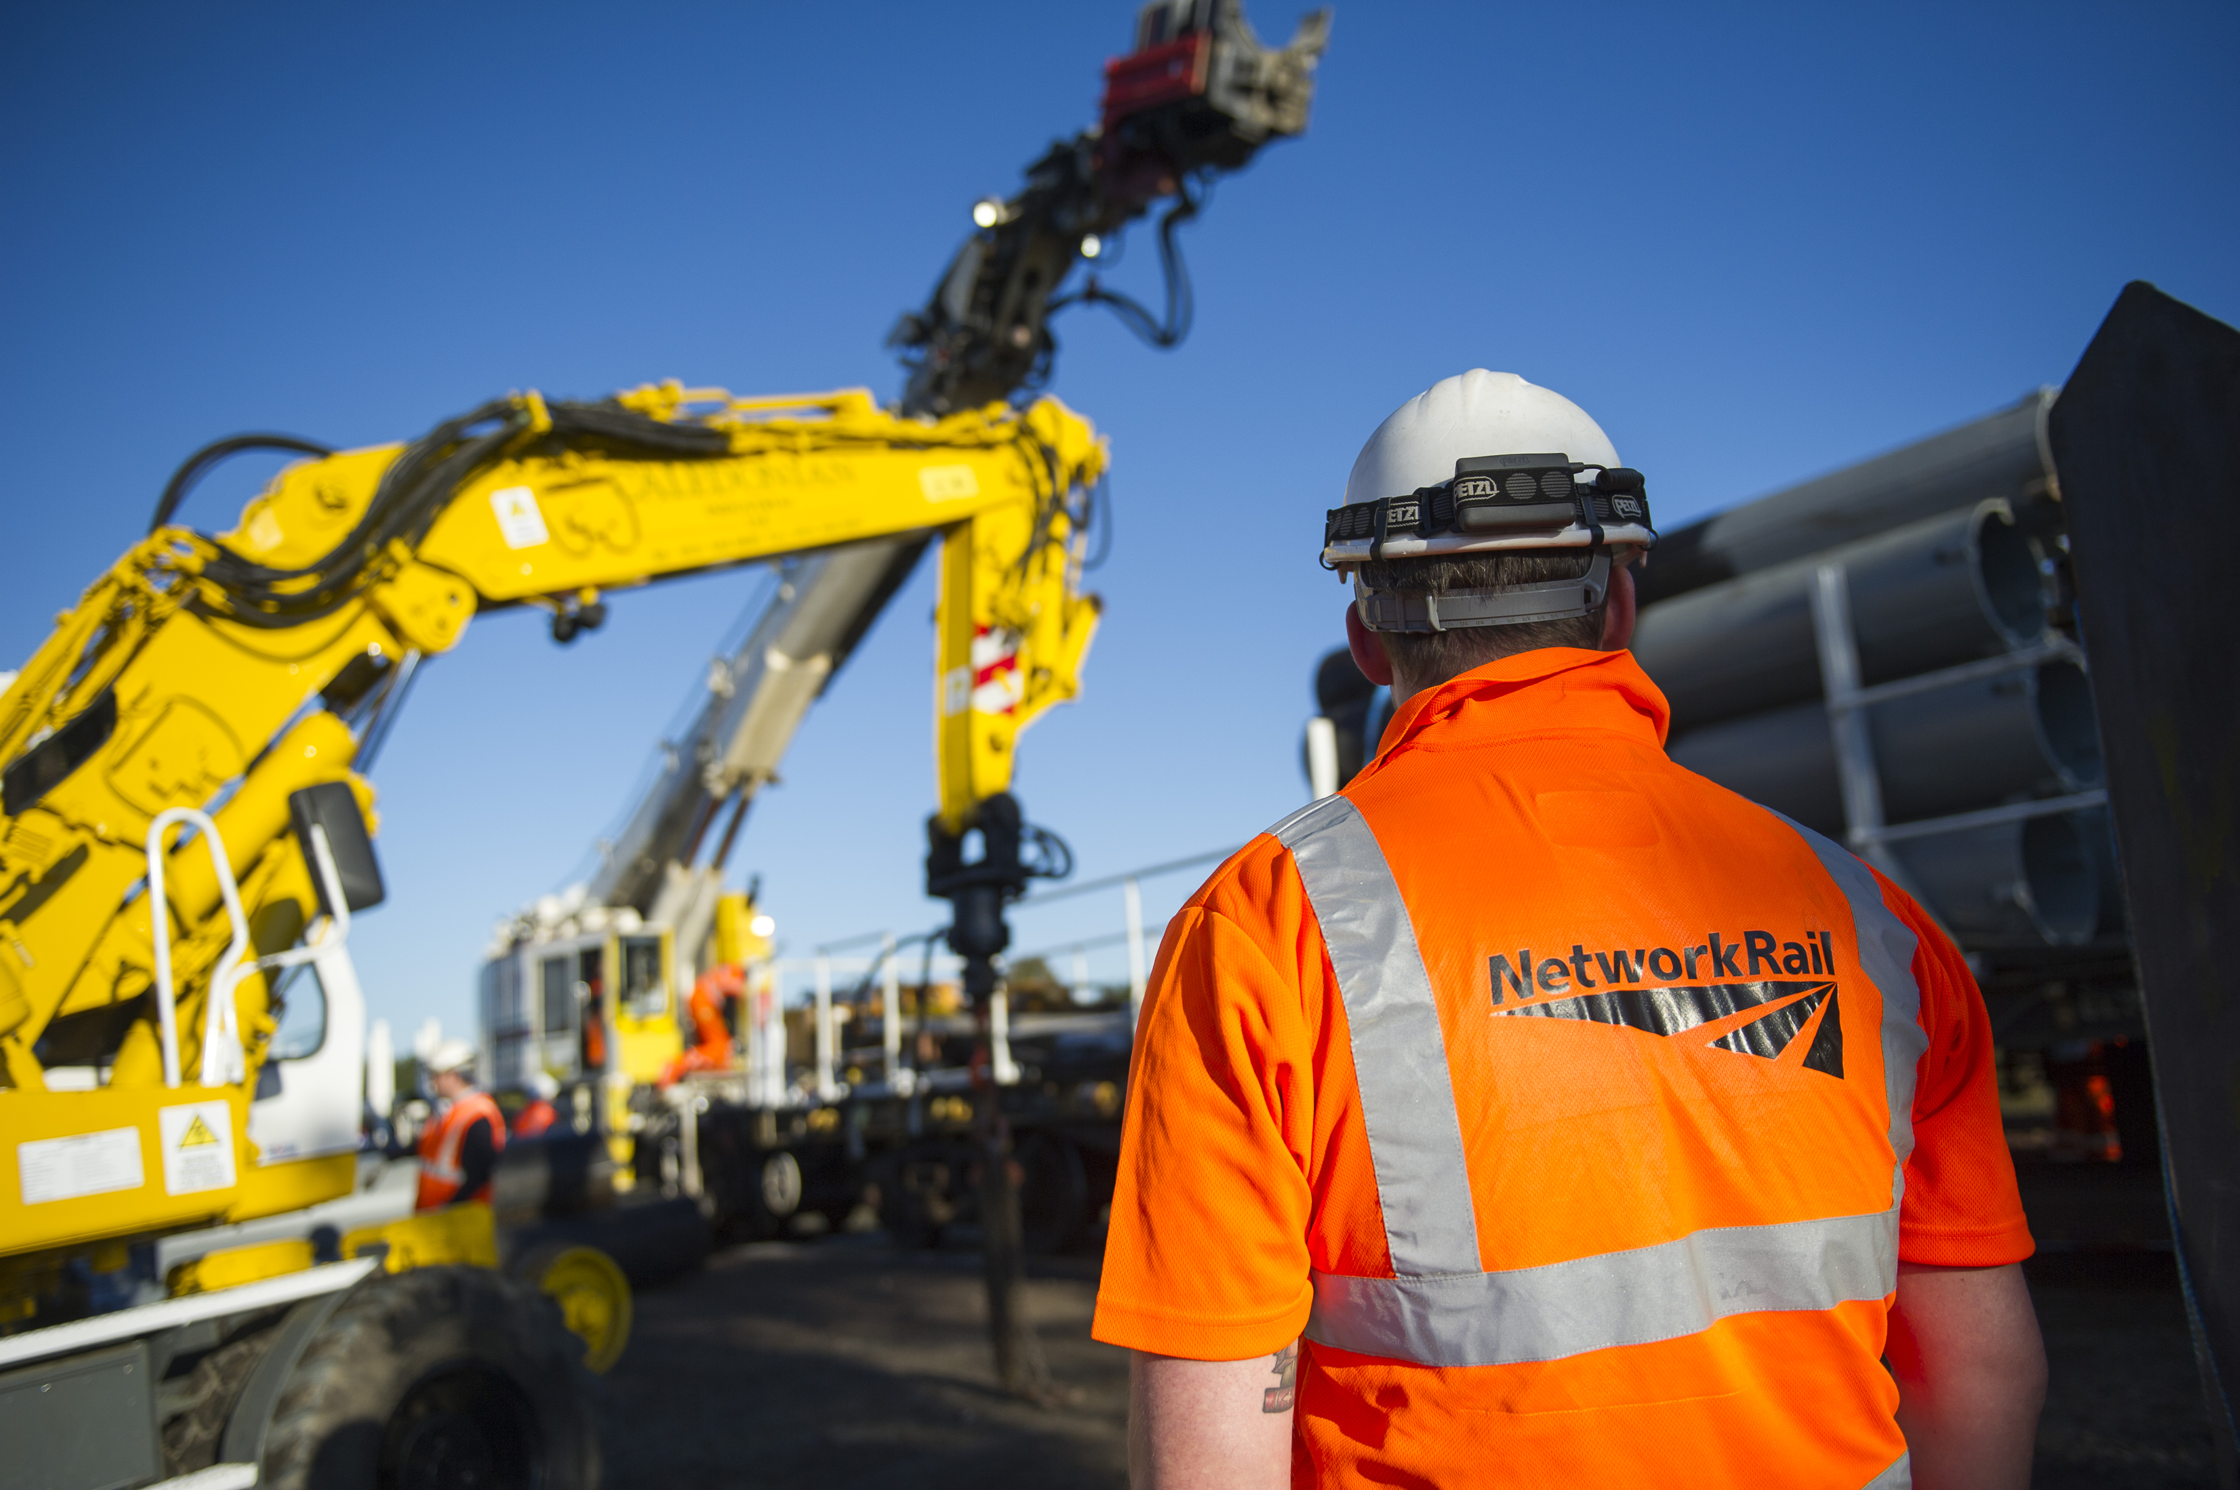
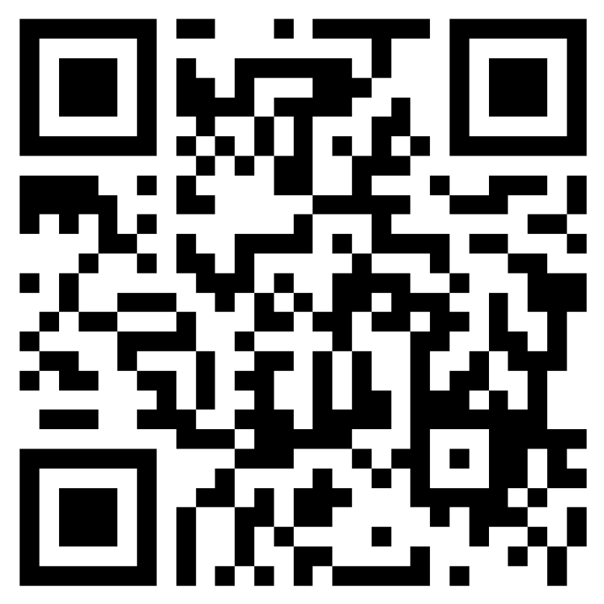

Thank You
Fill in the Feedback Form Here:
https://forms.office.com/r/qMQ6JtHQrM
Notes:
https://forms.office.com/r/qMQ6JtHQrM

Slide 19
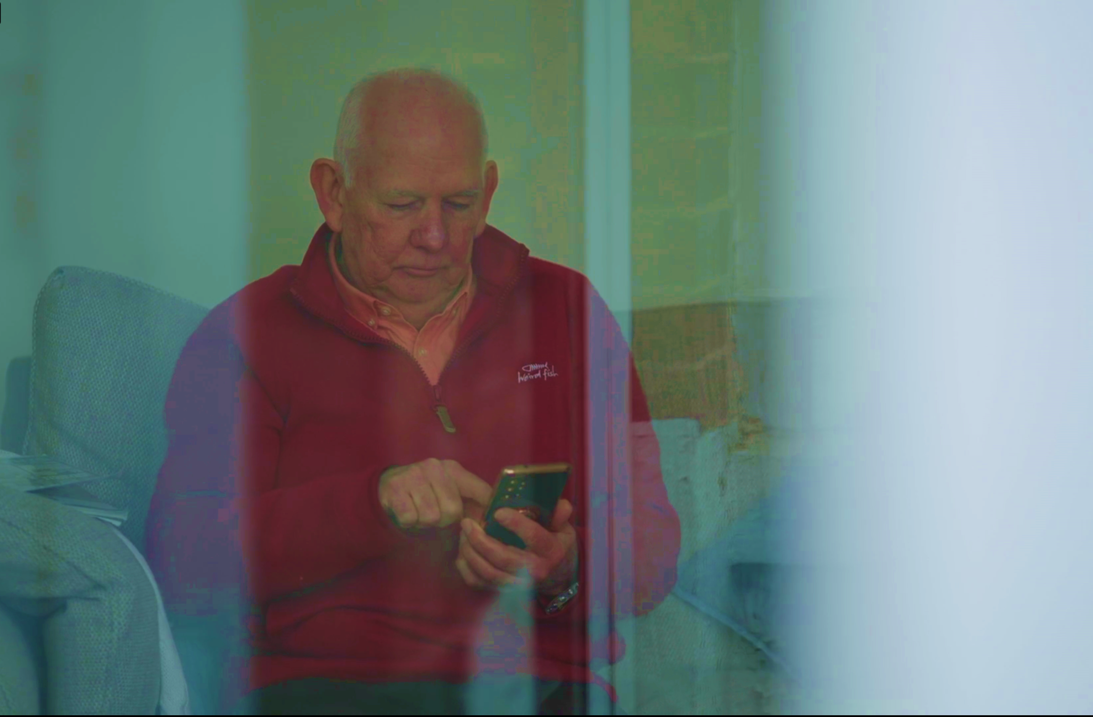
Bryant’s Story - It Happened to Me
In this session, we are going to discuss the impact that Bryant’s account has had not only on him but on his extended family.
Notes:
Optional slide - may help with discussion

Slide 20

Discussion Points
This incident happened in September 1981. What do you feel has changed since then to improve safety when working on, or in close proximity to live 25kV Overhead Line Equipment (OLE)?
What could we do to make this type of incident less likely?
When establishing a new team or joining a new team, how can we build trust rather than complacency?
What are the barriers stopping you from using the Work Safe procedure and how can you/we overcome these?
Besides the obvious physical impact, what are the wider impacts?
What, if anything, will you take from Bryant’s story?
Notes:
Optional slide - may help with discussion
This incident happened in September 1981. What do you feel has changed since then to improve safety when working on, or in close proximity to live 25kV Overhead Line Equipment (OLE)?
The introduction of the Live Saving Rules, Test before earth, test before touch, the work safe procedure, Take 5
What could we do to make this type of incident less likely?
Understand the importance of procedure and process, check the paperwork against the location, roads, limits.
Have open discussions around the protection/paperwork
When establishing a new team or joining a new team, how can we build trust rather than complacency?
Be open, welcoming, approachable and understand each other. Fairness, inclusion, Respect
What are the barriers stopping you from using the Work Safe procedure and how can you/we overcome these?
People think it will stop the shift or cancel the work, it could be sorted in less than 30 minutes. people do not fully understand the procedure. People are worried they’ll be banned from site or dismissed and be viewed as a ‘troublemaker’.
Besides the obvious physical impact, what are the wider impacts?
Family/friends/work colleagues affected, others working in the same job role. Disruption to every day life, PTSD is a major issue, make sure people are offers help,
What, if anything, will you take from Bryant’s story?
Please record any feedback and send it to electricalculture@networkrail.co.uk.

Slide 21
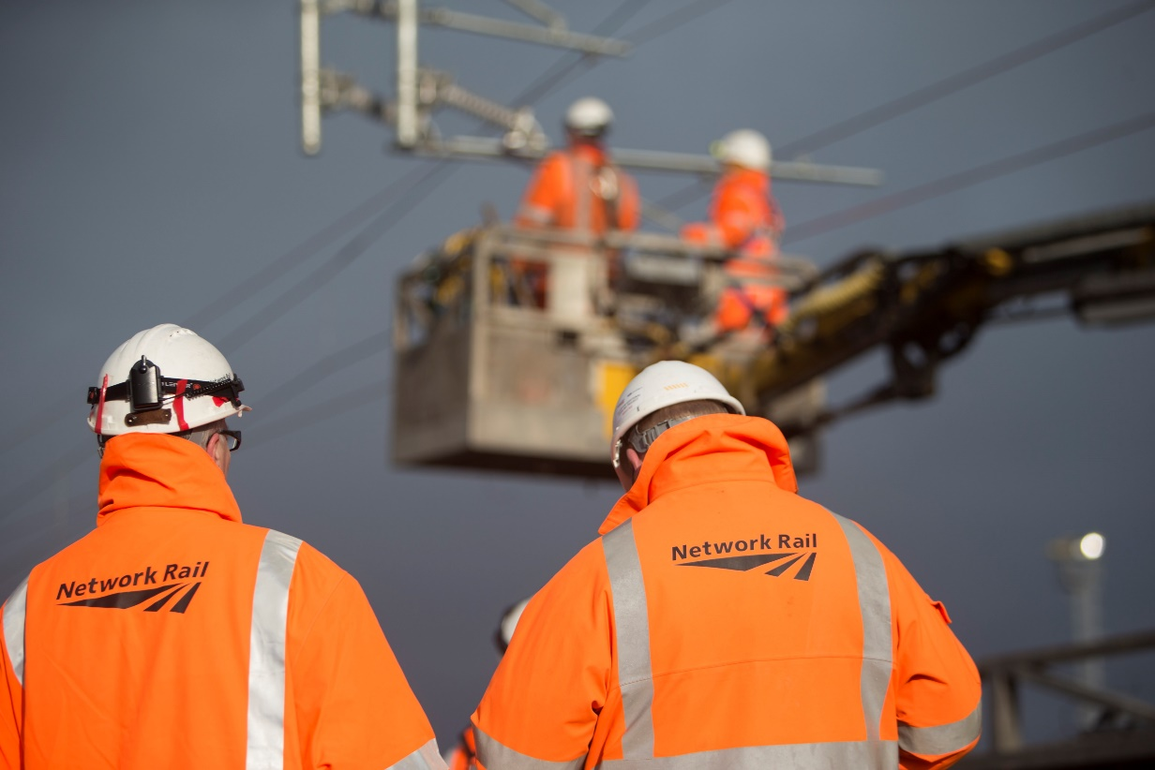
OLE – In the Basket
In this session, we are going to discuss the importance of challenging electrical safety, what actions we can take to stay safe, and what the consequences are if we act unsafely or do unplanned work.
And finally, the impact injuries can have both mentally and physically.
Notes:
Optional slide - may help with discussion

Slide 22
Discussion Points
Where in the scenario were there opportunities for staff to choose to challenge?
After the incident, what would you expect to happen next?
What could be improved in the quality of the Form C briefing?
Share an example if you’ve had to undertake work or witnessed work taking place that wasn’t ‘planned’?
What are the physical and mental consequences to all those involved in an electrical accident or near-miss?
Notes:
Optional slide - may help with discussion
Discuss with the group at which stage they feel either individual had the chance to challenge the others.
The machine operator and operative in the basket when discussing the defect
The Machine controller before the movement took place
Although not shown, the COSS(OLP) brief. What was said, did the COSS(OLP) confirm understand, he clearly mentioned the adjacent goods line was live but were any control measures in place?
After the incident, what would you expect to happen next?
Reporting the incident, offer support to those involved.
Near Miss?
Think about the affects it had on those in the basket and the rest of the group, PTSD is rarely immediate, counselling?
Should the incident be formally investigated, drugs and alcohol screening, or was the ‘conversation with the COSS(OLP) enough?
What could be improved in the quality of the Form C briefing?
Remember this is your first line of defence, what information should be briefed to the workgroup?
Do you undertake work that isn’t ‘planned’?
Do we put the work ahead of our own personal safety?
Discuss how doing the right thing in terms of improving the railway may be putting ourselves and others at risk.
Its important that a frank and open discussion takes place takes place
What are the physical and mental consequences to all those involved in an electrical accident or near-miss?
Life changing injuries, possibly fatal. What about the lasting impact on them physically and mentally, wider circle, family, friends colleagues
The surrounding teams would have witnessed the incident, the colleagues at the depot, make sure support is offered and remember its OK not to be OK.
Valuable lessons
Speak up and support your colleagues if they have questions
The test before touch rule is not an optional requirement, always bringing the tester with you.
Open and honest discussion around Test Before Touch
Follow up conversation
Discuss what considerations should be made when a defect is found during routine maintenance, how is the work risk assessed?
Discuss what people feel the impact would be on the individuals involved, their families, their colleagues. Consider drawing back to Bryant's story and how its impacted him and his family.
Further probing questions
How often could you recall the COSS(OLP)s brief, 3 or 4 hours into the work? what can be done to improve this?
Can momentary lapses in concentration be dangerous? If yes, how and why?

Slide 23
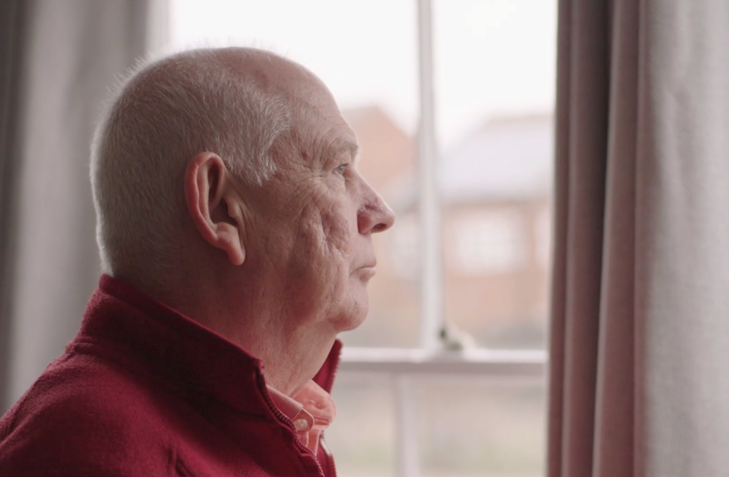
How Can we Prevent a Similar Incident?
If you were in the same situation, what could you and your team have done to prevent the event in the film from occurring?
What were the possible consequences?
What valuable lessons have you learnt from watching this scenario?
Notes:
Optional slide - may help with discussion
What If you were in the same situation, what could you and your team have done to prevent the event in the film from occurring?
COSS , if you was the COSS what would your brief contain, would you have added anything to highlight the presence of a Blue hat?
Challenges, are you comfortable being challenged as well as challenging
Would you have advised your mate to keep quiet, or encouraged him to challenge, maybe challenge on his behalf?
Assumption, what would be your response if told "it's the same as last night"?
Possible consequences
Life changing injuries, possibly fatal. What about the lasting impact on them physically and mentally, wider circle, family, friends colleagues
The surrounding teams would have witnessed the incident which can cause trauma
Potential disciplinary actions
Potential to lead to a full investigation that could lead to legal consequences
Valuable lessons
Speak up and support your colleagues if they have questions
The test before touch rule is not an optional requirement, always bringing the tester with you.
Open and honest discussion around Test Before Touch

Slide 24
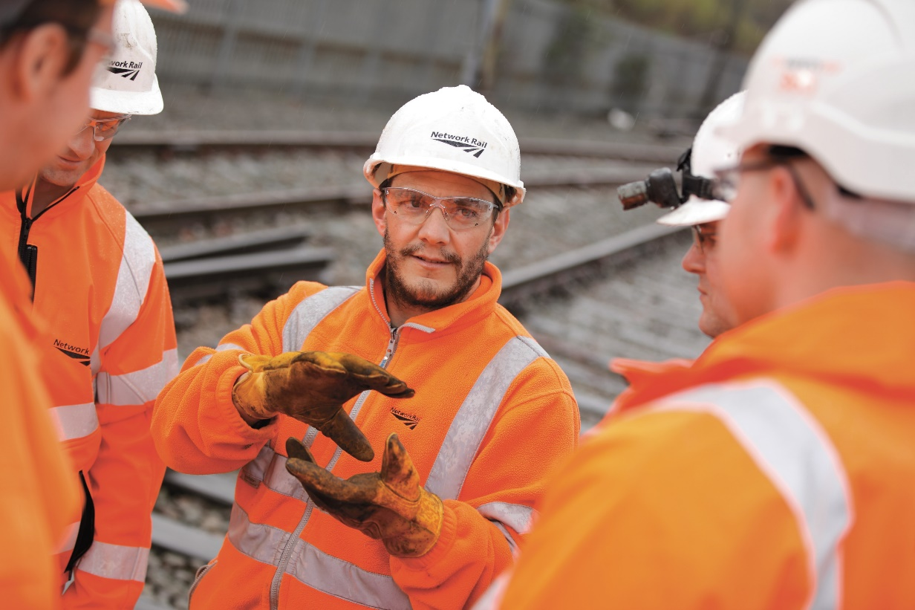
Electrical Safety – Who is Responsible?
In this session, we are going to discuss the importance of everyone taking responsibility for safety.
Recognise why the safety standards and procedures won’t exclusively keep you safe and understand how human factors play a part.
Notes:
Optional slide - may help with discussion

Slide 25
Discussion Points
Why do you think it’s important to challenge poor safety behaviours or paperwork?
Share your personal stories when you have chosen to challenge like Al. What happened?
Ultimately who is responsible for your safety?
What do you feel that you can do to ensure that the correct safety processes and procedures are followed every time?
Notes:
Encourage the group to be open and honest.
Why do you think it’s important to challenge poor safety behaviours or paperwork?
Share your personal stories when you have chosen to challenge like Al. What happened?
Ultimately who is responsible for your safety?
What do you feel that you can do to ensure that the correct safety processes and procedures are followed every time?
Summary:
Although we have extensive safety standards, processes, and procedures to keep us safe at Network Rail, serious electrical accidents and life-changing events are still happening.
Everyone holds responsibility for their safety; your choices and actions determine how safe you are.
Your ability to do a job safely is based on your training, behaviours, and actions.
Personal responsibility requires us to work safely, care about the safety of our co-workers, friends, and other people, and always intervene when we observe unsafe behaviours or conditions.

