Slide 1

Driving Safety
Stand Down
Notes:
Thank you all for attending, we realise holding these stand downs are disruptive but the next 90 minutes are hugely important in keeping ourselves and colleagues safe. I hope you will embrace and engage in the session.

Slide 2
Agenda for the driving safety stand down
Manager’s introduction – purpose and structure of the session
Manager-led discussion
  what is your reason for getting home safe?
  what are the impacts of unsafe driving practices?
Some views from our staff – why is safe driving important?
Exercises - video introduction
  Test your knowledge
  The Safety Challenge
Closing Comments
Notes:
There are five parts to the agenda today.
We will all get out of it, what we put into it.
This will take approx. 90 mins
[Manager to talk through agenda items]

Slide 3



Notes:
What is a stand down?
It is time-out from day-to-day work for an extraordinary event, in this case to focus on driving safety.
This is for everyone at Network Rail.
In the last month we’ve lost another two colleagues to Road Traffic Accidents. That makes a total of 12 colleagues (from NR and contractors) that we’ve lost since 2011
12 people with lives, families and aspirations, that went to work one day, and never made it back home.
We have failed. This is simply not good enough and it’s up to all of us in this room to do something about it.
Whilst we have rules, standards, and technology to help us reduce driving risk, compliance with these rules and tools sit with the individuals and it’s our job as leaders to foster a culture where our people take this seriously, and refuse to accept unsafe driving.

Slide 4
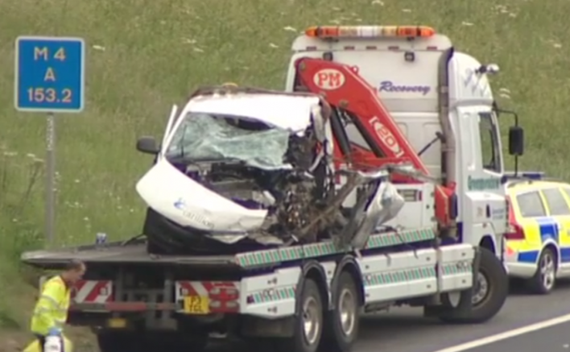
Why are we having a Stand Down?
Carillion – 9 June 2014
Notes:
Team left Reading at 4am to go to Mountain Ash, south Wales
Hotel rooms were booked, however they chose to drive home.
They were travelling in a Carillion Rail resourcing van along the M4 when they hit a lorry at Junction 17
Two colleagues were pronounced dead at the scene.
Another colleague died later in hospital.
The investigation confirmed that the three colleagues killed were not wearing seatbelts.
A few weeks ago the driver was found guilty of three counts of causing death by dangerous driving and received four-and-a-half year custodial sentence.

Slide 5
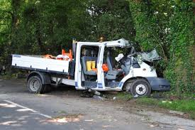
Why are we having a Stand Down?
Crossrail – 5 June 2016
Notes:
Two colleagues from a contracting organisation were returning from Abbey Wood Crossrail East site following a night shift
Their vehicle left the road on the A267 near Eastbourne travelling at around 40mph and collided with a tree
The passenger was killed but the driver was unscathed
A full investigation has been launched

Slide 6
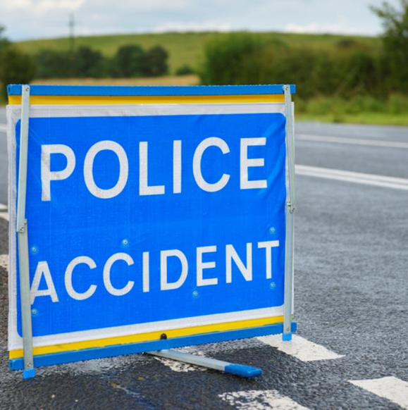
Why are we having a Stand Down?
Western – 11 June 2016
Notes:
Western – 11 June 2016
A construction manager was travelling on the A34 Northbound to do a night-shift on at a High Output Plant System (HOPS)
The colleague’s vehicle was struck by another vehicle travelling in the opposite direction after crossing the central reservation
The colleagues sustained multiple bleeds on the brain, cracked vertebrae, and was in cardiac arrest at the scene
He was lifted by air ambulance to John Radcliffe hospital in Oxford and placed in an induced coma
His family attended his bedside, having travelled back from Australia; his life-support machine was later switched off

Slide 7
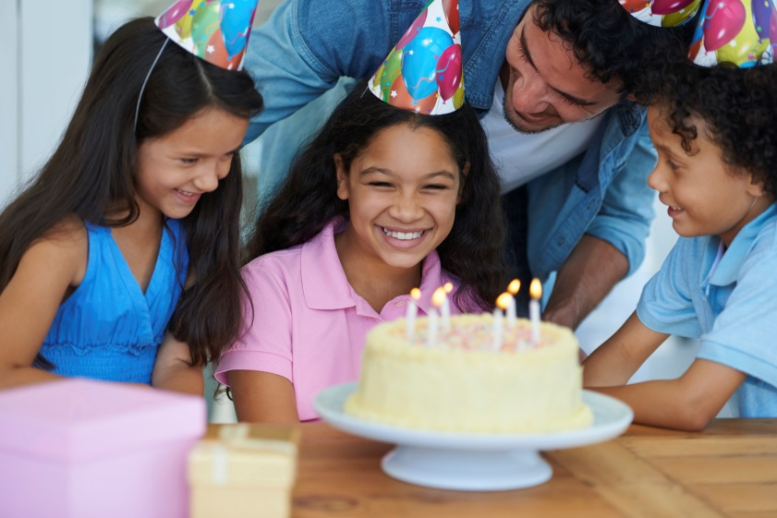
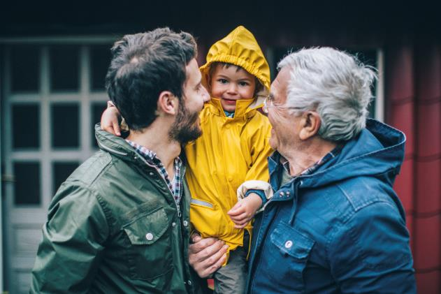
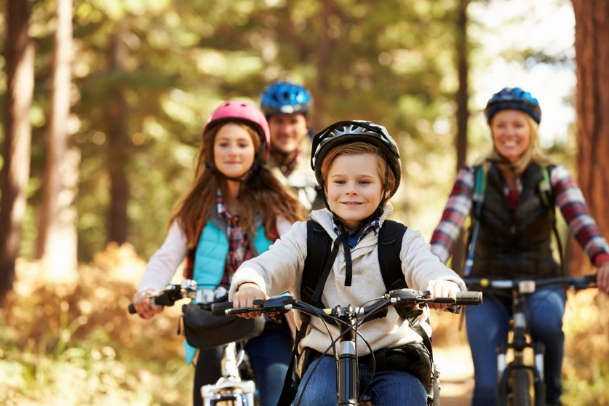
Take a moment…
Notes:
I want us all to take a moment and really think about the 12 colleagues we’ve lost.
Think about how their families are coping without them. Think about all of the things they’ll never get to do. The simple pleasures we take for granted, like going for a bike ride, or hosting a birthday party for their children.
Think about your loved ones, and what it would feel like to lose one of them. And how they might cope if you didn’t make it home one day.
12 people went to work one day and kissed their partners and children goodbye. 12 people who never made it back home.

Slide 8
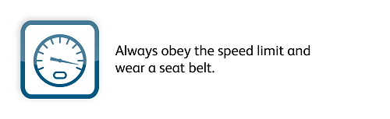
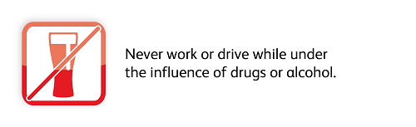
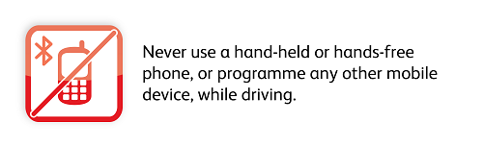
Why are we having a Stand Down?
It is important that we all drive safely
Driving safely includes following the Lifesaving Rules
Notes:
Our Lifesaving Rules are there to protect us. They also reflect the legal requirements.
Network Rail also has the requirement for vehicle driving license checking.
Details of how to comply with this are included within the drivers handbook.

Slide 9
Why are we having a Stand Down?
Accidents are often the result of a number of causal factors
By eliminating just one of these causal factors we can significantly reduce the likelihood of accidents occurring
We do not want anyone working for Network Rail to get hurt
Every single accident is a loss to the entire organisation
Notes:
By following the Lifesaving Rules, we can reduce the likelihood of having an accident and minimise the effects on us even where we can’t avoid

Slide 10

How can we be safe in a vehicle?
Team support
Wear our seat belts
Control vehicle speed
Personal responsibility
Notes:
Personal responsibility for our own actions – following the rules both legal requirements and Network Rail.
Team Support - challenging the behaviours of others e.g. other passengers not wearing their seatbelts.
Wear our seat belts – Always buckle up
Control vehicle speed – drive to the speed limits or to the conditions

Slide 11
Department for Transport research shows:
People are risking their lives… and the lives of others
31%
of
commercial
drivers
DO NOT wear seatbelts
32%
of
passengers
in commercial
vehicles
DO NOT wear seatbelts
Notes:
People are breaching our Lifesaving Rules, and putting themselves and others at risk.

Slide 12
People are risking their lives… and the lives of others
In 2015/16 there were 611 known breaches by Network Rail staff
Our Lifesaving Rules and the law have been broken.
Type of breach | Breaches
Travelling through red light | 14
Not wearing a seatbelt | 15
Speeding | 565
Using a hand-held device | 17
Speed limit | Driver’s speed | Variance
30mph | 56mph | +26mph
40mph | 66mph | +26mph
50mph | 78mph | +28mph
60mph | 83mph | +23mph
70mph | 101mph | +31mph
Notes:
Last year our rules, and the law, were broken 611 times. These are the ones we know about.
We have several recorded examples where drivers are travelling in excess of 20mph over the speed limit.
Seat belt laws came in in 1983!

Slide 13

Views from our colleagues……
Notes:
We will now see a video of some of our colleagues recounting their experiences of driving accidents
Using your cursor, click the Play icon in the bottom left of the video block, it will automatically play full screen for you

Slide 14
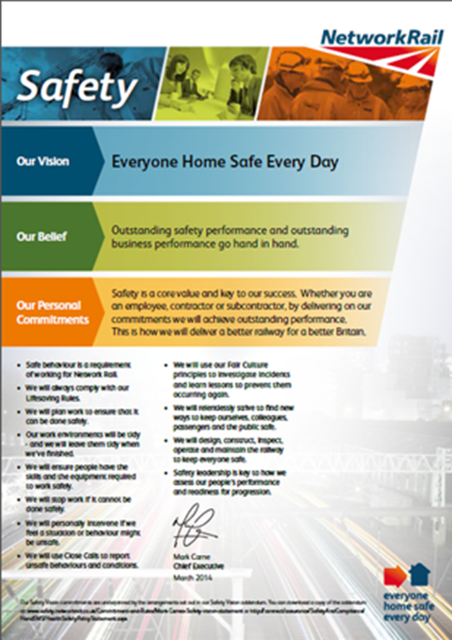
We all determine our safety culture
The safety culture on a site grows from the sayings and doings of us all.
It can grow strong, and we always have the potential to do things better and safer.
By being strong and committed we always improve our safety culture
Notes:
The safety culture on a site grows from the sayings and doings of us all.
It can grow strong, we always have the potential to do things better and safer.
By being strong and committed to safety we will improve our safety culture

Slide 15
Participation Sessions
Session 1
Test your knowledge
Notes:
The session is to test your knowledge on safe driving

Slide 16
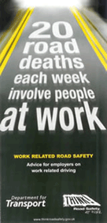
Test your knowledge…
Q1: Wearing seat-belts can reduce the risk of death by what percentage?
Q2: What percentage of crashes causing death or serious injury are tiredness related?
Q3:If travelling at 70mph how many car lengths will it take you to stop?
Q4:If travelling at 30mph and a person steps out three car lengths ahead of you could you stop without hitting them?
Q5: What percentage of crashes are down to driver error?
Notes:
Session leader gives guidance:
I’m now going to ask you five questions. Please call out the answer.
I will help you out by saying higher or lower…
Q1 Answer: 61% It is essential that back seat passengers belt up too, for their own safety and the safety of other vehicle occupants. In a crash, an unrestrained back seat passenger can be thrown forward with enough force to kill the person in front of them.
Q2 Answer: One quarter – One in four.
Q3: Answer: 24 car lengths. You will travel 21 meters while you think about your reaction and a further 75 metres to brake and come to a stop.
Q4: Answer: No. If travelling at 30mph you would hit them at 27mph the force of which is the equivalent of falling from the third floor of a building.
Remember the greater the impact speed the greater the chance of death.
“The risk of a pedestrian who is hit by a car being killed increases slowly until impact speeds of around 30 mph. Above this speed, the risk increases rapidly, so that a pedestrian who is hit by a car travelling at between 30 mph and 40 mph is between 3.5 and 5.5 times more likely to be killed than if hit by a car travelling at below 30 mph
Q5: Answer: 95%

Slide 17
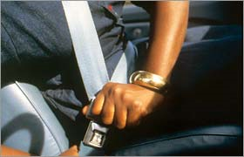
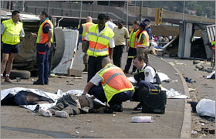
Question time: in the past week…
Q1: Hands up – how many of you have exceeded the speed limit in the past week?
Q2: Hands up how many of you have driven after a glass of wine in the past week?
Q3: Hands up – how many of you have driven while tired in the past week?
Q4: Hands up – How many of you have been distracted while driving and had a near miss?
Notes:
Session manager to say: Now let’s talk about what we have actually done over the past week. Please be honest.
Q1 . Get response of hands in room.
Commentary to add: A Brake and Direct Line survey found that nearly six in 10 (57%) drivers admit speeding in the past year. One in five (19%) said they’d done so deliberately, because they thought it was safe as there wasn’t much traffic around, showing disrespect for the law as well as ignorance of the risks.
Q2 . Get response of hands in room.
Commentary to add: Evidence established by Brake shows that people who have had alcohol and are below the alcohol limit still respond in a slower less accurate manner. Ie the best thing is not to drink and drive
Q3 . Get response of hands in room.
Commentary to add:
Too little sleep radically affects your ability to drive safely, increasing reaction times, reducing attention, and reducing your ability to control the vehicle. Research suggests driving tired can be as dangerous as drink-driving.
Q4 . Get response of hands in room.
Commentary to add: Anything which divides your attention away from driving including use of mobile technology, eating & drinking, loud music, sat navigation, passengers. All these cause a driver to divide their attention from driving and can cause a significant reduction in response times and driving performance.
NOTE to manager: if discussion is slow, then stimulate by:
Manager responding honestly themselves
Asking the person ‘why they did what they did?’

Slide 18
Participation Sessions
Session 2
The Safety Challenge
Notes:
This session has been designed to encourage our employees to challenge unsafe behaviours.
While the session is focusing on driving behaviour we should emphasise the fact that we are all responsible for safety and should challenge all unsafe behaviours.

Slide 19
Views from our colleagues……
Notes:
Using your cursor, click the Play icon in the bottom left of the video block, it will automatically play full screen for you

Slide 20
The Safety Challenge
1
Discuss unsafe behaviours relating to driving
2
Talk about personal responsibility
3
Positive actions we can take
Not wearing seat belts
Speeding
Driving Tired
Why do we choose to break the rules?
Report
Seek assistance
4
5
How do we feel about challenging?
Do we own safety or leave it to someone else?
How can we encourage challenge?
Do we all commit to challenge unsafe behaviours?
How our actions affect others
Challenge
Notes:
This is a discussion session to encourage our staff to take responsibility for safety and challenge unsafe behaviours.
Step 1 – play the video (optional)
Step 2 - Discuss each of the topics in order to facilitate a discussion where the audience agree we all have a responsibility to challenge and then ask how they would do this. Perhaps use role play if the audience is willing to participate.
As a facilitator think about the timings during the discussion
Avoid letting the discussion stray off topic
This session is designed to allow the audience to encourage each other to challenge unsafe behaviours

Slide 21

What else must we do?
Notes:
We must all take responsibility for getting ourselves and each other home safe every day
While we have rules, standards and technology to help us reduce driving risk, compliance with these rules and tools sit with all of us.
What is our team commitment?

Slide 22

What are we doing to prevent another?
Notes:
One death is too many ….

Slide 23


Find out more on….
Connect:
http://connect/communities/safetystanddown/default.aspx
#Safedriving
Notes:
This slide provides links to locations where additional information can be found.
Additionally there will be a special edition of the Network magazine published.

