Slide 1
Delivery & Collection Point Management
Lineside meet and greet good practice
Road Rail Vehicle Safety Improvement Programme (RRV-SIP)

Slide 2
Contents
Why good practice is needed
Delivery & Collection - at the planning stage
Delivery & Collection - on site
(Highways Interface issues covered in a separate good practice brief)

Slide 3
The need for good practice
There have been a number of catastrophic incidents over lineside deliveries and collections as exemplified by the Lisvane incident in 2014.
The ORR has stated that:
  Management arrangements for plant deliveries compares unfavourably with that normally found at non-rail construction sites
  Network Rail has been non-compliant with their CDM responsibilities
  ALO activities involved in lineside deliveries and collections are a significant and inadequately managed risk

Slide 4

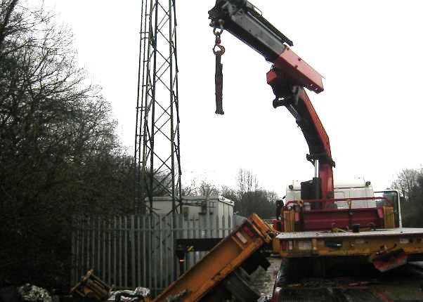
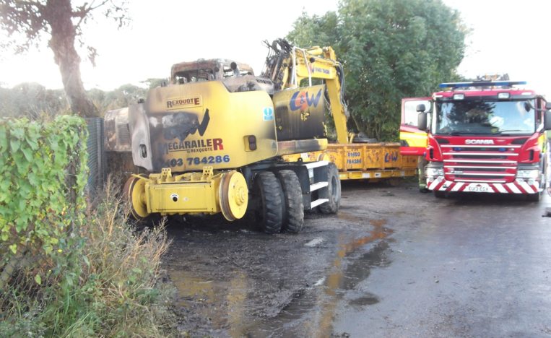
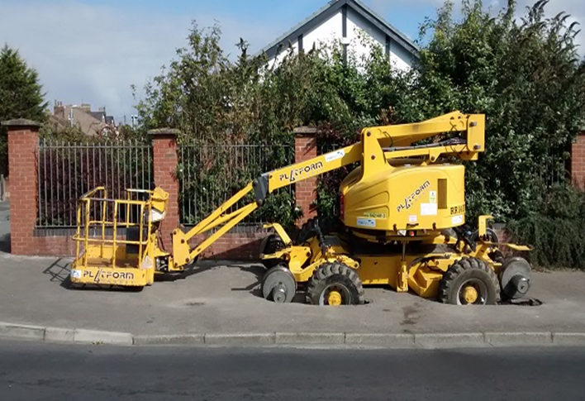
Multiple incidents
Life changing injuries
Lost shifts
Damage to third party property
Reputational damage
All preventable incidents through:
  Good planning
  Legislative compliance
  Application of life saving rules

Slide 5
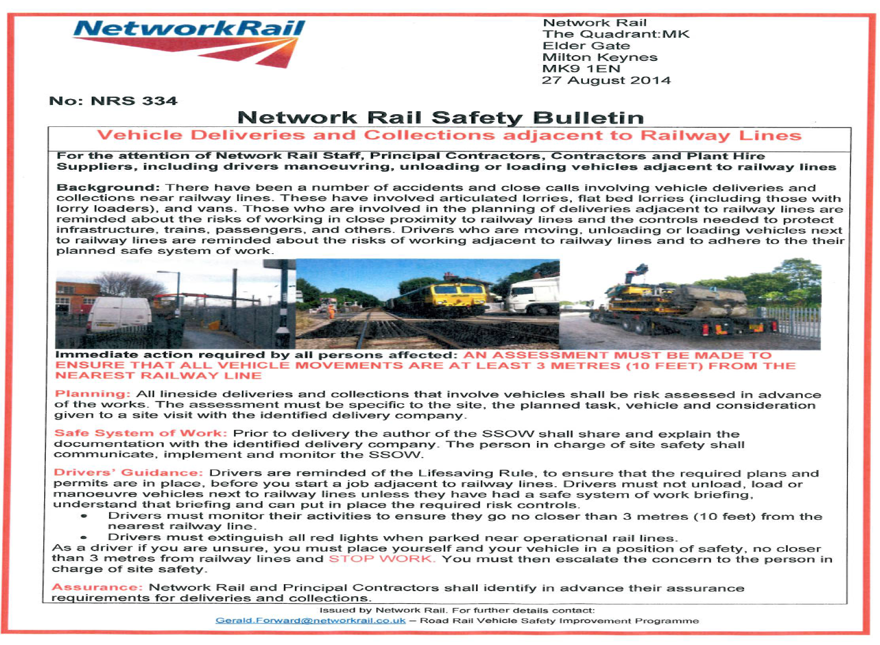
Refer to Safety Bulletin NRS 334
Issued 27th August 2014
Reinforces the need for good planning, including the need for risk assessment in advance of works
Points out, prior to delivery the author of the SSOW shall share and explain the documentation with the identified delivery company
Stresses that drivers must not unload, load or manoeuvre vehicles next to railway lines unless they have had a safe system of work briefing, understand that briefing and can put in place the required risk controls.

Slide 6
Delivery & Collection in the Planning stage
Should review vehicular accesses across DUs and Works Delivery to determine
Whether to STOP plant being stored at the access
Whether to STOP heavy materials delivered by lorry loader being stored at the access.
To determine ALO risk of deliveries of Plant and heavy materials (needing a crane or forklift to unload)
NOTE Accesses that have restrictions put on them may still be used as long as the delivery is within a possession and the Plant is removed before the possession is given up
Ellipse (Network Rail’s asset register) shall be used to better understand access points combined with site visits
Rail Infrastructure Network Modal (RINM) provides visualisation of access points.
A local dossier should then be produced with visualisation of each access along with the restrictions, with this then sent to third parties

Slide 7
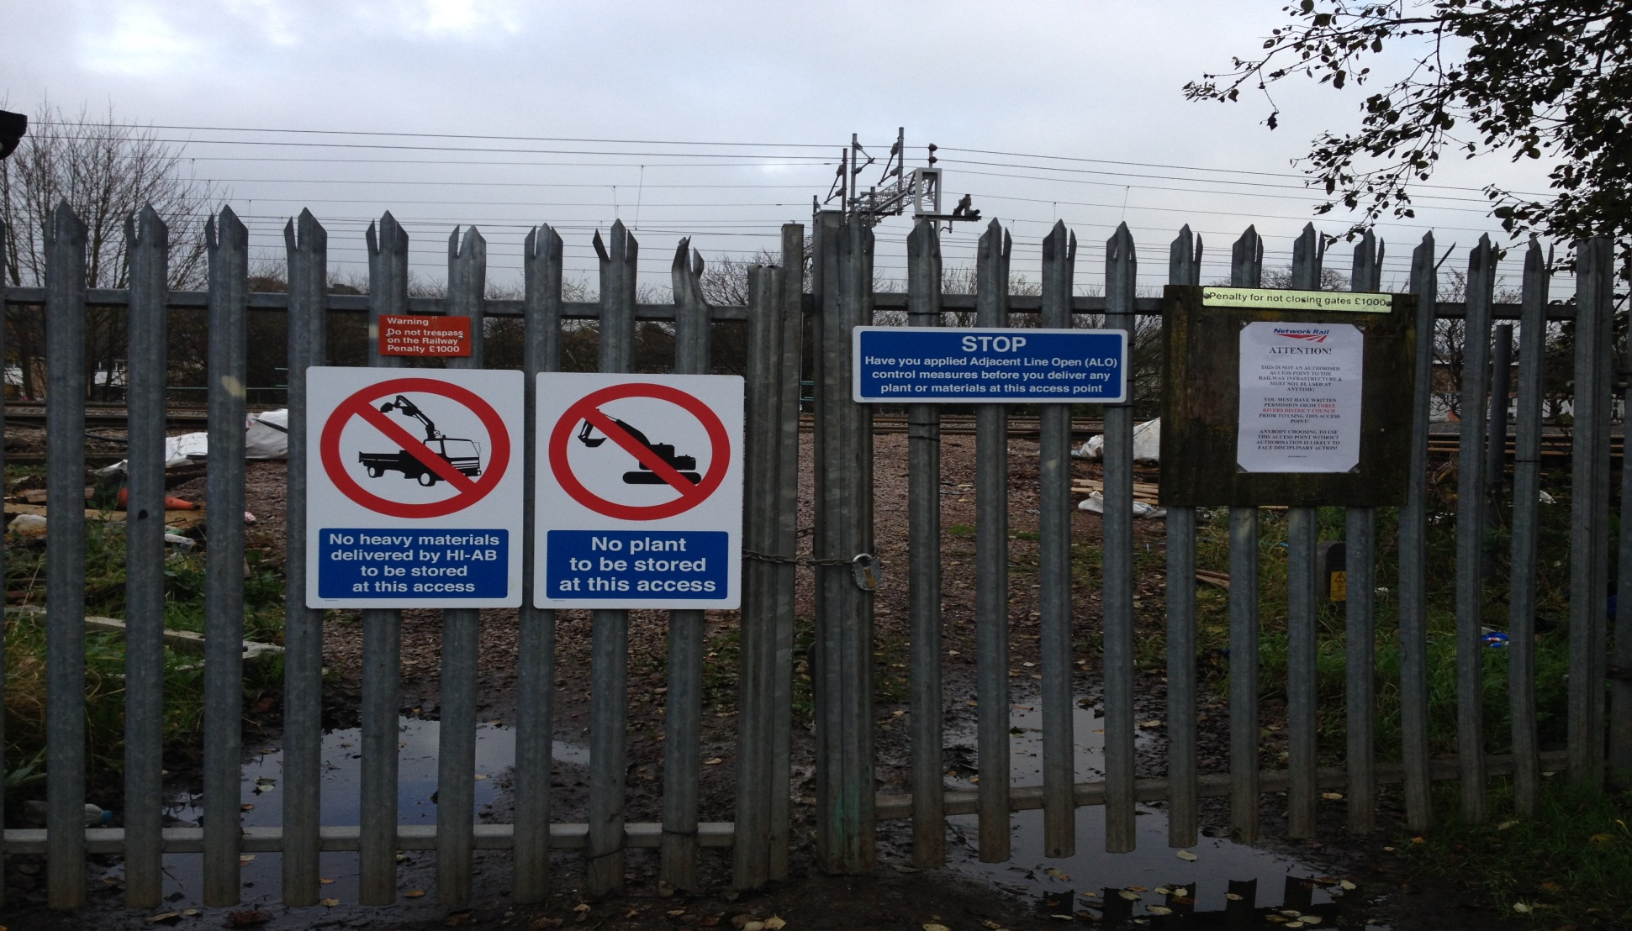
Example of good practice gate signage

Slide 8
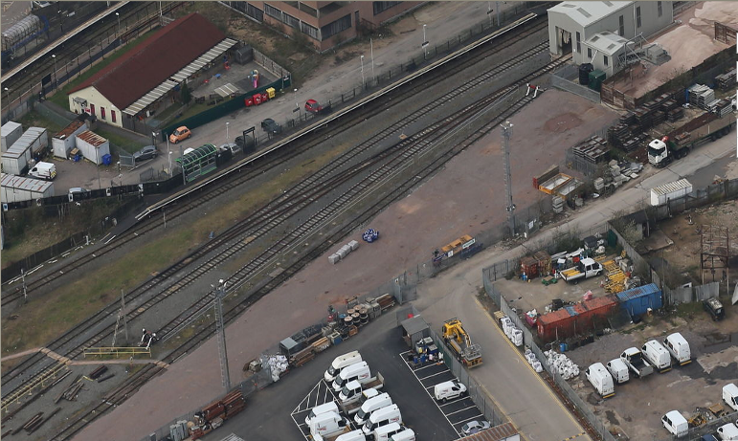
This is an overview of Watford sidings where plant and materials can be stored
ALO shall be considered
All OTP or heavy material (needing a crane or forklift to unload) deliveries and collections shall be met.
STOP Have you applied Any Line Open (ALO) control measures before you deliver any plant or materials at this access point.
ALL DELIVERIES MUST BE MET.

Slide 9
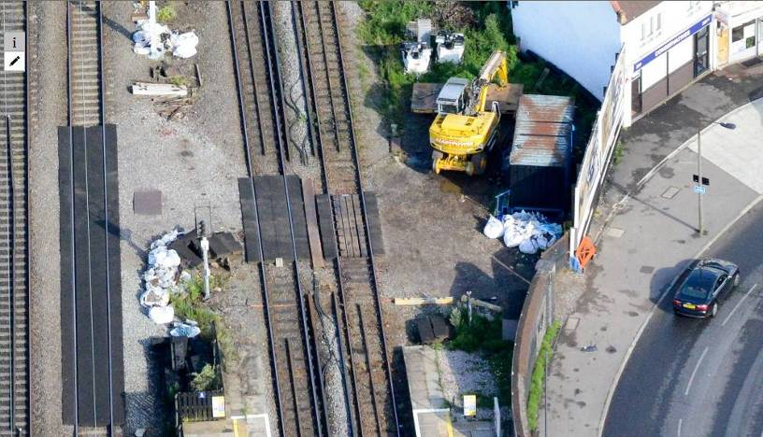
Overview of restrictions implemented at access
NO PLANT OR MATERIALS TO BE STORED AT THIS ACCESS
STOP Have you applied Any Line Open (ALO) control measures before you deliver any plant or materials at this access point.
ALL DELIVERIES MUST BE MET.
This is an overview of Headstone Lane access which is a good example of the risks involved when delivering plant.
There was no protection in place when the RRV was delivered and also no NWR rep on site.
The storage of plant and/or heavy materials (needing a crane or forklift to unload) is now restricted at this access.

Slide 10
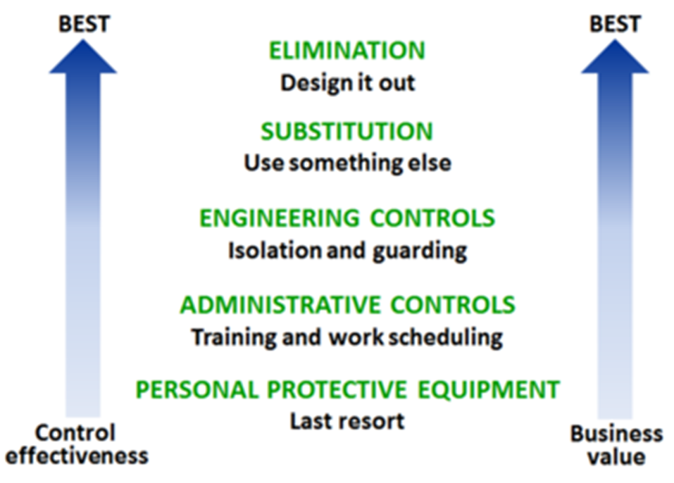
Delivery & Collection in the Planning stage
CDM Regulations 2015 apply to a wider range of activities, and apply to Network Rail
Focus is on prevention and following the continuous cycle of risk avoidance through informing others, eliminating hazards and reducing risk, working to design out risk and avoid hazards as follows:

Slide 11
Delivery & Collection in the Planning stage
HSE Guidance on client duties is that:
The Client has overall responsibility for the successful management of the CDM works and is supported by the Principal Designer and the Principal Contractor throughout the project
The Client ensures that the project is set up so that it is carried out from start to finish in a way that adequately controls the risks to Health and Safety of those who may be affected. Client must apply principles of prevention
CDM 2015 makes the Client accountable for the impact of their decisions and the approach they have on Health, Safety and Welfare
Standard NR/L2/OHS/0047, has been updated alongside supporting documents

Slide 12
Delivery & Collection in the Planning stage
To ensure compliance with legislation, that a SSOW is in place, and ALO is adhered to, ALL deliveries and collections of OTP and heavy materials (needing a crane or forklift to unload )shall be met by a Network Rail/Principal Contractor representative. This is also stated within Plant Supplier contracts.
This will ensure no one is alone if an accident takes place
  The representative is there to carry out COSS/SWL duties and ALO site co-ordinator duties and must be competent to do so.
  The representative is not at any time there to assist in the unloading or slinging of OTP or materials

Slide 13
Delivery date/time spread sheet:

Slide 14
Collection date/time spread sheet:

Slide 15
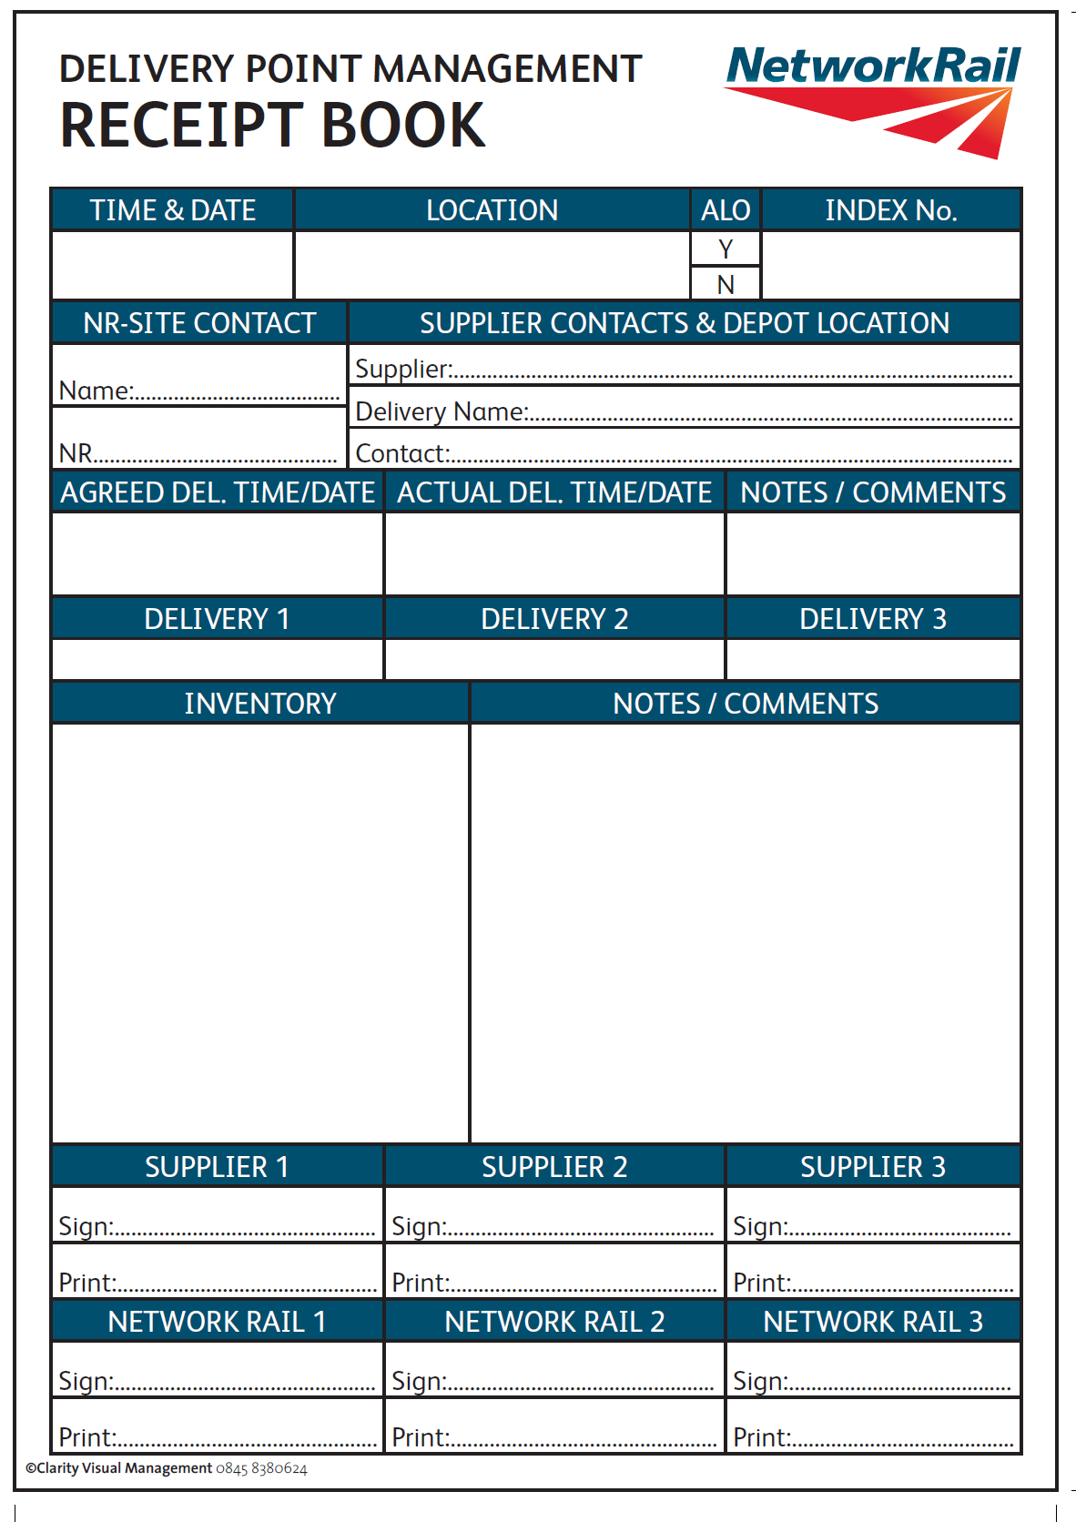
Delivery & Collection on site
Example receipt book for Delivery & Collections

Slide 16
Delivery & Collection on site
  The representative will open, close and secure the access point
  The representative will make provision for all traffic/pedestrian movements to be stopped or controlled on Network Rail property enabling loading/unloading of Plant, machines, attachments and materials. This shall be in the form of gate closures, cones, barriers, bollards, signs or warning tape and an exclusion zone created and enforced
  Duplex Communication can be used to maintain communication as appropriate

Slide 17
Delivery & Collection on site
No delivery or collection, including loading and unloading activities, shall interfere with the Operational Railway or come with at least 3 metres (10 feet) of the nearest running rail which includes over sailing on both Network Rail infrastructure or 3rd party areas. The ONLY exception shall be if a LINE BLOCKAGE has been taken for this purpose
  Full PPE shall be worn
  The representative shall ensure that all Plant/Machinery/Attachments/Materials are stored/left in a safe and secure manner with all security gates locked
  The representative if unsure must get the deliverer, their vehicle and themselves to a position of safety at least 3 metres (10 feet) from the nearest running line, STOP WORK, and escalate to the person in charge of site safety
  Note Network Rail and Principal Contractors shall identify in advance their assurance process for deliveries and collections

Slide 18
Delivery & Collection Good Practice benefits
Risks from lone working delivery/collections removed
Compliance with CDM 2015 requirements
ORR concerns addressed
SSOW will always be in place
Protection of the infrastructure by means of ALO implementation
Network Rail/Principal Contractor representative will ensure correct plant/attachments/materials delivered
Site presence providing a deterrent to vandals and thieves
By implementing restrictions at access points, together with robust meet and greet arrangements will help ensure:
Everyone Home Safe Everyday

