Slide 1
Design Close Calls
Rail Industry Forum
Carlos Gallego – H&S Manager
Network Rail Design Delivery

Slide 2
Agenda item | Presenter | Role
Why are we here? | Paul Welford | Chief Design Engineer
Why do we need DCC? | Kobirul Mustafa | Programme Manager
What does a good DCC look like How do we raise a good DCC? | Paul Guest & Daniel Pollitt | Programme Engineering Manager & Programme Manager
New Close Call System | Liam Cooke | Project Manager
What data and information do we have? | Carlos Gallego | H&S Manager
Shared Learning | Christopher Walters | Project Manager
Shared Learning | Ian Barry | Design Team Manager
What’s next? | Carlos Gallego | H&S Manager
Q&A - Survey

Slide 3
Why are we here?
Paul Welford – Chief Design Engineer

Slide 4
Why are we here?
  Network Rail and the Supply Chain collaboration - share and discuss DCC’s in the rail industry and how to progress
  Design Close Call initially lead by Southern Shield & other groups (Northern Programs)
  Common practise across the supply chain
  Network Rail Design Delivery (NRDD) lead design organisation in Network Rail – Ownership and driving collaboration with NR Regions and Supply Chain.
  Gathering of good practices across the rail industry, promote the principles, enhanced safety influence at design stage, safer industry
  Improved collaboration, visible data, better analysis, consistent learning.

Slide 5

Activities so far
2017-2018
March – December 2019
January
March
February 2019
DCC implemented by Southern Shield and used in other groups
NRDD to co-ordinate and lead DCC for the Rail Industry
Review source material around principle
Create common place to access DCC information, guidance and dashboard data
Enhanced Close Call System for future data analysis
Supply Chain collaboration
NRDD leading DCC
More than 700 DCCs reviewed
DCC industry dashboard
Coordination with suppliers via DCC Rail Industry Forum
Liaison with existing groups to promote DCC
NRDD DCC data analysis

Slide 6
Why do we need Design Close Calls?
Kobirul Mustafa – Programme Manager

Slide 7
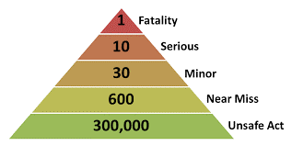
Whilst the reporting, capture and monitoring of Close Calls is widely used for site-based activities, they are not currently used effectively for design activities.
Understanding what hazards and risks are occurring during the design stages will allow us to take direct steps to reduce them in the future. This will improve the safety within all designs that are developed and subsequently reduce incidents and accidents during on-site activities.

Slide 8
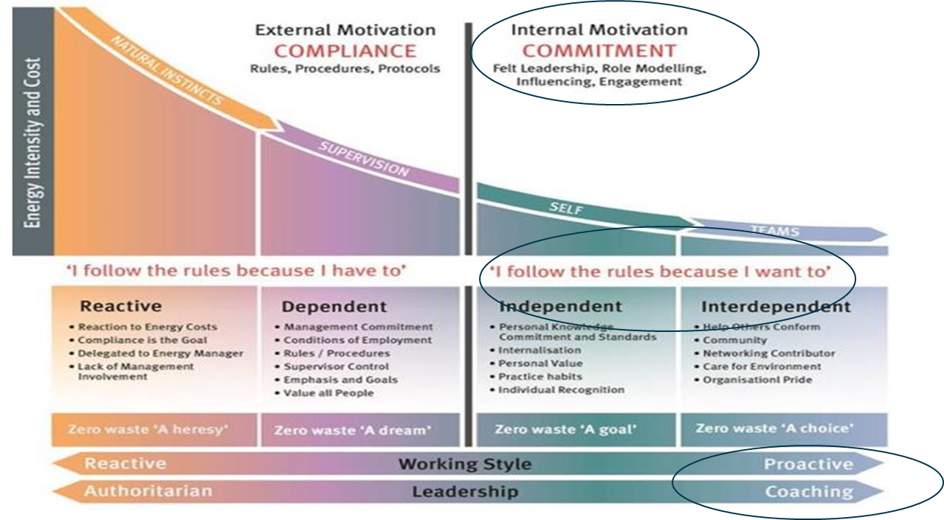
DuPont – Bradley Curve

Slide 9
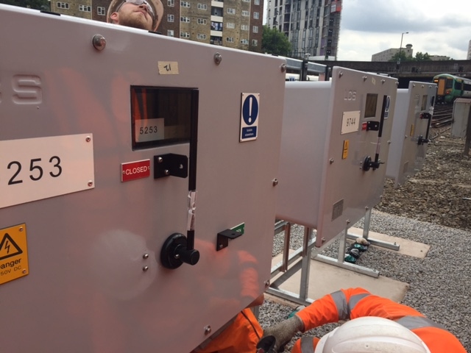
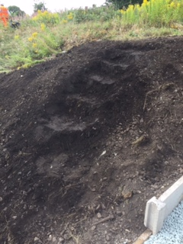
Should we still be designing equipment
where the specified method of installation is a ‘four person lift’?
Should this be considered a ‘safe’ temporary works access?

Slide 10
Definition
A design condition or situation (including errors and omissions) which could have been identified earlier in the design review / verification process
Something which has been signed off and subsequently found to have the potential to cause harm or injury to people or the environment
A design which harbours a latent hazard. This may be the result of design assumptions or option decisions which have not been adequately tested, managed or communicated.

Slide 11
Definition (Cont.)
A set of parameters which places members of the project team under sufficient stress to endanger or damage their wellbeing or compromise their ability to fulfil their role effectively; this is likely but not necessarily the result of pressure to deliver on time. However there are other potential causes of stress which could be design or individual specific e.g. having to design to a bare minimum clearance.
It also allows for capturing observations of good and/or novel practice.
Notes:
Key messages:-

Slide 12
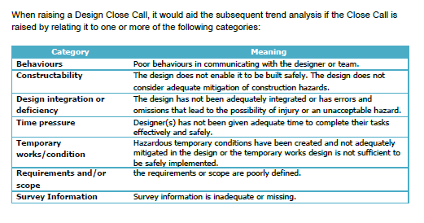
Process and Reporting
Using Current Close Call System
All close calls related to a design supplier’s activity should be raised within their close call system, as we do currently for site based issues.
The RSSB system now includes a close call category for ‘Design’
When logging a Close Call, the main Category of 'DESIGN' should be used. Also include the Sub-Category the Close Call can be related to. This will then allow a download to be taken of those Close Calls specifically related to Design from the RSSB system to allow detailed analysis

Slide 13
Barriers and challenges to raising DCC’s
Culture
  Leadership across all organisations will be critical in achieving a positive culture around design Close Calls.
  It is everyone's responsibility to create a positive, no blame culture around design Close Calls.
  Design close calls must not be used as a means to criticise and penalise individuals; the focus should be on identifying and learning from failures in process.
  The Close Call process is an opportunity to develop and share learning and the initiator and owner of the issue should engage with each other in a collaborative, learning spirit, to agree a proposed course of action
  Raising design Close Calls needs to be actively reinforced as a positive behaviour at all levels of designer, principle contractor and client organisations.
  Design close calls are no different to site close calls in terms of the importance of collecting information to drive safety improvement
System

Slide 14
What does a good Design Close Call look like?
Paul Guest - Programme Engineering Manager

Slide 15
The Challenge
The biggest challenge is being able recognising a Design Close Call
The Definitions of a Design Close Call give the foundations
Key is being able to differentiate between normal business and a Design Close Call.
  Common difficulty “Identifying errors is part of normal company governance and assurance processes e.g. design development DRN’s and construction red lines?”
Process are there to help us get designs right and not put pressure on staff.
Generally Design Close Call’s should capture when these processes fail or there are unexpected results.
The aim of capturing Design Close Calls is to improve and ideally sharing this information for other to improve – e.g. Significant Event Procedure.
15

Slide 16
Good Practice when capturing a Design Close Calls
Three key bits of information
Understand the context and include that in the description
Attempt to understand the impact and what could have happened
Take the action or recommend an action that has the potential to stop the error happening
OR In the case of a good practice recommend how it can be repeated or shared

Slide 17
Design Close Calls - Examples
Not using all available information – raised by PM team
Description:
A DRN was created for a CR2 drainage report, and one of the comments was questioning whether the Geo-RINM drainage layer was used to inform the report. The DRN response was that they were unaware that this layer existed in Geo-RINM. This shows that the design team do not know about all the survey/existing information they have.
What could have happened:
This could have led to presenting land boundaries at consultation which shows additional land take into properties not accounted for.
Action required:
Brief design team on all the different layers available in Geo-RINM.
Encourage a behaviour whereby designers are checking all sources of data.

Slide 18
Design Close Calls - Examples
Putting Pressure on design team – Raised by PM
Description:
I put undue pressure on the design team to review and issue a design in a very short time scales. This meant people were updating models ‘live’ as opposed to developing in their own time and then integrating in to the overall model. I also asked for draft, non approved designs to be sent out for impact assessing.
What could have happened:
Different items could have been missed (such as worksites potentially not being suitable to construct the design) as no time was given to fully understand the impact of the any changes on their discipline. Further, had the designs been shared for impact assessing in draft, items could have been missed, and not potentially have a knock on impact further along the design/construction process. In addition to all of this, it is against the design review and approval process which ultimately exists to ensure all designs are fully integrated and safe
Action required:
Postpone pairwise meeting and change control to allow sufficient time to undertake work.
18

Slide 19
How do we raise a good DCC?
Daniel Pollitt - Programme Manager

Slide 20
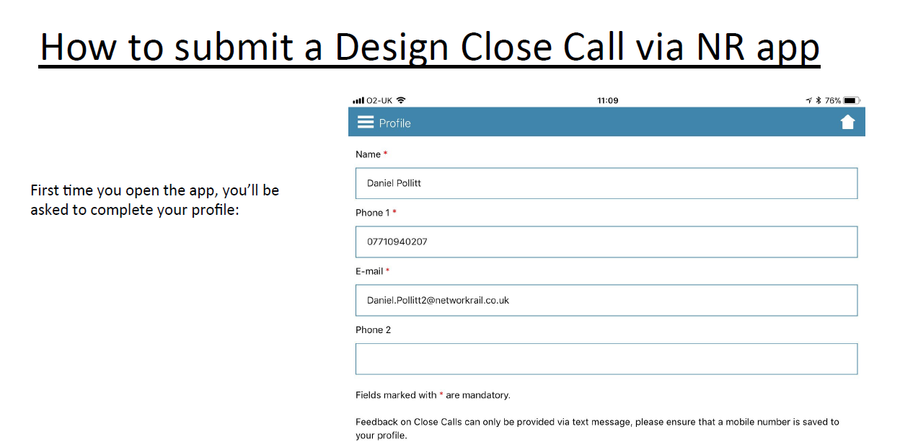

Slide 21
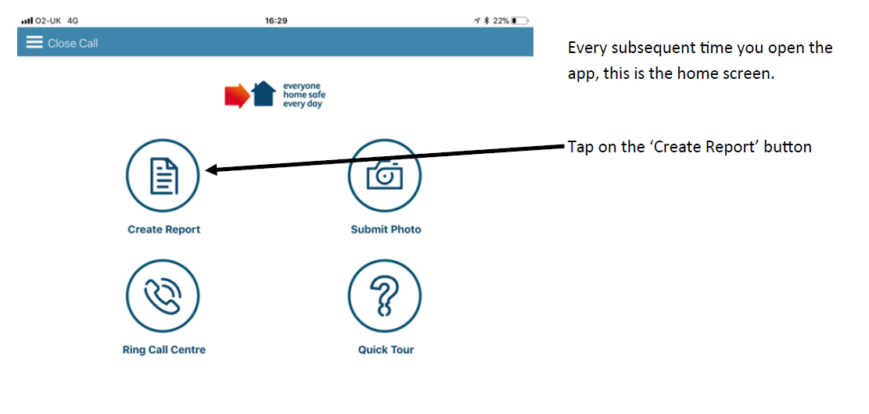
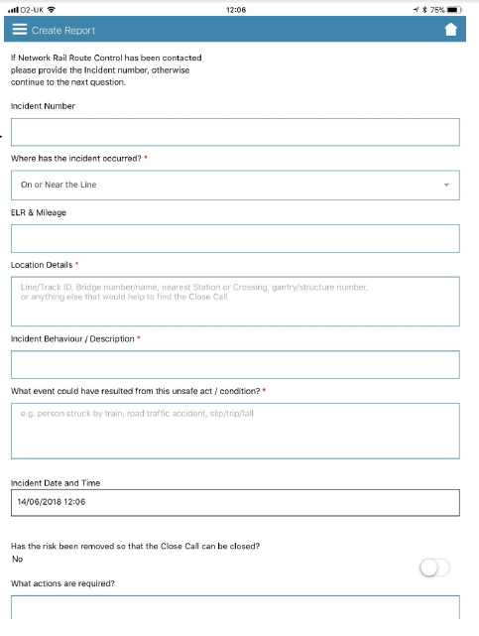

Slide 22
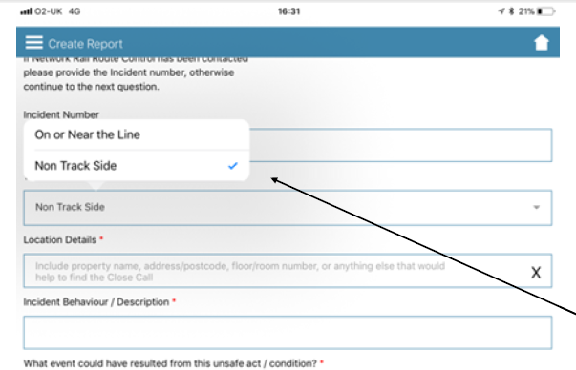
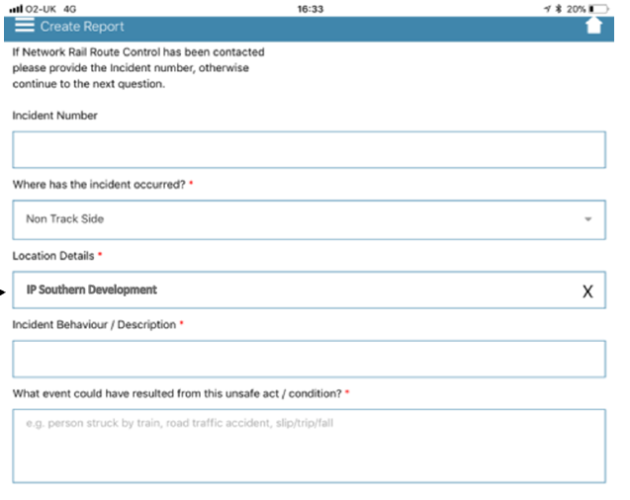

Slide 23
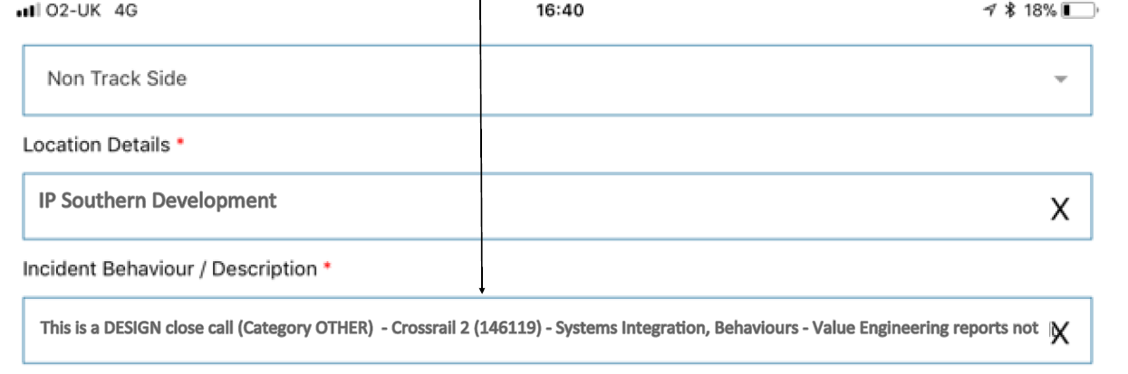
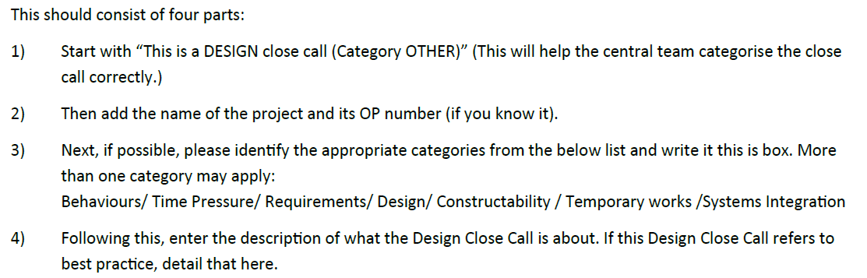

Slide 24
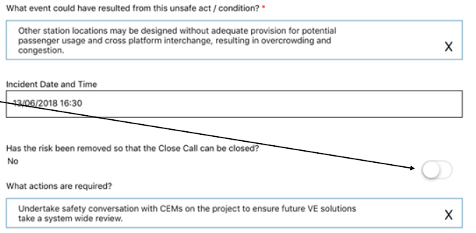
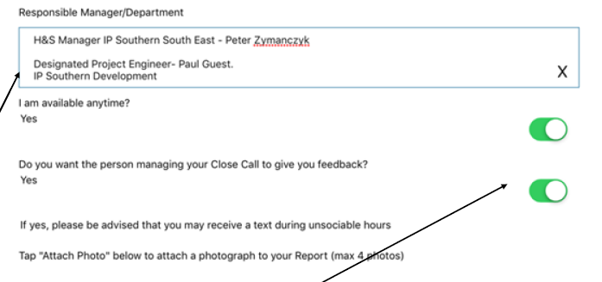

Slide 25
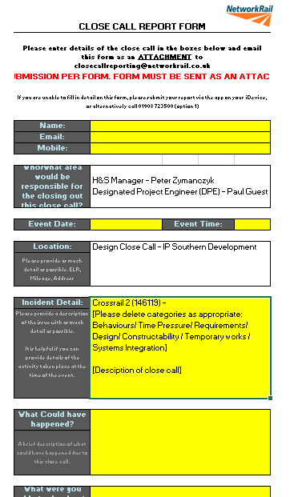
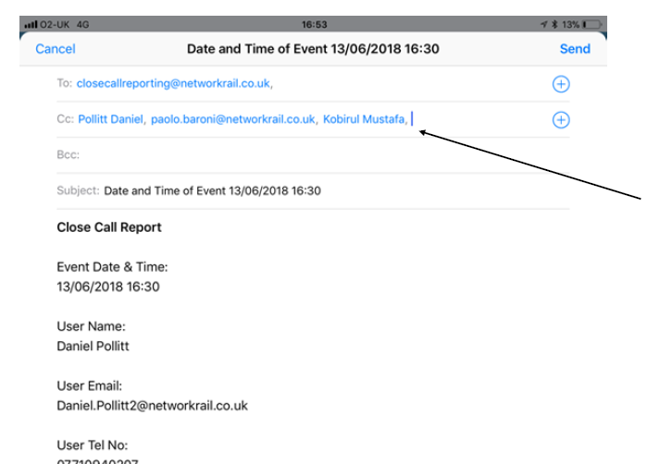

Slide 26
New Close Call System
Liam Cooke – Project Manager

Slide 27
Current system
Close Call System is ‘unfit for purpose’ to deliver business needs today
Processing of a close call can take 2 weeks from notification
Non existent analytics restrict any form of useful intelligence
7 FTEs process close calls – along with licences and operating system costs £750k/yr. Not value for money
Replacement system
Instant processing of close calls
User experience will reflect a modern web based system
Instant ownership for managers and those who raise close call to track progress
Administration and hierarchy management of close calls can be administered within the routes – reduces cost
Excellent business analytics to help target proactive risk controls
Benefits
Platform will be managed in house - reducing running costs
Advanced analysis and reporting, allowing for better understanding of Close Call data and learning of potential risks
App not restricted to Network Rail devices, but open to Supply Chain and Railway Industry partners
New e-learning portfolio with materials for users of all levels accessing the system
Frontline workers will have ability to view and process close calls via App, visibility of close calls whilst preparing SSOW packs or carry ‘Take 5’ briefings

Slide 28
New Functionality
Data and Analysis - Live data dashboard bespoke to each users’ geographical focus and area of responsibility will allow for instant visibility of close calls
Pre-mapped location interfaces - Pre populated location details allowing instant allocation of close call
Mobile App and Web App users profiles – notifications as close call moves through each stage
Forgotten Password facility – reset facility reducing need to contact close call team
Visible location map - reporting showing plots of all Close Calls with filter facility
Pre-configured SLA – will provide enhanced audit trial of close calls within each Region/Route/Function and visibility of resolution against pre-defined SLAs
Early Warning Indicator – scope to link triggers with other applications (Risk Assurance Level 1 and Incident Investigation) to warn of potential incidents
Timelines (TBC)
High level timelines are
  Start Procurement May 2020
  Solution Design signoff September 2020
  Testing February 2020
  New System Go live April 2021
(Timescales removed as it’s under review)

Slide 29
What data and information do we have?
Carlos Gallego – Health and Safety Manager

Slide 30
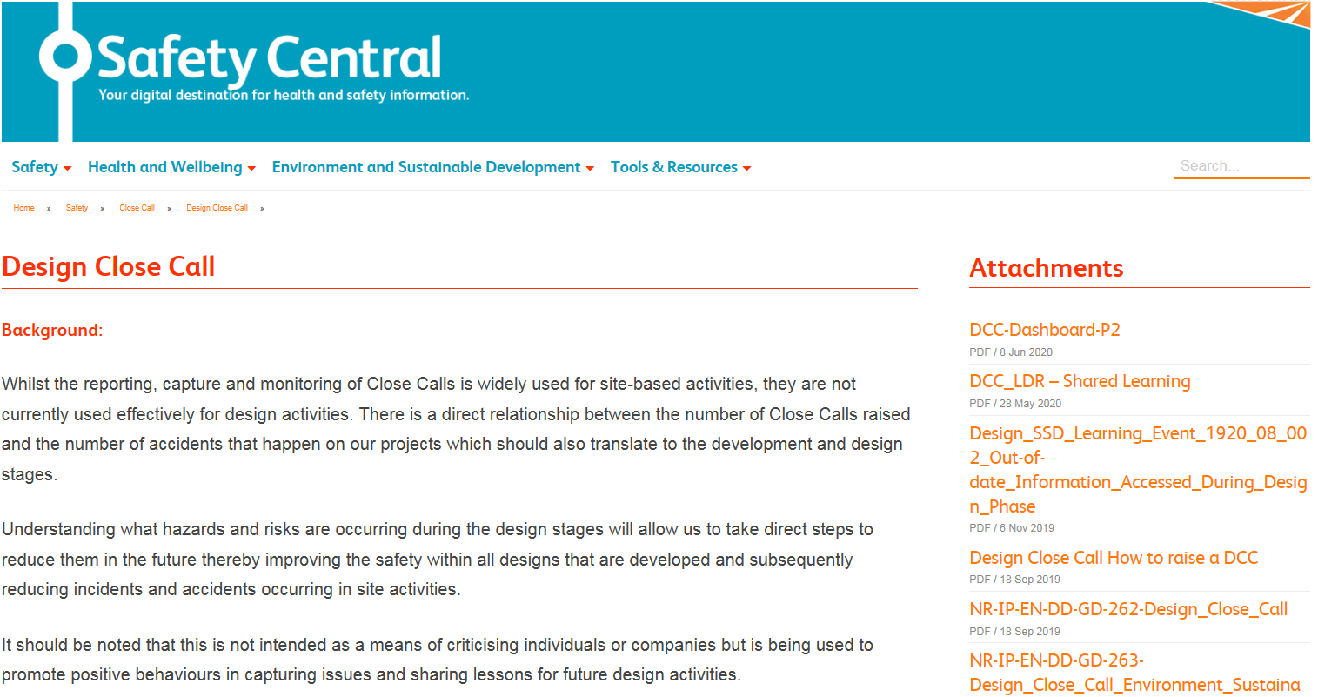
DCC - Safety Central
To access DCC page please go to Safety Central – Safety – Close Call and select DCC at the right-hand site!

Slide 31
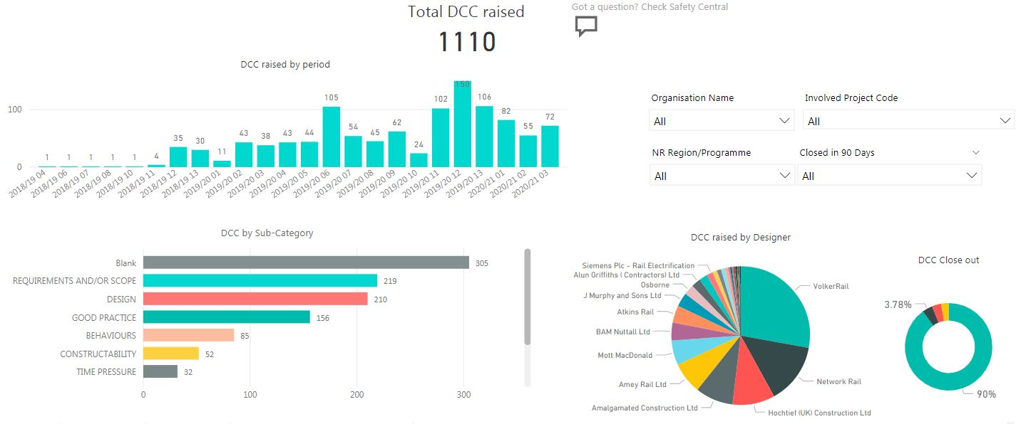
DCC Dashboard

Slide 32
Shared Learning 1
Christopher Walters – Project Manager

Slide 33
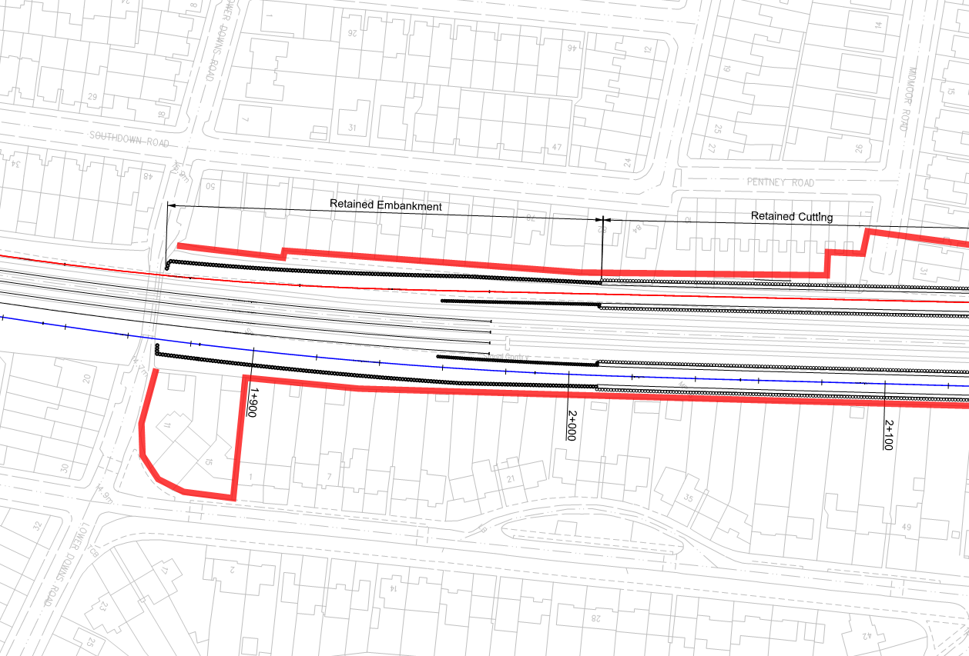
Design Close Call Example
Incident:
Following construction review there was confirmation that a new version of track design was available. This was not formally issued with notes to highlight changes.
What Could Have Happened?
Land take at consultation does not reflect required land take
Two alignments do not align for consultation
Impact to the bridge due to change of track alignment which has not been reviewed
Actions taken:
Highlighted in design issue tracker and review during the next design stage
Agreed approach for implementing and issuing documents
Lessons Learned:
With a number of interfaces, understand how this will be controlled and agree approach for each stage
Clear understanding of changes through workshops and followed by report

Slide 34
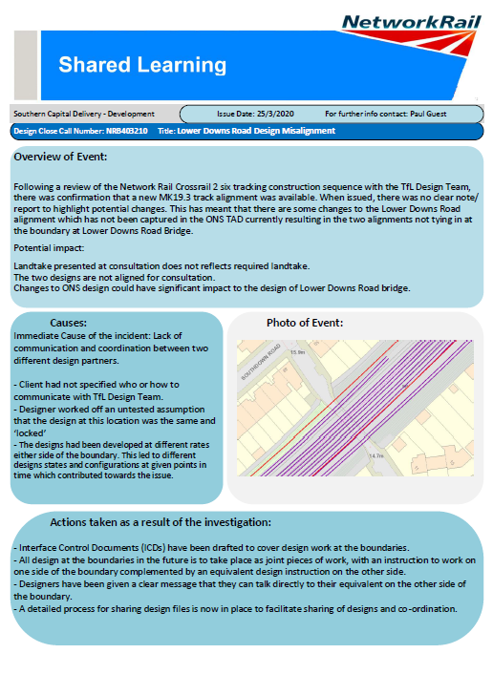
Shared Learning

Slide 35
Shared Learning 2
Ian Barry – Design Team Manager

Slide 36
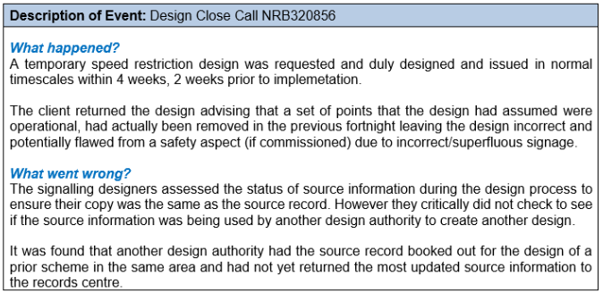
Design Close Call Example
Action points:
Ensure you are using the source record for your design or a parallel design agreement is in place.
In the case of late notice or ‘emergency’ designs ensure you are aware of all potential schemes within or in the vicinity of your designs.
When considering correlation waivers ensure that the validity and age of the survey data being used in lieu of correlation is carefully considered.
Discussion points:
Are you using the most up to date source information for your designs?
Are you aware of parallel works being undertaken, including in late notice & emergency design situations? If not then consult with the asset owners – If you don’t ask, you won’t know!
Is a correlation required or have you got a correlation waiver?
Is the accuracy of source information as important as the accuracy of the proposed design? [It’s a rhetorical question!]

Slide 37
What’s next?

Slide 38

DCC Rail Industry Forum - What’s next?
July
September
November
August
April
January
DCC Rail Industry Forum
Online survey
Review of feedback, proposals and analysis of data
Central DCC Shared Learning site
New Close Call System
2nd Rail Industry Forum

Slide 39
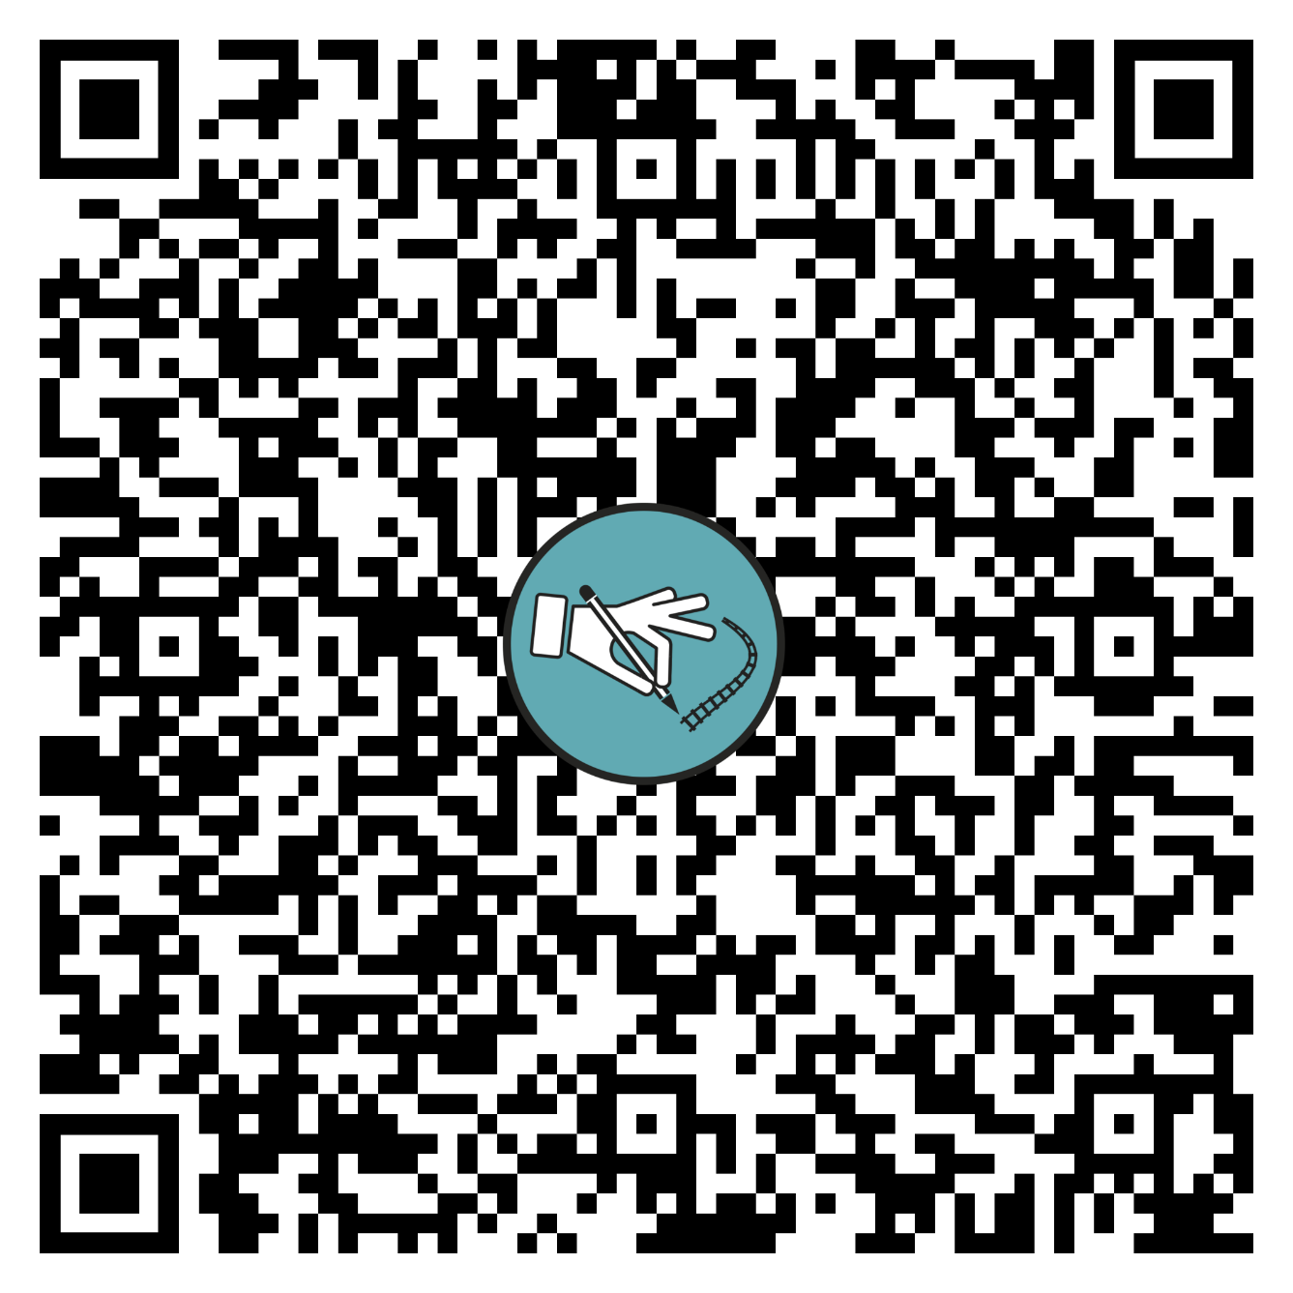
Q&A & Survey
Share with us your thoughts!
Just open your camera and an select the link when prompted!

