Slide 1
Introducing CBH into Murphys
22 November 2011

Slide 2
Why have we done it
Over 12 000 deaths each year are estimated to have been caused by past exposure at work
An estimated 1.2 million people who worked in 2010/11 report suffering from a work-related illness.
75% of the new work-related conditions in 2010/11 were either musculoskeletal disorders or stress, depression and anxiety
Other work-related illnesses include skin disease, respiratory disease, hearing loss and vibration-related disorders

Slide 3
Putting Health back into H&S
We in the industry have focused on Safety and reducing the risks to our workers
We have made great progress in this but people are still getting harmed by the work we are doing.
37 times more deaths in construction are health related and NOT due to workplace accident or injuries.

Slide 4
What we needed
We had always undertaken health surveillance.
However we identified key issues that we hadn’t fully covered and needed to improve at:
Fitness for Work Task Assessment
Sickness Absence
Rehabilitation
Education
Promotion
Awareness
Heath by design
Counselling

Slide 5
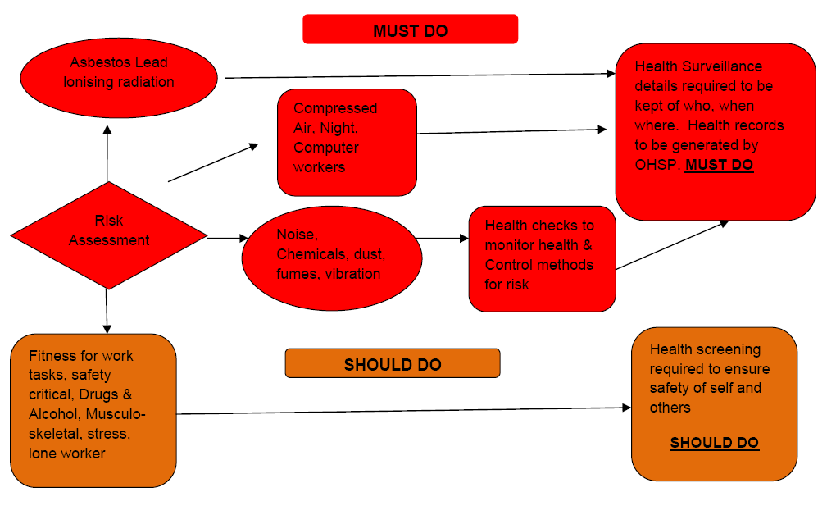
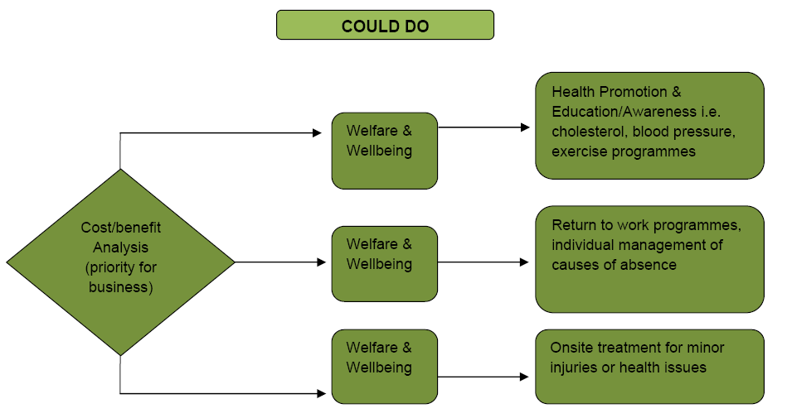
What we needed

Slide 6
How CBH Works
Construction Industry Employers
Corporate Membership – annual subscription
Occupational Health Service Providers
CBH accredited to:
Provide services to industry standards
Input clinical data to national database

Slide 7
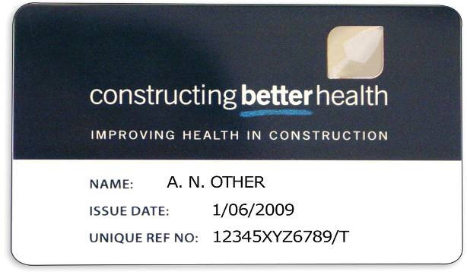
How CBH Works
Workforce
Receive CBH unique reference number
(or can use CSCS or equivalent card)
Give consent for clinical data to be held
Present the card on site

Slide 8
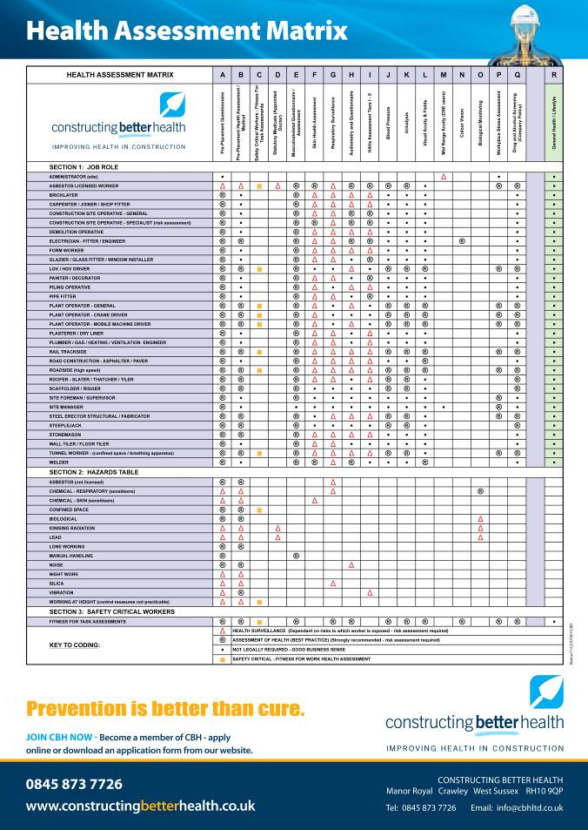
Data Management
Fitness for Work
Job
Demands/requirements
Safety critical work
Hours, travel etc
Risks
Employee
Contractors
Person
Relevant medical history
Functional capacity (physical/psychological)

Slide 9
Data Management

Slide 10
Industry Guidance Information

Slide 11
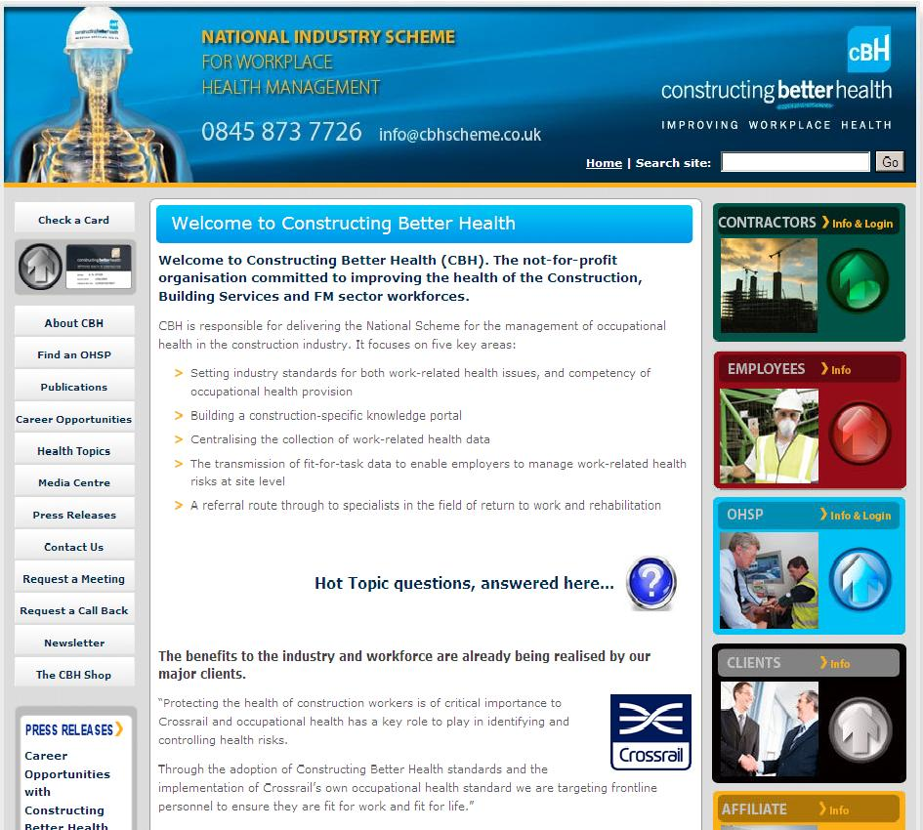
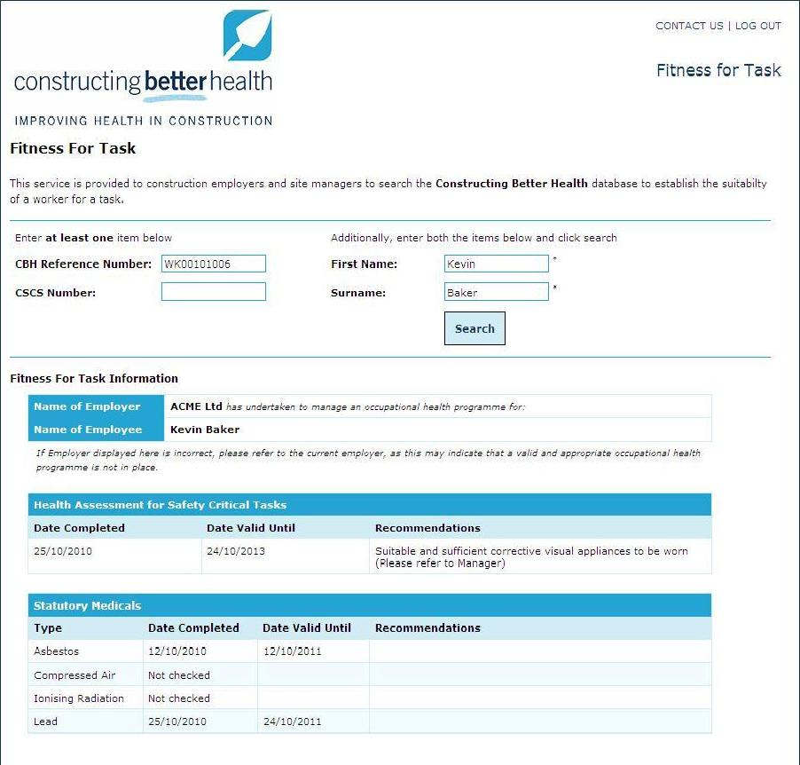
Visibility on Site

Slide 12
How CBH has Benefited Murphys
Demonstrates management of OH at site level
Web based solution for access to ‘real time’ ‘fitness for task’ data at SITE level
Key to managing safety critical workers
Efficient and cost effective monitoring of an individuals health
OHSP access to previous clinical data for comparison/monitoring
Reduces need for unnecessary and costly repeat HS/FFT checks
Improves retention of experienced workforce
Healthy workforce = improved productivity
Centralised storage of data
Limited valid data currently exists
Benefits research for long term improvements to industry ‘health’
Enables Client project legacy

Slide 13
Obstacles faced & How we dealt with these
CHAT v1
Issues with duplication of effort
No expiry flagging system
Unable to remove leavers from company screen
D&A Pass/Fail not identified
Cost
Based on company size not number of employees in the system
Remote Access
IT Issue on small sites
Supply Chain
Whole supply chain to be CBH members (Crossrail Mandate)

Slide 14
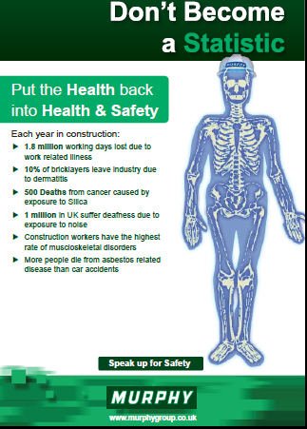
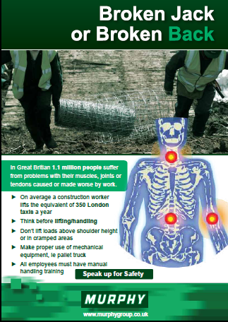
Campaign Posters

Slide 15
Campaign Handouts

Slide 16
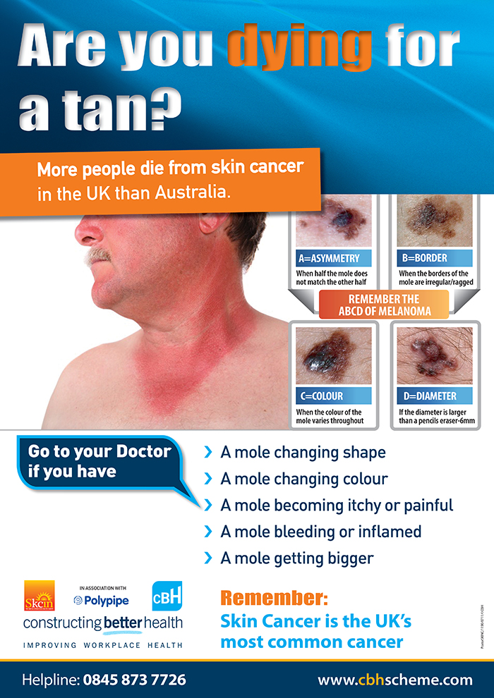
Sun/Skin Cancer Preventative Campaign

Slide 17
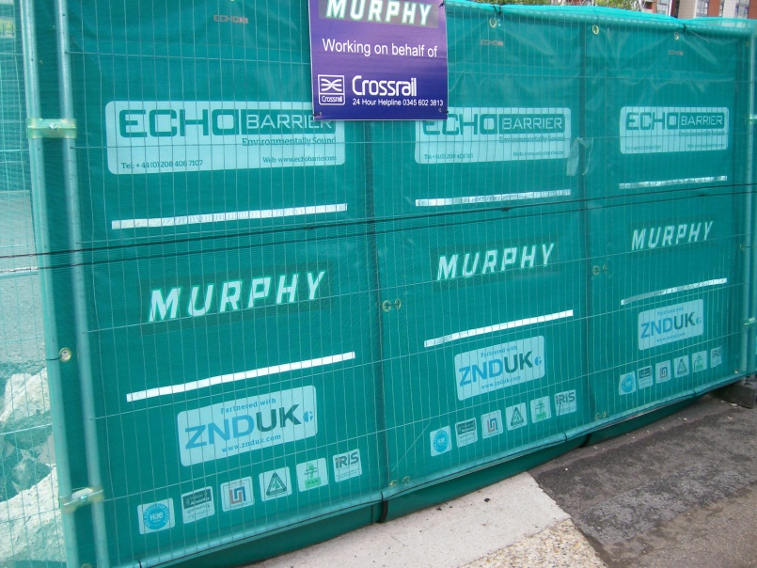
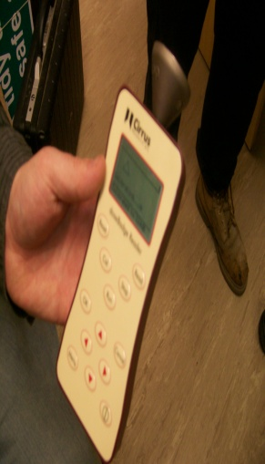
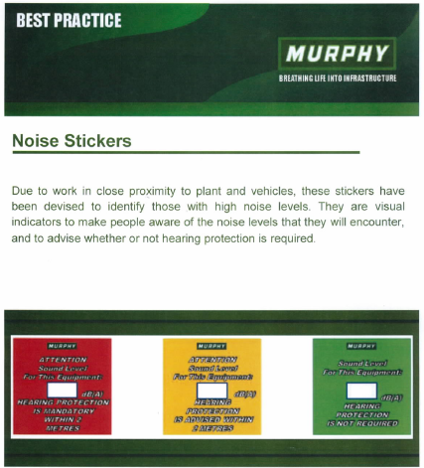
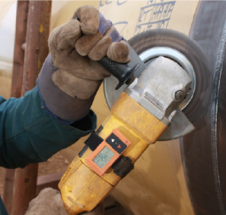
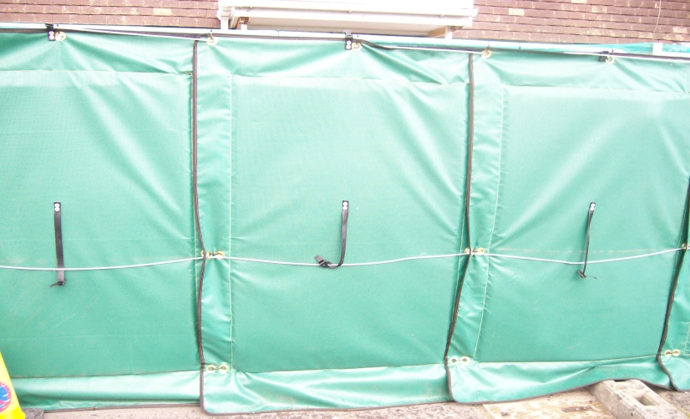
Noise – Best Practice

Slide 18
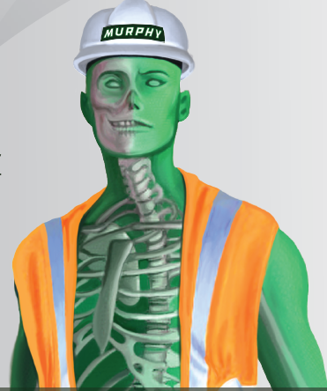
PUTTING THE HEALTH
BACK INTO
HEALTH
& SAFETY

Slide 19
Questions

