Slide 1
Ballast Dust
Management Briefing

Slide 2
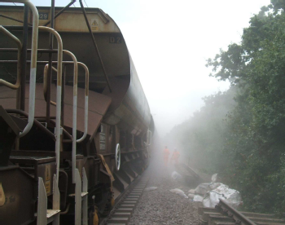
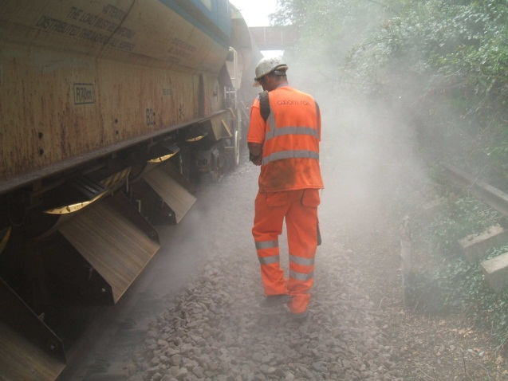
Ballast Dust – Why are we looking at this?
There are 2 key hazards associated with ballast dust:
Weather conditions and site environments can have an impact on the dust generated and dispersed during working activities
Site safety
(lack of visibility for operators and ground staff)
Occupational health issues
(breathing in dust and associated respiratory issues)

Slide 3
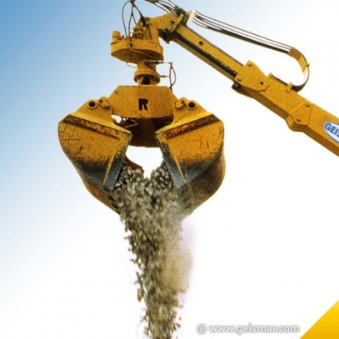
Risks to your staff
Site Safety
Poor visibility for the operator when moving plant
Collision with other equipment/plant
Contact with individuals, causing personal injuries
Damage to delivery wagons, plant and equipment
Collision with lineside equipment, structure or obstructions
Contact with overhead line equipment
Materials falling from lifting/loading equipment

Slide 4
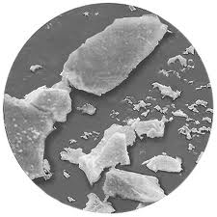
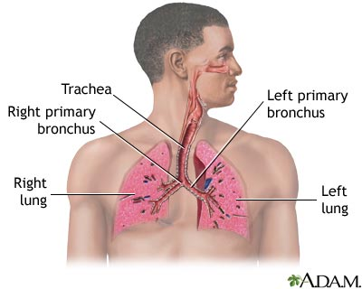
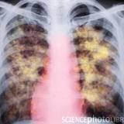
Risks to your staff
Occupational Health Issues
Natural Aggregates, including ballast, contain silica and produce silica dust known as Respirable Crystalline Silica (RCS).
Inhaling RCS can lead to silicosis. Silicosis is a serious and irreversible lung disease that causes permanent disablement and early death. This can be exacerbated by smoking.
Silicosis is an occupational lung disease that develops over time when dust that contains silica is inhaled into the lungs.
Silicosis damaged lungs
Microscopic RCS

Slide 5
What do you need to do?
Comply with CoSHH Regulations and SSOW’s on worksites
Run briefing sessions
Report issues of ballast dust to your Line Manager/Supervisor and raise Close Calls
Work with your employer to reduce risk levels on site
Ensure that staff
move away from the area if they are not involved in the task to avoid breathing in dust
wear the PPE and RPE supplied to them –
have shaved within 8hrs of starting a shift if they are required to wear a tight fitting face mask (FFP3)
keep their PPE/RPE and equipment clean and working properly

Slide 6
Questions

