Slide 1
Ballast Dust on Worksites
Use of Respiratory Protective Equipment (RPE)

Slide 2
Key considerations
Keep exposure to ballast dust as low as reasonably practicable
Roles that require further protection from ballast dust will be identified
Where the expected levels of exposure to dust for staff on worksites is <50% Workplace Exposure Limit, a tight fitting dust mask with an assigned protection factor of 20 (e.g. FFP3) can be used. Face fit testing must be provide to individuals required to wear a tight fitting facepiece
Notes:
Work planning should always aim to reduce exposure to ballast dust to as low as reasonably practicable. Should the work risk assessment still identify roles that require further protection from ballast dust, the use of Respirable Protective Equipment (RPE) will be identified, to reduce the levels of dust exposure to staff on worksites. Staff required to wear tight fitting face masks should receive face fit testing.
Where the expected levels of exposure to dust for staff on worksites is minimal or below the 50% Workforce Exposure Level (WEL) for Total Inhalable, Respirable and Respirable Crystalline Silica dusts, a dust mask with an assigned protection factor of 20 (e.g. FFP3) can be used to protect individuals from dust exposure.

Slide 3
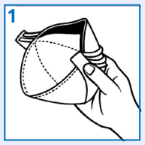
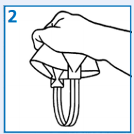
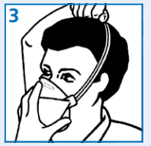
Disposable masks
A nose clip is located in the top panel. Gently bend it at the centre. Hold the mask in your hand and pull out the bottom panel to form a cup.
Turn mask over so you can grasp the elastic straps
Cup the mask under your chin. Ensure the two straps are separated and pull the straps over your head
A nose clip is located in the top panel. Gently bend it at the centre. Hold the mask in your hand and pull out the bottom panel to form a cup. Turn mask over so you can grasp the elastic straps. Cup the mask under your chin. Ensure the two straps are separated and pull the straps over your head. Locate the lower strap below the ears and the upper strap across the crown of your head. Adjust top and bottom panels of the mask for a comfortable fit. Using both hands, mould the nose clip to the shape of the lower part of your nose. DO NOT pinch the nosepiece using only one hand as this may result in a less effective seal.

Slide 4
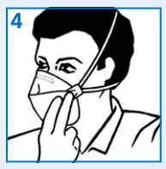
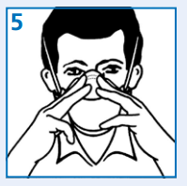
Disposable masks contd…
Locate the lower strap below the ears and the upper strap across the crown of your head. Adjust top and bottom panels of the mask for a comfortable fit.
Using both hands, mould the nose clip to the shape of the lower part of your nose. DO NOT pinch the nosepiece using only one hand as this may result in a less effective seal.

Slide 5
Check it fits
MASKS WITH VALVES Cover the front of the respirator with both hands, being careful not to disturb its position on your face.
Breathe IN sharply. A Negative pressure (like it is sticking to your face) should be felt inside the mask. If air leaks around the nose, readjust the nose clip. If air leaks at the sides adjust the straps back along the sides of your head. Repeat this until the mask fits properly
MASKS WITHOUT VALVES Cover the front of the respirator with both hands, being careful not to disturb its position on your face. Breathe OUT sharply. A Positive pressure (like blowing up a balloon) should be felt inside the mask. If not, adjust as above.

Slide 6
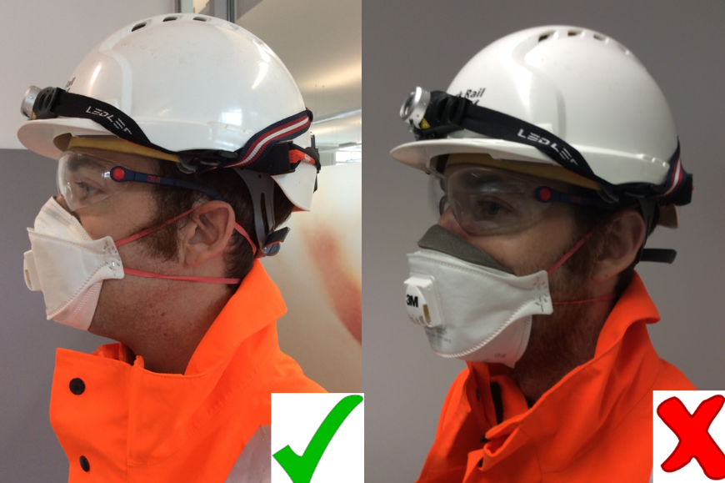
Beards and facial hair
Facial hair will reduce the protection provided by a tight fitting facepiece. Where appropriate, individuals should shave within 8hrs of the start of a shift. If you can’t achieve an effective seal, you must not enter the area where dust is present. Report it as a Close Call. Remember: Only YOU can really tell if your mask fits – Sort it – Report it!
Please report very dusty events to NSC 24/7 on T: 01908 723500

Slide 7
What have you learnt?
Question: How will you know if you are required to wear Respirable Protective Equipment to undertake your work?
Question: What should you do to get the dust mask to fit properly?
Question: What should I do if I can’t get the RPE to fit properly?

