Slide 1
Safe by Choice
A sustainable BBS programme
Andrew Livingston
Steve Wiskin

Slide 2
Aims of Safe by Choice
Introduced in 2007 to promote an awareness that safety is everyone’s responsibility. SSoW alone are insufficient
To train staff and contractors how to constructively and confidently challenge unsafe behaviour and reinforce safe behaviour
To weave SbC into the fabric of our business to ensure SHE management is driven by our people
Close Call reporting is a key element of SbC
“Safety is delivered by people not paper”

Slide 3
SbC Training Programme
Key Influencers
Courses developed for target audience profiles
DRA a key element
Importance attached to Close Call reporting
High risk groups prioritised in training programme
Safety Leadership
Developing
Influence
Overview

Slide 4
Some Fundamentals
What influences what we do ?
30
20%
A
Behaviour
C
80%

Slide 5
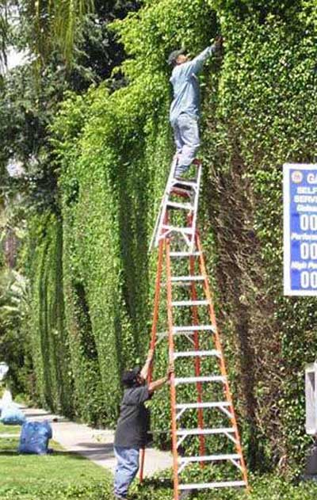
Unsafe Behaviours
Bad Habits & Violations

Slide 6
Bird’s Triangle
Consequences
Loss
Close calls
Unsafe Behaviour
Lack of consequences reinforce the attitude that:
“It won’t happen to me”.

Slide 7
‘Close Call’ Reporting
Many unsafe behaviours are routine violations - HABITS
‘Close Call’ reporting can help identify unsafe behaviours
We can then focus on creating safe habits
Operating a fair reporting culture

Slide 8
SbC Support Structure & Enablers
Nominated SbC Champion and support staff
Role Profile for Key Influencer (KI) part of BMS and KI performance included in PDRs.
Ongoing mentoring of KIs and coaching forum/objectives setting
Behavioural analysis is key part of investigations
SbC conversations part of Director Safety Tour programme
SHE Committee and Marketing Dept involved in continually developing and promoting SbC

Slide 9
Supply Chain Engagement
All safety critical labour suppliers briefed and supported
Joint training and not for profit in-house contractor courses delivered
Over half our Close Calls are now reported by contractors
Annual Supplier Safety Forum and SbC award
Leading KPIs collected on contractor buy-in
Duty of cooperation is sometimes tested by investigations
Culture change is key to sharing lessons learnt and good practice

Slide 10
SbC impact
“Want-to” curve
Performance
Discretionary requirements
“Have-to” curve
Minimum requirements
Time

Slide 11
A Sustainable & Evolving Programme
Feedback and progressing actions from Close Calls is essential
Robust investigation for high potential events (ABC analysis)
Supply chain engagement in ongoing programme
Client engagement – merits to different BBS programmes and Close Call systems, the key is cooperation and sharing lessons learnt
Beyond Close Call reporting – immediacy, ownership & action
Safety by Design embedded within our SbC programme

Slide 12
SbC & Safe by Design
CDM is not new! Systems, procedures and techniques are not enough
Technical Close Call reporting and investigation promoted to increase understanding of how design impacts safety downstream
Confidential Reporting on Structural Safety (CROSS) introduced in 2005
Engaging with our construction partners to help early identification of problems in temporary works
SbC engagement with designers, engineers and architects!

Slide 14
SbC Awards
Winner 2011 Winner 2011
Highly Recommended in the Network Rail Partnership Awards 2011

