Slide 1

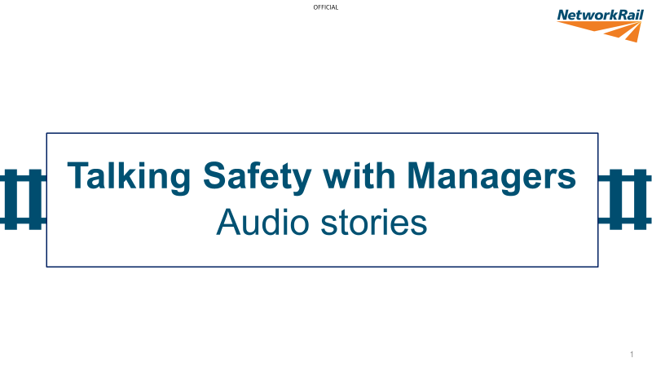
Safety moment
Stacey's story

Slide 2

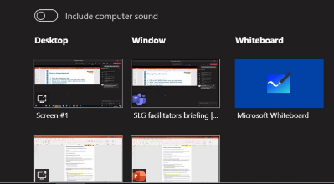
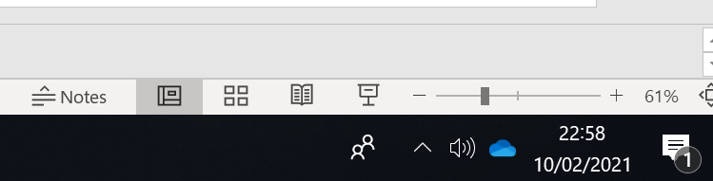
Getting ready
Allow 30 minutes for your ‘safety moment’ discussion
Technical set-up (for Teams)
Open the PowerPoint file on your desktop before sharing
Click on ‘share content’ icon (top right hand of screen)
Select ‘include computer sound’ (bottom left hand of screen) before selecting the slides
Select PowerPoint file you want to share
Slides must be in slideshow for audio to play automatically
Further information
This is designed as a plug and play resource. However, if you would like more guidance on running your team discussion, take a look at the Manager’s Guide [link to guide]

Slide 3
Stacey’s story …
Stacey is a supervisor for the Off Track Section Team.
It’s a relatively new role and she moved up north away from family down south.
She is keen and determined to do a good job.
She has worked for Network Rail for three years and is three months into her new role.
*Spoken by an actor – based on composite of real events

Slide 4

everyone
home safe
every day
It’s like there’s a culture, a deep entrenched culture, where years on the job seems to trump everything; where it’s all about whether ‘your face fits’ –
and honestly, I don’t know how I can change that myself.
I keep asking myself – what could I have done differently?
Maybe I could have been more assertive as their supervisor.
But the problem seems bigger than me.
I dialled 999 and, the ambulance arrived. Pete was in a right state! It turned out he had broken his ankle – in several places but thankfully nothing more serious.
Still, he’ll be off for some months. But he’s lucky, he could have died.
And then it just bashed into him – and he screamed! I felt sick.
And then it happened….the chipper starts to shift to the left, towards Pete.
I shouted – too late.
I asked what was going on and got a very terse ‘We do this sort of thing all the time, love. It’s all under control– we’ve got the winch and the rope to steady it – alright?!’
It was all a bit intimidating.
I could see they were taking a short cut to get the chipper off the site and down the bank rather than going to the access point, which would have taken longer.
Their shift had nearly finished, and they just wanted to clear off.
The embankment they were working on was far too steep for the chipper and Pete,
one of the contractors, was too close to it.
Once everything was set up for the day and safe, I went off to check the other two teams.
When I got back later that afternoon, I was horrified to see that they were using the woodchipper. We’d agreed that the plan was to cut and stack the vegetation rather than use the chipper.
making it clear that they just wanted to be left to get on with the job.
I say the usual….I mean I talked, they all stood with their arms folded, looking at each other, rolling their eyes
We arrived at the access point, we all came in separate cars because of Covid
and the usual briefing was done.
I had three teams that day doing de-veg work along the track
so I was splitting my time between them.

Slide 5
Questions
Stacey's story
What’s going on in the story?
What issues does this story reveal?
Why might this happen?
What’s under the surface?
What might this mean about the culture?
Summarise the key points back to the group – these could include:
A frontline workforce that feels they are ‘above the rules’ because they have done the job for so long. They feel they can make ‘judgement calls’ about when to take short cuts.
A level of prejudice against supervisors / managers who might not be ‘one of the lads’ e.g., female, not white, LGBTQ, age etc. (Note: although the lead in this story was a woman, what other ‘minority’ might this apply to?)
Lack of supervisor / management confidence / competence.
Highlight three or four key issues to focus on:
What can we do as individuals?
What can we do as a team?
What do we need to do differently?
How committed to improving safety culture are we?

