Slide 1
Hazard Identification & Risk Management
Or; Why Bother Staying Safe?
John Partington: Safety, Health & Environment Specialist

Slide 2
In the Railway Industry…
We Love
2015-2016!
…Why?
Notes:
No Workforce Fatalities

Slide 3
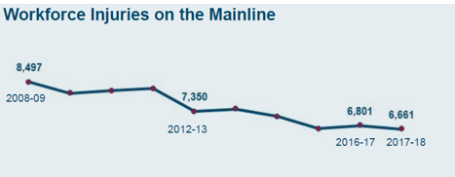
Workforce Injuries, 2008-2018
A general downward trajectory but with setbacks in 2010-12, 2013-14 & 2015-16
WHAT happened in 2012!!!?
Notes:
Lifesaving Rules Introduced

Slide 4
Quiz Time, Part 1:
They were inspired by real-life incidents from a range of areas over a six year period, including working at height, which saw 39 major RIDDORs; using machinery; working with electricity, which saw 775 personal accidents and incidents; and driving.
Question: What Year Were the Lifesaving Rules introduced?
Answer: 2012!

Slide 5
Lifesaving Rules: Working Responsibly
Notes:
Can you identify the lifesaving rule without the text?

Slide 6
Lifesaving Rules: Driving

Slide 7
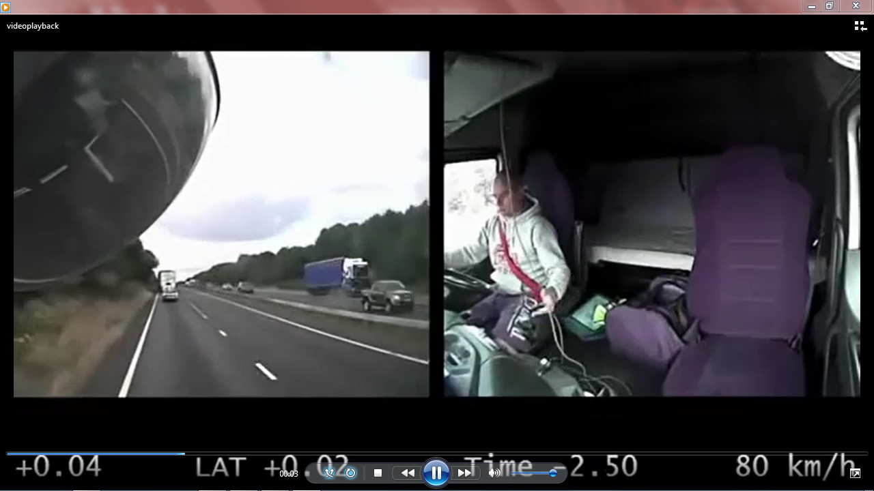
A34 Lorry Crash, 2016
Notes:
This horrific crash shows how a breaching the life saving rules kills. Although this individual was not working for NR, if he has been following the life saving rules and the law this would have been avoided.

Slide 8
Lifesaving Rules: Working at Height
Working with Moving Equipment

Slide 9
Lifesaving Rules: Working with Electricity

Slide 10
Quiz Time, Part 2:
Identify the Electrical Hazards…

Slide 11
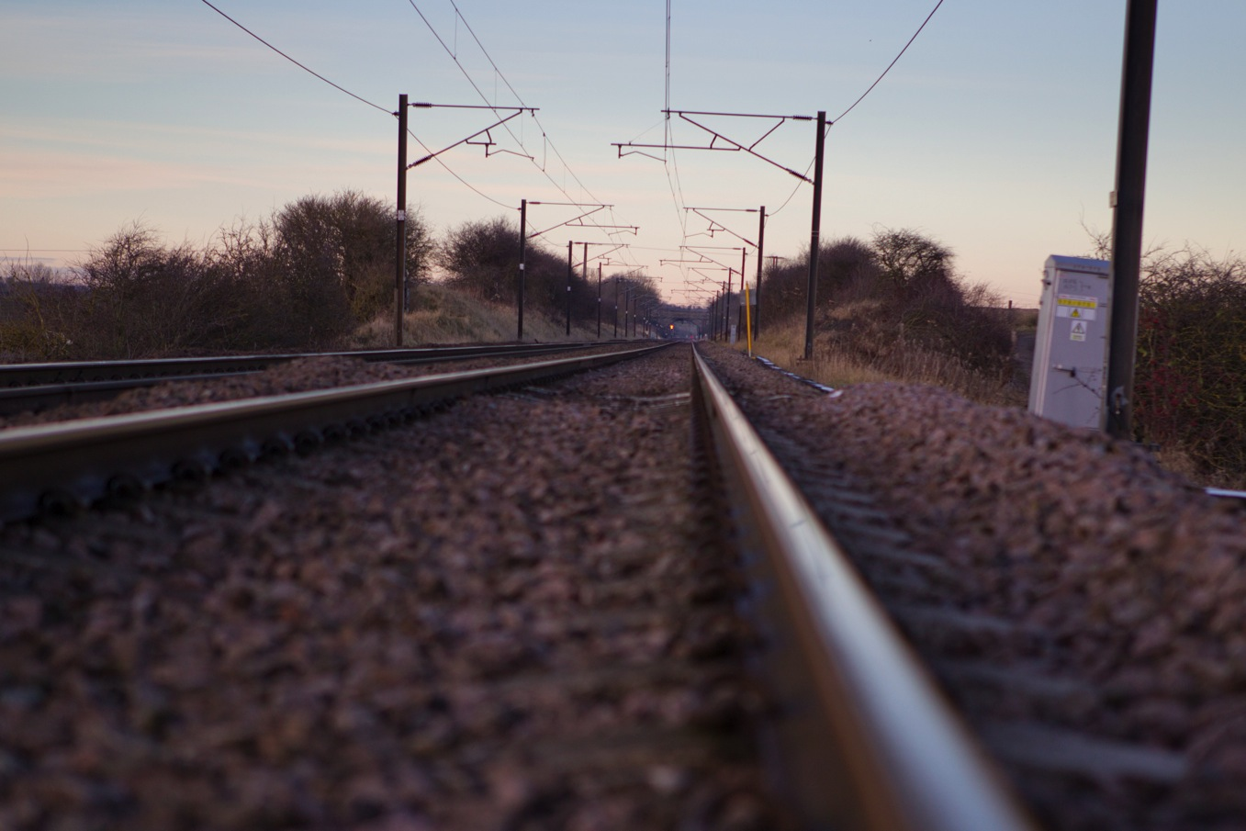
Discover the hidden dangers
LOCATION CASE
650 volts
OVERHEAD LINES
25,000 volts
BEWARE! ELECTRICITY CAN ‘JUMP’...
BURIED CABLE
25,000 volts
3rd RAIL
750 volts

Slide 12
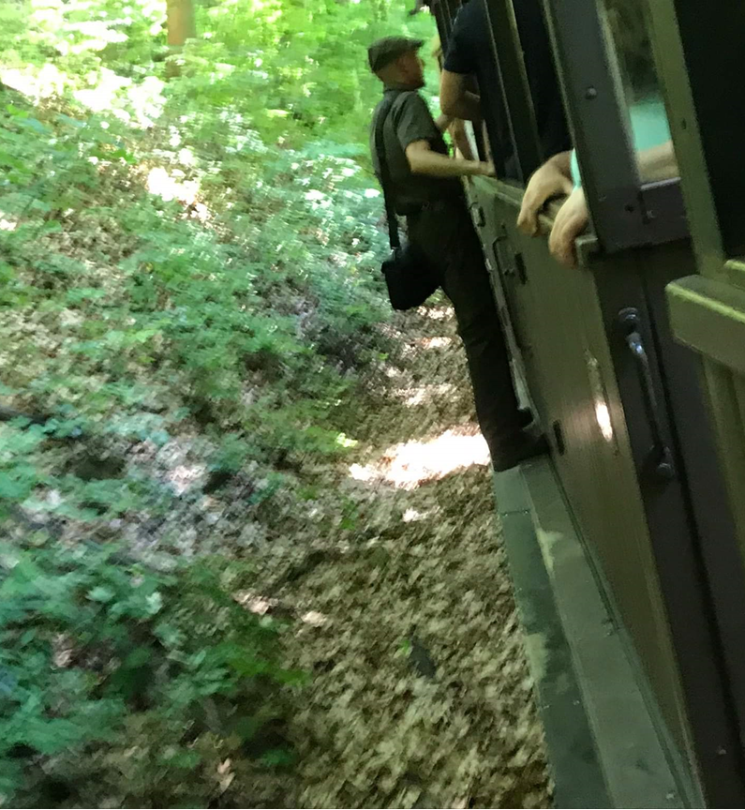
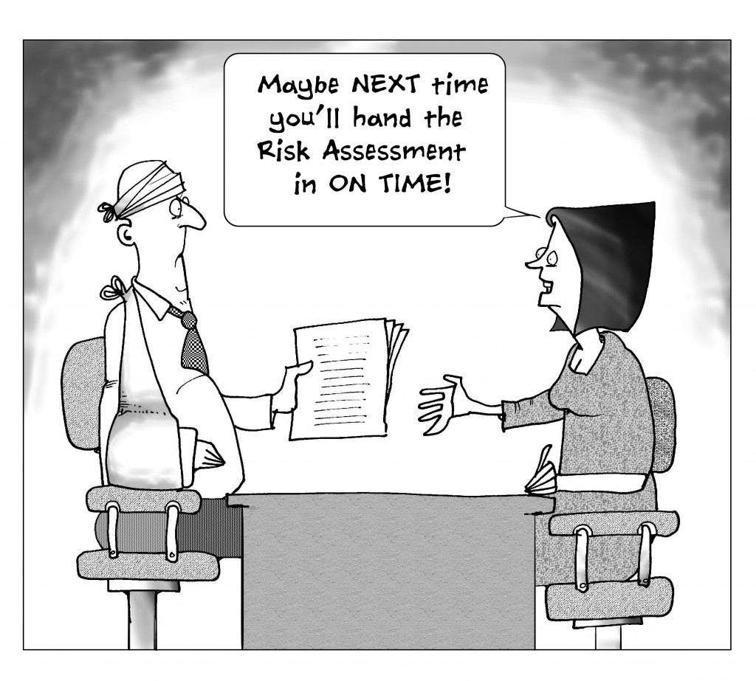
Identify, Assess, Control
Notes:
How many of us have carried out of a risk assessment at work?
Even if you haven’t carried out a risk assessment at work, us as humans carry out simple risk analysis in our head before carrying out our every day tasks like crossing the road.
We will look at the hierarchy of control on a later slide.

Slide 13
Hazard Identification
What is a Hazard?
Anything that could cause harm to a person or property or the environment – or damage to Network Rail’s reputation
Examples of workplace hazards include:
Frayed electrical cables
Boxes stacked precariously
Noisy machinery
Trains or on-track plant and machinery
Members of the general public
If you see, hear or smell anything that causes you concern or seems out of the ordinary – report it to your supervisor and raise a close call. If it is safe to do so and you are confident and competent, you can close the close call on the spot – but remember to still raise the close call. Why?

Slide 14
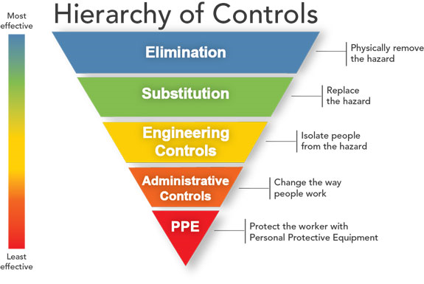
Assessing risk means deciding how likely it is that a hazard will harm someone or something, and how serious the harm could be.
Whenever you spot a hazard, assess the risk by asking yourself two questions:
How likely is it that the hazard could cause harm?
How bad could the harm be?
Risk Assessment
Risk Control
Notes:
When looking at controlling the risk you have assessed, our main aim is to reduce the severity and the likelihood of the risk.
When implementing control you would first look at options of elimination, now this isn’t always an option (or in H&S language, reasonably practicable) so you would move down the hierarchy and look at replacing the hazard, then to engineering control such as guarding from equipment, then administrative control like processes and procedure and finally PPE.
As you can see, PPE is the final level of control, we aim to look at reducing the risk before the need for additional PPE is required.

Slide 15
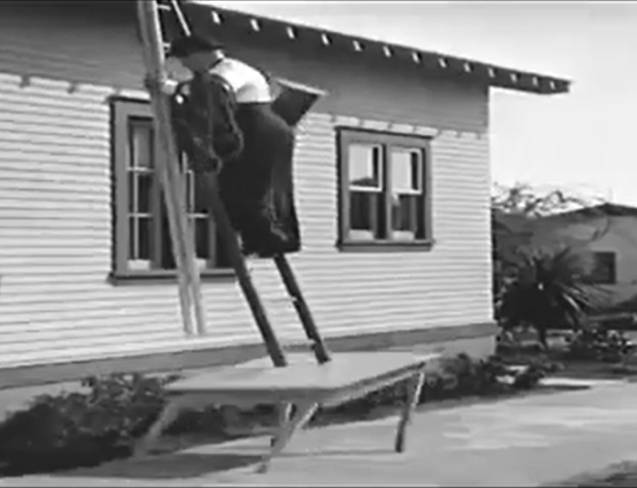
Quiz Time, Part 3: Spot the Hazards (any Lifesaving Rule Breaches?)

Slide 16
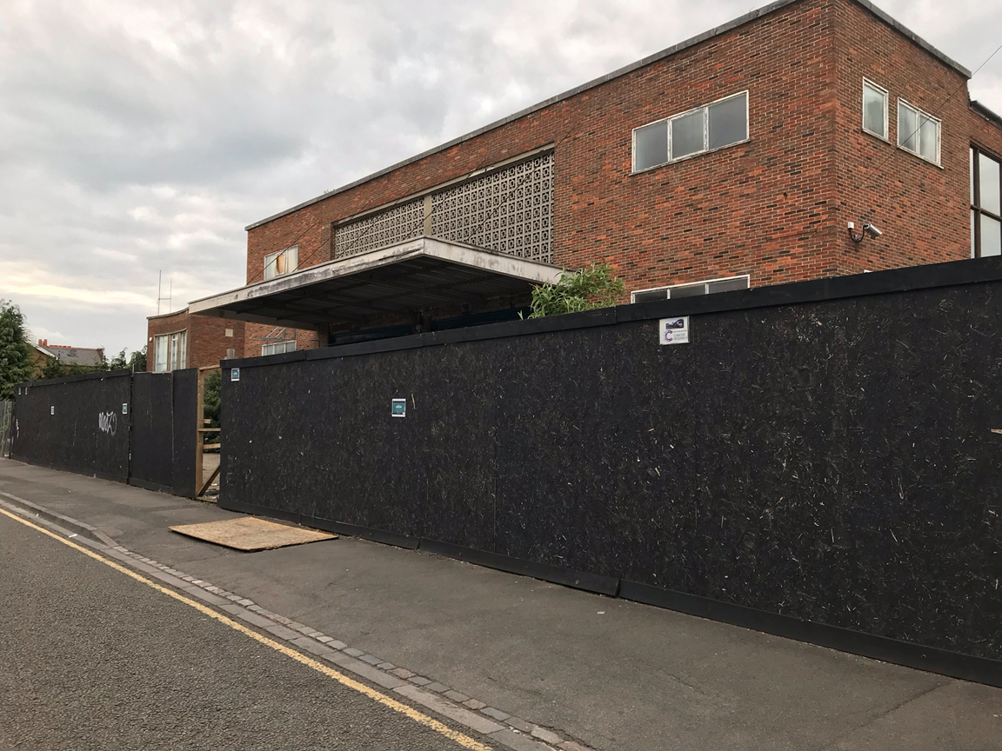
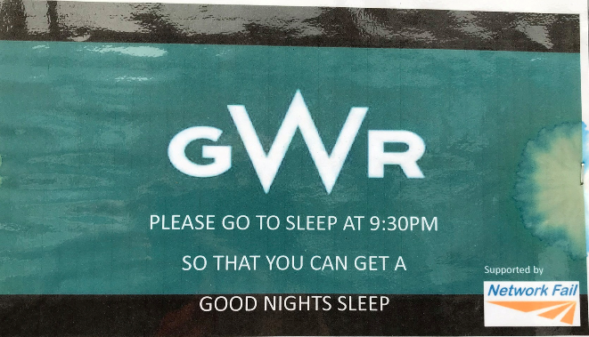
Reputational Close Call
Cardiff Road, Reading, 6 May 2019
Notes:
Poster erected by anti-GWR campaign groups using official branding.
What do you think the impact could be of this? Discuss as a group.

Slide 17
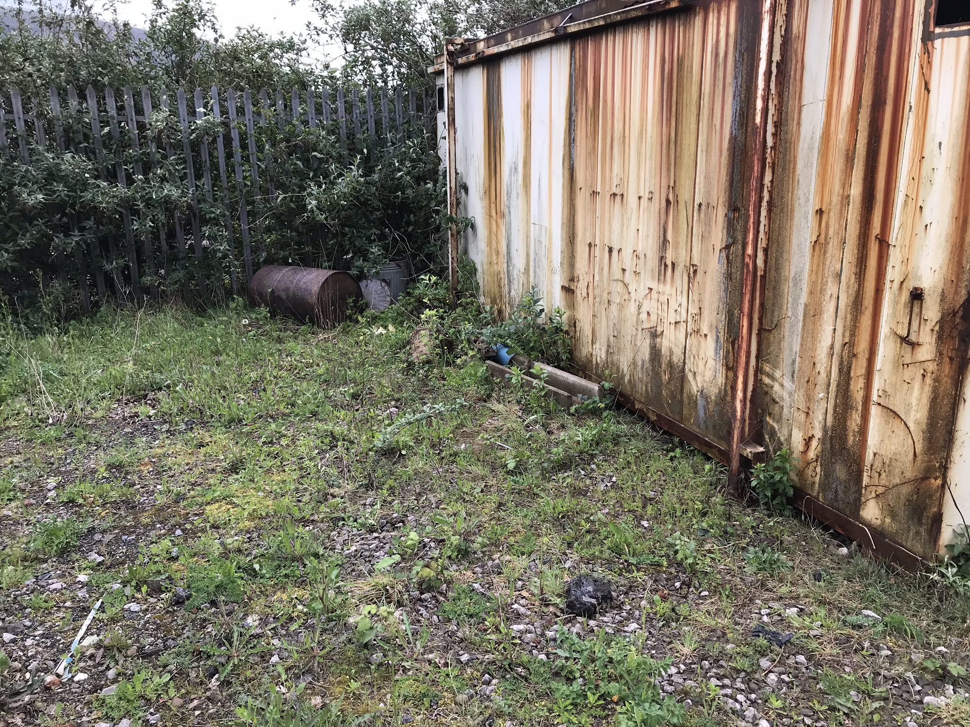
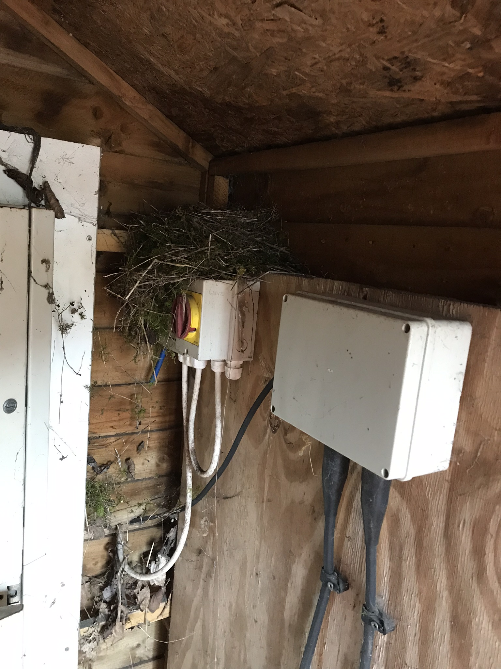
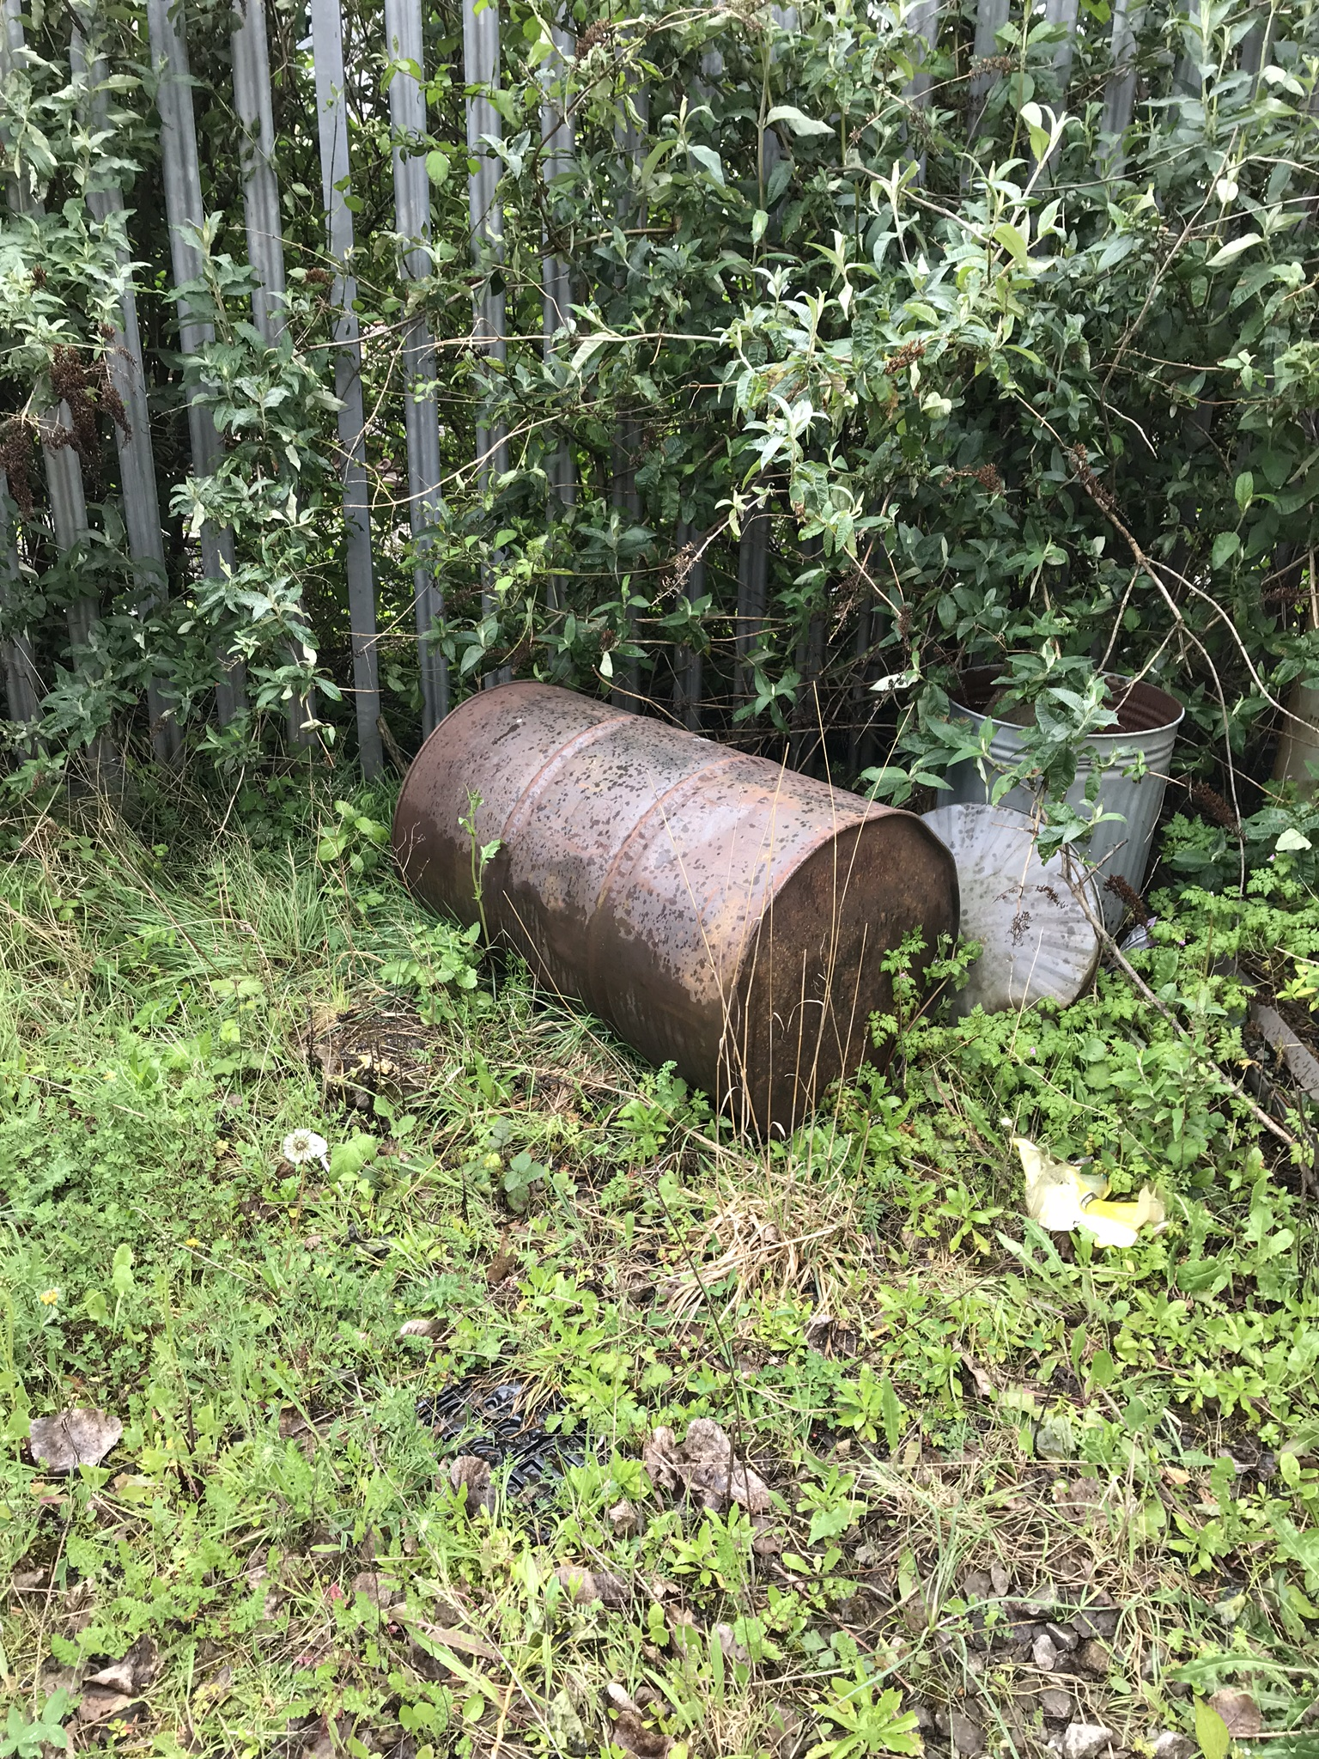
Environmental Close Calls
Port Talbot Training Centre, 29 April 2019
Notes:
NOTE: BIRDS HAD LEFT THE NEST AND THE DRUM DID NOT CONTAIN ANY HARMFUL SUBSTANCES.
Nesting Birds found in a shed on the top of an isolation rotary switch. Why is this a potential concern?
Discarded drum. Can you identify the potential consequences or impact associated with the drum in this picture?

Slide 18
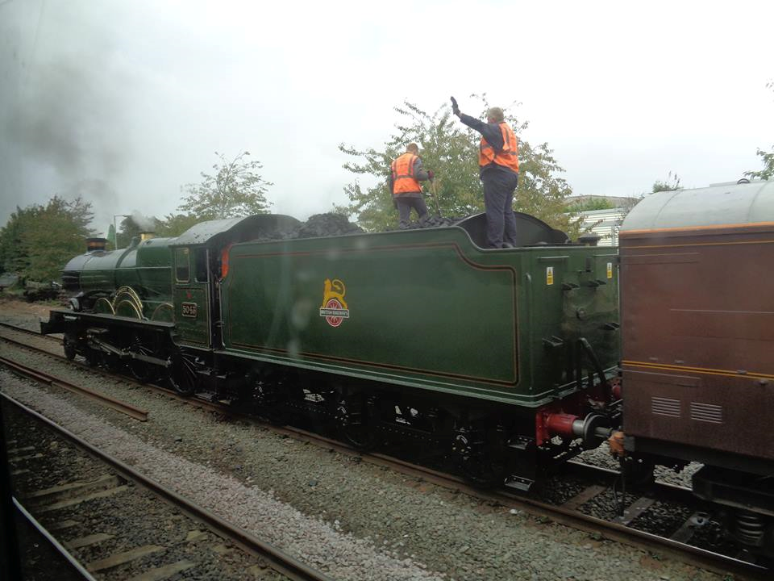
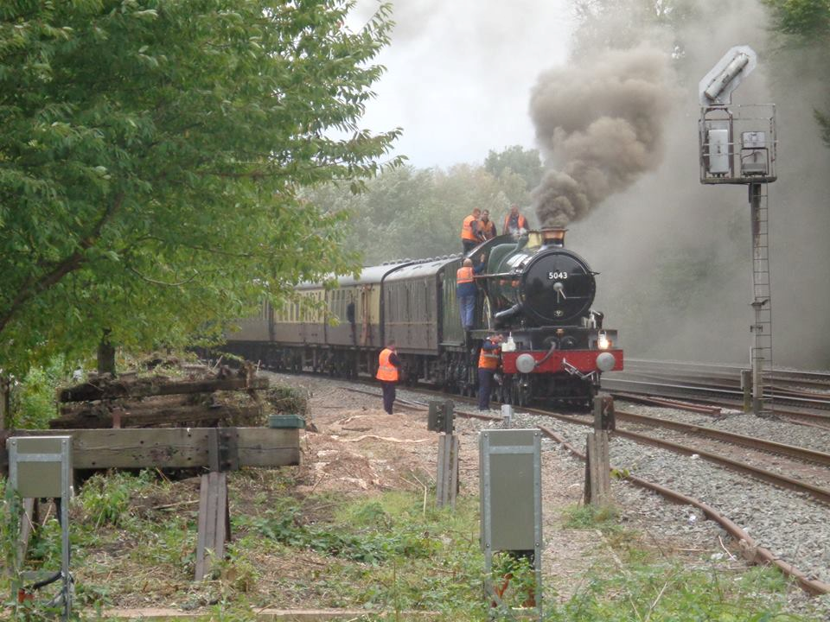
Close Call: Human Risk
West Coast Railway staff atop the Earl of Mount Edgcumbe, Oxford, 8 October 2016
Notes:
What is the risk in these photographs?
Lifesaving rule breach or not? You decide….

Slide 19
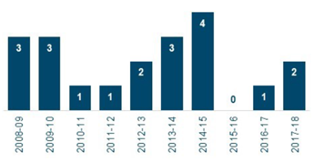
Workforce Fatalities, 2008-2018
And That’s Why We Love 2015-2016!

