Slide 1
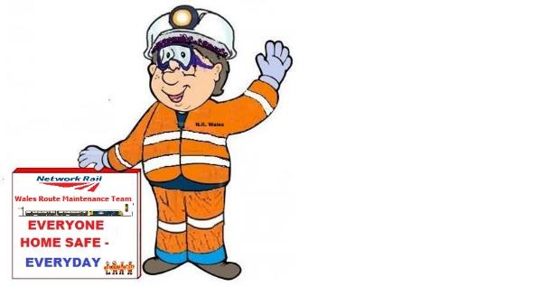
Wales & Borders route – Maintenance
OUR CHANCE TO LEARN
Injury sustained at Llanfairfechan
Felled Tree struck Person

Slide 2
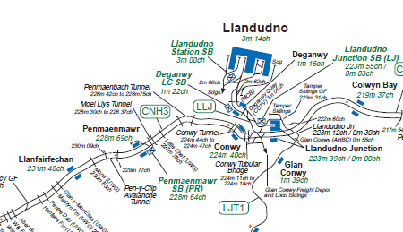
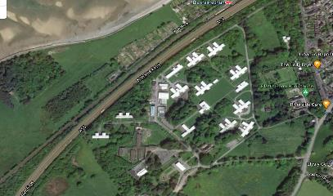
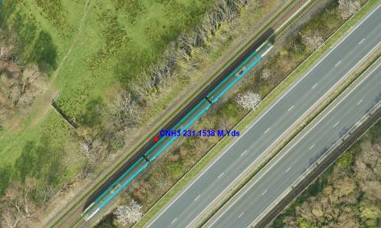


Incident CNH3 231m 70ch on 08-Dec-20
On 8th December at approximately 10:55 a team from Llandudno Off Track with specialist Arboriculture Sub-Contractors were undertaking tree and vegetation clearance works near to Llanfairfechan Stn.
The works were planned using Separated Protection with the IP undertaking Site Warden Duties.
The IP was placed by the PIC / COSS in a position they believed to be clear of the fall exclusion zone that a tree was planned to be felled into.
Site
Wales Maintenance – Getting everybody home safe - Everyday

Slide 3
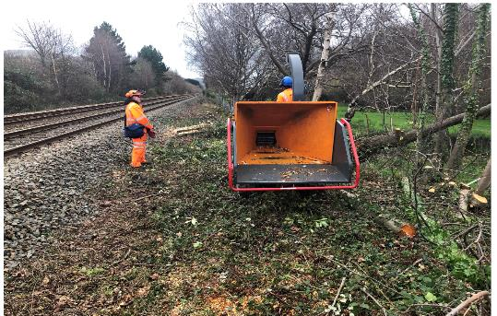
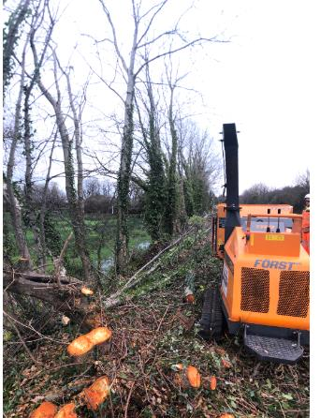
Incident CNH3 231m 70ch on 08-Nov-20
The weather was a gusty wind on the day with the direction being northerly, blowing towards the track. The plan was for the tree to fall parallel to the track.
As the tree fell, it hit branches of an adjacent tree which, when combined with wind direction, caused the tree to fall towards the track & the IP
Luckily a chipper was positioned between the IP and the tree and this took the brunt of the tree fall.
Wales Maintenance – Getting everybody home safe - Everyday

Slide 4
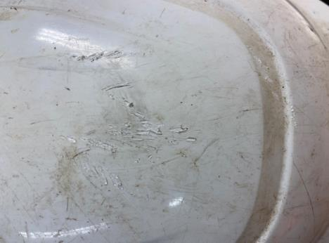
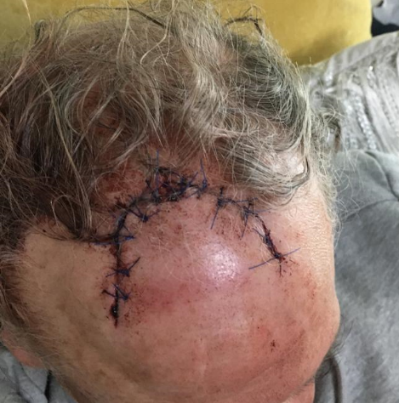
Result of fall
The IP still sustained a serious head injury as the tree branches ripped his hard hat off his head as it fell
1st aid was given at site and the was taken to the nearest hospital for emergency treatment, and received a CT scan and 11 stitches.
However this incident had the potential to have caused a much more serious injury
Wales Maintenance – Getting everybody home safe - Everyday

Slide 5
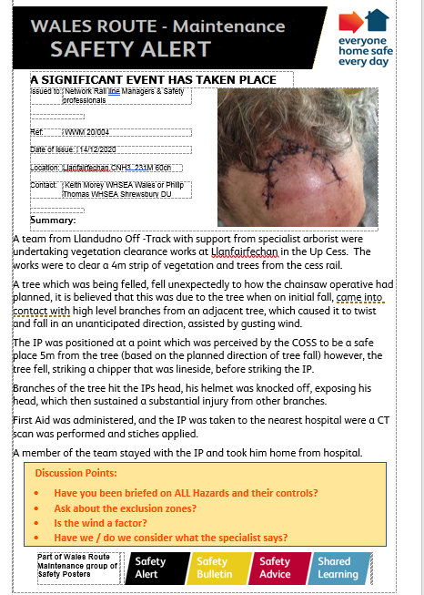
Initial Findings
We have also issued a Safety Alert for all staff
A Safety Stand Down Brief for all Off Track staff has also been undertaken.
The emphasis on the need to set up and maintain exclusion zones around felling operations, and the TRCS must be read as they contain the control measures to be taken for the other task hazards.
Wales Maintenance – Getting everybody home safe - Everyday

Slide 6
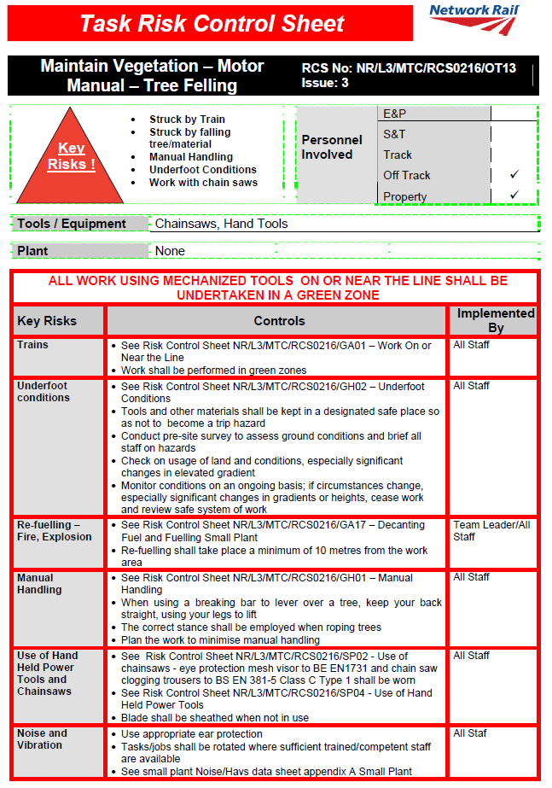
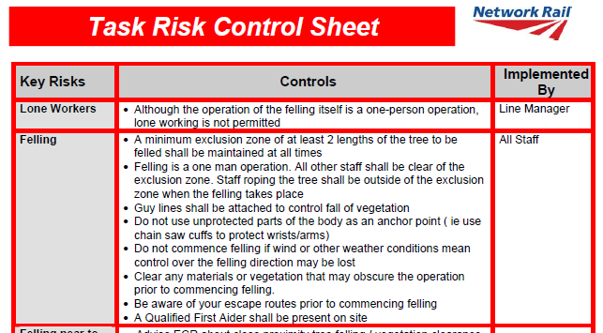
Findings of investigation
The level 1 investigation found that the required exclusion zone had been set up but only for the direction of the fell
It was also identified that TRCS are not fully referenced when briefing, instead the index of TRCS is used as reference.
The PIC / COSS Concentrated on Safety of the line and believed that the Specialist contractor would control the hazards of their activity.
Wales Maintenance – Getting everybody home safe - Everyday

Slide 7
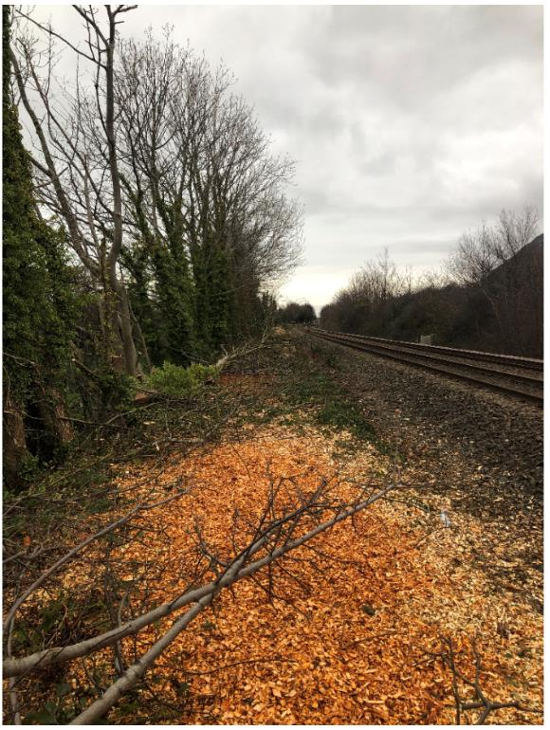
Action being taken - Immediate
1 – Safety Alert issued
2- Off Track Stand Down Brief
3 – Review of TRCS as this does not state a 360 exclusion zone
4 – PIC to work with the Specialist with a view for each risk being understood – whether on the TRCS or known to the specialist.
Wales Maintenance – Getting everybody home safe - Everyday

Slide 8
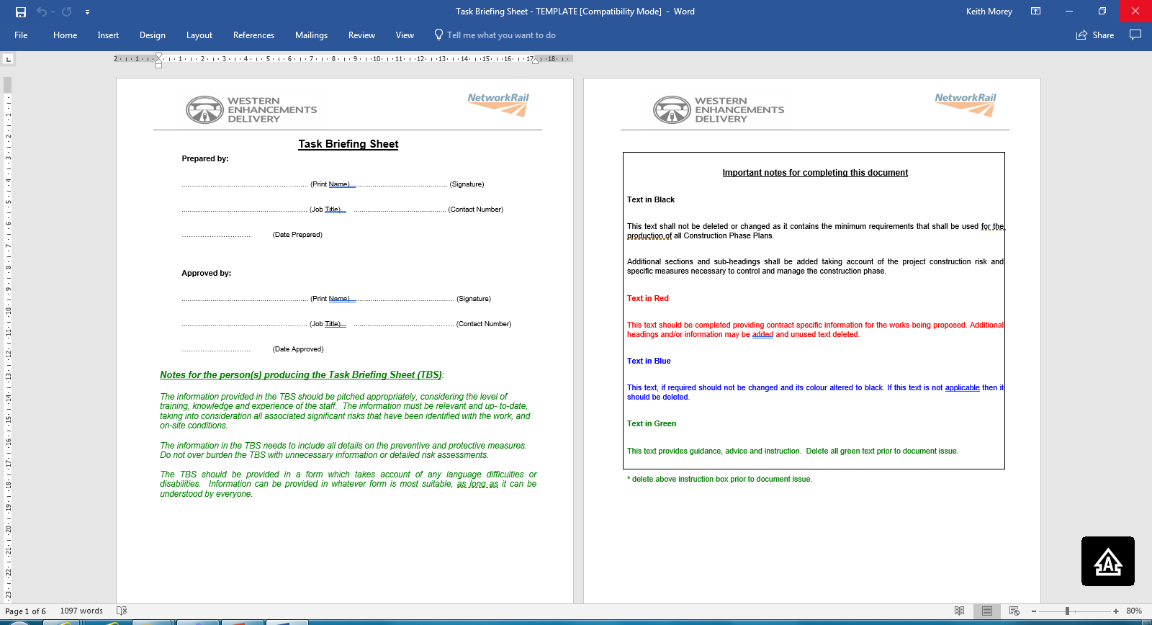
Action being taken – Med/Long Term
Medium to Long Term – In Wales a specific Task Briefing for and with specialist contractors to be used for tasks.
Thus making more specific to the hazards presented by the work activity and site when the risk is not about track safety.
Where Network Rail retains the PIC / COSS role and controls.
This can then be used with the SSOWP
Wales Maintenance – Getting everybody home safe - Everyday

Slide 9
So what can you do? – ASK!
Ask about the Exclusion zone – What is it for?
What environmental conditions could impact this activity?
How can you get a specialist to explain their risk?
Are there adjacent obstacles that can interfere with expectation?
What are the hazards and controls?
ASK!
Wales Maintenance – Getting everybody home safe - Everyday

Slide 10
Within Wales Route we believe no one should be afraid of asking for help and the smallest voice has a right to be heard.
Based on your feedback we have come up with :
ASK!
A
Ask for help if you don’t understand a briefing or instruction or if something doesn’t look right before starting work
Speak up if you don’t know how to do or use something or if someone is doing something that could affect your safety or health of others
Know your supervisor will take you seriously and that looking the other way is not the safe option
S
K
No one has been killed because they asked a question
!
Wales Maintenance – Getting everybody home safe - Everyday

Slide 11

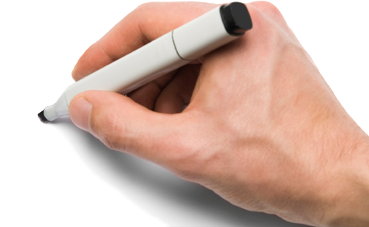
Any Questions…

