Slide 1

Safety Hour
Festive Driving
By: Joe Brown (SHE Specialist)
Route Services

Slide 2
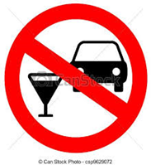

Festive driving do’s and don’ts
Don’t drink and drive – not even a little bit.
Drivers with even small amounts of alcohol or drugs in their system are known to be slower to react than normal. So remember this Xmas its NONE FOR THE ROAD!
Take it easy
Plan ahead and leave plenty of time for your journeys – better to be ‘late’ than ‘the late’…..!
Take it steady
Accidents are often really ‘misjudgements’ by drivers - speed, distance, corners, road-surface, weather, ETC
Don’t use mobiles!
Drivers are still seen using phones whilst driving a vehicle –the punishment is £200 & 6 points! Is it worth it?

Slide 3
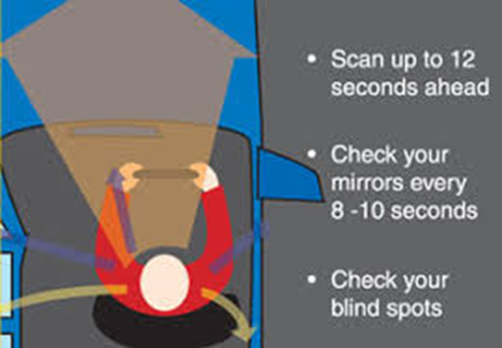
Don’t get caught out ‘suddenly’!
Often after an accident or incident drivers use phrases like ‘suddenly he pulled out’ or ‘suddenly’ this or that happened.
Its more likely that things were happening but drivers just did not notice the clues in time.
Keeping your wits about you and concentrating on what’s going on is a vital aspect of driving safely.
Being aware of what is happening in front of you and off in the distance can give you advance warning to adjust your driving.

Slide 4
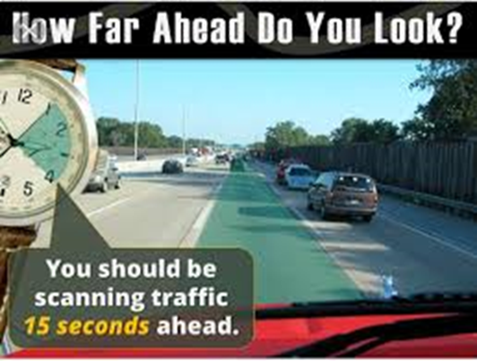
Driving observation
1 – Look forward to a point 15 seconds ahead of your vehicle
2 – Leave 4 seconds between your vehicle and the one in front
3 – Keep your eyes moving, avoid focusing on an object for more than 2 seconds
4 – Leave yourself an ‘out’ – surround yourself with space
5 – Make eye contact

Slide 5
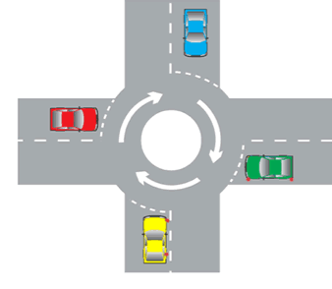
Priority is NOT right of way!
Having ‘Priority’ on the road is NOT the same as ‘Right Of Way’.
‘Priority’ on the road is determined by road-markings and road-signs but this does not mean you have a ‘right of way’.
Other road users may not be as sensible as you so be prepared to give way even if you have ‘priority’.
Better to be right than dead-right!

Slide 6
Remember...
Drive Responsibly
Drive Safely
Merry Christmas &
Happy New Year

