Slide 1

Off-Track Stand Down
Let’s Talk

Slide 2

Off-Track Stand Down – Let’s Talk
The days are short. It’s cold, wet and often windy. The work we do is necessary and important……. and can be dangerous.
Everyone involved in vegetation management is asked to take an hour away from their tasks to discuss three very serious incidents that have happened in recent weeks. Four front line staff have been injured.
Whether you let contracts, risk assess the task, use a chainsaw or do assurance visits...we all have a part to play.
What does Network Rail’s safety vision mean for you?
Think about each incident and discuss how you will prevent another.
Take the time to reflect on your own tasks to ensure that they are safe.
All the incidents here have happened in the last three weeks.
STOP, THINK and TALK

Slide 3
Chainsaw kick-back at Truro.
Nasty neck injury needing nine stitches.
Chain snagged on fence wire in undergrowth.
The right tool for the task?

Slide 4
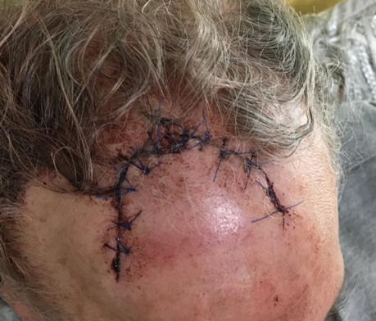
Tree felling at Llanfairfechan.
Helmet dislodged and open head wound.
The person hurt was less than two tree lengths away. The tree being felled changed direction when branches caught on another.
How do you check everyone on site knows the basic rules?

Slide 5
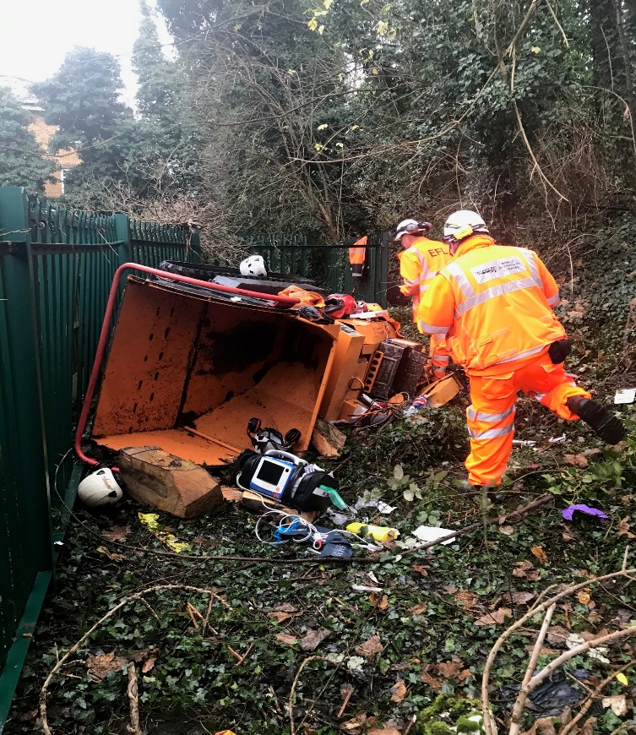
Lost control of tracked chipper on embankment at Maidenhead
Two people hurt: crushed chest and broken ankle.
Shortcut used was not in the Work Package Plan.

Slide 6
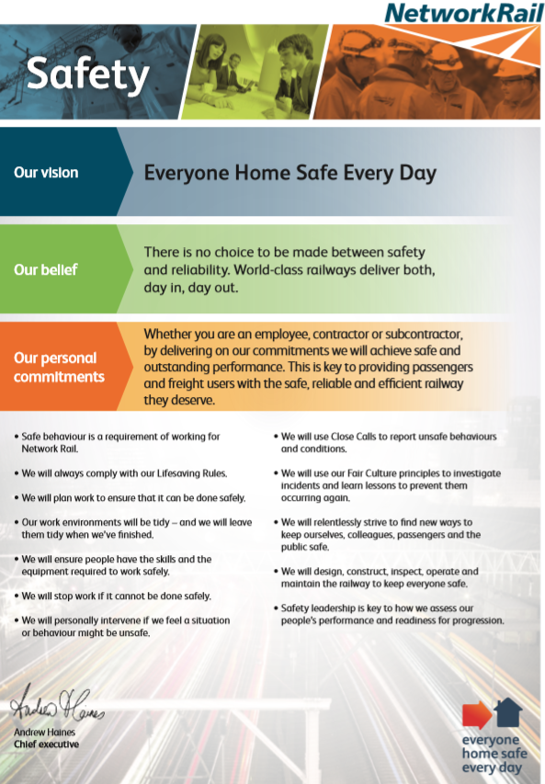
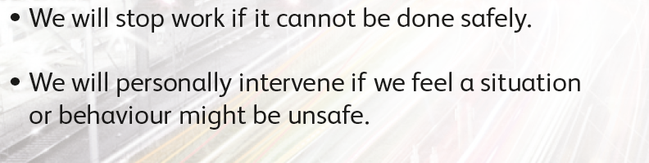
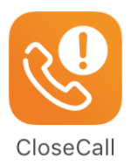
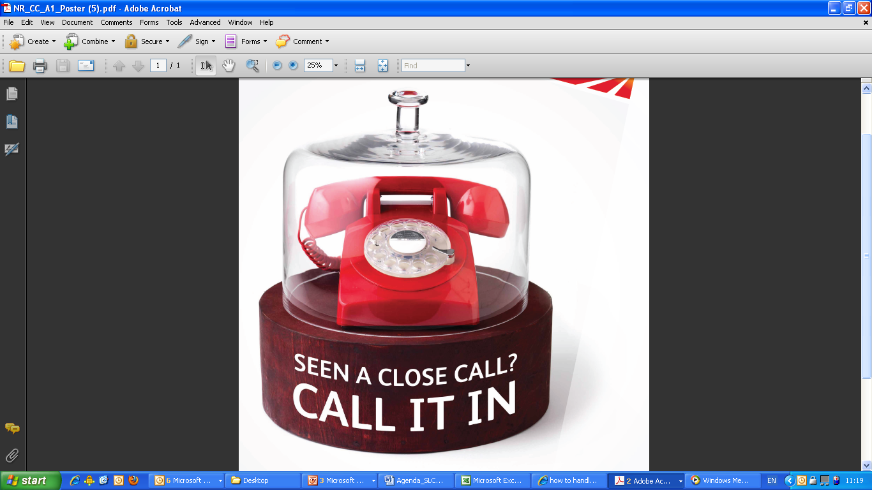
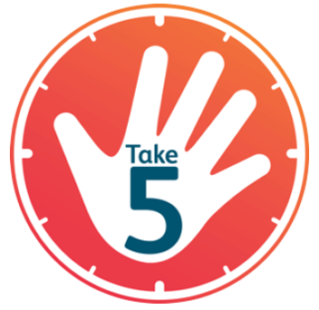
Ask yourself…
Can you be sure the work will be safe?
What will you do to avoid the next one being you?
Always report close calls.
Use the Worksafe Procedure.
01908 723500

