Slide 1
Margam.
Could it happen anywhere?

Slide 2
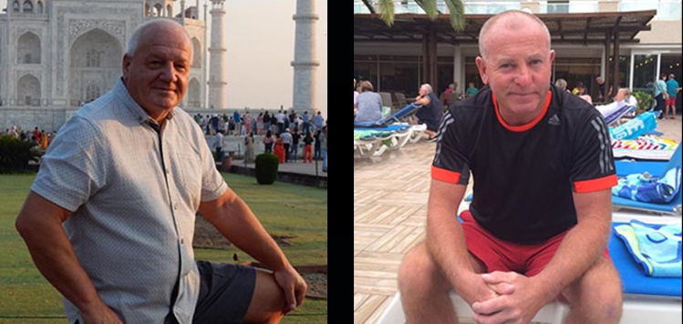
On 3 July 2019, at 09:52 the driver of a Great Western Railway train from Swansea to London Paddington reported that the train had struck three track staff on the Up Main line at Margam East Junction between Port Talbot and Pyle stations on the South Wales Main Line.
Our colleagues Gareth Delbridge, 64 and Michael (Spike) Lewis, 58 were struck and fatally injured.
A third colleague escaped by inches.

Slide 3
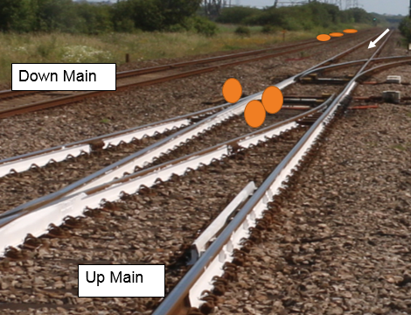
Overview
After changes to the order and type of work that day and while the Controller of Site Safety (COSS) was temporarily working further down the line, Gareth and Spike started work on an open line with their colleague using a petrol-engine impact driver to tighten bolts in a crossing.
They were all wearing ear defenders due to the high noise levels. When a bolt seized, they all became focussed on the task with no-one looking out.
When the train approached at approximately 70mph, both men were struck and fatally injured. The third colleague escaped impact with just inches to spare.

Slide 4
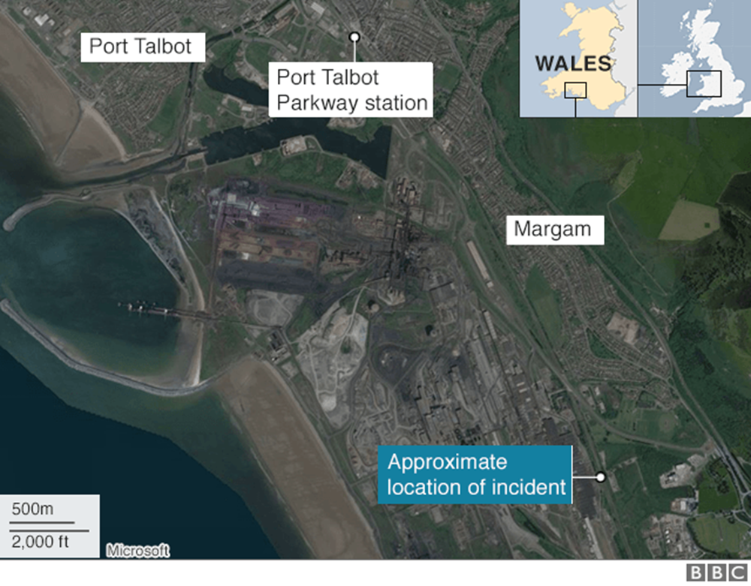
3 July 2019 - a clear and dry day
Thirteen permanent way staff left Port Talbot depot to work at Margam (20 mins away). They arrived just after 08:00.
The team split into two – one team of seven working at Margam Moor and another group of six at Margam East Junction.
The group at Margam Moor worked in a planned line blockage.
Six other experienced colleagues went to Margam East Junction. One of the technicians was asked to be the Person in Charge (PIC). He appointed another team member as the COSS.
Work had been planned there in the afternoon in a line blockage. But the safe work pack contained a second option to work with unassisted lookouts that afternoon.
The COSS was told to use the second system and appointed distant and site lookouts.

Slide 5
The team of six on site at Margam East Junction decided to do extra work that wasn’t in the plan.
Some of the extra work involved noisy plant to maintain bolts in a crossing at PT9577B points
A group of three including the COSS, site lookout and another moved about 150 yards away, leaving their colleagues to wait for their return.
The other three left at the points started to work on the crossing bolts. There was no appointed COSS with them, no safe system of work and no distant lookout in place.
The Person in Charge said he would look out then became involved in the work, focussing on the bolts. None of them saw the train coming.
Does this ever happen to you? How will you stop this happening in the future?

Slide 6
Interim report findings
The Safe Work Pack did not specify all of the work and how it was to be safely undertaken.
The COSS was only appointed that morning.
The COSS had his authority undermined – the PIC didn’t believe a distant lookout was needed.
The work was started in the morning, not the afternoon as planned.
There was no safe system of work in place.
The COSS was not with the group involved when the accident occurred.
The group all became focussed on the task and were unaware of an approaching train.
The wide experience of the closely-knit group and familiarity with each other potentially affected their perception of risk.
The reasons why this happened, how widespread the problems are and what needs to be changed to prevent a repeat are still being investigated and will be covered in the final investigation report before the end of 2019.

Slide 7
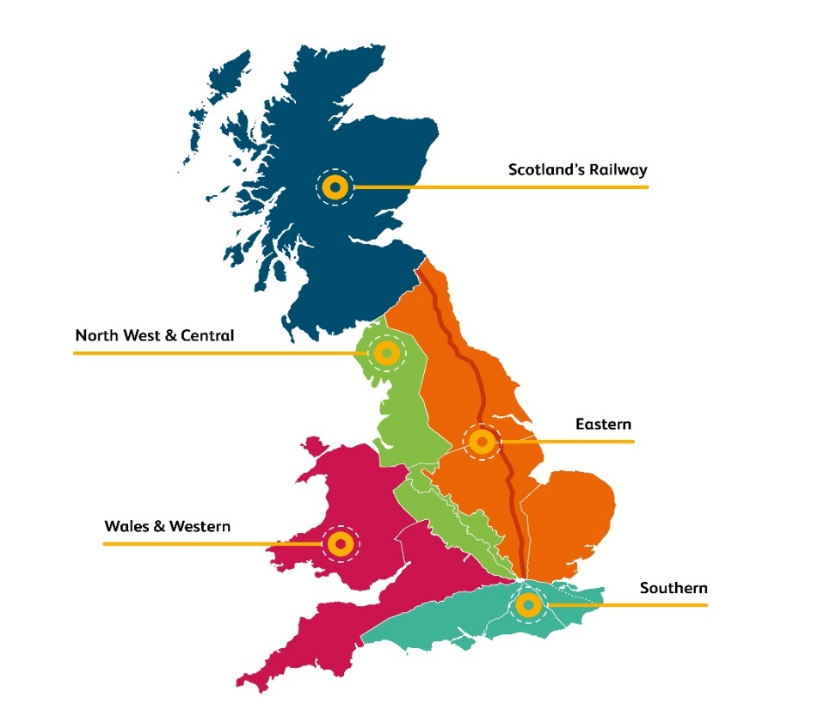
What went wrong?
There was weakness in the planning
There was weakness in the supervision
Everyone would recognise the way the work was done on site was not right
Could this happen again in your team?

Slide 8
Discussion points from the interim report
1) What will you do today that stops you being next?
2) How do you check you are managing risk not just being lucky?
3) How are teams checking each others’ safe behaviours?
4) Who is in charge of your safety?

