Slide 1
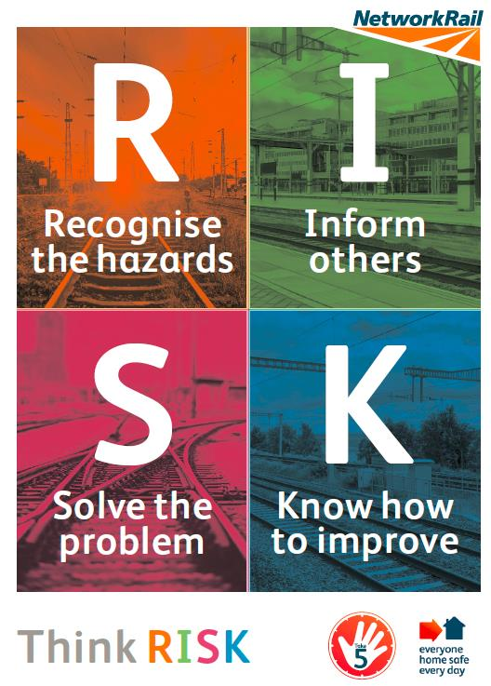
Safety Hour Discussion Pack
Topic: Think RISK
Purpose of the discussion:
To encourage colleagues to Think RISK – a series of prompts to help people in Network Rail to identify and manage risk more effectively.
This session is designed to help our people to understand what Think RISK is, how to do it, and commit to making it part of their daily routine.
For facilitators: please follow the steps in the notes section
Discussion points: Use below to plan your facilitated discussion. Remember, you don’t have to have all the answers – the role of the facilitator is to create an engaging discussion where everyone identifies and commits to solutions.
Discussion points | Supporting notes
What is Think RISK? | Start the session by playing the introductory video You may follow this by playing the team conversation video (optional) to help give a view of a typical discussion. Explain what Think RISK means, going through each letter and using the supporting document (RISK appendix) Have a conversation about how your team manages risks; - When would you use Think RISK? (e.g. for many frontline teams, it will be most helpful to Think RISK in their Take 5 moment.)
How is Think RISK relevant to our team? | Ask the group why they think Network Rail has too many workforce accidents - many of which result in lost time injuries. Tell a story of when an accident or incident nearly happened and how using Think RISK could have helped. Pick a task/job relevant to the team. Work through RISK with the team: Recognise – what safety risks would you expect to encounter? Inform – who else would need to know about this and how would you make sure you had the information to proceed safely? Solve – what action they would take if they felt a task was unsafe? Would the correct application of PDSW, for example, have removed the risk? Know – would the team members feel confident speaking up, and challenging each other, if they felt something was not safe? If not, why not?
Think RISK in practice | Ask the group to commit to using Think RISK in the very next task they do. If possible, film yourselves taking this approach and posting it to the Yammer page under #think risk Agree to share one example of Think RISK in practice at your next team meeting.
Notes:
As a facilitator for Think RISK we recommend you:
Familiarise yourself with the materials
Arrange sessions including inviting all those who need to attend.
Use the posters to create awareness by placing in the most visible of areas.
Carry out sessions and fill in the feedback form which shares learning and attendance.
Please complete the form and e-mail it back to: STEcommunications@networkrail.co.uk
For Network rail staff you can share your films of local events/good practice by going onto. Yammer and posting them by adding #thinkrisk

