Slide 1
NR/L2/OHS/019 Simplification
Issue 12
Standard Change Briefing

Slide 2
Introduction
This presentation will cover:
  Background to this new version of NR/L2/OHS/019 Issue 12 Simplification
  The changes explained
  Further information
Notes:
This briefing will walk you through the 019 Standard, touching base on its principles, the main format changes since the previous Issue, and the new features. Keep in mind, the principles of the Standard have not changed.

Slide 3
Engagement Feedback
Recommendations from RAIB 07/27 Track Workers Class Investigation and RAIB Margam Report have required that Network Rail continued their commitment to improve staff safety by completing a review of the 019 standard and developing a simplified standard.
The principles of 019 have NOT changed with simplification
The review of the standard included:
  Engagement sessions with the industry on Issue 10/Issue 11 of the standard to explore:
    Whether the standard was clear, easy to brief and supported safe working on or near the line, in line with its current principles
    Communicated to the relevant audiences in an appropriate way
    Independent evaluation of the existing 019 Standard
Notes:
The class investigation, The report describes the RAIB’s investigation into the safety of track workers working outside possessions of the line (i.e. those cases in which the normal running of trains has not been blocked to allow engineering work to be carried out).
Three examples are:
improvements in procedures and/or training for those in leadership roles to be able to adapt to changes in circumstances;
improvements to the training of track workers in non-technical skills;
changes in the competence requirements for people who lead track work in higher- risk situations

Slide 4
Engagement Feedback
  Engagement with the industry on issue 10/11 of 019 has been radically different in exploring whether the standard was clear and supported safe working on or near the line in line with its current principles
    1-2-1 interviews
    Online surveys
    Feedback from Infrastructure Leadership Group (ISLG) & Track Safety Alliance (TSA)
    Focus groups which has included end users of the standard
  Participants provided feedback on their feelings towards the standard, the roles, layout and comprehension, and support and communication about how updates could be provided.
Notes:
We approached senior leaders to track workers for the engagement activities
This was an independent activity from the core project team to promote open discussion

Slide 5
Engagement Feedback
Feedback on the standard, roles, layout, and language has been instrumental in how the standard has been designed. The simplification of the standard has included:
Re-organise content by role and push reference material to the end of the document
Add graphics such as flow diagrams and tables for processes
Re-phrase clauses to aid understanding and removed ambiguity
Remove duplicate info and incorporate good practise.
Additional functionality such as hyperlinks within the standard
Further engagement to review the standard during development
Notes:
You have seen what the 019 Standard is about and who needs to use it. In this section you are going to learn about the simplification process and the main changes between Issue 11 and Issue 12.
This section will explain why Network Rail undertook a simplification process, and how this has been carried out.
Read more about the simplification process: Click on the circles and answer any questions. Remember, you’ll be able to go back and review the content whenever you need.
In a continued commitment to staff safety, Network Rail undertook a review and update of the 019 Standard. This major piece of work, spread over several months, included gathering thoughts and opinions from all types of users of the Standard, including feedback on the changes as they have been made.
We have engaged with more than 250 people across the industry. You may have attended one of the many focus groups, workshops, or interviews, and for that we thank you.
To find out what the changes to the 019 Standard are for Issue 12, click on the next section.
Feedback has allowed us to identify five key areas that would simplify the Standard.
Format
The preferred format for Issue 12 is to keep it as a PDF document, as with other standards and previous Issues, but to make greater use of interactive features.
Issue 12 introduces the use of hyperlinks.
Layout
The engagement sessions highlighted how simplification of the content was needed to make the Standard flow better.
Some topics such as roles and responsibilities appear earlier in the Standard, while parts that
are less frequently used such as the definitions, references, and any supporting material, are pushed towards the end of the document
Clarity
Feedback from stakeholders confirmed that Issue 11 was very wordy. Issue 12 includes strong visual cues to help identify tasks relevant to each role. Other features such as flowcharts, diagrams, and tables now add clarity to the Standard content and processes.
Language
Issue 12 uses clear, simple, and accessible language.
Some clauses have been re-phrased to remove ambiguity and the table of definitions includes more detail.
Content
The revisions for Issue 12 include the removal of duplications and the addition of new content, such as good practice guidance and examples of a Safe Work Pack. The module on runaway risk has been removed as separate industry guidance is being developed.

Slide 6
Engagement Feedback
Post working group:
Review by readability software to confirm ease of understanding and simple language, with improvement from 24% to 88% improvement
Review by individuals with no knowledge of the standard to confirm it is easy to understand and follow
Updates and development have been shared with Infrastructure Leadership Group (ISLG) & Track Safety Alliance (TSA) and Trade Unions. All have been highly supportive of the approach and the simplified standard.
Notes:
The further engagement included workshops with people from the industry who used the standard on a day to day basis, these took place in November 2022 and January 2023 at different stages of the standard development to confirm we were taking the standard in the right direction

Slide 7
Simplification explained.
Issue 12 has been simplified in line with the requirements and feedback from the industry. It has been designed specifically for the end users. It is now process based, following a logical journey of the planning process for the 3 roles/competencies.
Feedback from the Working Group on the how we simplified the standard and the ‘what next’ is currently underway. Similar surveys will be planned for each of the Town Hall Briefings will be undertaken with conclusions provided in September ’23.
For the first time the standard will have an interactive briefing guide for users and a comprehensive Town Hall Briefing Programme for the industry.

Slide 8
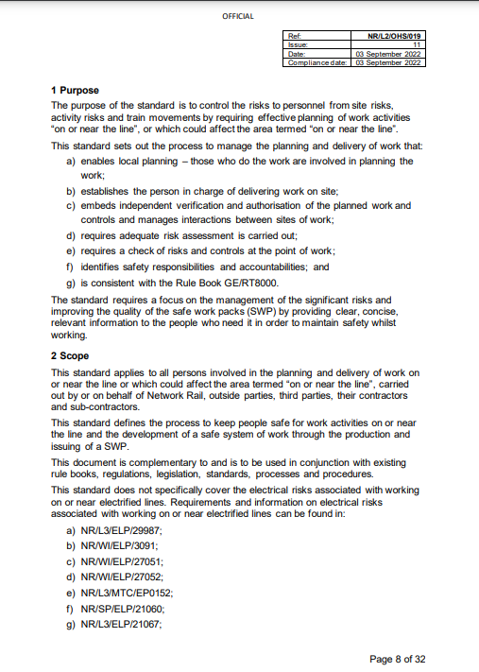
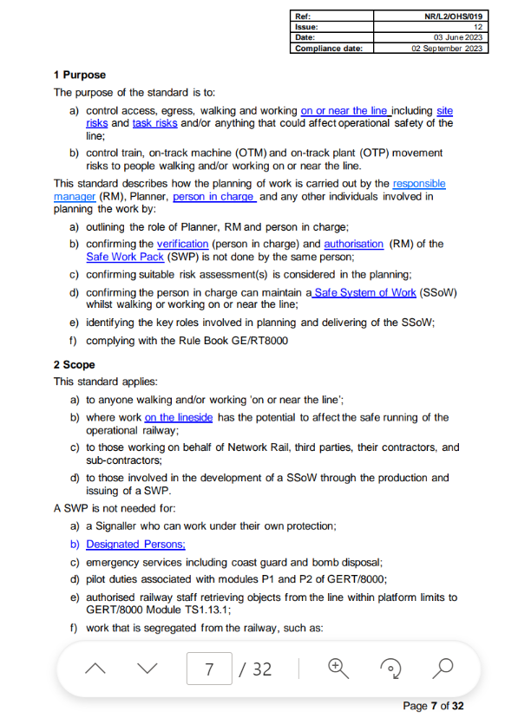
Simplification explained
Purpose & Scope
The purpose of the Standard is to control the operational, site, and task risks.
This Standard describes how the planning of work shall be carried out by the Responsible Manager, the Safe Work Planner, and the Person in Charge, during the planning, verification, authorising, and implementing of a Safe Work Pack, often referred to as the SWP
Notes:
The roles of Safe Work Planner [hover over definition], Responsible Manager (or RM) [hover over definition], and Person in Charge [hover over definition], are outlined in this Standard, clearly assigning responsibility and accountability to each of them. The Standard explains in detail the SWP and the process of creating it.
It also gives the guidelines for the person in charge to maintain a Safe System of Work (or SSoW) [hover over definition], whenever walking and working on or near the line.
The 019 Standard applies to all individuals involved in the planning and delivery of work. This includes work on or near the line and where work on the lineside has the potential to affect the safe running of the operational railway. It also includes people working on behalf of Network Rail, third parties, their contractors, and sub-contractors.
The Standard addresses the development of a Safe System of Work through the production and issuing of a Safe Work Pack.

Slide 9


Simplification explained
The Three Roles
The Responsible Manager (RM)
  is accountable for the preparation of Safe System of Work (SSoW)
  decides how the work is to be prioritised, planned, and delivered
  appoints the Planner and delegates the preparation of the SWP
  appoints the person in charge to help plan and implement the SSoW and the works
  reviews and authorises or rejects the verified SWP
The Planner
  is responsible for planning the work as instructed by the RM
  shall have suitable and sufficient task and site risk knowledge and experience, or shall consult with those who can provide such knowledge and experience
  shall be assessed and competent as a SSoW Planner
Notes:
This is now at the back of the standard
The avatars as what we have used for the interactive briefing tool

Slide 10

Simplification explained
The Three Roles cont.
The Person in Charge
  is accountable for their own safety and the safety of all persons in their work group
    This includes the risk of being struck by trains and the risks associated with the task and location
  shall hold one of the following competencies:
    COSS; or
    when working alone, Individual Working Alone (IWA) as a minimum
  retains accountability for safety at a site of work and has the final decision as to whether a SWP is acceptable before it is implemented
Remember, the person in charge shall not perform the duties of:
  Site Warden
  Lookout

Slide 11
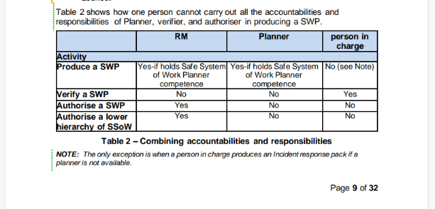
Simplification explained
Accountabilities & Responsibilities
Table 2 of the Standard shows how one person cannot carry out the accountabilities and responsibilities of the Planner, the verifier, and the authoriser in producing a SWP
Note: the only exception is when a person in charge produces an incident response pack when a planner is not available
Notes:
A table has been introduced for the first time to explain what each role can do and when in the planning process

Slide 12
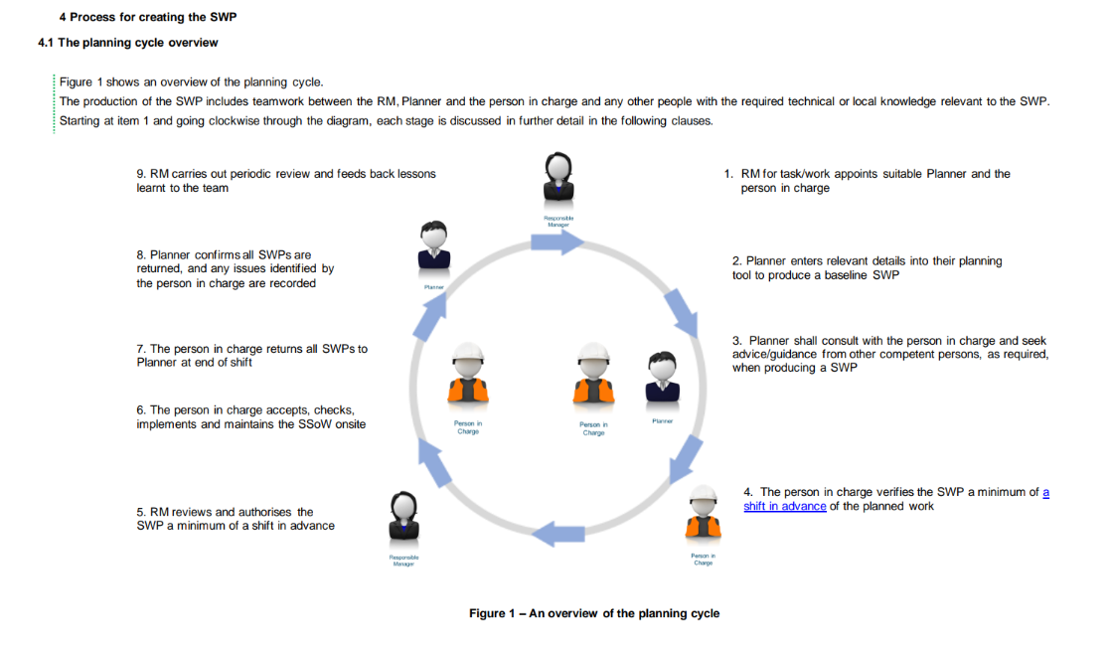
Simplification explained
Process for creating a SWP
Notes:
This section presents and explains the steps to follow during the development of the SWP.
It is worth mentioning that there are a few occasions when a SWP is not needed. Let's see them quickly together!
The SWP is not needed for a Signaller who can work under their own protection, a Designated Person, emergency services including coast guard and bomb disposal, station staff retrieving objects from the line within platform limits, and work that is segregated from the railway such as platform works.
The production of the SWP involves teamwork between the RM, the Planner and the person in charge and any other people involved with the required technical or local knowledge relevant to the SWP.
Starting from step 1 and moving clockwise, the diagram walks you through the planning cycle. Click on each of the phases to learn more about them and their requirements.
Producing
The RM firstly identifies the tasks and appoints a suitable Planner and the person in charge and provides them with enough time and resource to produce, review, and verify the SWP.
The Planner enters relevant details into the planning tool to produce a baseline SWP. Information such as the location of work and resources required are entered in the SWP. The SWP shall also provide clear information to enable the person in charge to control the operational, site and task risks.
The Planner shall consult with the person in charge and seek advice and guidance from other competent persons.
Verifying
The person in charge verifies the SWP a minimum of a shift in advance of the planned work. During this process the person in charge shall advise of any errors or omissions found in the SWP and confirm the suitability of access.
Reviewing and Authorising
The RM shall review the SWP and advise the Planner of any errors or omissions. The RM then either authorises the SWP (at least a minimum of one shift in advance) or returns the SWP to the Planner for changes and notifies the person in charge. The RM shall not authorise the SWP until it has been verified and reviewed.
Implementing and Completing
The person in charge accepts, checks, implements, and maintains the SSoW onsite. If the person in charge cannot maintain the planned SSoW they shall suspend the works and tell the workgroup why. Any change to the SSoW onsite, needs to be discussed with the RM who will provide an authorisation number to continue the work. When work is finished the person in charge will make sure that all people, equipment, and material have been removed from the track prior to hand back.
The person in charge shall return the completed SWP to the Planner at the end of the shift.
Monitoring
The Planner checks that all packs are returned. They correct any errors or changes in the SWP before future use and remove all incorrect SWPs from use. They also advise the RM of any undertaken actions.
The RM carries out a periodic review and feeds back lessons learnt to the team.

Slide 13
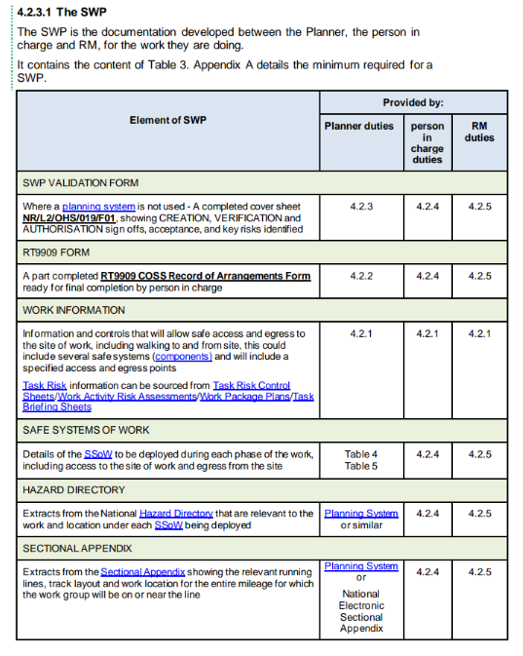
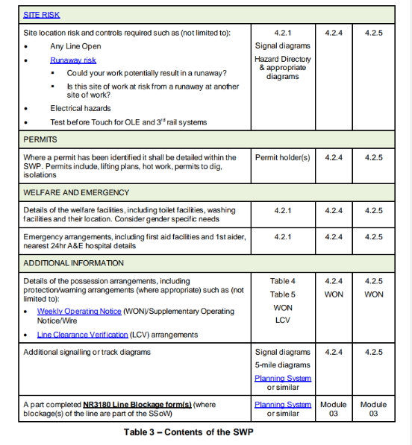
Simplification explained
What should a SWP contain
Notes:
This is new to give an early indication in the standard what makes up a SWP and what the three roles are required to do during the planning stages
This is where runaway risk now sites within the main standard, under Site risk
Appendix A is still included at the end of the standard as another reminder

Slide 14
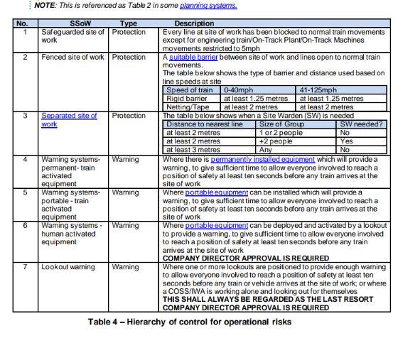
Simplification explained
Hierarchy of Control for Operational Risk
The layout has been enhanced with more content to aid
the planner in deciding the most appropriate SSOW
Notes:
The Planner shall determine the SSoW by starting at the top of the hierarchy of controls for operational risk and move down the hierarchy to find the safest suitable option for the work to be done.
Issue 11 vs Issue 12
The list of systems is the same as per Issue 11, but the column of possible considerations for not applying this SSoW has been removed, as well as the column of Examples of safe systems (not an exhaustive list).
The text has been simplified and duplicate descriptions and any references to obsolete definitions have been removed.

Slide 15
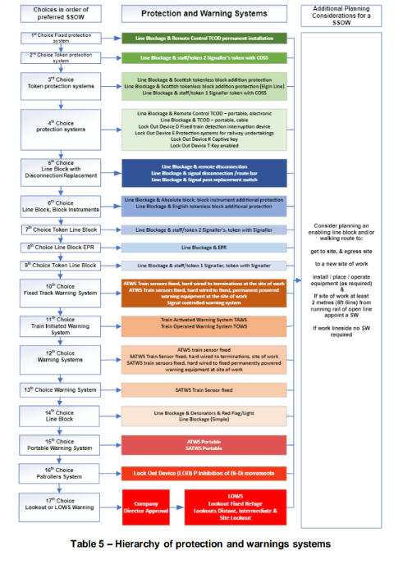
Simplification explained
Protection & Warning systems
There has been no change to the protection and warning systems as this was out of scope of simplification (except for the colour scheme)
Notes:
Issue 11 vs Issue 12
The Hierarchy of protection and warnings systems was already present in Issue 11, and no change has been made to this table. Nevertheless, it is interesting to see the main aspects and purpose of this hierarchy.

Slide 16
Simplification explained
Verifying the SWP & defining what a shift in advance means
The definition of a shift in advance can be found in Appendix C of the 019 Standard as follows:
The person in charge shall review and verify the SWP on or before their last working day before the work is due to commence. The person in charge does not review and verify on the day the work is due to commence unless:
      The nominated person in charge is unable to work
      The RM nominates a new person in charge
    The RM authorises the SWP
Notes:
Shift in advance was a cause of much debate during the early engagement, working groups and the latter engagement.
As we were not changing the principles of the standard this has remained the same apart from a simplification of the language. A simplified definition has now been added in the definitions table, appendix C.

Slide 17
Simplification explained
Review & authorise the SWP
The RM carries out the role of reviewing and authorising the SWP
The RM does not authorise the SWP until the person in charge has verified the SWP
The RM then checks the SWP to confirm that:
the hierarchy of control for operational risk in Table 4 is appropriate.
the protection and/or warning system in Table 5 chosen for both the site and task is the most appropriate
all site, task, and operational risks have been included and all control measures are identified
the requirements of verifying the SWP have been met.
If no errors or omissions (or when changes have been made by the Planner), the RM authorises the SWP at least a shift in advance
Notes:
The process has not changed apart from a simplification of the language

Slide 18
Simplification explained
Verifying & authorising cyclical and repeated SWPs
As a reminder a cyclical maintenance task or inspection which is performed to a frequency schedule specified in Network Rail standards
A Repeated SWP is a task that is repeated with no defined frequency
The RM checks that the SWP meets one of the above definitions and has been verified by the person in charge
The SWP is valid for:
A maximum of 6 months when using a warning safe system of work
A maximum of 12 months when using a protection safe system of work
The person in charge performs a final acceptance check that the cyclical or repeatable SWP is still valid
Human activated warning systems and Lookout SSoW shall not be permitted as cyclical SWPs unless approved by a company director
Notes:
This has not changed apart from a simplification of the language

Slide 19
Simplification explained
Delegation of COSS duties
Delegation of duties can be a critical aspect. If you are not sure when the person in charge can delegate their duties, this section will clarify this.
It is recognised that certain activities relay on delegation to affectively undertake work.
The following are examples where delegation will be allowed:
where a pre-planned, specialist COSS certification is required for a specific task/area, the person in charge may not hold (for example but not limited to):
ERTMS COSS on Cambrian lines
RETB COSS taking line blocks in North of Scotland
when the person in charge is required to be a Rail Incident Officer
When acting as a Lookout or Site Warden
Notes:
Delegation of duties can be a critical aspect. If you are not sure when the person in charge can delegate their duties, this section will clarify this.

Slide 20
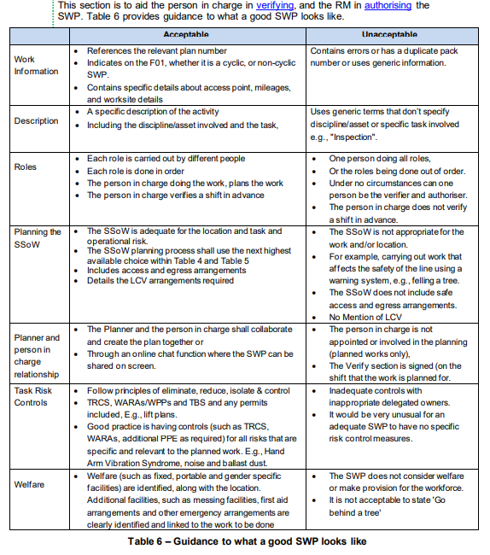
Simplification explained
What does a good safe work pack look like?
Notes:
This is new to give the planner a clear explanation of a good SWP

Slide 21
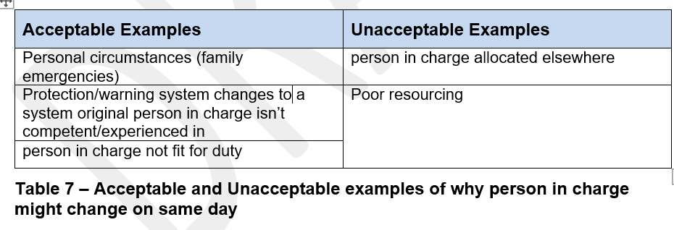
Simplification explained
Changes to the safe work pack after authorisation
Notes:
Due to an unforeseen absence of the named person in charge, a new person in charge can be appointed by the RM
The newly appointed person in charge needs to carry out the following checks:
Only accept a SWP that has been authorised by the RM;
be given time to read and understand the complexity of the work and verify the SWP;
have the same level of knowledge/competence/experience as the person in charge in the following:
Task risks
Operational risks
Site risks
provide feedback to the RM prior to implementation of the SWP;
receive an authority number from the RM and record it in the SWP for the change of person in charge; or
if this cannot be achieved the works shall be cancelled.

Slide 22
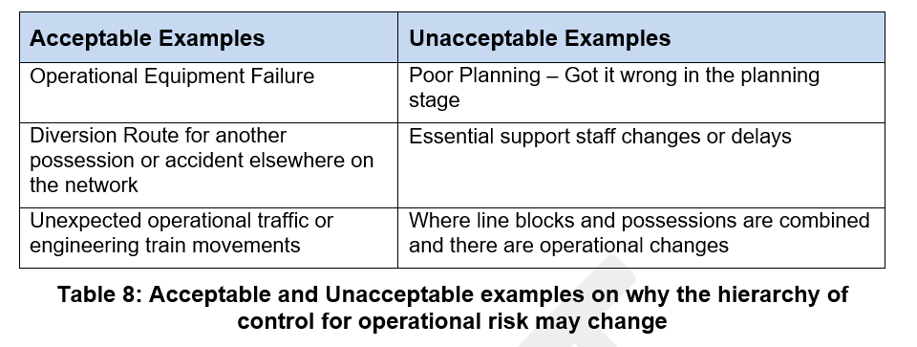
Simplification explained
Making changes to the SSoW and moving down the hierarchy of control for operational risks
Notes:
The person in charge will initiate this
There may be exceptional times when the planned SSoW may not be suitable and may need to be changed. Acceptable reasons for a change in SSoW include:
Operational equipment failure
Diversionary route as a result of another possession or accident elsewhere on the network
Unexpected operational traffic or engineering train movements
Where the person in charge makes a request to move down the hierarchy of control for operational risks:
only move down the hierarchy if the chosen hierarchy option is the safest available and a suitable option;
the RM shall authorise the change; and
issue an authority number.
If the SSoW hierarchy cannot be agreed, then works shall be cancelled by the person in charge

Slide 23
Simplification explained
At the end of the shift
The person in charge does this
When work is finished the person in charge shall confirm all equipment and people that can affect safety of the line, has been removed from the track prior to hand back and the line is safe for the passage of trains.
Note: Line Clearance Verification should be carried out in accordance with NR/L3/OPS/084 Line Clear Arrangements Following Engineering Works in Axle Counter Area
Notes:
There is a slight change to include line clear arrangements following the completion of work.
The Challow recommendation, where a train collided with a trolley left on the line, that is why it is now specifically referenced

Slide 24
Simplification explained
Completing & Returning the Safe Work Pack
The person in charge does this
At end of shift, the person in charge shall:
sign off the completion of work sign off form
return the used or unused SWP to the Planner;
where SWPs are unused, or errors identified, the person in charge shall state the reason why in the SWP

Slide 25
Simplification –changes explained
Appendix A Contents of a Safe Work Pack
There is no change to this form
Appendix B Monitoring & Assurance Framework
A new assurance section has been created to show when assurance activities need to be carried out and by whom
Appendix C Definitions
This section has been moved to the end of the standard, simplified and additional definitions have been included
Notes:
Appendix A remains the same as before apart from a few more examples in the right hand column
Appendix B is new, previously content on this was in the main standard, the language has been simplified, more detail on what is required and by who has been included
Appendix C, moving the definitions to the back of the standard came from stakeholder feedback during the engagement sessions, users of the standard wanted to get into what was required to plan earlier in the standard, the content has been enhanced

Slide 26
Simplification explained
All the modules
The modules have been simplified to cover the additional requirement for the responsible manager, a planner and person in charge. Signposting to other relevant standards and other sources of information has also been introduced.
The new modules are:
module 1 planning and working for fault failure & incident response
module 2 planning & working in a possession
module 3 planning & working using protection & warning systems
module 4 planning & working for High Output and track renewals involving engineering trains
module 6 planning & working for isolation duties and possession support
The Runaway Risk Module (previously Module 5) has now been removed from the standard and additional guidance will be published on this shortly by Corporate Workforce Safety. Runaway Risk is contained within the planning systems
Notes:
Module 5 is withdrawn It has been agreed that the Runaway Risk module will be taken out of the 019 standard for Issue 12. Runaway Risk was added as a module in 019 for Issue 10 as it was felt at the time it was the best place as no agreement could be reached as the most logical place for it.
Standard owner, Corporate Workforce Safety are producing industry guidance on the minimum requirements to manage runaway risk. This guidance will be supplemented by a risk assessment
The content in the modules has been simplified to only include the difference from the main standard and sign posts have been added to the main standard and other relevant standards as required

Slide 27
Simplification explained
Module 1 Planning and Working for fault failure & incident response
This module describes the additional considerations for planning a SSOW for fault, failure, or incident response. It shall only be used where either:
The normal planning timescales cannot be used
An incident number has been generated
A competent person is appointed for an emergency or failure.
It outlines the actions required to respond where immediate action is required. Where timescales permit, a SWP is still produced as described in the 019 Standard, otherwise an Incident Response Pack is required
Notes:
This module has been renamed to reflect that this module can be used for more than just incident response and used by signalling technicians when responding
As a reminder if the content is in the main standard the content is no longer included in this module or the others

Slide 28
Simplification explained
Module 2 planning & working in a possession
This module describes work taking place in a possession, and the additional requirements for planning:
Complex site of work
Possessions
Worksites
There are additional people involved in the planning and working, including:
Person in Charge of Possession (PICOP)
Engineering Supervisor (ES)
Additional person in charges or COSSs as required
Additional technically competent people to assist in producing the SWP
Notes:
This module has simplified, new content has been added though through consultation with the working group and via engagement feedback

Slide 29
Simplification explained
Module 3 planning & working using protection & warning systems
This module describes the additional requirements when using either protection arrangements or warning systems. It includes actions to determine whether the site is a complex site of work, how to decide which system to use, whether additional protection is required, and understanding which tasks affect safety of the line
Notes:
This module has changed to now include warning systems, this was a request from the working group and other engagement sessions
More guidance has been added of items that will need to be considered during the planning process, such as:
Converging and diverging junctions
Activities that need to be separated in time and distance
Multiple contractors on site

Slide 30
Simplification explained
Module 4 Planning and Working for high output and track renewals involving engineering trains
This module describes the additional considerations for planning and working for:
High Output tasks
Track renewals involving engineering trains
This module covers works that are taking place in protection zones and possessions
Notes:
This is an enhanced module to cover more content on high output activities and track renewals works, it was felt previously the standard lacked detail on how to plan for these activates, when SSOW need to be set up
It includes items to consider such as:
Whether a works supervisor is required
Any ALO requirements
Level crossing arrangements

Slide 31
Simplification explained
Module 6 Planning and Working for isolation duties and possession support
This module describes the additional considerations for planning a safe system of work for:
Persons working on or near Overhead Line Equipment or DC/3rd rail
Implementing an earthed isolation on OLE
Implementing an isolation on DC/3rd rail
Possession support planning/activities
Notes:
This is a new module as it was felt a gap for how to plan a SWP for these activities.
This includes consideration of planning for:
persons working on or near Overhead Line Equipment (OLE) or DC/3rd and 4th rail;
implementing an earthed isolation on OLE;
Implementing an isolation on DC/3rd and 4th rail;
possession support planning/activities.

Slide 32
For further information contact us at
CWSafety@networkrail.co.uk
Notes:
For further information please use the Corporate Workforce Safety email address. The technical lead will receive notification of any question or enquiry

