Slide 1
Guidance on completing the Network Rail whole life carbon reporting template (Excel version) for capital delivery projects
Clive Jones
Version Rev.1
20 February 2024

Slide 2
Purpose
This slide deck provides illustrated guidance for completing the Excel format of the Network Rail whole life carbon reporting template for capital delivery projects.
Not all fields are described or illustrated in this guidance document as many fields are considered self-explanatory.

Slide 3
What is the Network Rail whole life carbon reporting template?
An Excel reporting worksheet to collate summarised project-level carbon emissions data aligned to the life cycle modules and carbon accounting boundaries of BS EN 17472:2022 ‘Sustainability of construction works — Sustainability assessment of civil engineering works — Calculation methods’.
Note 1: For project works that are designing and constructing buildings there is sufficient alignment within the Network Rail template to comply with the equivalent BS EN 15978:2011 ‘Sustainability of construction works — Assessment of environmental performance of buildings — Calculation method’.
The reporting template is for high level reporting only and its main function is to enable project-level whole life carbon data to be gathered and reported in a consistent way and to highlight gaps or deficiencies in life cycle data.
The reporting template DOES NOT perform detailed project-level carbon assessment. Project teams will need to use a valid life cycle carbon assessment tool or platform and assign competent resources to undertake their detailed carbon assessment and quantification within the life cycle modules.
The current Excel template requires manual completion to transcribe relevant carbon totals from the chosen carbon assessment tool or platform.
Note 2: Future iterations of the carbon reporting solution may offer a webform reporting interface or much more automated data interfaces with carbon assessment platforms, but these enhancements are not currently available. A Network Rail project is underway with a team from Route Services Information Technology to develop carbon reporting enhancement proposals. Until these improvements are available this Excel reporting template provides a minimum viable product manual solution.
The reporting template is divided into three main parts and this guidance document is structured around those three parts.

Slide 4
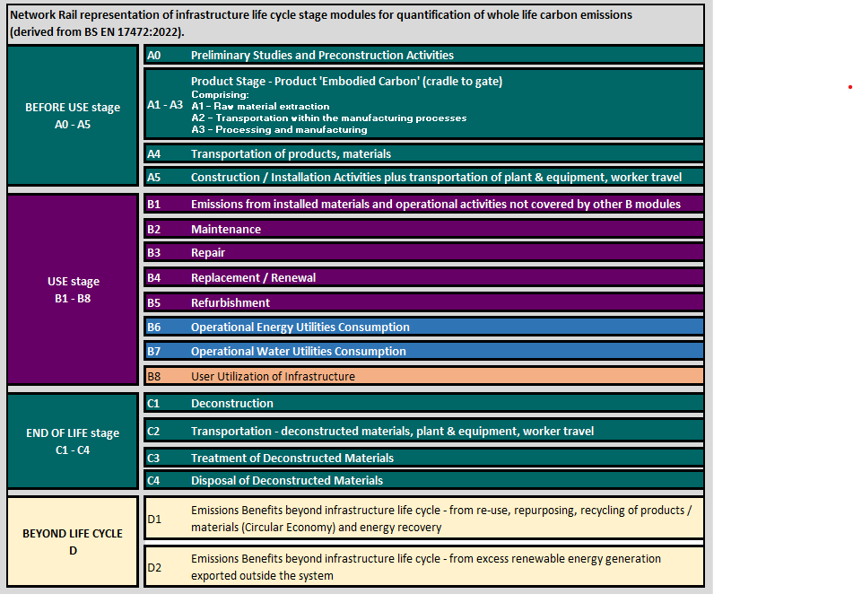
Life cycle modules for assessment of whole life carbon (CO₂e) emissions
Legend
Capital carbon - emissions arising from Capex expenditure
Mix of capital and operational carbon emissions (Capex and Opex expenditure)
Operational carbon – emissions arising from Opex expenditure only
User carbon, from utilisation of the infrastructure
Carbon benefits outside the life of the infrastructure system

Slide 5
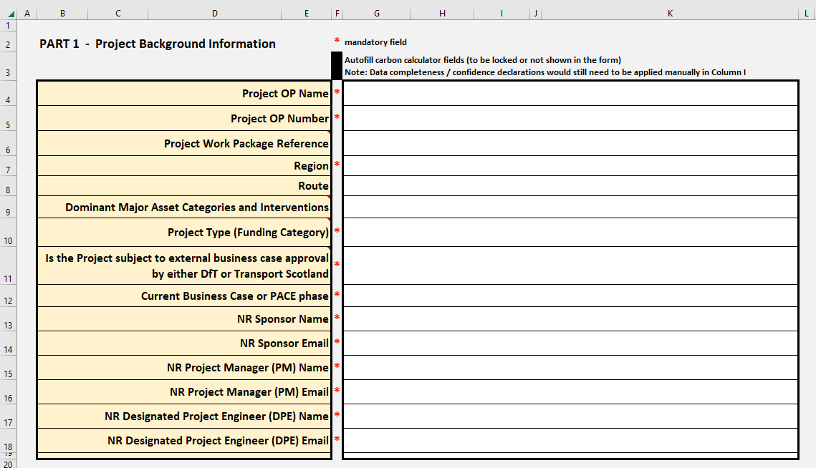
Part 1 – Project Background Information
Column F indicates which data entry rows are mandatory*
Rows 6, 9, 10 & 11 have embedded explanatory notes in the beige cells
All Part 1 data entry cells (white cell groups) are free-text apart from rows 10 and 11 where responses are selected from a dropdown list / menu.

Slide 6
Part 2: Current carbon assessment and reporting phase
Column F indicates which data entry rows are mandatory* and which rows use formulas to auto-fill values
Rows 26 & 27 have embedded explanatory notes in the beige cells
Most Part 2 data entry cells (white cell groups) are free-text apart from rows 23 and 25 where responses are selected from a dropdown list / menu.
Row 23 is critical as it uses a dropdown menu to select which project stage or PACE milestone the carbon assessment relates to
Insert details of the person responsible for creating and submitting the carbon assessment, even if that person is a supply chain organisation representative
(i.e. designer or principal contractor)
Row 25 selects the reference study period from a dropdown menu.
Only two reference study period options are offered – 60 years or 120 years

Slide 7
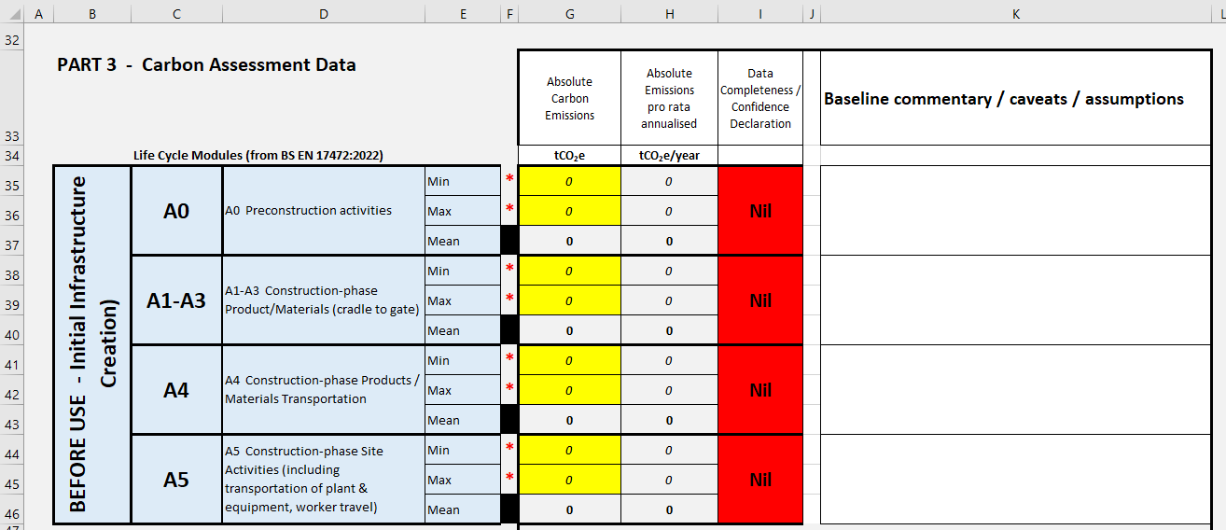
Part 3: Carbon Assessment Data – Data entry
Column F indicates which data entry rows are mandatory* and which rows use formulas to auto-fill derived values
Throughout Part 3 - Columns B, C & D are used to describe the life cycle modules and boundaries for which carbon contributions must be assessed
In Part 3 carbon data entry fields are highlighted in yellow.
Carbon data are entered as Minimum and Maximum values to allow the user to express a data range if required.
If the user does not want to indicate a range the same value can be entered for Min. and Max.

Slide 8
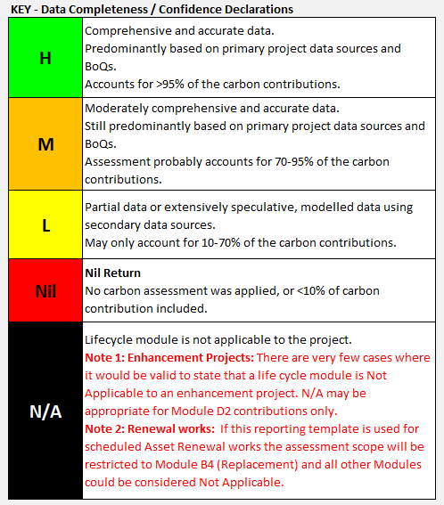
Part 3: Carbon Assessment Data – Data completeness declarations
Throughout Part 3 each carbon data module includes a field (column I) to declare the data completeness. A simple dropdown menu is used to assign a data completeness / quality rating that best describes the module data.
The default setting for each module assumes a ‘Nil Return’ until the user changes a declaration rating.
Five colour-coded ratings are available to indicate the data quality
Caution is needed before indicating that a life cycle module is ‘Not Applicable’!
For an enhancement project undertaking a whole life carbon assessment, absence of data is more likely to be a ‘Nil Return’ than genuinely ‘Not Applicable’
Interpretation guidance is provided in the Key as shown.

Slide 9
Part 3: Carbon Assessment Data – Commentaries
Throughout Part 3 users are given opportunities to record short free-text commentaries alongside individual life cycle modules (column K).
Module-specific commentary boxes are not mandatory but users may wish to summarise key aspects, such as:
key constraints / caveats applicable to the module
Assumptions made
Advances made since a previous version of the project carbon assessment
Changes to the design or construction method that have delivered beneficial carbon reduction outcomes

Slide 10
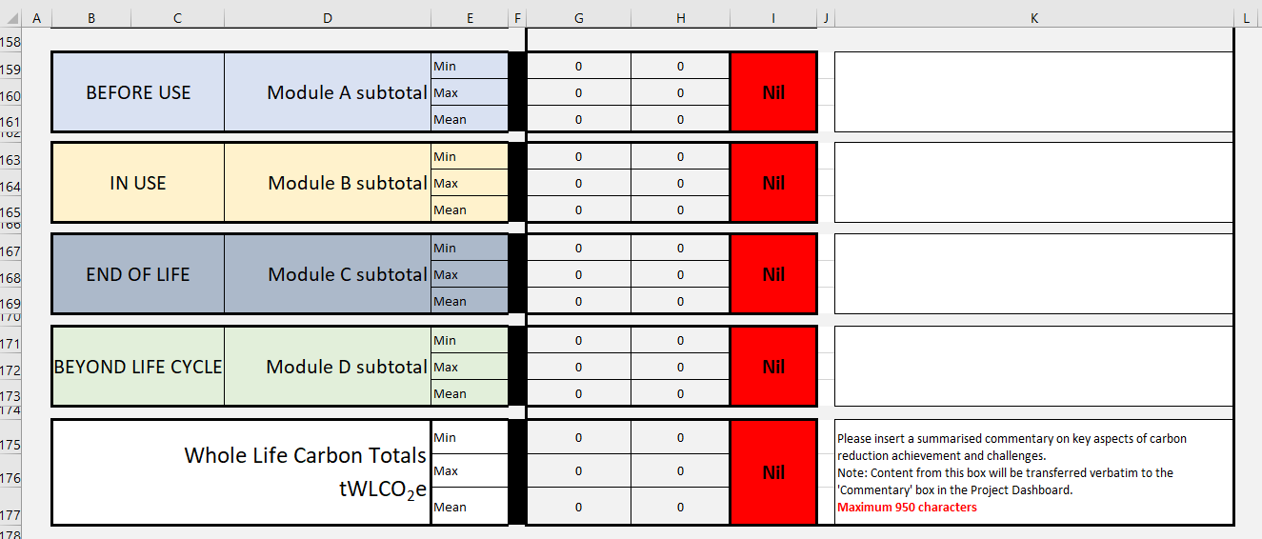
Part 3: Carbon Assessment Data – Module Totals
In the module-totals part of the worksheet users are given further opportunities to record short free-text commentaries alongside each module.
Module-total commentary boxes are not mandatory but users may wish to summarise key aspects, such as:
key constraints / caveats applicable to the module
Assumptions made
Advances made since a previous version of the project carbon assessment
Changes to the design or construction method that have delivered beneficial carbon reduction outcomes
All the module A, B, C and D totals at the bottom of the assessment template are auto-fill derived values
In the current worksheet the data completeness declarations for the module total boxes need to be assigned manually. It may be possible in a future version to develop an algorithm to derive these ratings based on the ratings applied to individual modules.

Slide 11
END
Further Assistance:
Clive.jones@networkrail.co.uk
07710 940 636

