Slide 1
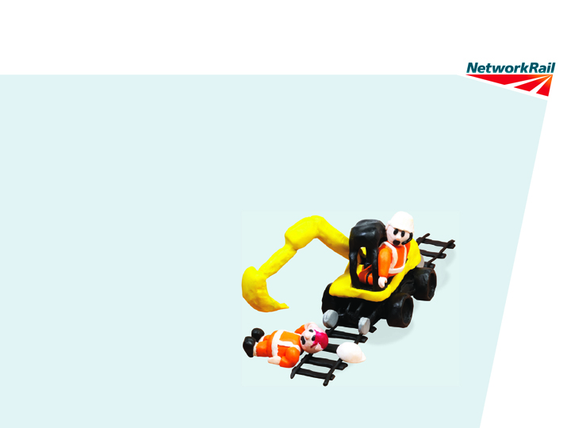
Lifesaving Rule:
Plant Exclusion Zones
(RRV Operations)
Key Principles
Mandatory Briefing for ALL PTS holders.
Notes:
The following instructions have been developed by a cross industry working group that included multiple Network Rail Functions and Contractors and Trade Unions on behalf of the RRV Safety Improvement Programme.
The briefing must be given to ALL PTS Holders
The reason for this is that any PTS holder may come across an RRV when on track and needs to understand these requirements to ensure they protect their personal safety.
In the past PTS holders have been warned that moving machinery is dangerous. These instruction now require PTS holders to be proactive when approaching RRVs. This represents a change of behaviour and safety culture.

Slide 2
Person Plant Interface (RRV Operations) Key Principles
Our Lifesaving Rules
Over the past six months we have consulted with over
1,300 staff members, union colleagues, suppliers and
other organisations to develop our Lifesaving Rules.
We have agreed 11 Lifesaving Rules. They’re here to protect all of us. If you’re ever asked to break or ignore
any of these Rules, you have the right to say no.
For more information please speak to your line manager.

Slide 3
Person Plant Interface (RRV Operations) Key Principles
Lifesaving Rule: Plant Exclusion Zones
RRV’s are dangerous and unpredictable. That’s why our new Lifesaving Rule requires us to keep a clear exclusion zone around all moving machinery.
Before you pass or work near an RRV always make sure you have
permission from the Machine Controller or Crane Controller.
When in doubt ASK B4U PASS
Never enter the agreed exclusion zone, unless directed to by the person in charge.
Notes:
The Plant Exclusion Zone Life saving rule (LSR) applies to ALL moving machinery being deployed on behalf of Network Rail whether it be in a rail, construction or high-street environment.
The following Instructions are specifically targeted at RRVs. Information on how the LSR applies to other types of plant and moving machinery will be supplied during the next three months.
RRVs for the benefit of these instructions includes ALL Road Rail Vehicles including MEWPs (including Unimogs, SRS and Cherry Pickers) and all other RRVs eg Gators & Dumpers etc.
NB:- RRVs are only dangerous and unpredictable if planned safe systems of work are not followed or machines treated with respect.

Slide 4

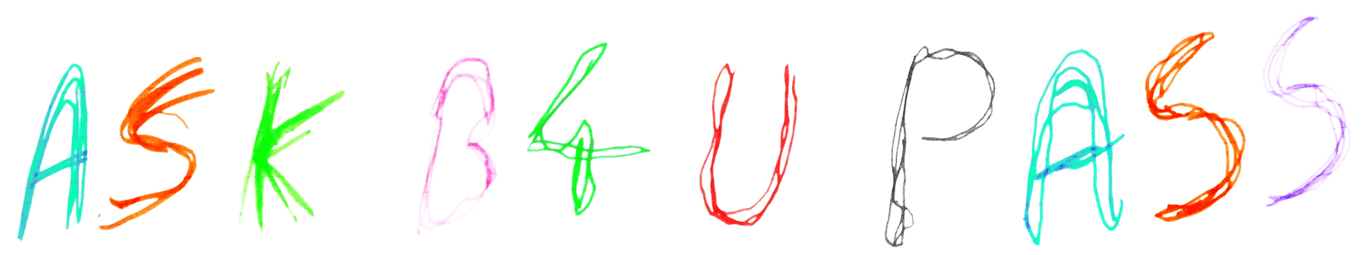
Person Plant Interface (RRV Operations) Key Principles
Walking past - Risk
Applicable to ALL
When you need to move past a machine stop at a safe distance
Make contact with the MC/CC
Only proceed when authorised by the MC/CC
MC/CC
Waiting for
authority to pass
Machine
operating area
Notes:
In this scenario track workers are required to take responsibility for there own safety. They are required to be proactive and communicate with the Machine Controller/Crane Controller, who will in turn communicate with the machine Operator and make it safe for the trackworker to pass.
They should not be taking any risks or making their own judgements as to whether it is safe to pass the machine.
ASK B4U PASS!

Slide 5
Person Plant Interface (RRV Operations) Key Principles
Working in the vicinity of a machine - Risk
Applicable to ALL
Before you work in the vicinity of a machine you must first make contact with the MC/CC
The MC/CC will inform you if you can work in that particular area
Only when you receive this authority from the MC/CC can work commence
MC/CC
Waiting for
authority to start work
Machine
operating area
Notes:
In this scenario the team of trackworkers may be working near to or in the vicinity of an RRV (not with it).
If you are working near to an RRV always communicate with the Machine/Crane Controller before you start work to establish what each others work is and how you can maintain a safe exclusion zone from the machine.
You must not commence work until you have agreed a safe method with the Machine/Crane Controller which maintains a safe exclusion zone around the machine.
If an agreement cannot be reached then the issue must be escalated to the Site Manager BEFORE work commences.

Slide 6
Person Plant Interface (RRV Operations) Key Principles
Working with a machine - Risk
Applicable to ALL
You must discuss with MC/CC what type of work is required to be carried out
The MC/CC will inform you when this work can commence
Only when you receive this authority from the MC/CC can you undertake
this work
MC/CC
Waiting for authority
to work with machine
Machine
operating area
Notes:
In this scenario you will be working with the machine e.g. installing new S&C components.
Where staff are working in such close and dangerous proximity to the machine then the Machine/Crane Controller must enforce strict control of the exclusion zone. Trackworkers must not enter the danger zone unless given specific permission to do so.

Slide 7

Person Plant Interface (RRV Operations) Key Principles
MC/CC - Important Reminder
Always be aware of the area around your machine
Do not let anyone enter the area where the machine is operating
without your permission
Only allow site personnel to pass your machine when it is safe to do so
Anyone entering your area without your permission ‘stand down’ the machine and report it to the Site Supervisor/Team Leader

Slide 8
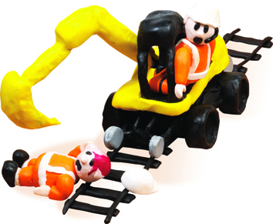
Person Plant Interface (RRV Operations) Key Principles
Machine Operator – Important Reminder
The MC/CC will inform you of the work location, work activity, site risks and personnel authorised to work in/near the operating area of the machine
Always be aware of personnel working with or near your machine
Any unauthorised personnel entering your operating area
‘stand down’ your machine and inform the MC/CC

Slide 9
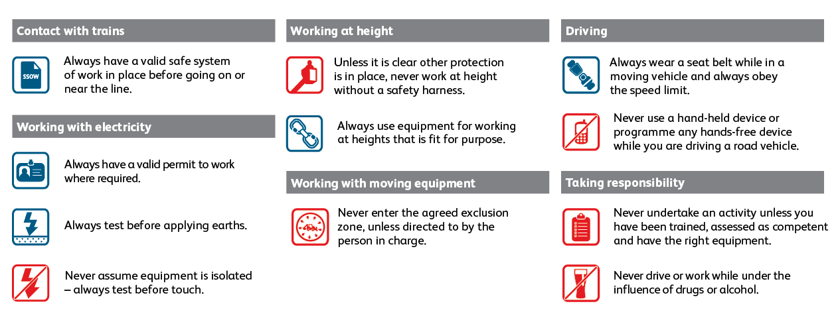
Person Plant Interface (RRV Operations) Key Principles
Our Lifesaving Rules
For more information on the Lifesaving Rules please visit: www.safety.networkrail.co.uk/LSR

Slide 10
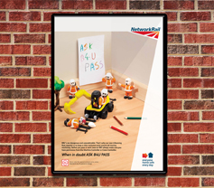
Person Plant Interface (RRV Operations) Key Principles
Lifesaving Rule: Plant Exclusion Zones

