Slide 1
“Should I say something?”
“We shouldn’t be doing this…”
“This doesn’t feel right…”
It’s your call…

Slide 2
What is a Close Call?
Definition: Anything that has the potential to cause harm or damage.
This includes the potential to:
Harm a person including minor, major injuries, and fatalities
Harm the environment and/or protected species
Damage railway infrastructure, plant, vehicles, tools and equipment.

Slide 3
Types of Close Call
Operational Close Call
Fault and Close Call
Close Call
An unsafe behaviour or condition that poses an immediate threat to the safe running of trains.
A fault on railway infrastructure that needs to be fixed, but could also cause harm or damage
An unsafe behaviour or condition.
Take immediate action to protect the line, workforce and passengers.
Report as a fault to Route Fault Control.
Report as a Close Call via the Close Call system.
Report as a Close Call via the Close Call system.

Slide 4
Which Close Call system to use?
I’m working on railway infrastructure, in a Network Rail building, or travelling on Network Rail business.
I’m working on railway infrastructure managed by a Principal Contractor.
Report via the Network Rail Close Call System.
Call: 01908 723 500
Log via NR Close Call app (not currently available to contractors)
Report via the contractor Close Call system
Details should be given in site induction – if in doubt, speak to your supervisor

Slide 5
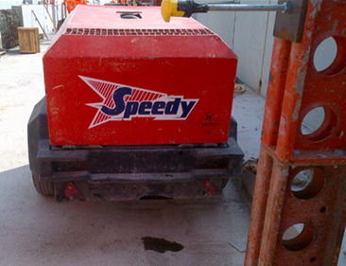
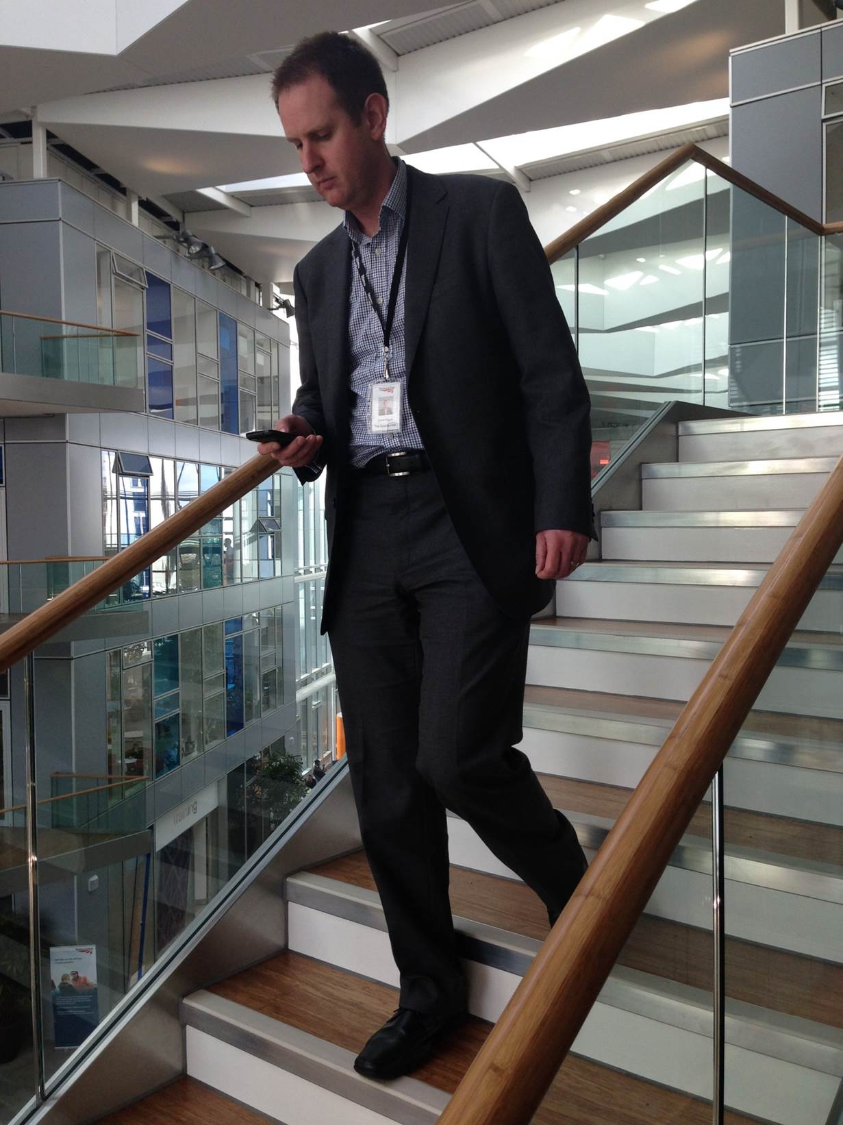

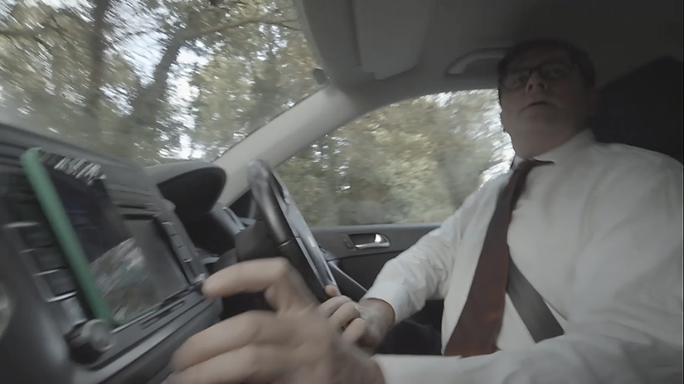
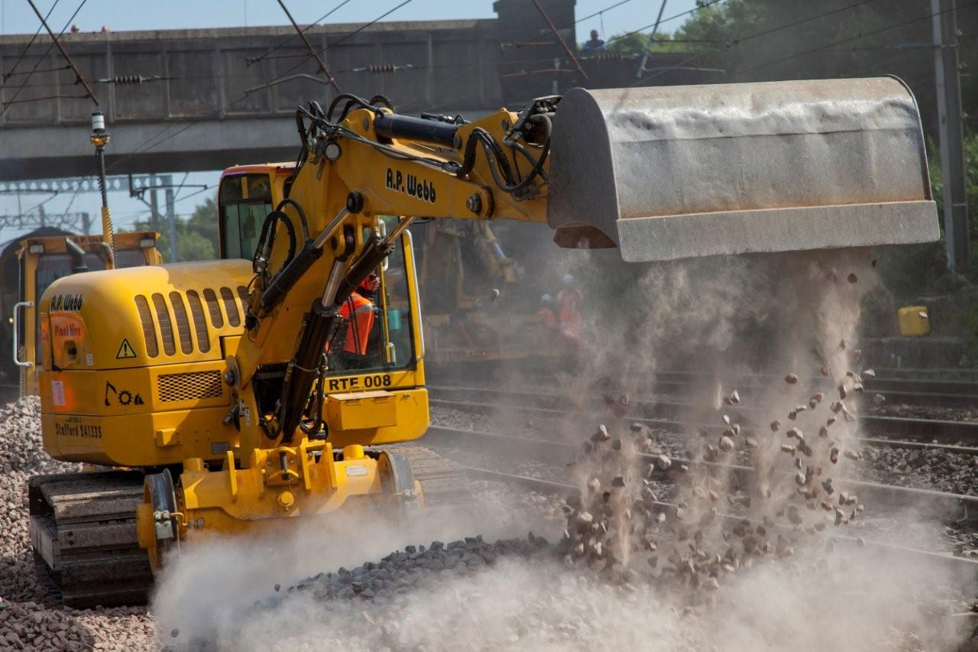
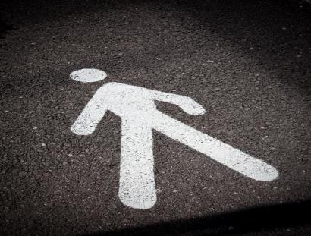
Close Call examples
Generator with no drip tray in place
Texting while walking down the stairs
Ceiling leak at a station
Going to take a call on hands-free while driving
Going to enter a site where ballast dust is being created without proper protection
Obstacles blocking safe passage

Slide 6
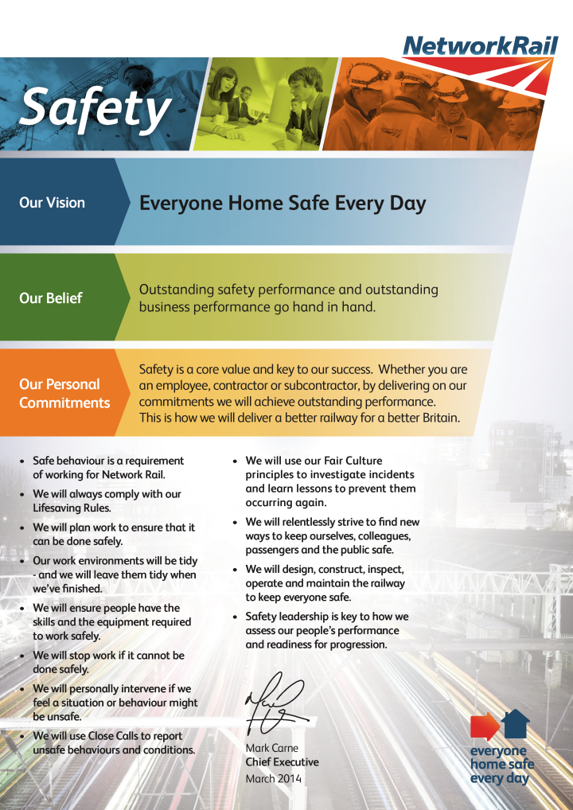
Vital to our Safety Vision
To achieve our Safety Vision of Everyone Home Safe Everyday we must always recognise, respond to, and report Close Calls…
Safe behaviour is a requirement of working for Network Rail
We will personally intervene if we feel a situation or behaviour might be unsafe
We will use Close Calls to report unsafe behaviours and conditions
We will stop work if it cannot be done safely

Slide 7
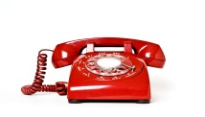

How do Close Calls help us achieve our safety vision?
36 drivers, intending to drive without wearing a seatbelt,
are challenged and report their behaviour as a Close Call.
Close Call system
36 individuals are now safer when driving. 36 home safe.
National driver safety training developed and rolled-out to support everyone. Everyone Home Safe.

Slide 8
The Close Call system will improve
We know that there are several improvements that colleagues would like to see, including:
Improving feedback to end-users on the progress of their Close Call
More customisable and detailed reporting
The ability to tag the source of reports to a Route, Delivery Unit or Function
Contractor access to use the Close Call app
A simpler interface for Responsible Managers

Slide 9
It’s your call…
Recognise: Could it cause harm or damage?
Respond: What can you do?
Fix the situation, if you can do so safely – then report it
Always challenge unsafe behaviour – then report it
Report: Always report Close Calls

Slide 10
Information is key
Information is key to locating and closing out Close Calls. Here’s what you should aim to cover when you report one:
A detailed description of the event/hazard
• Location details; such as an address and/or track location (ELR, Mileage, Track ID).
• Details of all persons, vehicles and machinery/tools involved, if applicable
• Details of any works or projects that may be related, if applicable
• All available information regarding any actions taken or planned, if any, including who has been made aware
• Any other information which may be helpful
Don’t worry if you haven’t got all the info – the most important thing is to report it.

Slide 11
Be confident when reporting Close Calls
Insert ‘Be Confident’ video

Slide 12
Close Calls can make all the difference
Insert ‘Your Call’ video
01908 723 500

Slide 13
It’s your call
What might stop us from reporting Close Calls?
How do we overcome these issues so we can always recognise, respond to and report Close Calls?
What are we going to commit to do going forward?
How are we going to make sure we continue to talk about and share positive experiences of Close Calls?

Slide 14


