Slide 1


Circular economy
Resource efficiency workshop
Add project name and date

Slide 2
Agenda
Description | Start | End
Safety Moment | 5 mins
1. Introduction to topic workshop format | 15 mins
2. Materials and design | 15 mins
Workshop 1 | 20 mins
Comfort Break
3. Carbon & soil | 15 mins
Workshop 2 | 20 mins
4. Water & other initiatives | 10 mins
Workshop 3 | 15 mins
Recap, Feedback and Next Steps | 10 mins
Notes:
Fill in agenda based on your project time allowance. Suggested minutes per item are given in the notes on the following slides.

Slide 3

Safety Moment

Slide 4
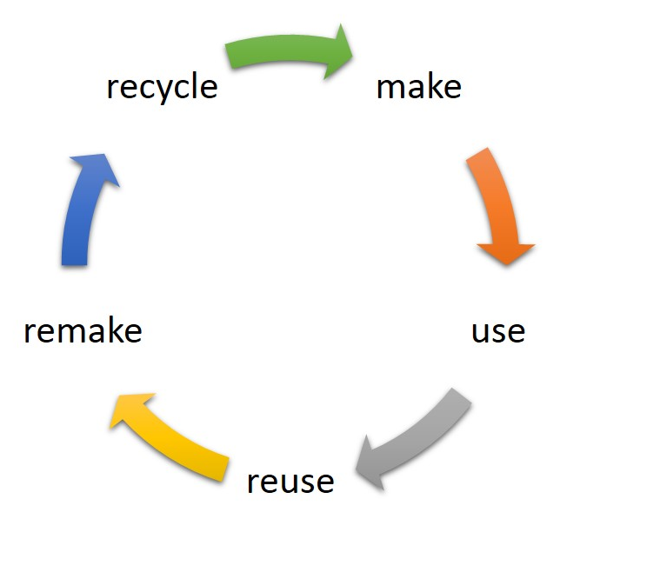
Aims of this workshop
Image: Catherine Weetman
Notes:
Network Rail is beginning its journey to a circular economy approach. We need to continue to implement resource efficiency as a part of this.
In this workshop we will apply these principles by identifying opportunities for optimising material use in your project which includes;
prioritising low carbon solutions;
preserving the value of materials
specifying reused/recycled/recyclable material
considering end of asset life options for materials
finding other opportunities to reduce waste and;
committing to practices which use less water.

Slide 5
How it will work
Three break out sessions
Assess the feasibility of the opportunities using opportunities matrix.
Discuss how shortlisted opportunities should be taken forward into the design development process and who is responsible.
Agree dates when actions will be reviewed to ensure progress.

Slide 6
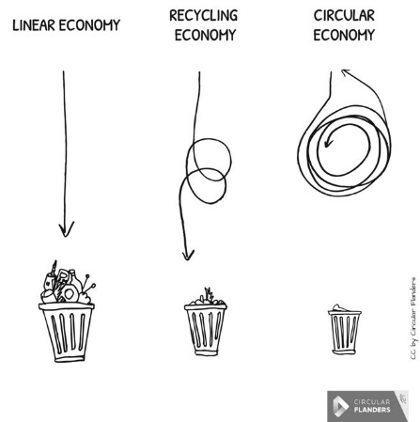
1. Circular economy
Notes:
Network Rail’s definition of Circular Economy as in NR/L2/ENV/015
‘A circular economy is a sustainable alternative to the traditional linear economy of make, use and dispose.
The aim of a circular economy is to extract fewer virgin resources from the planet and to keep existing resources in use for as long as possible.
Resources, products and materials should be re-used, repaired and regenerated in order to extend their useful lifespan and extract their maximum environmental, social and financial value.
This approach reduces embodied carbon, water and social impacts and keeps waste to a minimum.’

Slide 7


What are the benefits?
Environmental
Financial
Reputational
CEEQUAL and BREEAM points
Contributing to strategic objectives.
Notes:
Environmental benefits; the planet has finite resources. Transitioning to a circular economy means using less of these resources and using them in a smarter way. Staying within planetary boundaries is essential to build a sustainable society.
Financial benefits: buying less material, energy/fuel and water. Spending less on waste disposal (£20 to £50/tonne for inert waste and £150 to £200/tonne for non hazardous mixed waste)
Design decisions which are more resource efficient can contribute to gaining points under the CEEQUAL and BREEAM schemes, which demonstrate the environmental quality of a project.
Reputational benefits & contributing to strategic objectives.

Slide 8
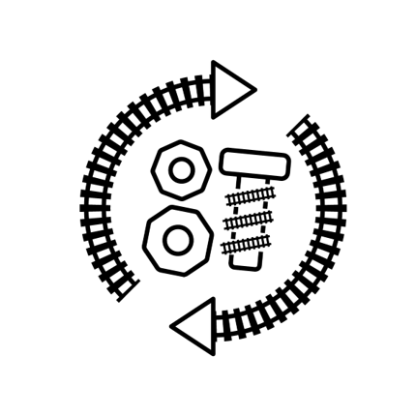
2. Materials & design
Notes:
See next page for examples

Slide 9
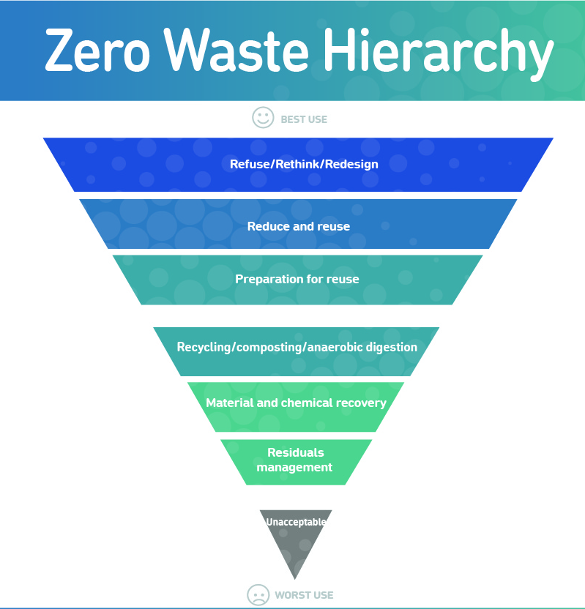
Image: Zero Waste Europe
Notes:
The idea of preserving a material’s value by reusing or remanufacturing before recycling follows the principles of the waste management hierarchy.
In this workshop consider the principles of this hierarchy when coming up with ideas for your project.
Options towards the top of the hierarchy should be considered first.

Slide 10
Design for deconstruction
Design Phases
Construction/Commissioning Phase
Operational Maintenance and Refurbishment
End of Life – Deconstruction/
Decommissioning
Consider adaptability for potential future expansion
Consider adaptability to climate change conditions.
Consider deconstruction flexibility.
Add any required future expansions fittings/connections.
Use easily disassembled components.
Consider the options for a material’s second life, prioritising reusing or remanufacturing
Notes:
Design with deconstruction and flexibility in mind. The key time to consider deconstruction is at the design phase!
We need to consider how materials can be recovered effectively during the project operational life cycle.

Slide 11

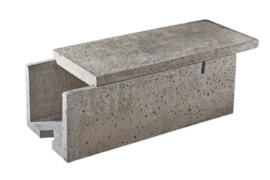
Acquiring surplus material - SurPlus App
Image: Anderton Concrete
To get access to the Surplus app you can email surplus@networkrail.co.uk
You must have a Network Rail login to be able to access the app currently.
Notes:
Network Rail has an internal app called SurPlus Sur+ which can be accessed via the App Catalogue. The Surplus app enables colleagues to buy or sell surplus materials which are new or used but still fit for purpose.
The app works in a similar way to eBay, where colleagues can post items for sale with a picture and details that make it easy for others to search for items they need.
One of our teams in North, West and Central (NW&C) used the app to find excess concrete troughing for a renewals project.
They saved the organisation more than £300,000 and an estimated 88.5 tonnes of carbon because they didn’t have to buy new. The team who had the asset saved money as they didn’t have to pay for disposal.

Slide 12
Design for off site construction
Reduced timescale/ programme
Improved H&S
Reduced transport movement
Reduced waste on site
Minimises impact to neighbours
Notes:
Off Site Construction
This can have environmental, commercial and social benefits, including:
Improved workmanship quality and reducing errors
Reduced construction timescales and improved programmes
Improved Health and Safety on site through avoidance of accidents
Reduced construction related transport movements
Reduced Waste on Site.
Waste on site is reduced because;
Factory Controlled Process Conditions – Increased resource efficiency. e.g prefabricated units on site
More controlled storage conditions minimises material wastage.
Reduces the workload effort required on site – less waste to manage.
Modular and pre-fabrication reduces material use and waste, reduces risk of pollution, minimises impacts on our neighbours through quieter construction and less road congestion from deliveries.

Slide 13

Off site construction – case study
Blackfriars and London Bridge, Thameslink
Used modular and pre-fabricated components for bridge decks, platforms units, lifts, escalators and station furniture and standardised components for station glazing.
Notes:
Project - Blackfriars and London Bridge, Thameslink
Initiative - At Blackfriars and London Bridge we used modular and pre-fabricated components for bridge decks, platforms units, lifts, escalators and station furniture and standardised components for station glazing.

Slide 14
Refuse/Rethink/Redesign
Lean design, use less material
Check Surplus (if available to your project)
Adapt method of works to protect the value of the material
Use off-site construction methods
Notes:
Examples
Structural solutions using less concrete (e.g. post tensioning)
Minimize/eliminate use of timber as false works
Can track be cut to no less than 60ft lengths where possible and sent back to SCO (60ft is
optimal for reuse)?
Use of precast formwork, piles or precast components for retaining walls, bridges and other structures
Platform modular construction

Slide 15
Reduce & Reuse
Specifying products which contain reused/recycled/recyclable material
Reusing material on site
Making other products from recovered materials
Identify local options for reusing unwanted materials or items
Arrange take-back for surplus with a supplier
Notes:
Examples – try to elicit some from the audience.
e.g. composite plastic sleepers (which can be remanufactured at end of life)
e.g. reuse existing foundations, floor slabs, pavements, structures and drainage
e.g. design handrails and site boundaries by reusing fencing from another project
e.g. crush/screen arisings for use as recycled aggregates if they can’t be reused as ballast. (Crushing ballast is downgrading the material though so try not to overorder)
e.g. build relationships/agreements with local authorities/nearby sites/land owners/charities for reusing unwanted materials/items.

Slide 16

Opportunities Workshop 1
Brainstorming session for 15 mins.
Score ideas using matrix (next slide).
Capture actions and ownership
Notes:
Brainstorming session for 15 mins. Get ideas on paper. In this session focus on materials, design and options for reuse.
Score ideas using matrix (next slide). Ideas with the biggest impact and easiest implementation are the top opportunities to prioritise.
Capture actions and ownership – use templates or make your own

Slide 17
Opportunity Matrix
 |  | Ease of Implementation (e.g engineering risk, resource required)
Impact (Reduction in carbon or water, potential financial gain, amount of material reused or waste avoided) |  | Difficult to implement 1 | Easy to implement 2
Low impact 1 | 1 | 2 | 3
High impact 2 | 2 | 3 | 4
Key
 | Not likely to be feasible
 | Further investigation required to determine if feasible
 | Excellent opportunity, should be implemented where possible

Slide 18

Break – X mins

Slide 19


3. Carbon & soil
Notes:
See next page for examples

Slide 20
Processing
Manufacturing
Delivery
Whole Life Carbon
Disposal
Transport
Replacements
Maintenance
On site
emissions

Slide 21
Reducing carbon in projects
Using less material (covered in workshop 1)
Alternative materials
Reducing carbon in construction materials
Lowering emissions through on site practices
Reducing waste to landfill (which produces methane)
Notes:
Examples
Using alternative materials which are less carbon intensive
Specifying materials with high recycled content or with a longer asset life reduces future material use. E.g. composite plastic sleepers have an asset life of 50-75 years, hardwood sleepers average around 20 years.
Reducing carbon in construction materials
Use of ground granulated blast-furnace slag (GGBS) or fly ash to replace Portland cement can significantly reduce the overall greenhouse gas emissions associated with the production of concrete.
Lowering emissions through your practices on site
e.g. More fuel efficient vehicles, generators etc. Low carbon fuels (e.g. biofuels) used on site where possible
Designing out waste and reducing waste to landfill (which produces methane

Slide 22
Reducing carbon through design – case study
Sustainable Piling Solution at Waterloo Station
Reinstating platforms & realigning tracks
Innovative design checking that no new piles were required.
1480 tonnes, 17 weeks, £4.9 million
Notes:
A key element to the Wessex Capacity Alliance works at Waterloo involves reinstating the former Waterloo International Terminal (Platforms 21-24) for passenger services. This requires the realignment of tracks into Waterloo.
Initial design required 65 new piles along the approach to Waterloo Station
Innovative design development found that the existing piles would be able to take the additional load from the project so no new piles were required.
This had a carbon saving of over 1480 tonnes - To put that into perspective, this equates to roughly to taking 246 cars off the road for a year, or the whole CO2 impact from burning 545 tonnes of natural gas, which could meet the full energy requirement of 2 semi-detached houses for a year.
This also saved significant amounts of waste which would have occurred if the new piles had of been implemented.
And also saved 17 weeks of extra work that would have been required.
There were massive financial benefits estimated to be around £4.9 million

Slide 23
Reducing waste through soil management
Some options are;
Optimise cut and fill
Retain on site
Plan storage areas in advance
CL:AIRE’s Code of Practice
Treat if required
Notes:
Managing excavated waste spoil and soil effectively to reduce excess to landfill saves money and carbon.
Consider appropriate site levels to optimise cut-and-fill, thereby eliminating the requirement to move soils to other sites, or landfill.
Retain on site:
Develop landscape schemes that can retain excavated material on site.
Design and build foundations and drainage to minimise removal of excavated material from site
Use CL:AIRE’s The Definition of Waste: Development Industry Code of Practice (DoWCoP), which provides a management process for soils ceasing to become a waste.
Allocate land (if possible) for the storage of soils during the construction phase. Soils are not classified as a waste until they leave site.
Reuse of excavated soil on site and off site – treat if required to make suitable for reuse.

Slide 24
Soil management – case studies
Farnley Haugh Landslip, Scotland and North East
40 tonnes in CO2 emissions.
£1.75 million saved
Horsham field sidings & Maintenance Delivery Unit facilities, Thameslink
Reused 950 tonnes of material
£16,000 saved
Notes:
Initiative – At Farnley Haugh a significant landslip on the Newcastle to Carlisle line led to the excavation of around 50,000 tonnes of saturated inert soil. By the project cooperating with local land owners and the EA, an agreement was formed to landscape the soil in a safe area in the surrounding fields.
Initiative - At Horsham we reduced the need for excavation and subsequent fill materials site by also reducing track level and layout alterations. This identified opportunities to reuse 950 tonnes of material on and off-site generating £16,000 of savings.

Slide 25
Opportunities Workshop 2
Brainstorming session for 15 mins.
Score ideas using matrix (next slide).
Capture actions and ownership
Notes:
Brainstorming session for 15 mins. Get ideas on paper. In this session focus on carbon and soil.
Score ideas using matrix (next slide). Ideas with the biggest impact and easiest implementation are the top opportunities to prioritise.
Capture actions and ownership – use templates or make your own

Slide 26
Opportunity Matrix
 |  | Ease of Implementation (e.g engineering risk, resource required)
Impact (Reduction in carbon or water, potential financial gain, amount of material reused or waste avoided) |  | Difficult to implement 1 | Easy to implement 2
Low impact 1 | 1 | 2 | 3
High impact 2 | 2 | 3 | 4
Key
 | Not likely to be feasible
 | Further investigation required to determine if feasible
 | Excellent opportunity, should be implemented where possible

Slide 27

4. Water & any other initiatives to reduce waste
Notes:
See next page for examples

Slide 28
Reducing water consumption hierarchy
Eliminate
Reduce
Alternative Sources
Reuse
Recycle
.
.
Notes:
Eliminate - Change practices to eliminate unnecessary water use.
Reduce – Use less water intensive technologies
Alternative Sources - Use lower quality sources (e.g. rainwater) for suitable applications.
Reuse - Higher quality water used in a process can sometimes be reused as lower quality water elsewhere on the site.
Recycle - On site treatment to allow water to be reused rather than discharged
And only then – DISCHARGE - ensuring effluent quality standards are adhered to.

Slide 29
Reducing water in projects
On site uses
Water-metering on site
Rainwater harvesting
Water efficient processes
Treating water for reuse
Behaviours
Notes:
Select materials and products with lower water footprint. Consider the whole life cycle
Product selection – consider water used during raw material extraction and manufacture
Consider water used on site (e.g. dust suppression, concrete wash out, commissioning, bathroom/toilets)
Make sure there is accurate water metering on site
Can you do rainwater harvesting?
Can you use water efficient processes (hose control, low flush/sensory taps)?
Behavioural piece (posters, toolbox talks etc) e.g. don’t ignore leaks
Can you treat water to make it suitable for reuse?
Consider water used during maintenance and demolition

Slide 30
Other ideas to reduce waste
Minimisation and reuse of supplier packaging
Specify high recycled content packaging where required
Train staff in appropriate handling and storage to avoid damage and waste
Case study
Project – Farringdon Station, Thameslink
Initiative - At Farringdon we arranged for our PPE suppliers to remove packaging from all our orders and take back pallets and at Borough Viaduct we recycled hard hats thus reducing waste to landfill, costs and saving space on site.

Slide 31
Opportunities Workshop 3
Brainstorming session for 10 mins.
Score ideas using matrix (next slide).
Capture actions and ownership
Notes:
Brainstorming session for 15 mins. In this session focus on water and any other ideas for reducing waste not captured in workshops 1 and 2.
Score ideas using matrix (next slide). Ideas with the biggest impact and easiest implementation are the top opportunities to prioritise.
Capture actions and ownership – use templates or make your own

Slide 32
Opportunity Matrix
 |  | Ease of Implementation (e.g engineering risk, resource required)
Impact (Reduction in carbon or water, potential financial gain, amount of material reused or waste avoided) |  | Difficult to implement 1 | Easy to implement 2
Low impact 1 | 1 | 2 | 3
High impact 2 | 2 | 3 | 4
Key
 | Not likely to be feasible
 | Further investigation required to determine if feasible
 | Excellent opportunity, should be implemented where possible

Slide 33
Recap and Feedback
What went well?
What could be improved next time?
Agree next steps and review of actions for each of the three workshops
If you have feedback on the content or materials of this workshop or would like to submit a case study please email:
sustainabledevelopment@networkrail.co.uk

