Slide 1


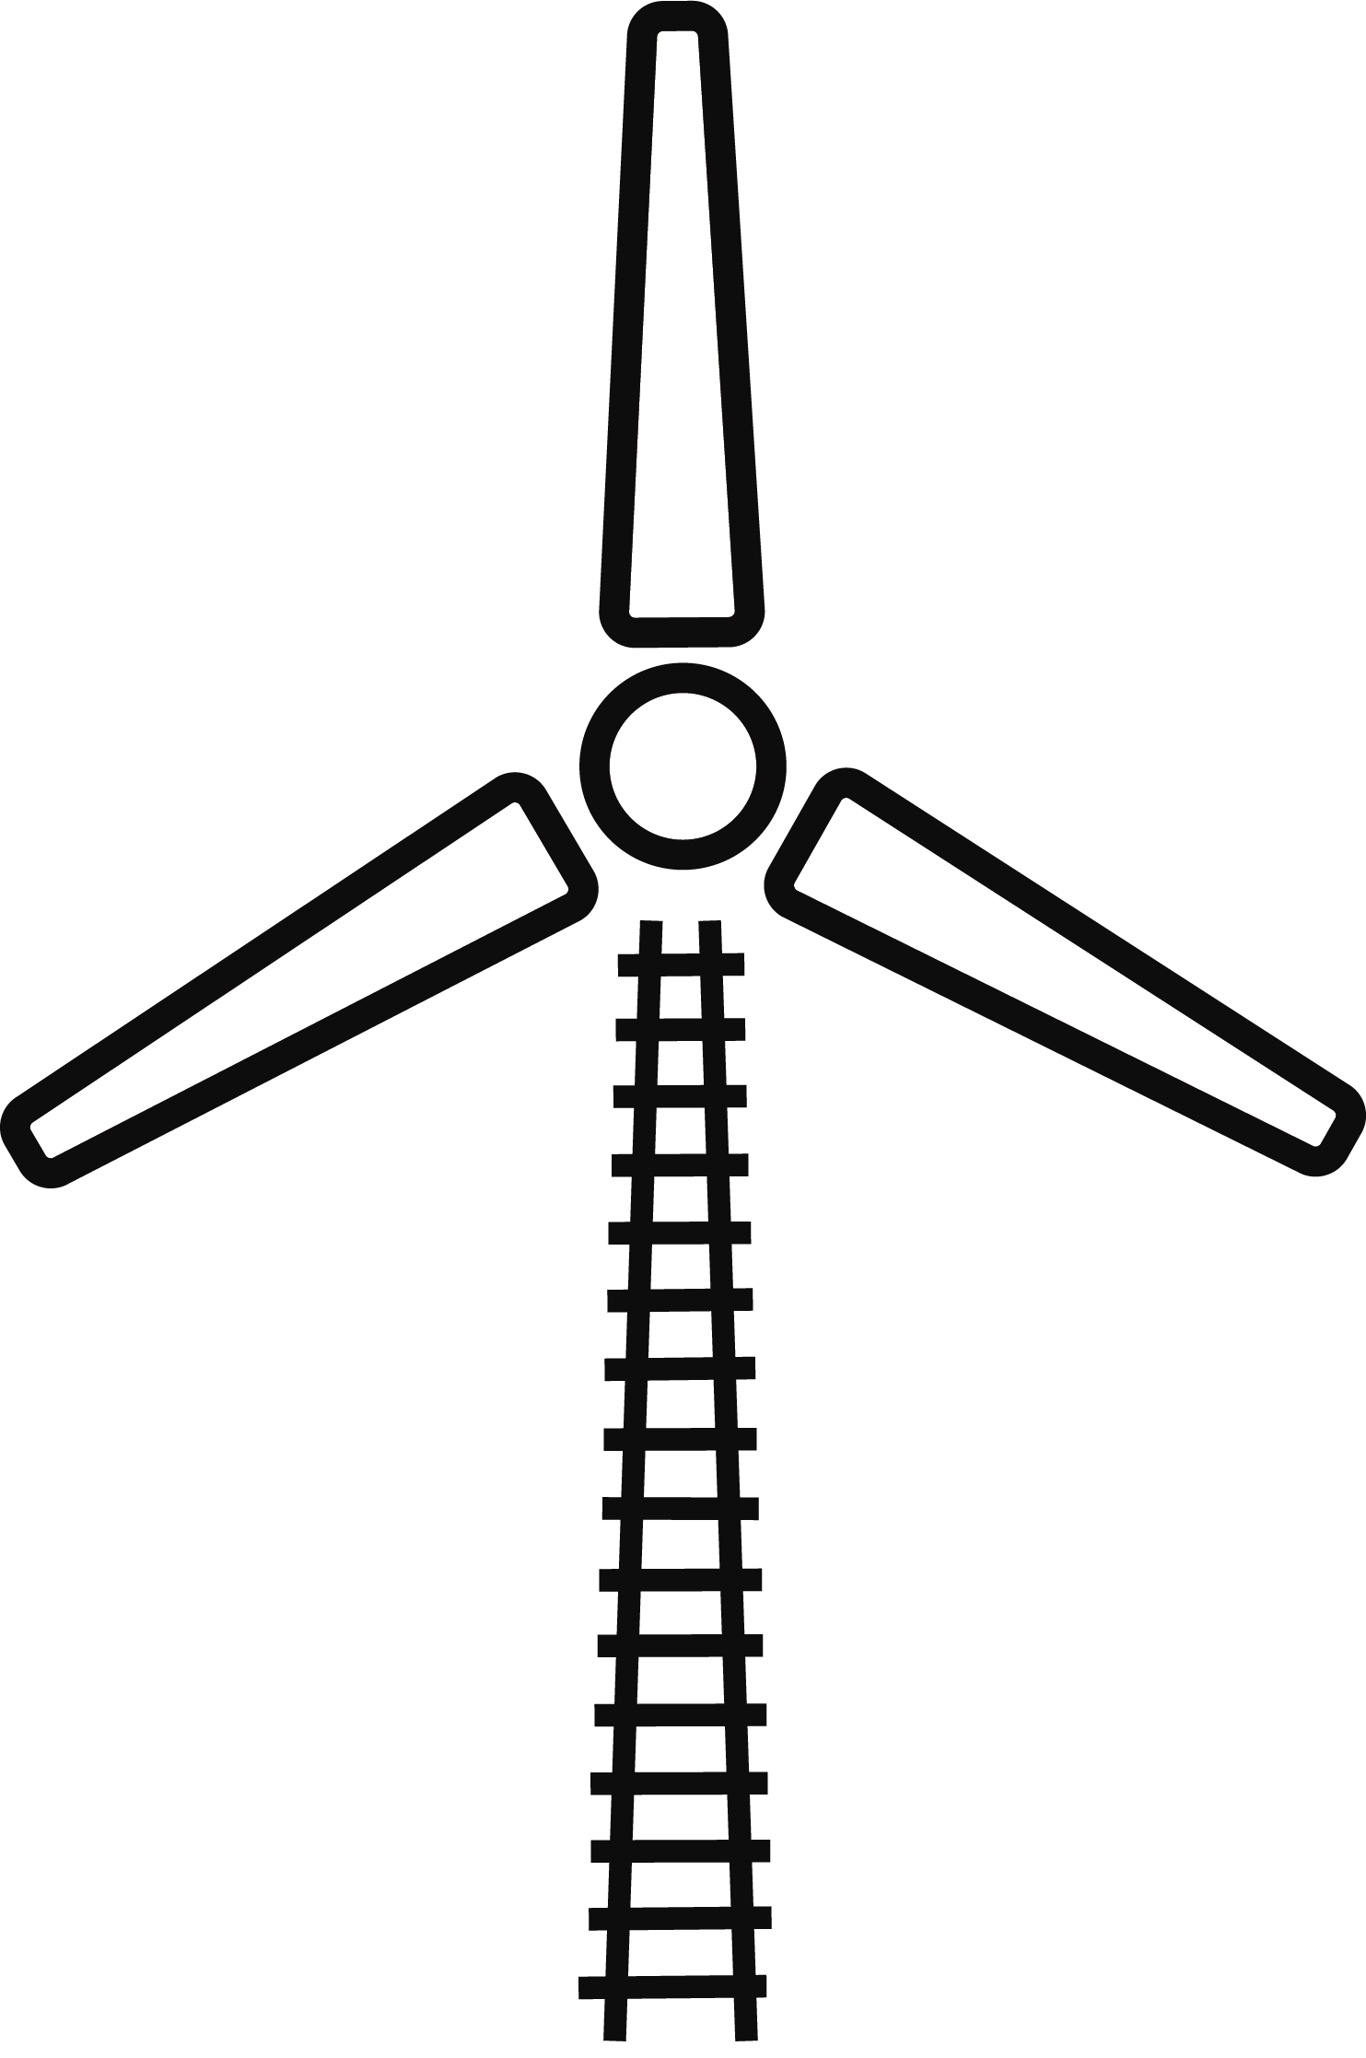

Environment & Social Minimum Requirements for Projects
Technical Briefing Pack
Jan 2019

Slide 2

The purpose of this pack
This briefing is designed for people who should be aware of Network Rail’s Environment and Social Minimum Requirements for GRIP-managed projects.
This briefing will provide an overview of:
What our sustainability standard means for Network Rail employees and suppliers
Why environmental and social responsibility is important to Network Rail
How to deliver railway works in a way that manage sustainability risks and maximise opportunities to add value
Where to find advice, guidance, tools and templates to help you deliver industry best practice.

Slide 3
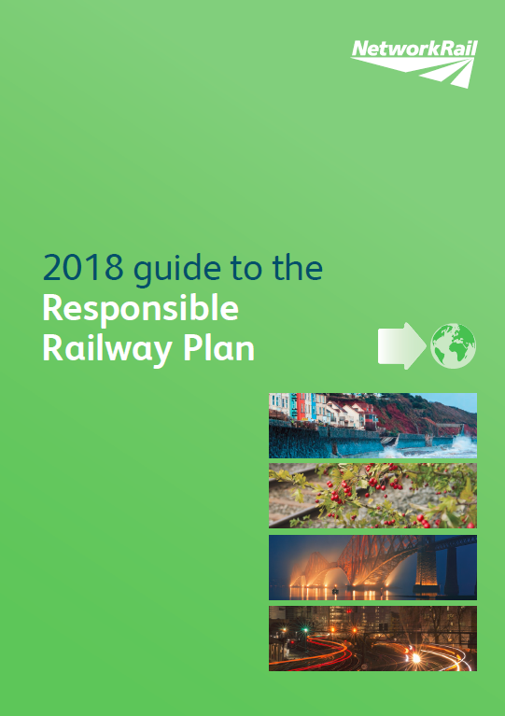
Building and managing a responsible railway
At Network Rail we have a sustainable approach to what we do and we are keen to
understand how our activities affect the environment locally as well as globally.
At the same time, we drive social responsibility and actively seek to reduce community
risks and maximise opportunities to create social value.
We are continually working to integrate sustainable development into business processes
and, although we are making progress, our overall environmental and social performance
needs to improve. We are one of the largest power consumers in the UK, one of the
largest land owners in Europe, and we impact millions of passengers and lineside
neighbours every day. This places a big responsibility on the company and our supply
chain to ensure that through our activities and continued sustainability work, we leave
a positive legacy for future generations which we can be proud of.

Slide 4
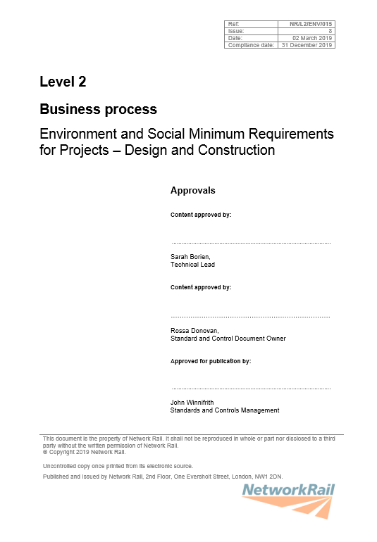
Environment and Social Minimum Requirements
(NR/L2/ENV/015)
This Level 2 Network Rail standard is mandatory for all design and construction when delivering GRIP-managed projects.
It has a publication date of 2nd March 2019 and has a compliance date of 31st December 2019.
Network Rail is committed to improving its environmental and social performance.
This standard sets out the minimum requirements for the management of environment and social risks and opportunities.

Slide 5
What’s in scope?
This standard is mandatory for all construction and design work within GRIP-managed projects carried out by Network Rail and its contractors.
This includes:
Designers/Contractors contracted to Network Rail for the provision of design and/or construction services; and
Network Rail business units where they act as a design or contractor entity according to Construction (Design and Management) Regulations (CDM) definitions, e.g. Network Rail Design Delivery and Works Delivery.
This standard does not apply to Route Business Maintenance works.

Slide 6
What’s changed?
The 2011 version of this standard was called Contract Requirements Environment (CRE) and it was applicable to Network Rail contractors.
This version of the standard has significantly changed to include:
Key updates to effective management of environmental risks and opportunities (including the introduction of sections on Energy & Carbon and Weather Resilience and Climate Change); and
All new requirements to effectively manage social risks and opportunities.
The scope of this standard has also been expanded to include:
All Network Rail business units responsible for carrying out construction and design works on GRIP-managed projects.
NOTE – This new standard (version 8) replaces the previous version which was published in June 2018 and included Route Business Maintenance works. We have now removed Route Business Maintenance works from the scope. A separate standard will be written to cover Maintenance in CP6.

Slide 7
What’s changed since v7 was published in June 2018?
Version 7 of this standard was published in June 2018. Since then, there have been no major changes aside from removing Route Business Maintenance teams from the scope.
However, some minor amends have been made which include:
Adding ALARP (as low as reasonably practicable) to the Definition section;
Adding a reference to the new Worker Behaviour training in the Being a Caring Neighbour section;
Updating the wording when referring to Alliances.

Slide 8
Why the change?
When we do not consider the environment and social risks associated with designing, building and maintaining the railway, we see an increase in cost, delays, and regulatory or reputational damage.
Whilst we do not have data to support this statement at a national level, we have multiple individual examples, such as:
Media attention surrounding vegetation clearance led to the Rail Minister suspending all tree felling during nesting season and launching an independent investigation into Network Rail’s operations
Poor management of noise, nuisance and disturbance has resulted in multiple high-level complaints to Network Rail, national press and Members of Parliament, and legal action was taken against Network Rail for causing serious long-term mental and physical health conditions
Poor planning of waste removal left a mound of 70,000 tonnes of excavated waste on site for over 2 years, when it could have been reused or recovered during the earlier phases of the project. This resulted in a £4million cost to send the 70,000 tonnes of waste to landfill.
Lack of engagement with local communities ahead of a change to lineside fencing led to complaints, petitions, land access charges, a 16 month delay to the work and an additional £148k to the original project cost.

Slide 9
What are the opportunities?
Not only do we need to improve the way we manage environment and social risks, we also need to improve our ability to maximise opportunities to create environmental and social value for Great Britain.
Some business areas have demonstrated that by following the new policy, standard, appraisal tool and guidance notes, they have:
Introduced energy efficiency programmes which will reduce energy by at least 18%, which in turn will realise cost savings of £15m each year. Simply using energy-efficient light bulbs at a managed station saved £40k per annum
Designed schemes to be resilient to future weather conditions and used whole life costing analysis to replace like-for-better rather than like-for-like when a weather event caused catastrophic asset failure
Used community art projects to reduce graffiti and vandalism on NR assets by 100% and reduce trespass in the area by 80% leading to a reduction in asset maintenance work, community complaints and schedule 8 payments
Increased spend with local suppliers and small and medium sized enterprises (SMEs) which not only improves the local economy but is an area of work driven by MPs across public sector organisations
Early planning and negotiations with the local authority enabled a project to reuse 104,000 tonnes of waste for the construction of a new highway, saving over £1 million and over 40 tonnes of CO2.

Slide 10
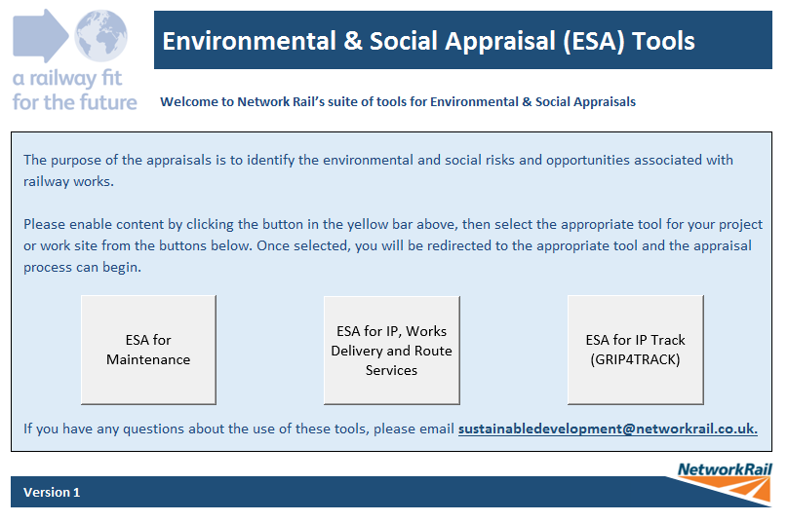
The Environment and Social Appraisal (ESA)
This tool replaces the current Environmental Appraisal used by
IP and is a brand new tool for Works Delivery.
There are different versions of the tool, relevant to each part of the business – you should select the button relevant for the work you are completing.
The appraisal is one of three Environment & Sustainable Development GRIP Products.

Slide 11

Please note…
Not all sections of the standard are applicable to all works.
To identify which sections of the standard should be followed, the user should use the new Environment and Social Appraisal (ESA) Tool.
This tool should be used from GRIP 2.
The ESA will provide the user with an action plan, which will identify the mandatory sections of the standard.
The ESA works as a selection tool to identify the relevant high impact areas and help you to manage your risks and maximise your opportunities.

Slide 12
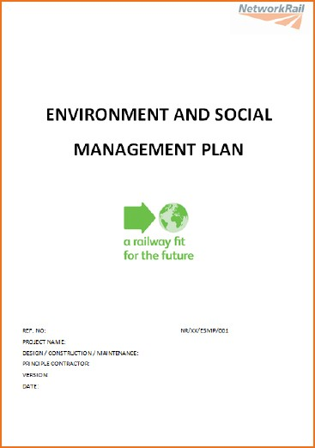
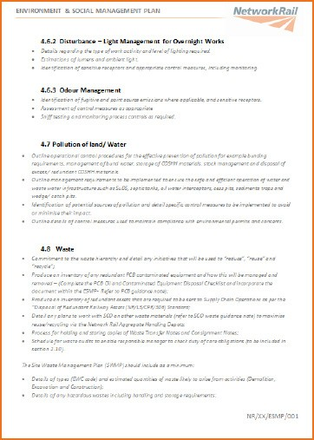
Environment & Social Management Plan (ESMP)
This be covered in each section. template replaces the current Environmental Management Plan.
This is a mandatory template to make sure projects provide all the necessary information. Each section contains a list of bullet points to explain what should
However, the user can provide this in any format they choose; we have allowed complete flexibility in the way the information is demonstrated and evidenced.

Slide 13
Environment themes
Biodiversity and ecological planning
Water resources
Waste Management
Emissions to air and air quality
Noise, nuisance and disturbance
Pollution to land and water
Materials – responsible sourcing
Sustainable Travel
Carbon in infrastructure
Energy and operational carbon
Weather Resilience and Climate Change Adaptation
Contaminated Land

Slide 14
Social themes
Being a caring neighbour
Keeping communities safe
Connecting communities with the environment
Creating positive industry
Inspiring tomorrow's workforce
Making rail a great experience
Making travel accessible
Respecting cultural heritage and rail history
Creating engaged employees
Supporting Britain's economic development

Slide 15

Key environment updates
Biodiversity
As a minimum, a Preliminary Ecological Appraisal (PEA) shall be undertaken to inform decision-making and work-planning. The PEA shall identify the need for further surveys.
In addition, for any works with a construction value over £20,000 or a footprint greater than 1500m² which will impact plants and/or animals, the Designer/ Contractor shall undertake biodiversity accounting using the Network Rail Biodiversity Calculator.

Slide 16
Contaminated Land
The Designer/Contractor shall conduct a preliminary risk assessment to identify potential land contamination and pollutant pathways.
Where the risk assessment survey identifies confirmed or suspected contamination, the Designer/Contractor shall conduct a Phase 2 investigation.

Slide 17

Emissions to Air (NEW section)
The Designer/Contractor shall assess potential sources of harmful or nuisance pollutants (including dust) that may arise during both the construction and operation of the asset.
The Designer shall design in opportunities to reduce emissions to air during the construction and operational use of the asset.

Slide 18

Energy & Carbon
Managing Carbon in Infrastructure (PAS 2080)
Capital Carbon
Energy and Operational Carbon
Managing Carbon in Infrastructure (NEW section)
The Network Rail Project Manager shall put arrangements in place to demonstrate collaboration between all value chain participants to investigate and drive carbon reduction opportunities across the asset life-cycle.
The Designer and Contractor shall promote well-reasoned proposals to encourage the client / asset owner / manager to adopt low carbon solutions across the asset life-cycle.

Slide 19
Capital Carbon
The Designer/Contractor shall use the Rail Carbon Tool to identify opportunities for carbon reduction for any works over £1 million encompassing:
Track;
Structures;
Geotechnical/earthworks;
Electrification and fixed plant infrastructure; or
Buildings.
Complex componentry asset systems like signalling and telecoms can be excluded.

Slide 20
Energy and Operational Carbon
The Designer/Contractor shall generate estimates for in-use operational energy (regulated and unregulated) and associated carbon emissions, excluding traction energy.
The Designer/Contractor shall undertake energy performance certification requirements for all new or modified buildings using industry approved assessment methods.
The Contractor shall procure and install fixed services in accordance with the design specification, and provide the Employer’s Representative with a commissioning plan to verify that key services are operating within predicted energy performance limits.

Slide 21

Materials
Responsible Timber
Concrete and Aggregates
Low Environmental Impact Products
Herbicides
Responsible Timber
Any works requiring new forest products that are derived from the UK, EU or North America shall source timber that has Forest Stewardship Council (FSC) certification or Programme for the Endorsement of Forest Certification (PEFC). Any works requiring new forest products that are derived from outside of the UK, EU or North America shall source timber that has Forest Stewardship Council (FSC) certification.
The standard makes reference to a reporting spreadsheet. This has now been replaced by the KPI Tool and the standard will be updated to reflect this at the next review.
Notes:
It’s important to note at this point that there will be a Goods and Services version of this standard following Design and Construction, which will contain more detail about the environmental and social impacts of procuring materials.
The timber reporting spreadsheet will remain on Safety Central, but it will be disabled and will include a link to redirect to the KPI tool.

Slide 22
Concrete and Aggregates
For any works using in excess of 50 tonnes of aggregate-based materials, the Designer/Contractor shall identify the types of concrete and aggregate, including approximate quantities, to be used.
The Designer/Contractor shall adopt a benchmarked industry best practice target for the proportion (% by weight or volume) of responsibly sourced concrete and/or aggregates used on the project, excluding rail ballast. The target shall meet or exceed the Employer’s target where one has been set.
Notes:
It’s important to note at this point that there will be a Goods and Services version of this standard following Design and Construction, which will contain more detail about the environmental and social impacts of procuring materials.

Slide 23
Low Environmental Impact Products
The Designer/Contractor shall assess the range of products and materials proposed for use in the construction and fit-out of the project. Identify those with harmful constituents that might be released during or after installation.
The Designer/Contractor shall use the information from the assessment to influence design decisions and consider cost-effective alternatives, and incorporate these within the Materials section of the ESMP.
Herbicides
Herbicides shall only be applied in accordance with the product label and shall take into account the requirements of the Pesticide Agreement on Safety Central.
Notes:
It’s important to note at this point that there will be a Goods and Services version of this standard following Design and Construction, which will contain more detail about the environmental and social impacts of procuring materials.

Slide 24

Noise, nuisance and disturbance
Design to control noise and vibration emissions from fixed plant and minimise disturbance from intrusive lighting emissions, increased site traffic and reduced access points.
Agree an appropriate noise and vibration monitoring programme with the Employer’s Representative and, where appropriate, the relevant local authority.
Seek Local Authority consent under Section 61 of the Control of Pollution Act, unless agreement from the Employer’s Representative confirms that construction noise will be managed without need for consent.
Design to control dust and odour emissions from fixed plant and site construction activities and design in considerations in the delivery of projects.

Slide 25
Pollution to Land and Water (NEW section)
Don’t rely on temporary or permanent connections to any water supply or drainage infrastructure until agreement has been received from the Employer’s Representative.
Assess risks and pollution pathways for harmful materials that will be stored, handled, used or transported within the completed operational development.

Slide 26

Sustainable Travel (NEW section)
Where the development involves provision of public parking facilities, take into account the provision of facilities and infrastructure to support users of alternatively fuelled low-carbon vehicles.
Where the development involves design of new, extended or refurbished occupied buildings, include facilities to promote low- carbon modes of travel for building occupants.
NOTE – This is a green requirement, not amber

Slide 27

Waste
The Designer shall hold a Resource Efficiency Workshop to identify opportunities for designing out waste.
Apply the waste hierarchy and document within the SWMP the types, quantities and proportions of waste expected to be reused, recycled, recovered or disposed.
For the design of stations, occupied buildings or depots, assess the waste types and estimated quantities expected monthly during the operation. Buildings shall be designed with space for the safe movement, segregation and storage of operational wastes awaiting removal or re-use.

Slide 28

Water
Don’t rely on any permanent connections to existing water supply or drainage infrastructure without agreement in writing from the Employer’s Representative and the relevant regional regulator/statutory undertaker.
Reduce construction and operational water consumption, including specifying water efficient plant and equipment.
Where the design proposes abstraction of ground water as a supplementary operational water source, the Designer shall assess the impact on any existing abstraction or impoundment licenses or requirements for new licences.

Slide 29

Weather Resilience and Climate Change Adaptation (NEW section)
Assess the impact of adverse and extreme weather and/or future climate change on the project/works and use the findings to influence design decisions and health and safety plans.
Identify the potential for weather events to impact the area surrounding the project including direct/indirect impacts on rail infrastructure, neighbouring communities and/or the local environment.
Identify the potential for the project to change the capability of associated assets (drainage, earthworks, structures etc.) to deal with current and future weather events.

Slide 30
NOTE – The social section is all new
Being a Caring Neighbour
Comply with Network Rail’s Code of Conduct.
Identify a list of stakeholders and appropriate methods of engagement and communication.
The Designer shall take into account the social impact of visually prominent structures and agree appropriate design responses.
Where work is taking place within 150 metres of residential properties or business premises, the Designer/Contractor shall inform Network Rail local community relations representative.

Slide 31

Connecting Communities with the Environment
The Designer shall take account of the social impact of any visually prominent structures that will replace trees and/or other vegetation.
The Designer shall take account of the safety implications of removing lineside vegetation, such as improved access for trespassers.

Slide 32
Creating Engaged Employees and Positive Industry Partnerships
Comply with Network Rail’s behaviours and Code of Business Ethics.
Use Speak Out, Network Rail’s reporting service, for reporting concerns, suspicions or knowledge of wrongdoing taking place in Network Rail.
Comply with Network Rail’s anti-slavery and human trafficking policy.
Complete Equality, Diversity and Inclusion training as requested by the Employer’s Representative.

Slide 33

Inspiring Tomorrow’s Workforce
Conduct an employment and skills assessment to identify the opportunities for school engagement, entry-level employment and skills programmes as part of the works. The assessment shall consider:
School visits;
Work experience;
Work placements;
Traineeships;
Apprenticeships; and
Graduate placements.

Slide 34
Keeping Communities Safe
The Designer shall assess the potential opportunity for trespass created as a result of railway works.
The Contractor shall check that all access points to the operational railway are secured when leaving the site, secure all plant/assets, and remove all redundant and/or unused plant/assets on completion of work.
If working in a suicide hotspot area, all staff shall complete the rail industry suicide prevention module and be issued with the suicide prevention tactics card – both available as part of the rail industry learning tool on Safety Central.

Slide 35
Making Rail a Great Experience
Read and comply with Network Rail’s Code of Conduct.
Identify opportunities to improve the passenger experience as a result of station or lineside enhancement.

Slide 36

Making Travel Accessible
For any works impacting passengers or communities and/or changing the accessibility of infrastructure, the Designer shall complete a Diversity Impact Assessment (DIA).
The Designer shall use the information from the DIA to influence design decisions.
The Contractor shall confirm that any alternative routes put in place for construction activities do not negatively impact accessibility of the infrastructure for the duration of the work.

Slide 37
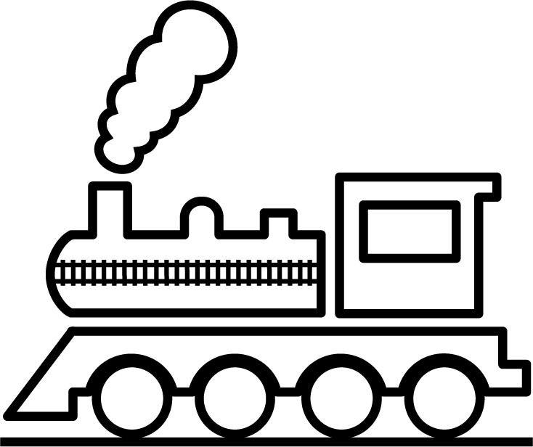
Respecting Cultural Heritage and Rail History
The Designer/Contractor shall complete a heritage assessment, prepared in consultation with local and statutory authorities.
The Contractor shall carry works so that there is no disturbance to:
scheduled monuments;
archaeological sites and deposits; or
buildings of historical and architectural interest (both statutorily listed buildings and important non-listed above ground features and structural elements).
In the event of unexpected archaeological finds, such as remains or artefacts, the Contractor shall immediately suspend work until further instruction and inform the Employer’s Representative.
Notes:
Note – although this is a new section, it includes elements of the old archaeology section in CRE.

Slide 38

Supporting Britain’s Economic Development
Where goods and/or services are being procured at a value less than
£5,000 and outside of a framework agreement, identify opportunities to procure from local businesses, Small and Medium Enterprises (SMEs) and social enterprises.
Advertise opportunities to recruit locally through local Job Centres, Further/ Higher Education Institutions and employment support networks.

Slide 39
External benchmarking
Where the employer has elected to apply a formal sustainability assessment method or certification scheme such as BREEAM, CEEQUAL or Considerate Constructors Scheme (CCS), Designers/Contractors shall:
Agree with the Employer’s Representative the target level of performance expected for the sustainability assessment scheme, if not previously specified at invitation to tender; and
Fulfil the relevant requirements, as defined by the assessment scheme, including the provision of an evidence pack that enables the independent scheme assessor to award an as-built rating that meets or exceeds the agreed target.

Slide 40

The implementation plan
We will be delivering Technical Briefings to the environment community, the Rail Infrastructure Sustainability Forum, the wider profession through CPD, and the Project Management community. An electronic briefing pack will also be created, and the environment community will further cascade technical briefings. Awareness briefings will be delivered to Heads, Directors and Exec level staff, as well as the Infrastructure Safety Leadership Group and RSSB.
The Level 2 Environment and Social Minimum Requirements standard is a big change for Route Business Works Delivery teams and therefore we will be conducting work to understand the current gaps against the standard, which will be the basis of a route-specific implementation plan.

Slide 41
GRIP product update
The ESA should be used from GRIP 2 and updated as and when knowledge of the project increases. It should be updated until GRIP 4, when the ESMP should be created.
In line with the policy, standard and tools mentioned in this briefing pack we have updated the GRIP products. The format/structure has not changed, but they have been amended to include the environmental updates and add the new social elements where relevant. The products remain as:
EN1 – Environment and Social Appraisal
EN3 – Review and Acceptance Form
EN4 – Inspection Checklist
NOTE – Existing projects at GRIP 3 can continue to use the current GRIP products and the previous version of the standard, NR/L2/ENV/015 Contract Requirements Environment.
Any project in GRIP stage 1 or 2 should use the new version of the standard and the updated GRIP products.
Notes:
This is an optional slide, intended for IP and Works Delivery project teams only but can be kept in the pack for Route Business information if required.

Slide 42
Further information
The standard will be available from 02 March 2019 via the Network Rail standard’s website on Connect.
The Environment and Social Appraisal and the Environment and Social Management Plan template are available on the E&SD Safety Central website: safety.networkrail.co.uk/environment-and-sustainable-development.
The Environment and Social Appraisal is also available in the GRIP Product List, along with two other checklists relating to the standard: the Inspection Record and the Review & Acceptance Form.
There are 22 guidance notes available which provide advice and guidance on how to comply with the standard, plus information on industry best practice and case studies. There are available on the E&SD Safety Central website: safety.networkrail.co.uk/environment-and-sustainable-development.

Slide 43
Useful links
Safety Central:
https://safety.networkrail.co.uk/environment-and-sustainable-development/
GRIP Products:
http://connect/Delivery/MajorProjectsandInvestment/GRIP/Default.aspx
Policy and Standard:
http://networkrailstandards/bsi/Index.aspx
Questions:
sustainabledevelopment@networkrail.co.uk

Slide 44
Any questions?

